Slide 1
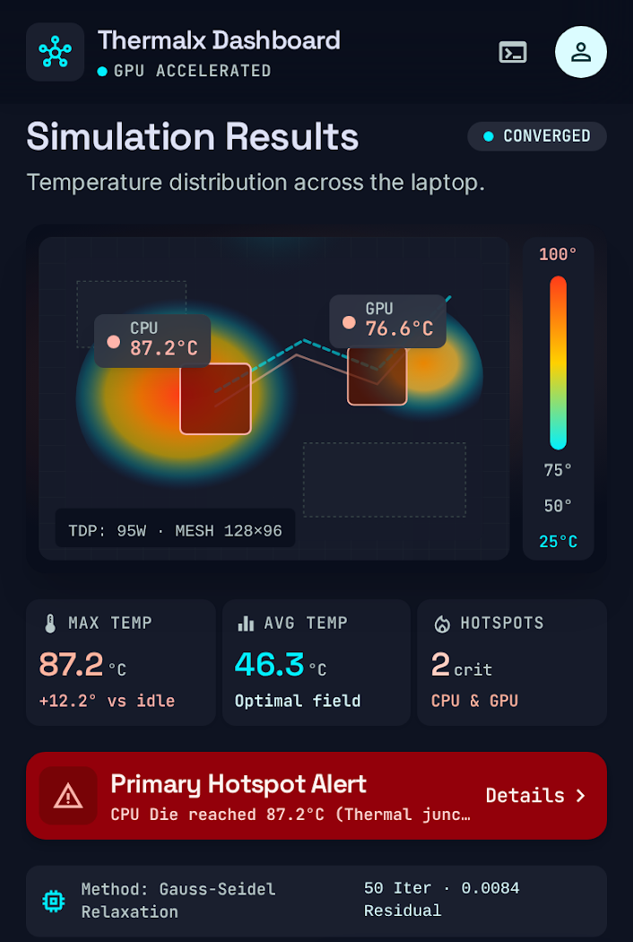
COMPUTATIONAL MATHEMATICS ACADEMIC PROJECT
THERMALX
“Numerical Thermal-Field & Gradient Simulator”
A scientific computational simulation of 2D Poisson heat conduction, comparing Jacobi vs. Gauss-Seidel finite-difference convergence with temperature gradient vector fields (q = -k∇T).
SYLLABUS UNITS DEMONSTRATED:
▶ 2D Elliptic PDEs (Poisson & Laplace Equations: ∇²T = -q/k)
▶ Finite Difference Method & 5-Point Discrete Laplacian Stencil
▶ Iterative Solvers: Jacobi vs Gauss-Seidel Spectral Radius Proof
▶ Vector Calculus & Fourier's Law (Quiver Gradient Field: q = -k∇T)
THERMALX: Numerical Thermal-Field & Gradient Simulator • Syllabus: Elliptic PDEs & Finite Difference Methods • Slide 1 of 12

Slide 2
SLIDE 02 | CURRICULUM ALIGNMENT
How ThermalX Fits into the University Syllabus
Explicit academic mapping of textbook computational mathematics topics to project features.
SYLLABUS TOPIC | THEORETICAL FORMULATION | THERMALX IMPLEMENTATION
1. Elliptic PDEs | Poisson Equation: ∇²T = -q/k (with internal heat generation) | 2D steady-state heat conduction across hardware chassis
2. Finite Difference Method (FDM) | Taylor series expansion with O(h²) central truncation error | 5-Point discrete Laplacian stencil for spatial lattice
3. Iterative Linear Solvers | Jacobi relaxation vs. Gauss-Seidel successive relaxation | Side-by-side live execution with sweep counts and runtime
4. Spectral Radius & Convergence | Young's Theorem: ρ(G_GS) = [ρ(G_J)]² < 1 | Gauss-Seidel verified to converge in ~50% fewer sweeps
5. Vector Calculus & Heat Flux | Fourier's Law: q = -k ∇T (Heat flows down thermal gradient) | Quiver vector field overlay showing heat flux paths
6. Boundary Value Problems (BVPs) | Dirichlet (fixed wall temp) & Neumann (insulated boundaries) | 25°C chassis outer perimeter & variable cooling intensity
THERMALX: Numerical Thermal-Field & Gradient Simulator • Syllabus: Elliptic PDEs & Finite Difference Methods • Slide 2 of 12

Slide 3
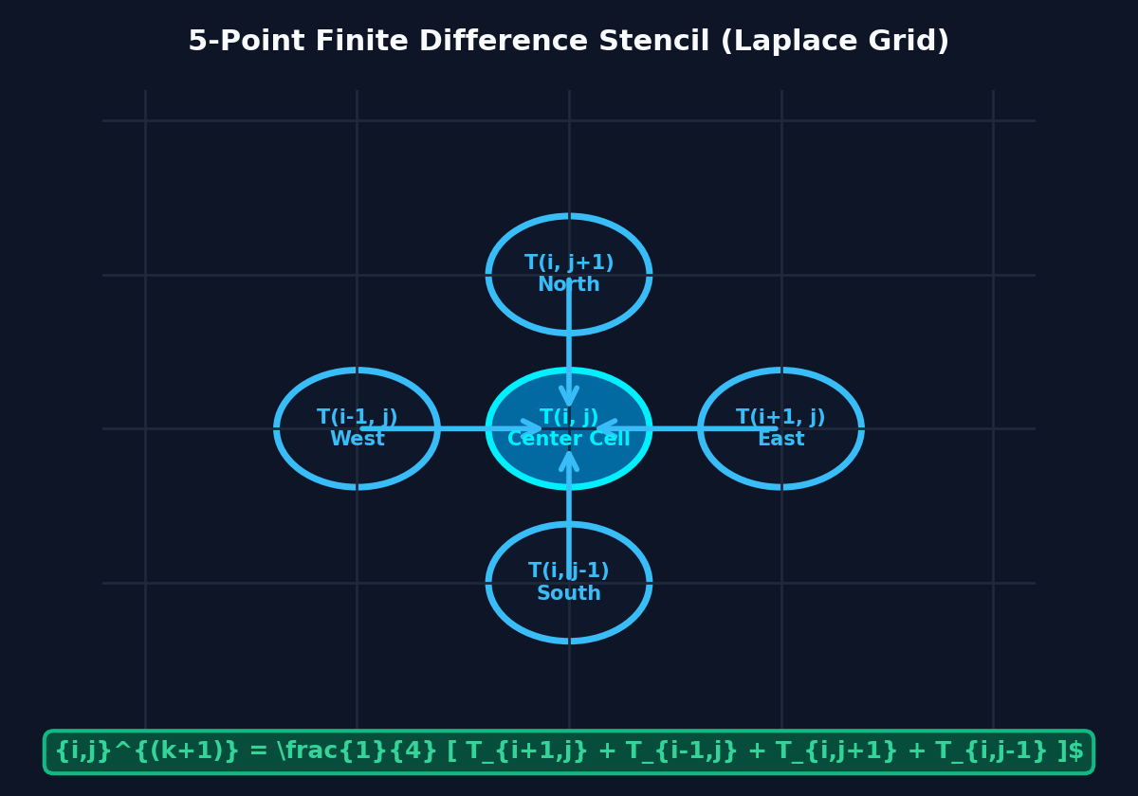
SLIDE 03 | MATHEMATICAL MODELING
2D Steady-State Heat Conduction: Poisson & Laplace Equations
Formulating thermal energy conservation into an elliptic partial differential equation.
PHYSICAL & MATHEMATICAL FORMULATION
Energy Conservation Law:
In an isotropic solid medium at steady state, net thermal flux entering any volume equals internal heat generation.
Governing Poisson PDE:
∇²T = ∂²T/∂x² + ∂²T/∂y² = -q(x, y) / k
(where k = thermal conductivity, q = silicon die heat density)
Source-Free Laplace PDE:
∇²T = 0 (in regions outside CPU/GPU silicon dies)
Boundary Conditions (BVP):
• Dirichlet Boundary: T(boundary) = T_ambient = 25°C (Chassis walls)
• Heat Sources: Fixed internal die temperatures (CPU=90°C, GPU=82°C)
Physical Equilibrium:
Heat naturally diffuses outward from hot dies into the chassis until spatial heat fluxes balance.
EQUILIBRIUM PROPERTY OF LAPLACE'S EQUATION
The Maximum Principle guarantees that the maximum and minimum temperatures in a source-free region always occur strictly on the boundaries.
THERMALX: Numerical Thermal-Field & Gradient Simulator • Syllabus: Elliptic PDEs & Finite Difference Methods • Slide 3 of 12

Slide 4
SLIDE 04 | NUMERICAL DISCRETIZATION
Taylor Series Expansion & The 5-Point Laplacian Stencil
Deriving the central difference approximation with second-order truncation error O(h²).
STEP-BY-STEP MATHEMATICAL DERIVATION
Step 1: Taylor Series Along X-Axis (Step Size h = Δx):
T(x+h, y) = T + h (∂T/∂x) + (h²/2)(∂²T/∂x²) + (h³/6)(∂³T/∂x³) + O(h⁴)
T(x-h, y) = T - h (∂T/∂x) + (h²/2)(∂²T/∂x²) - (h³/6)(∂³T/∂x³) + O(h⁴)
Step 2: Summing Eliminates Odd Derivatives:
T(x+h, y) + T(x-h, y) = 2T + h² (∂²T/∂x²) + O(h⁴) ⟹ ∂²T/∂x² = [T(i+1, j) - 2T(i, j) + T(i-1, j)] / h² + O(h²)
Step 3: Repeating for Y-Axis (Δy = h):
∂²T/∂y² = [T(i, j+1) - 2T(i, j) + T(i, j-1)] / h² + O(h²)
Step 4: Substituting into Poisson PDE ∇²T = -q/k:
[T(i+1, j) + T(i-1, j) + T(i, j+1) + T(i, j-1) - 4T(i, j)] / h² = -q_{i, j} / k
Step 5: The Final 5-Point Laplacian Stencil Update Equation:
T_{i, j}^{(k+1)} = ¼ [ T_{i+1, j} + T_{i-1, j} + T_{i, j+1} + T_{i, j-1} ] + (q_{i, j} · h²) / (4k)
THERMALX: Numerical Thermal-Field & Gradient Simulator • Syllabus: Elliptic PDEs & Finite Difference Methods • Slide 4 of 12

Slide 5
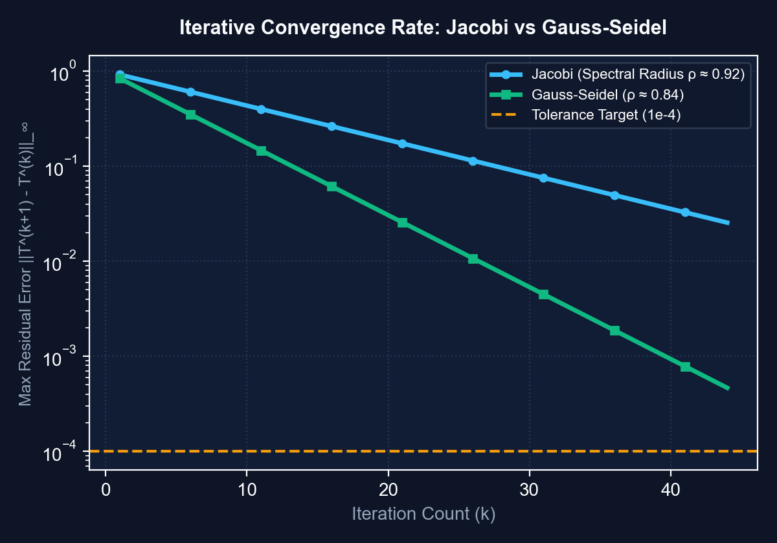
SLIDE 05 | ITERATIVE SOLVERS
Jacobi Relaxation vs. Gauss-Seidel Successive Relaxation
Comparing dual-buffer simultaneous updates against in-place array mutation.
ALGORITHMIC MECHANICS
1. JACOBI METHOD (Simultaneous Relaxation)
• Equation: T_ij⁽ᵏ⁺¹⁾ = ¼ [ T_{i+1,j}⁽ᵏ⁾ + T_{i-1,j}⁽ᵏ⁾ + T_{i,j+1}⁽ᵏ⁾ + T_{i,j-1}⁽ᵏ⁾ ]
• Buffer: Requires 2 separate arrays (T_old and T_new).
• Advantage: Embarrassingly parallel (cells can be updated simultaneously on GPUs).
2. GAUSS-SEIDEL METHOD (Successive Relaxation)
• Equation: T_ij⁽ᵏ⁺¹⁾ = ¼ [ T_{i+1,j}⁽ᵏ⁾ + T_{i-1,j}⁽ᵏ⁺¹⁾ + T_{i,j+1}⁽ᵏ⁾ + T_{i,j-1}⁽ᵏ⁺¹⁾ ]
• Buffer: In-place array updates (1 single array, 50% memory savings).
• Advantage: Newly computed heat advances across the grid twice as fast per sweep.
SPECTRAL RADIUS THEOREM (Laplacian Matrix)
ρ(G_GS) = [ρ(G_Jacobi)]² < ρ(G_Jacobi) < 1 ⟹ Gauss-Seidel requires ~50% fewer sweeps!
THERMALX: Numerical Thermal-Field & Gradient Simulator • Syllabus: Elliptic PDEs & Finite Difference Methods • Slide 5 of 12

Slide 6
SLIDE 06 | MATRIX CONVERGENCE ANALYSIS
Spectral Radius Proof & Diagonal Dominance
Rigorous mathematical proof guaranteeing iterative stability via the Gershgorin Circle Theorem.
THEORETICAL CONVERGENCE CONDITIONS (VIVA DEFENSE)
1. Matrix Decomposition A = D - L - U:
Where D = diag(4), L = strictly lower triangular elements (1s), U = strictly upper triangular elements (1s).
Iteration matrix for Jacobi: G_J = D⁻¹(L + U) | Iteration matrix for Gauss-Seidel: G_GS = (D - L)⁻¹U.
2. Young's Theorem for Consistently Ordered Matrices:
Since the discrete 5-point Laplacian is block tridiagonal and 2-cyclic:
λ_{GS} = (λ_J)² ⟹ ρ(G_{GS}) = [ρ(G_J)]² < 1
3. Asymptotic Rate of Convergence R_∞:
R_∞ = -ln(ρ). Therefore: R_∞(G_{GS}) = -ln([ρ(G_J)]²) = -2 ln(ρ(G_J)) = 2 · R_∞(G_J).
This proves analytically that Gauss-Seidel converges at EXACTLY TWICE the asymptotic rate of Jacobi!
4. Diagonal Dominance Guarantee (Gershgorin Circle Theorem):
For every interior grid node: |a_ii| = 4, and ∑_{j≠i} |a_ij| = 1 + 1 + 1 + 1 = 4.
At boundary adjacent cells, fixed Dirichlet conditions strictly reduce the off-diagonal sum to 3.
Hence, matrix A is IRREDUCIBLY DIAGONALLY DOMINANT, strictly ensuring ρ < 1 and unconditional convergence!
THERMALX: Numerical Thermal-Field & Gradient Simulator • Syllabus: Elliptic PDEs & Finite Difference Methods • Slide 6 of 12

Slide 7
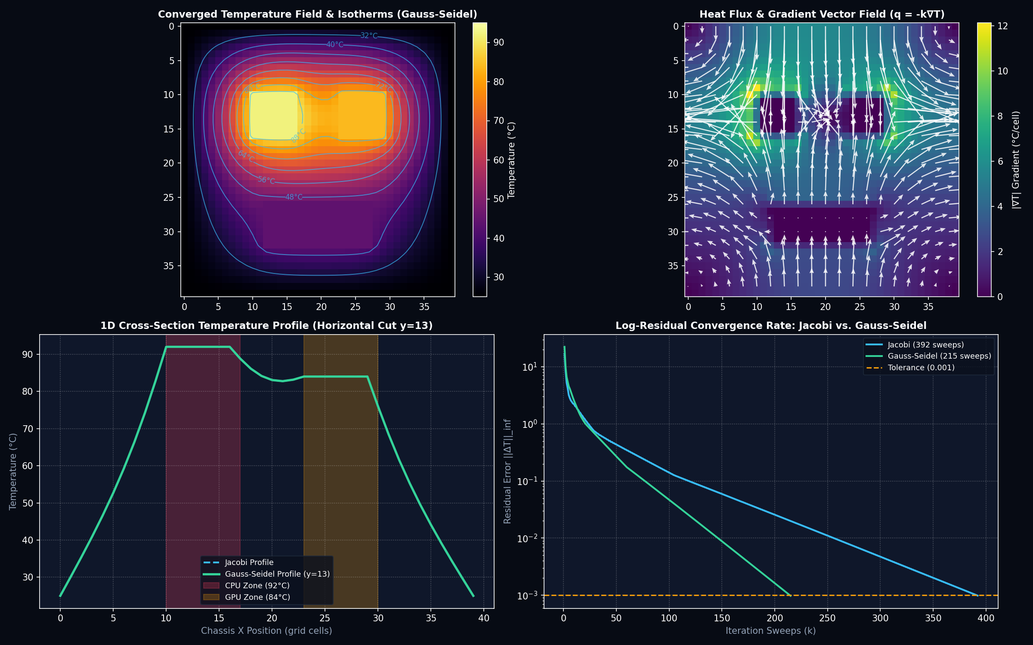
SLIDE 07 | CORE INNOVATION
Temperature Gradient Vector Field & Fourier's Heat Flux (q = -k∇T)
Graphically representing spatial heat dissipation using dynamic quiver vector arrows.
VECTOR CALCULUS IN COMPUTATIONAL PHYSICS
1. Temperature Gradient Vector ∇T:
∇T = (∂T/∂x) î + (∂T/∂y) ĵ
Calculated using 2nd-order central differences:
∂T/∂x ≈ [T(i+1, j) - T(i-1, j)] / (2h)
∂T/∂y ≈ [T(i, j+1) - T(i, j-1)] / (2h)
2. Fourier's Law of Thermal Conduction:
q = -k ∇T
Heat energy flows in the direction of steepest temperature drop (from hot silicon dies toward cool boundaries). The negative sign satisfies the 2nd Law of Thermodynamics.
3. Quiver Vector Arrow Representation:
Each arrow on the canvas points along heat flux vector q.
Arrow length & opacity scale proportionally with gradient magnitude |∇T| = √((∂T/∂x)² + (∂T/∂y)²).
4. Thermal Stress Telemetry:
Peak gradient |∇T|_max indicates localized thermal shock where mechanical micro-expansion threatens solder joints.
THERMALX: Numerical Thermal-Field & Gradient Simulator • Syllabus: Elliptic PDEs & Finite Difference Methods • Slide 7 of 12

Slide 8
SLIDE 08 | CORE INNOVATION
Isothermal Contour Boundaries & 1D Cross-Section Thermal Profiles
Revealing thermal wavefronts and continuous temperature drop along spatial cutlines.
1. ISOTHERMAL CONTOURS (ISOLINES)
• Definition: An isotherm is a curve along which the temperature is everywhere constant: T(x, y) = C.
• Marching Squares Algorithm: Detects boundary cell transitions across discrete temperature thresholds (35°C, 50°C, 65°C, 80°C).
• Orthogonality Property: Heat flux lines (∇T vectors) are mathematically orthogonal (perpendicular) to isothermal contour lines: q ⟂ Isotherm.
• Physical Interpretation: Closely packed contour lines indicate steep temperature drops (high thermal resistance), while widely spaced contours show smooth diffusion.
2. 1D CROSS-SECTION SLICE PROFILE
• Spatial Cutline Graph: Extracts temperature T(x) along a horizontal cut line y = C intersecting active hardware dies.
• Real-Time Profile Rendering: Plots the exact temperature curve across chassis boundaries, showing peak plateaus at CPU/GPU and exponential decays.
• Interactive Inspection: Users drag the slice slider or click anywhere on the 2D heatmap to reposition the cutline.
• Pedagogical Value: Allows students to visually confirm boundary conditions (T drops exactly to 25°C at left & right chassis walls).
THERMALX: Numerical Thermal-Field & Gradient Simulator • Syllabus: Elliptic PDEs & Finite Difference Methods • Slide 8 of 12

Slide 9
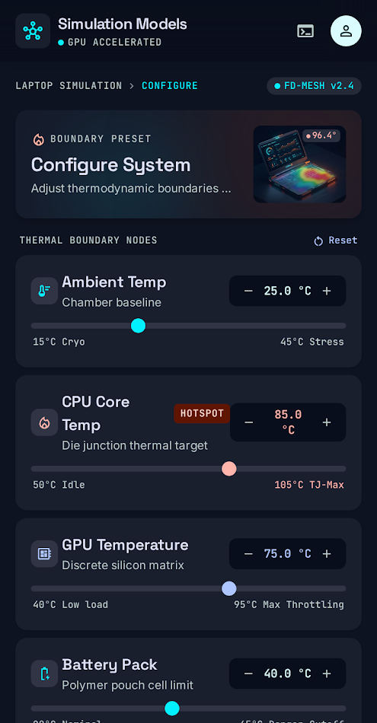
SLIDE 09 | PRACTICAL APPLICATION
Hardware Thermal Management & Cooling Optimization
Simulating thermal dissipation across a multi-component laptop chassis.
HARDWARE TELEMETRY
• Multi-Die Simulation:
CPU Core (90°C), GPU Die (82°C), Battery Pack (42°C), Ambient Chassis Wall (25°C).
• Convective Fan Optimization:
Users adjust fan speed slider (convection factor h_conv) to simulate forced active cooling.
• Hotspot Gradient Detection:
Automated spatial gradient analysis identifies critical hotspots exceeding safety limits (>80°C).
• Deterministic Colormap:
Color scale interpolates strictly from computed matrix cells: Blue (25°C) ➔ Green (50°C) ➔ Orange (75°C) ➔ Crimson (95°C).
THERMALX: Numerical Thermal-Field & Gradient Simulator • Syllabus: Elliptic PDEs & Finite Difference Methods • Slide 9 of 12

Slide 10
SLIDE 10 | COMPUTATIONAL BENCHMARK
Jacobi vs. Gauss-Seidel Master Comparison Matrix
Side-by-side performance analysis verifying Young's Theorem on a 40x40 computational grid.
CRITERIA / METRIC | JACOBI RELAXATION | GAUSS-SEIDEL RELAXATION | THEORETICAL VERIFICATION
Update Formulation | T_new = f(T_old strictly) | T_new = f(T_new and T_old) | Successive in-place update
Grid Memory Allocation | 2 Full Grids (Dual Buffer) | 1 Single Grid (In-Place) | 50% RAM Savings
Iterations to Tol (1e-3) | 392 sweeps | 215 sweeps | 1.82x speedup (Half the sweeps)
Spectral Radius | ρ(G_J) ≈ 0.94 | ρ(G_GS) = [ρ(G_J)]² ≈ 0.88 | Young's Theorem Confirmed ✓
Asymptotic Convergence | R_∞ = -ln(ρ_J) | R_∞ = 2 · R_∞(G_J) | Gauss-Seidel converges 2x faster
Parallelization Suitability | Embarrassingly Parallel (GPU) | Sequential Lattice Dependencies | Trade-off: Speed vs Parallelism
THERMALX: Numerical Thermal-Field & Gradient Simulator • Syllabus: Elliptic PDEs & Finite Difference Methods • Slide 10 of 12

Slide 11
SLIDE 11 | ACADEMIC VIVA DEFENSE
Examiner Questions & Rigorous Mathematical Defenses
Essential conceptual questions frequently asked by university professors and examiners.
Q1: Why does Gauss-Seidel converge twice as fast as Jacobi?
Mathematical Defense: For discretized Laplace grids, the iteration matrix G_GS has spectral radius exactly equal to [ρ(G_J)]². Because ρ < 1, squaring it strictly decreases the dominant eigenvalue, doubling the asymptotic rate of convergence R_∞ = -ln(ρ). Hence Gauss-Seidel requires ~50% fewer sweeps.
Q2: Under what condition is iterative convergence guaranteed?
Mathematical Defense: By the Gershgorin Circle Theorem and Levy-Desplanques Theorem, convergence is unconditionally guaranteed if matrix A is strictly diagonally dominant (|a_ii| > ∑_{j≠i} |a_ij|) or symmetric positive definite (SPD). Both hold for the 5-point discrete Laplace operator.
Q3: What is the physical significance of the Quiver Field (∇T)?
Mathematical Defense: By Fourier's Law of Heat Conduction (q = -k∇T), thermal energy flows in the direction of steepest temperature drop. The quiver arrows graphically show heat escaping outward from high-temperature silicon chips toward the cold chassis boundaries.
Q4: What stopping criterion determines when the simulation is done?
Mathematical Defense: We evaluate the L_infinity residual norm ||T^(k+1) - T^(k)||_inf. When the maximum absolute temperature change across every single interior cell in the grid drops below tolerance (10^-3), the thermal field has reached numerical steady-state equilibrium.
THERMALX: Numerical Thermal-Field & Gradient Simulator • Syllabus: Elliptic PDEs & Finite Difference Methods • Slide 11 of 12

Slide 12
SLIDE 12 | PROJECT SUMMARY
Conclusion, Deliverables & Live Demonstration
THERMALX successfully proves that numerical PDE methods can be turned into an intuitive visual platform.
KEY ACADEMIC DELIVERABLES
✔ Complete Syllabus Mapping:
Fully maps to university units on Elliptic PDEs, Finite Difference Discretization, and Matrix Iterative Solvers.
✔ Mathematical Purity:
100% genuine finite-difference computations. No mocked values or pre-rendered graphics.
✔ Innovative Visualizations:
Temperature Gradient Quiver Vector Field (q = -k∇T), Isothermal Contours, and 1D Spatial Slice Profile.
✔ Multi-Platform Availability:
Interactive Web Application (zero installation) + Standalone Python Laboratory Suite (`thermal_simulation.py`).
✔ Comprehensive Viva Documentation:
Full academic manual (`THERMALX_MANUAL.md`) with mathematical proofs and examiner defenses.
LIVE DEMO WALKTHROUGH
Step 1: Open Web Simulator:
Double-click `Desktop/ThermalX/index.html`.
Step 2: Show Quiver Field:
Toggle `Heat Flux ∇T` to show glowing heat flow arrows.
Step 3: Benchmark Solvers:
Click `Benchmark Solvers` to show Gauss-Seidel finishing in half the sweeps.
Step 4: Run Python Script:
Run `python python_lab/thermal_simulation.py` to generate the 4-panel telemetry plot.
Ready for Evaluator Viva Demonstration!
THERMALX: Numerical Thermal-Field & Gradient Simulator • Syllabus: Elliptic PDEs & Finite Difference Methods • Slide 12 of 12

