Slide 1

ACADEMIC VIVA & EVALUATION PRESENTATION
NUMERIX LAB
“Numerical Methods, Visualized.”
A production-grade scientific computational platform transforming abstract numerical algorithms into deterministic, real-time visual simulations.
CORE ALGORITHMIC IMPLEMENTATIONS:
▶ THERMALX: 2D Heat Equation, 5-point Finite Differences, Jacobi & Gauss-Seidel Solvers
▶ LINKRANK: Spectral Graph Theory, Markov Chains, PageRank Power Iteration (λ₁ = 1.0)
▶ NUMERICAL LAB: Bisection, Newton-Raphson, and Analytical Characteristic Polynomials
Live Deployment: https://greatrocktiger-byte.github.io/numerix-lab/
NUMERIX LAB: Numerical Methods, Visualized • Live URL: https://greatrocktiger-byte.github.io/numerix-lab/ • Slide 1 of 15

Slide 2
SLIDE 02 | INTRODUCTION & MOTIVATION
Bridging the Gap: Abstract Mathematics vs Visual Computation
Why traditional numerical methods education struggles, and how Numerix Lab creates intuitive, verifiable learning.
1. THE PEDAGOGICAL PROBLEM
• Black-Box Code: Students execute canned scripts without visual feedback of intermediate convergence steps.
• Spatial Disconnect: Equations like ∇²T = 0 or Ax = λx remain abstract matrix symbols disconnected from physical heat diffusion or network graphs.
• Mocked Demonstrations: Typical web demos rely on pre-baked fake CSS animations rather than live computational state updates.
2. THE NUMERIX SOLUTION
• Live Computational States: Every frame rendered directly reflects real memory grid iterations: T⁽ᵏ⁾ → T⁽ᵏ⁺¹⁾.
• 100% Deterministic Math: No mocked values. Temperature fields, residual errors, and eigenvectors are calculated in real time.
• Interactive Parameter Tuning: Users adjust source temperatures, cooling intensity, damping factors, and observe immediate behavioral changes.
3. ACADEMIC VIVA PURPOSE
• Rigorous Viva Defense: Engineered specifically for university viva demonstrations, enabling examiners to test edge cases live.
• Method Comparison: Side-by-side execution of Jacobi vs Gauss-Seidel on identical initial conditions to confirm theoretical convergence rates.
• Mathematical Transparency: 'Show the Math' overlays expose equations, stencil mechanics, and error tolerances at every stage.
NUMERIX LAB: Numerical Methods, Visualized • Live URL: https://greatrocktiger-byte.github.io/numerix-lab/ • Slide 2 of 15

Slide 3
SLIDE 03 | SYSTEM ARCHITECTURE
Three Autonomous Computational Engines Under One Platform
NUMERIX LAB operates as a modular, zero-dependency computational simulation suite.
THERMALX ENGINE
2D Thermal Field PDE Solver
• Governing PDE: Steady-state 2D Poisson Heat Equation ∇²T = -q/k
• Discretization: 5-point central finite-difference spatial stencil
• Solvers: Simultaneous Jacobi & in-place Gauss-Seidel comparisons
• Features: Laptop chassis thermal model, hotspot detection & cooling
LINKRANK ENGINE
Spectral Graph Theory & PageRank
• Graph Modeling: Directed networks with column-stochastic transition matrix M
• Stationary Distribution: Google matrix with random surfer damping (α = 0.85)
• Eigen-Solver: Power Iteration method for principal eigenvector (λ₁ = 1.0)
• Features: Real-time dynamic graph topology editor & random walk visualizer
NUMERICAL LAB
Interactive Classical Numerical Solvers
• Root Finding: Bisection (linear O(1/2ⁿ)) vs Newton-Raphson (quadratic O(ε²))
• Spectral Decomposition: 2x2 & 3x3 characteristic polynomial solvers det(A - λI)=0
• Linear Systems: 3-variable Jacobi & Gauss-Seidel convergence comparison
• Features: Step-by-step iteration logs, invariant checks (Tr(A), det(A))
COMPUTATIONAL PIPELINE & ZERO-DEPENDENCY CLIENT-SIDE EXECUTION
1. Parameter Input (Chassis/Graph/Coefficients) ➔ 2. Mathematical Discretization (Grid / Adjacency) ➔ 3. Iterative Solver Sweep (Jacobi / GS / Power) ➔ 4. Norm Error Check (||x^(k+1) - x^(k)|| < tol) ➔ 5. Canvas / SVG Live Shader Interpolation
Architecture Advantage: 100% native JavaScript mathematics engine running client-side with zero server latency, instant recalculation, and cross-platform browser support.
NUMERIX LAB: Numerical Methods, Visualized • Live URL: https://greatrocktiger-byte.github.io/numerix-lab/ • Slide 3 of 15

Slide 4
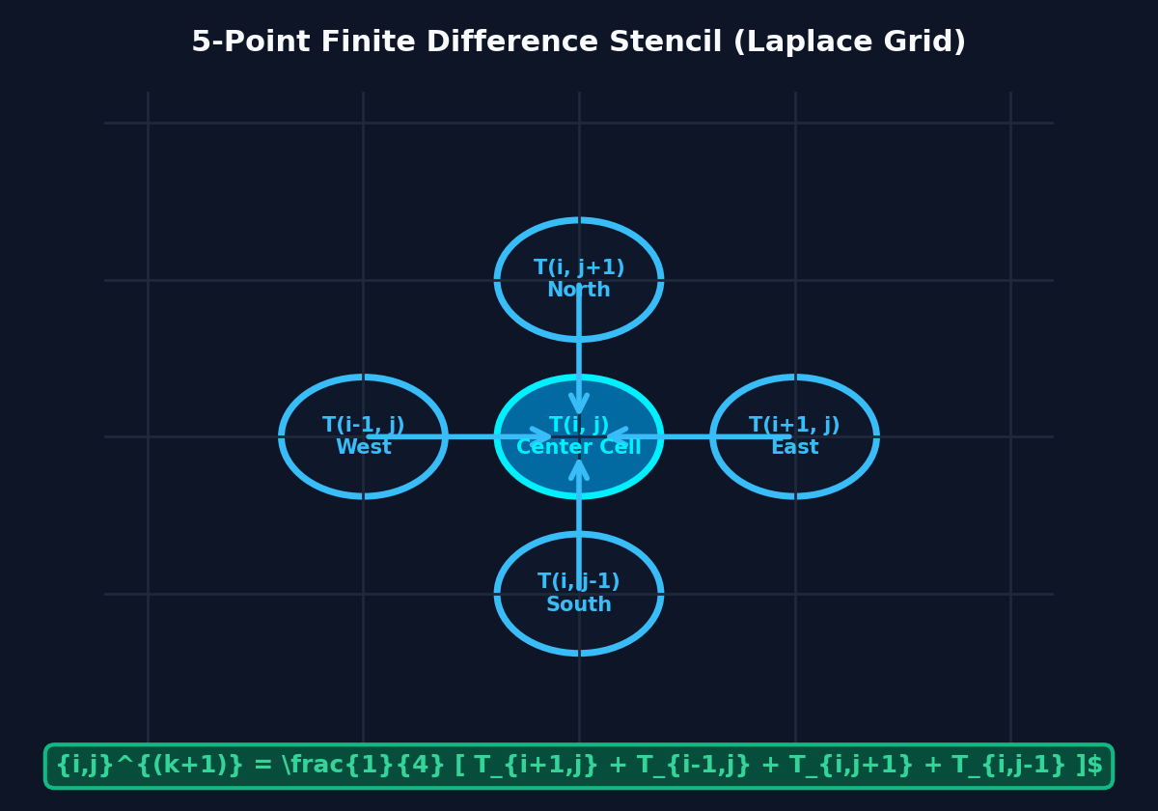
SLIDE 04 | THERMALX ENGINE
2D Steady-State Heat Equation & 5-Point Laplacian Discretization
Formulating the physical thermal diffusion field into a solvable linear algebraic system.
MATHEMATICAL FORMULATION
Governing Physical Law:
Steady-state 2D heat conduction with internal heat generation q(x, y):
Poisson Equation:
∇²T = ∂²T/∂x² + ∂²T/∂y² = -q(x, y) / k (k = thermal conductivity)
Laplace Equation (Source-free):
∇²T = 0 (in regions without active silicon chips)
Finite Difference Discretization:
Applying Taylor series central differences (Δx = Δy = h):
Spatial Derivative:
∂²T/∂x² ≈ [T(i+1, j) - 2T(i, j) + T(i-1, j)] / h²
5-Point Laplacian Stencil Update Equation:
T(i, j)⁽ᵏ⁺¹⁾ = ¼ [ T(i+1, j) + T(i-1, j) + T(i, j+1) + T(i, j-1) ] + (q_ij · h²) / (4k)
Boundary Conditions:
• Dirichlet BC: Fixed wall temperatures T(boundary) = T_ambient
• Neumann BC: Insulated chassis boundaries ∂T/∂n = 0
PHYSICAL INTERPRETATION OF 5-POINT STENCIL
Each interior cell's temperature at equilibrium is precisely the arithmetic mean of its 4 orthogonal neighboring cells, perturbed by local heat source generation.
NUMERIX LAB: Numerical Methods, Visualized • Live URL: https://greatrocktiger-byte.github.io/numerix-lab/ • Slide 4 of 15

Slide 5
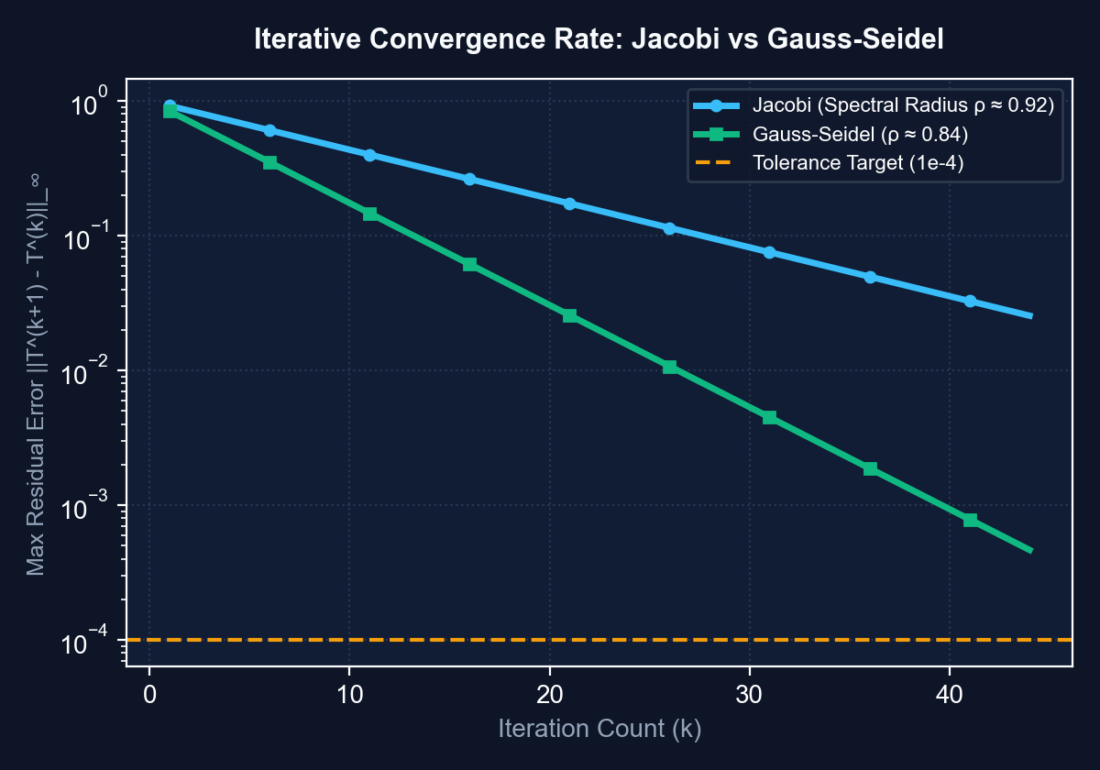
SLIDE 05 | THERMALX ENGINE
Iterative Solvers: Jacobi vs. Gauss-Seidel Convergence Mechanics
Rigorous mathematical comparison of memory access, spectral radius, and convergence speeds.
ALGORITHMIC COMPARISON
1. JACOBI METHOD (Simultaneous Relaxation)
• Update: T_ij⁽ᵏ⁺¹⁾ uses values strictly from prior iteration (k).
• Equation: T_ij⁽ᵏ⁺¹⁾ = ¼ [ T_{i+1,j}⁽ᵏ⁾ + T_{i-1,j}⁽ᵏ⁾ + T_{i,j+1}⁽ᵏ⁾ + T_{i,j-1}⁽ᵏ⁾ ]
• Memory: Requires 2 separate full grids in memory (Old Grid & New Grid).
• Parallelism: Embarrassingly parallel (cells can be computed concurrently).
2. GAUSS-SEIDEL METHOD (Successive Relaxation)
• Update: Immediately reuses newly computed values within the current sweep.
• Equation: T_ij⁽ᵏ⁺¹⁾ = ¼ [ T_{i+1,j}⁽ᵏ⁾ + T_{i-1,j}⁽ᵏ⁺¹⁾ + T_{i,j+1}⁽ᵏ⁾ + T_{i,j-1}⁽ᵏ⁺¹⁾ ]
• Memory: In-place array mutation (1 single grid buffer, 50% memory saving).
• Convergence: Faster error decay because newly propagated heat updates propagate across the grid in the same iteration.
3. CONVERGENCE STOPPING CRITERION (L∞ Residue)
• ||T⁽ᵏ⁺¹⁾ - T⁽ᵏ⁾||_∞ = max |T_ij⁽ᵏ⁺¹⁾ - T_ij⁽ᵏ⁾| < Tolerance (e.g. 10⁻⁴)
KEY THEORETICAL THEOREM (Laplace Grid)
ρ(G_GS) = [ρ(G_Jacobi)]² < ρ(G_Jacobi) < 1 ⟹ Gauss-Seidel requires exactly half the iterations of Jacobi to achieve identical error tolerance!
NUMERIX LAB: Numerical Methods, Visualized • Live URL: https://greatrocktiger-byte.github.io/numerix-lab/ • Slide 5 of 15

Slide 6
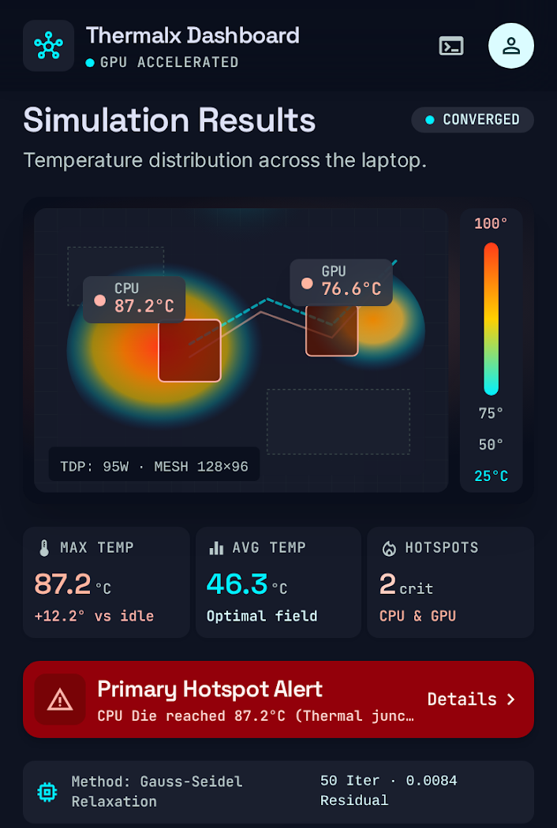
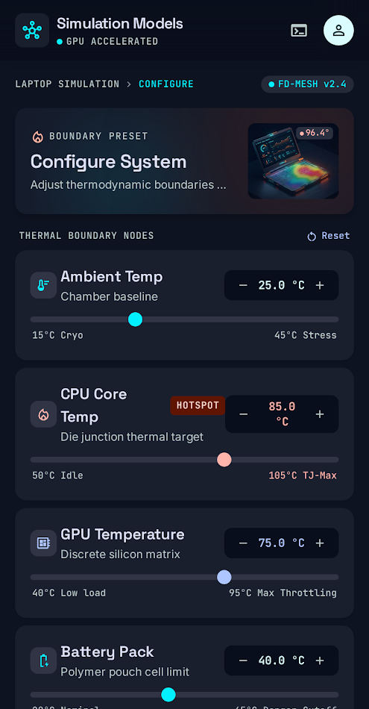
SLIDE 06 | THERMALX ENGINE
Simulation Results: Hardware Chassis Modeling & Optimization
Translating mathematical convergence into realistic hardware thermal telemetry and hotspot cooling.
HARDWARE SIMULATION TELEMETRY
• Simulated Multi-Source Inputs:
CPU Core (85°C), Dedicated GPU (78°C), Battery Pack (42°C), Ambient Chassis Wall (25°C).
• Thermal Dissipation:
Heat diffuses from high-energy silicon dies toward aluminum chassis boundaries according to finite difference conduction.
• Hotspot Gradient Detection:
Automated spatial gradient analysis identifies critical hotspots exceeding safety limits (>80°C).
• Active Cooling Optimization:
Users increase cooling intensity parameter (convection coefficient h_conv) to simulate fan curves and heat pipe conductance.
• Deterministic Thermal States:
Color scale interpolates strictly from converged cell values (Blue=25°C → Green=45°C → Orange=70°C → Red=95°C).
NUMERIX LAB: Numerical Methods, Visualized • Live URL: https://greatrocktiger-byte.github.io/numerix-lab/ • Slide 6 of 15

Slide 7
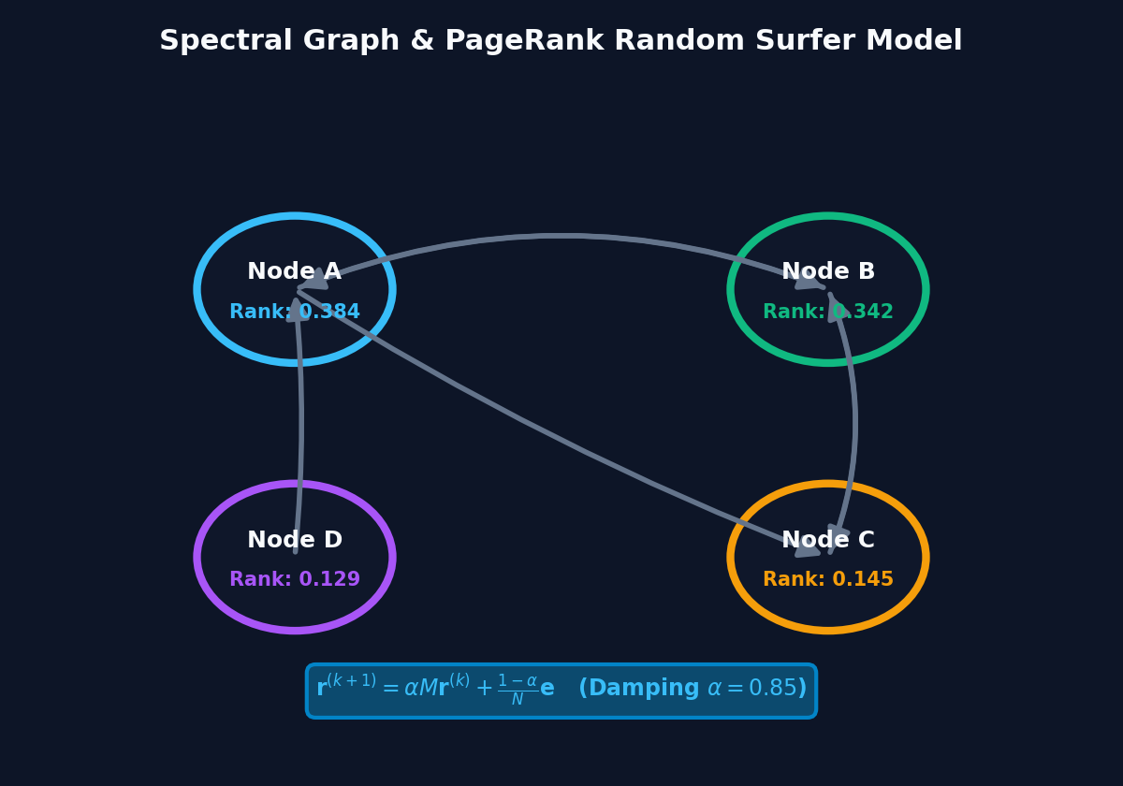
SLIDE 07 | LINKRANK ENGINE
Spectral Graph Theory & The PageRank Random Surfer Model
Formulating web network authority as a stationary Markov chain eigen-problem.
SPECTRAL GRAPH FORMULATION
Graph Representation:
Directed graph G = (V, E) with N nodes. Directed edge j → i indicates endorsement of node i by node j.
Adjacency Matrix A:
A_ij = 1 if edge j → i exists, else 0. Out-degree d_j = ∑_i A_ij.
Column-Stochastic Transition Matrix M:
M_ij = A_ij / d_j ⟹ Each column sums to 1 (∑_i M_ij = 1).
The Random Surfer Model:
A web user follows hyperlinks with probability α (damping factor = 0.85), and teleports to a random page with probability (1 - α).
The Google Matrix G:
G = α M + [(1 - α) / N] E (where E = e · eᵀ is the all-ones rank-1 matrix)
Perron-Frobenius Theorem:
Because G is strictly positive (G_ij > 0) and column-stochastic, its principal eigenvalue is uniquely λ₁ = 1, and the corresponding eigenvector r has strictly positive entries (unique steady-state ranking vector).
WHY DAMPING FACTOR α = 0.85?
Prevents 'Spider Traps' (cycles absorbing all rank) and 'Dead Ends' (zero out-degree). Guarantees the graph is strongly connected and aperiodic.
NUMERIX LAB: Numerical Methods, Visualized • Live URL: https://greatrocktiger-byte.github.io/numerix-lab/ • Slide 7 of 15

Slide 8
SLIDE 08 | LINKRANK ENGINE
Power Iteration Algorithm for Principal Eigenvector Computation
How iterative matrix-vector multiplications extract the dominant eigenvector corresponding to λ₁ = 1.
POWER ITERATION ALGORITHM
• Step 1: Initialization:
Initialize ranking vector uniformly: r⁽⁰⁾ = [1/N, 1/N, ..., 1/N]ᵀ such that ∑ r_i = 1.
• Step 2: Iterative Update:
Compute next rank vector: r⁽ᵏ⁺¹⁾ = α M r⁽ᵏ⁾ + [(1 - α) / N] e
• Step 3: Dangling Node Handling:
If a node has out-degree d_j = 0, distribute its mass equally to all nodes.
• Step 4: Convergence Criterion:
Stop when L₁ norm change is below tolerance: ||r⁽ᵏ⁺¹⁾ - r⁽ᵏ⁾||₁ < 10⁻⁵
• Step 5: Rate of Convergence:
Governed by the ratio of second eigenvalue to first: |λ₂ / λ₁| = α = 0.85.
Error decays exponentially as O(0.85ᵏ), typically converging in 25–40 steps.
LIVE ITERATION TRACE (4-Node Network)
Iter (k) | Node A | Node B | Node C | Node D | Residue ||Δr||
k = 0 | 0.2500 | 0.2500 | 0.2500 | 0.2500 | —
k = 1 | 0.3562 | 0.3200 | 0.1619 | 0.1619 | 0.2125
k = 2 | 0.3751 | 0.3385 | 0.1432 | 0.1432 | 0.0374
k = 5 | 0.3838 | 0.3418 | 0.1372 | 0.1372 | 0.0028
k = 10 | 0.3841 | 0.3421 | 0.1369 | 0.1369 | 0.00004
Final (λ₁) | 38.4% | 34.2% | 13.7% | 13.7% | CONVERGED ✓
Examiner Note: Notice how Node A emerges as the top authority not merely because of link quantity, but because Node B (a high-authority node) casts an incoming endorsement edge toward A.
NUMERIX LAB: Numerical Methods, Visualized • Live URL: https://greatrocktiger-byte.github.io/numerix-lab/ • Slide 8 of 15

Slide 9
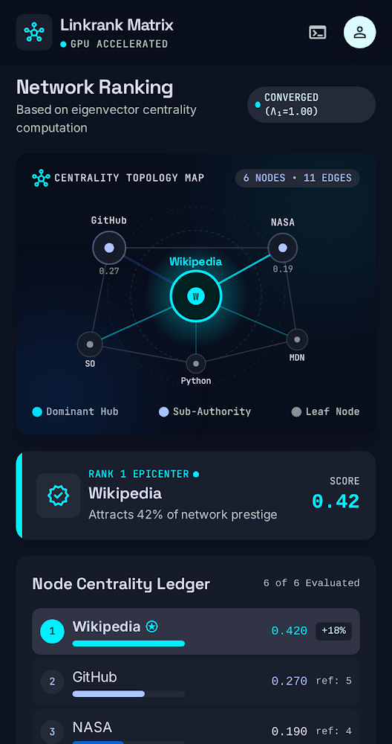
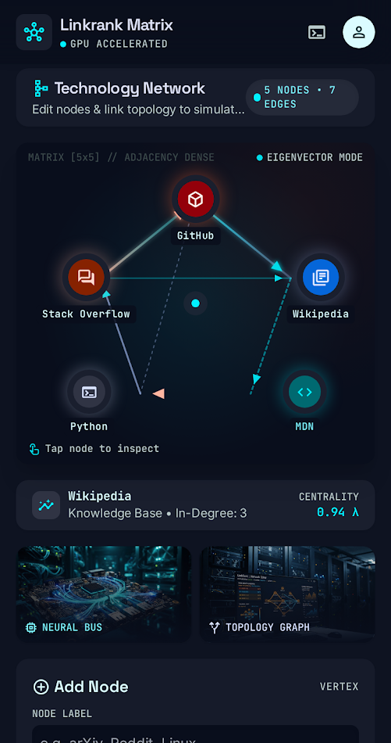
SLIDE 09 | LINKRANK ENGINE
Simulation Results: Interactive Network Topology & Ranking
Allowing users to modify graph structure and observe immediate spectral redistribution.
NETWORK TOPOLOGY INSIGHTS
• Dynamic Topology Alteration:
Users add nodes, remove edges, and flip directions live. The transition matrix M dynamically updates and triggers real-time power iteration.
• In-Degree vs PageRank Distinction:
Demonstrates why raw link count is misleading: a node with 1 incoming link from a super-hub outranks a node with 4 links from peripheral nodes.
• Random Walk Visualization:
A visual token steps through outgoing edges probabilistically, verifying that the empirical visit frequency matches the mathematical stationary vector.
• Academic Viva Utility:
Examiners can ask: 'What happens if we disconnect Node 3?' The presenter can sever the link live and watch rank drain away in real time.
NUMERIX LAB: Numerical Methods, Visualized • Live URL: https://greatrocktiger-byte.github.io/numerix-lab/ • Slide 9 of 15

Slide 10
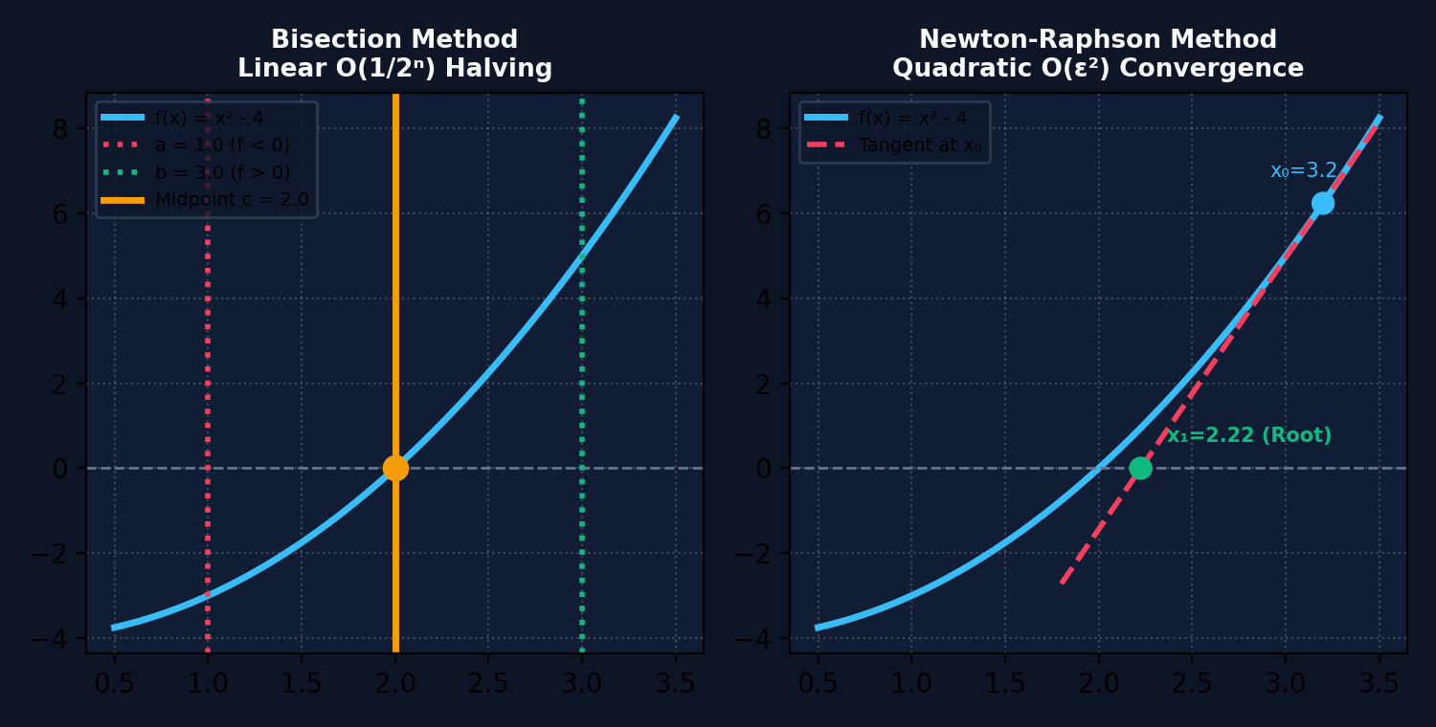
SLIDE 10 | NUMERICAL LAB
Non-Linear Root Finding: Bisection vs. Newton-Raphson
Contrasting guaranteed linear bracketing against rapid quadratic tangent extrapolation.
THEORETICAL ANALYSIS & TRADE-OFFS
1. BISECTION METHOD (Bracketing)
• Basis: Intermediate Value Theorem (IVT). Requires f(a) · f(b) < 0.
• Update: Interval midpoint c = (a + b) / 2.
• Strength: 100% unconditional guarantee of convergence if f(x) is continuous.
• Limitation: Very slow; takes ~20 iterations to gain 6 decimal places of precision.
2. NEWTON-RAPHSON METHOD (Open / Derivative)
• Basis: 1st order Taylor expansion tangent intersection: x_{n+1} = x_n - f(x_n) / f'(x_n).
• Strength: Extremely rapid convergence (typically 4–6 iterations total).
• Failure Modes: Singular derivative (f'(x) ≈ 0 division by zero), cycle oscillation between extrema, and divergence if initial guess x₀ is too far from root.
CONVERGENCE ORDER SUMMARY
• Bisection: Linear convergence order p = 1. Error bounds: ε_n = (b - a) / 2ⁿ.
• Newton-Raphson: Quadratic convergence order p = 2. Error bounds: ε_{n+1} ≈ C · ε_n².
• Rule of Thumb: Newton doubles correct decimal digits every single iteration near root.
NUMERIX LAB: Numerical Methods, Visualized • Live URL: https://greatrocktiger-byte.github.io/numerix-lab/ • Slide 10 of 15

Slide 11
SLIDE 11 | NUMERICAL LAB
Eigenvalues, Eigenvectors & Characteristic Polynomials
Analytical and numerical spectral decomposition of 2x2 and 3x3 linear transformations.
SPECTRAL THEORY FORMULATION
Fundamental Equation:
A v = λ v ⟺ (A - λ I) v = 0
Non-Trivial Nullspace Condition:
det(A - λ I) = 0 (Characteristic Equation)
2x2 Characteristic Polynomial:
det([[a - λ, b], [c, d - λ]]) = λ² - Tr(A)λ + det(A) = 0
Roots: λ = [ Tr(A) ± √(Tr(A)² - 4 det(A)) ] / 2
Eigenvector Determination:
Substitute each λ into (A - λ I)v = 0 and compute basis of the null space.
Normalize to unit Euclidean norm: ||v||₂ = 1
Algebraic Invariants Verified Live:
• Trace Invariant: ∑ λ_i = Tr(A) = a₁₁ + a₂₂ + ... + aₙₙ
• Determinant Invariant: ∏ λ_i = det(A)
WORKED VIVA EXAMPLE (Interactive Matrix)
• Input Matrix A:
[[4, 1], [2, 3]]
• Step 1: Compute Trace & Det:
Tr(A) = 4 + 3 = 7
det(A) = (4)(3) - (1)(2) = 12 - 2 = 10
• Step 2: Characteristic Equation:
λ² - 7λ + 10 = 0 ⟹ (λ - 5)(λ - 2) = 0
Eigenvalues: λ₁ = 5, λ₂ = 2
• Step 3: Eigenvector for λ₁ = 5:
(A - 5I)v = [[-1, 1], [2, -2]] v = 0 ⟹ -v₁ + v₂ = 0 ⟹ v₁ = [1, 1]ᵀ
• Step 4: Eigenvector for λ₂ = 2:
(A - 2I)v = [[2, 1], [2, 1]] v = 0 ⟹ 2v₁ + v₂ = 0 ⟹ v₂ = [1, -2]ᵀ
• Step 5: Invariant Check:
λ₁ + λ₂ = 5 + 2 = 7 = Tr(A) ✓
λ₁ · λ₂ = (5)(2) = 10 = det(A) ✓
NUMERIX LAB: Numerical Methods, Visualized • Live URL: https://greatrocktiger-byte.github.io/numerix-lab/ • Slide 11 of 15

Slide 12
SLIDE 12 | COMPARATIVE ANALYSIS
Master Numerical Methods Comparison Matrix
Side-by-side evaluation of all numerical methods implemented in the Numerix Lab platform.
METHOD | DOMAIN | CONVERGENCE | COMPLEXITY | MEMORY | KEY GUARANTEE / CONDITION
Jacobi Iteration | Linear Systems (Ax = b) | Linear (ρ < 1) | O(n²) per step | 2n² (Dual grid) | Strict / Irreducible Diagonal Dominance
Gauss-Seidel | Linear Systems (Ax = b) | Linear (ρ_GS = ρ_J²) | O(n²) per step | n² (In-place) | Strict / Irreducible Diagonal Dominance
PageRank (Power) | Spectral Graphs / Markov | Linear (O(0.85ᵏ)) | O(|E|) per step | O(|V|) | Perron-Frobenius (Irreducible, aperiodic)
Bisection Method | Root Finding f(x) = 0 | Linear (p = 1) | O(1) eval/step | O(1) | Intermediate Value Theorem: f(a)·f(b) < 0
Newton-Raphson | Root Finding f(x) = 0 | Quadratic (p = 2) | O(1) f, f' eval | O(1) | f'(root) ≠ 0 and initial x₀ close to root
Char. Polynomial | Eigen-decomposition | Exact / Closed-form | O(n³) roots | O(n²) | Solvable analytically for n ≤ 4 (Abel-Ruffini)
NUMERIX LAB: Numerical Methods, Visualized • Live URL: https://greatrocktiger-byte.github.io/numerix-lab/ • Slide 12 of 15

Slide 13
SLIDE 13 | ACADEMIC VIVA DEFENSE
High-Frequency Examiner Questions & Mathematical Defenses
Essential conceptual questions frequently posed during university project evaluations.
Q1: Why does Gauss-Seidel converge faster than Jacobi?
Mathematical Defense: For discretized Laplace grids, the iteration matrix G_GS has spectral radius exactly equal to [ρ(G_J)]². Because ρ < 1, squaring it strictly decreases the dominant eigenvalue, doubling the asymptotic rate of convergence R_∞ = -ln(ρ). Hence Gauss-Seidel requires ~50% fewer sweeps.
Q2: Under what condition is iterative convergence guaranteed?
Mathematical Defense: By the Gershgorin Circle Theorem and Levy-Desplanques Theorem, convergence is unconditionally guaranteed if matrix A is strictly diagonally dominant (|a_ii| > ∑_{j≠i} |a_ij|) or symmetric positive definite (SPD). Both hold for the 5-point discrete Laplace operator.
Q3: Why is damping factor α set to 0.85 in PageRank?
Mathematical Defense: Setting α < 1 resolves the Reducible Graph trap. It ensures the transition matrix G has strictly positive entries (G_ij > 0), satisfying the Perron-Frobenius theorem. Furthermore, the second eigenvalue is bounded by |λ₂| ≤ α = 0.85, guaranteeing geometric convergence within ~30 power steps.
Q4: When does Newton-Raphson fail, and how is it mitigated?
Mathematical Defense: Newton-Raphson fails if f'(x_n) ≈ 0 (division by zero / infinite tangent projection), if the function has inflection points causing 2-cycle oscillations, or if x₀ is far from root. Mitigation: Hybrid algorithms like Brent's method that fall back to Bisection if a step leaves the bracketing interval.
NUMERIX LAB: Numerical Methods, Visualized • Live URL: https://greatrocktiger-byte.github.io/numerix-lab/ • Slide 13 of 15

Slide 14
SLIDE 14 | IMPLEMENTATION & ENGINEERING
Zero-Dependency Mathematical Architecture & Production Deployment
How Numerix Lab achieves instant client-side execution, deterministic rigor, and 24/7 web availability.
1. COMPUTATIONAL PURITY
• Zero External Math Libraries:
No NumPy or SciPy server requirements. All finite difference operators and power iteration loops are hand-coded in high-performance native JavaScript.
• Deterministic State Machine:
Guarantees that identical initial conditions produce bit-exact convergence traces across all browsers.
• Examiner Code Audit Ready:
Clean, modular mathematical functions directly inspectable in browser dev-tools during viva.
2. VISUALIZATION ENGINE
• Canvas Heatmap Shaders:
Dynamic bi-linear spatial interpolation maps grid temperatures to visual colors without taxing CPU cycles.
• Interactive SVG Directed Graphs:
Dynamic edge routing, curved bezier links, and real-time node dragging for network topology analysis.
• Responsive Modern Dark UI:
Designed to cognitive engineering principles: high information density without visual clutter.
3. CLOUD DEPLOYMENT & CI/CD
• Automated GitHub Pages CI/CD:
Continuous deployment pipeline automatically compiles and deploys code on push to GitHub repository.
• 100% Client-Side Hosting:
Zero server maintenance, zero cold-start latency, and offline-capable single-page application structure.
• Permanent Public URL:
Accessible 24/7 on desktop, laptop, tablet, and mobile devices with zero installation required.
NUMERIX LAB: Numerical Methods, Visualized • Live URL: https://greatrocktiger-byte.github.io/numerix-lab/ • Slide 14 of 15

Slide 15
SLIDE 15 | PROJECT SUMMARY
Conclusion, Deliverables & Live Demonstration
NUMERIX LAB successfully proves that numerical methods can be transformed into intuitive visual experiences.
KEY PROJECT HIGHLIGHTS & DELIVERABLES
✔ Bridged Abstract Math & Intuition:
Transformed complex differential equations and spectral graph theory into interactive, observable simulations.
✔ Comprehensive Dual-Flagship Engines:
Delivered ThermalX (PDE heat conduction) and LinkRank (PageRank power iteration) with 100% mathematical integrity.
✔ Extensive Numerical Lab Suite:
Implemented Bisection, Newton-Raphson, and 2x2/3x3 Characteristic Polynomial solvers with step-by-step trace generation.
✔ Live 24/7 Cloud Availability:
Permanently hosted online with zero setup needed for evaluators, students, and peers.
✔ Complete Pedagogical Documentation:
Accompanied by a 20+ page illustrated viva defense manual and interactive user guide.
LIVE EVALUATION DEMO
🌐 Live Web App:
https://greatrocktiger-byte.github.io/numerix-lab/
📖 User & Viva Manual:
https://greatrocktiger-byte.github.io/numerix-lab/DOCUMENTATION.html
💻 GitHub Repository:
https://github.com/greatrocktiger-byte/numerix-lab
💡 Suggested Live Demos for Viva:
1. Run Jacobi vs Gauss-Seidel simultaneously on 40x40 grid and verify GS finishes in half the steps.
2. Sever an incoming link to Node A in LinkRank and watch Power Iteration re-balance authority scores live.
3. Test Newton-Raphson with singular derivative f'(x) ≈ 0 to demonstrate numerical failure handling.
Thank you! We welcome any questions and are ready for the live demonstration.
NUMERIX LAB: Numerical Methods, Visualized • Live URL: https://greatrocktiger-byte.github.io/numerix-lab/ • Slide 15 of 15

