Slide 1
Progress Report(May 25, 2021)
Joey Q. Harap

Slide 2
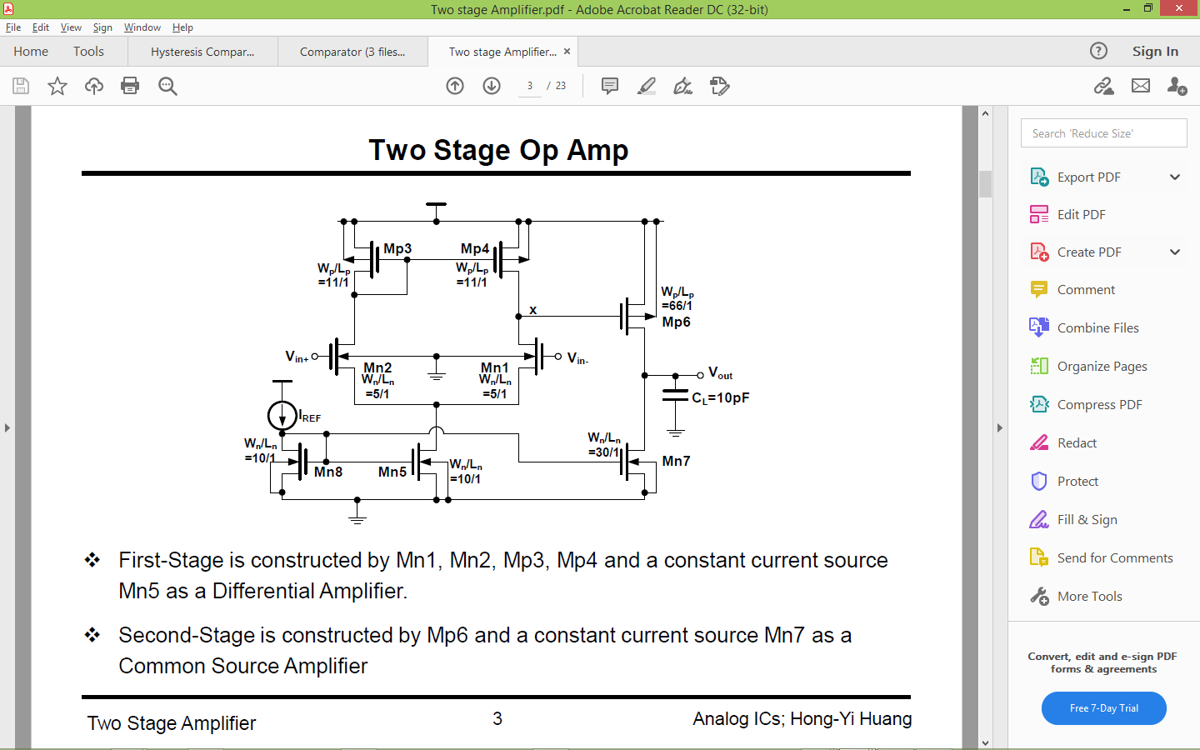
CONVENTIONAL COMPARATOR CIRCUIT DIAGRAM

Slide 3
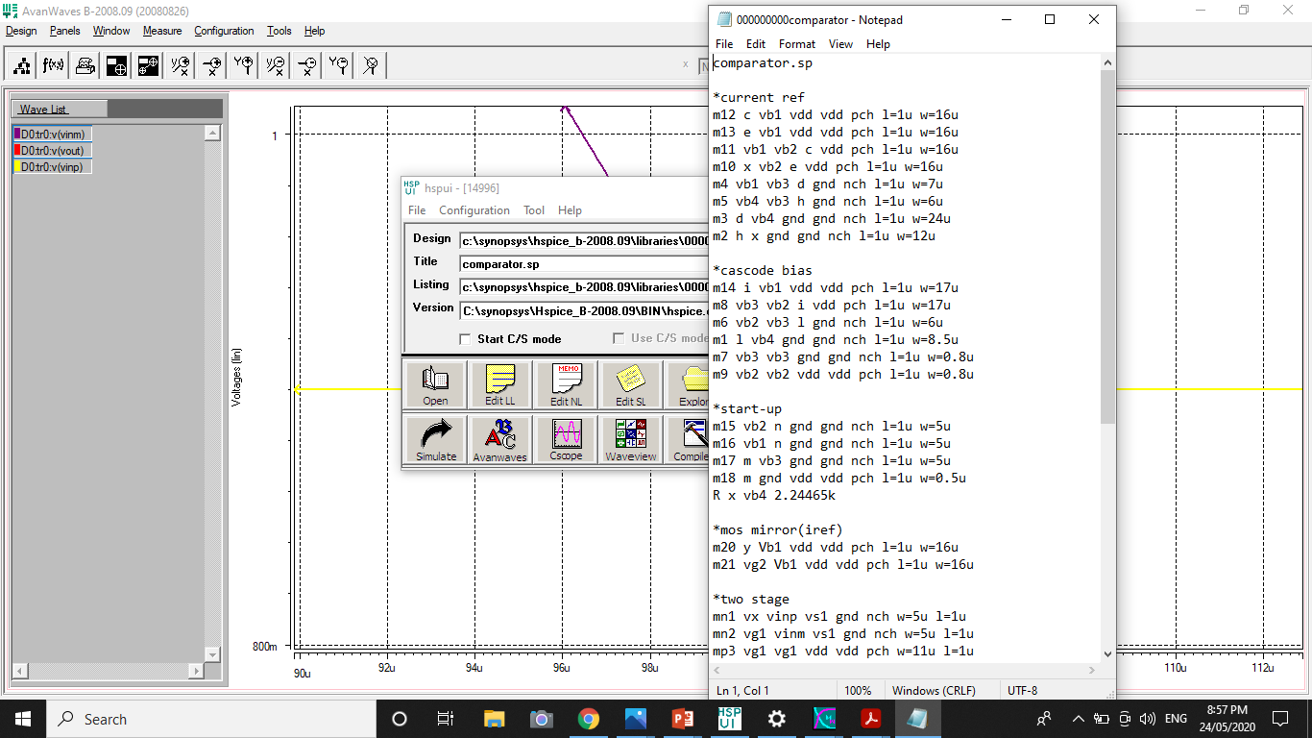
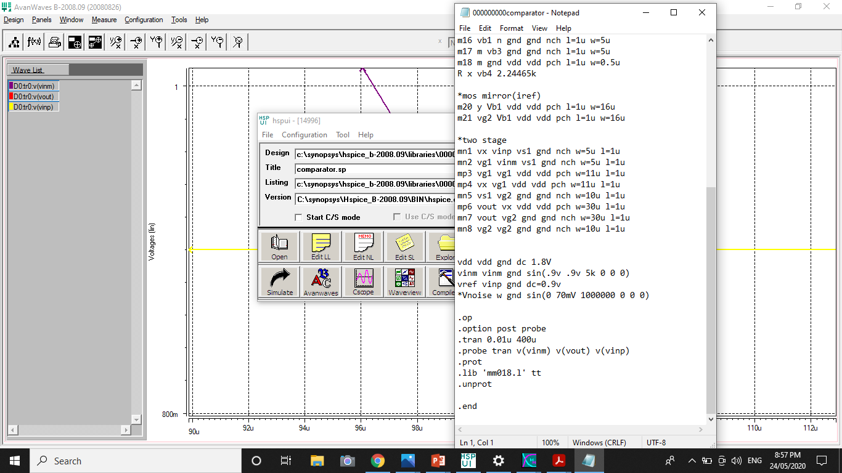
HSPICE CODE FOR NOISELESS COMPARATOR

Slide 4
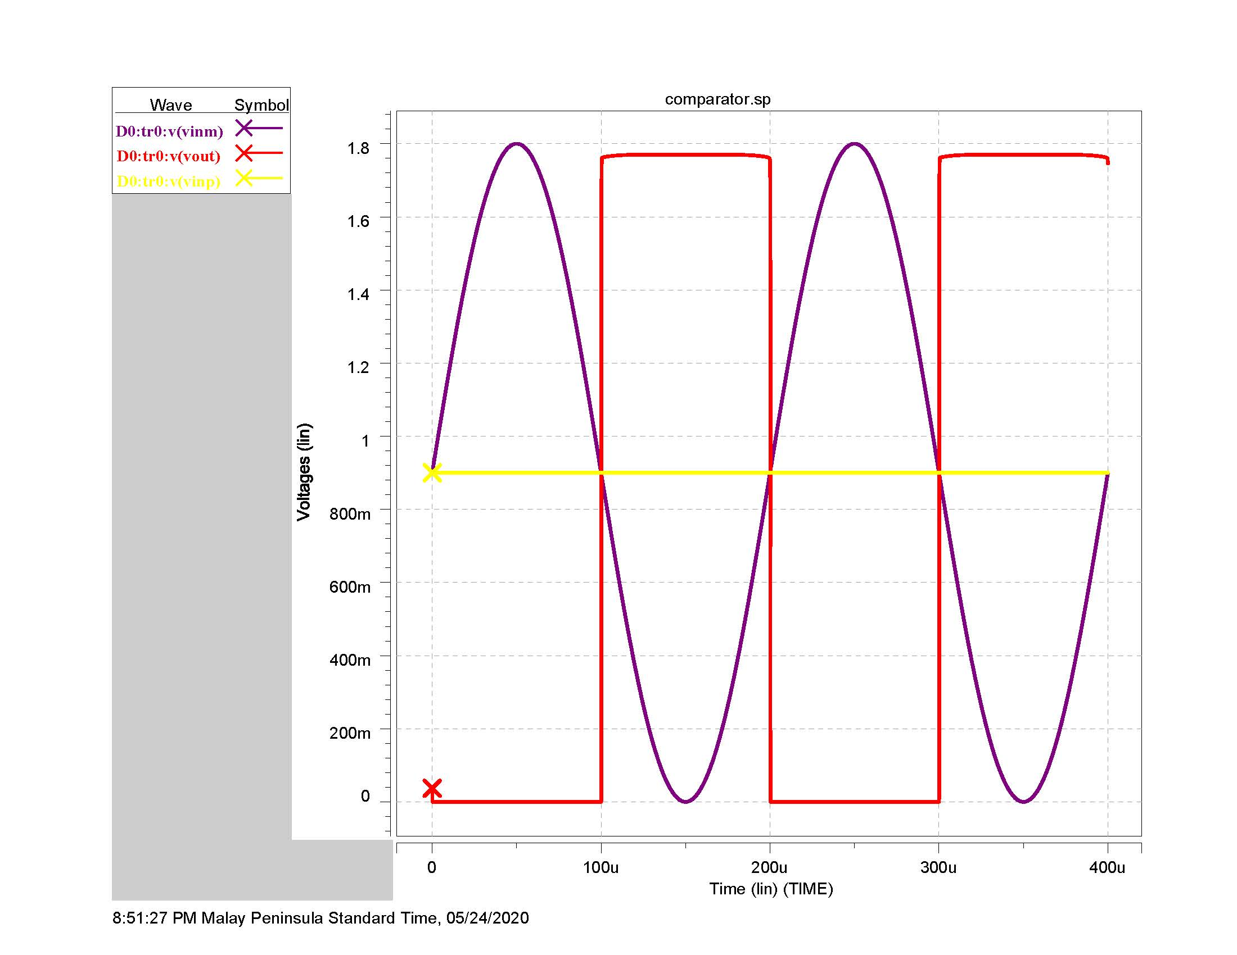

Slide 5
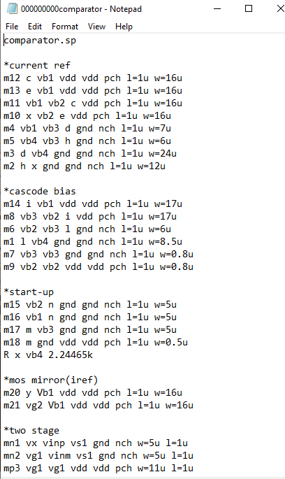
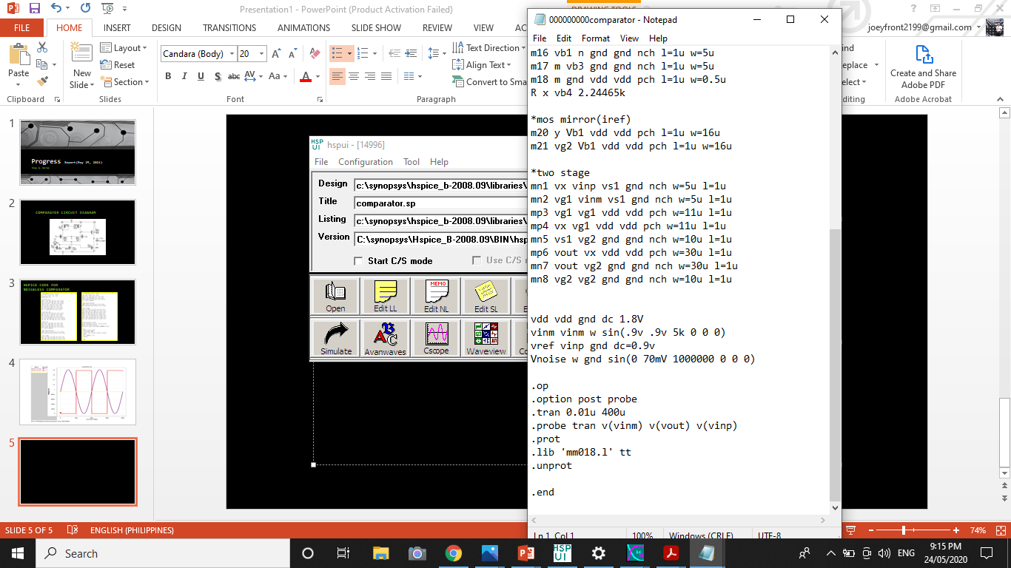
HSPICE CODE FOR COMPARATOR WITH NOISE

Slide 6
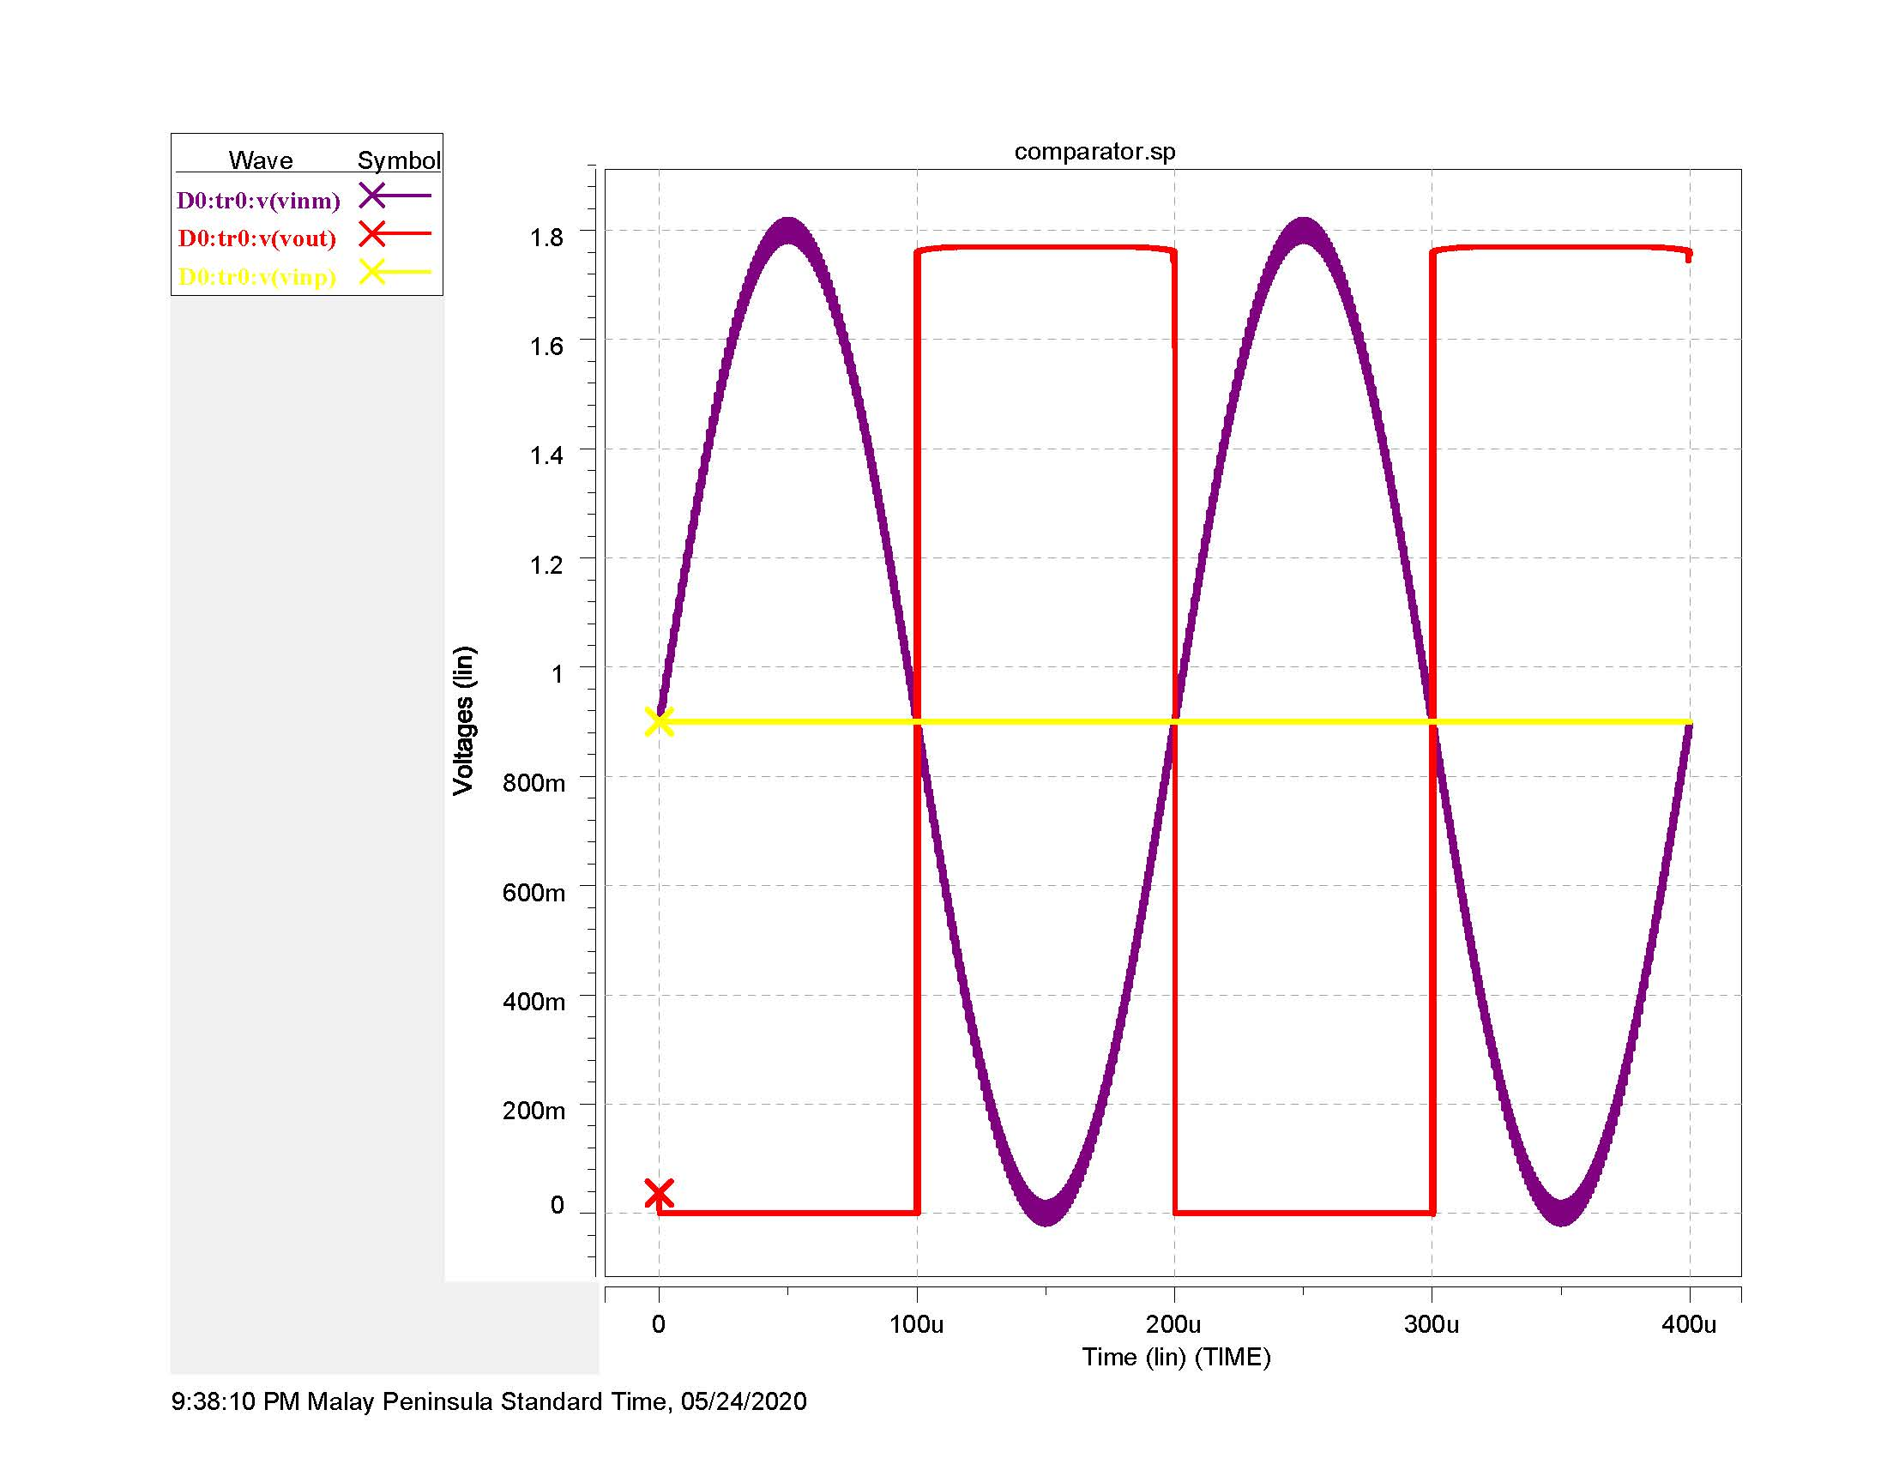
Noise @ 20mVpp

Slide 7
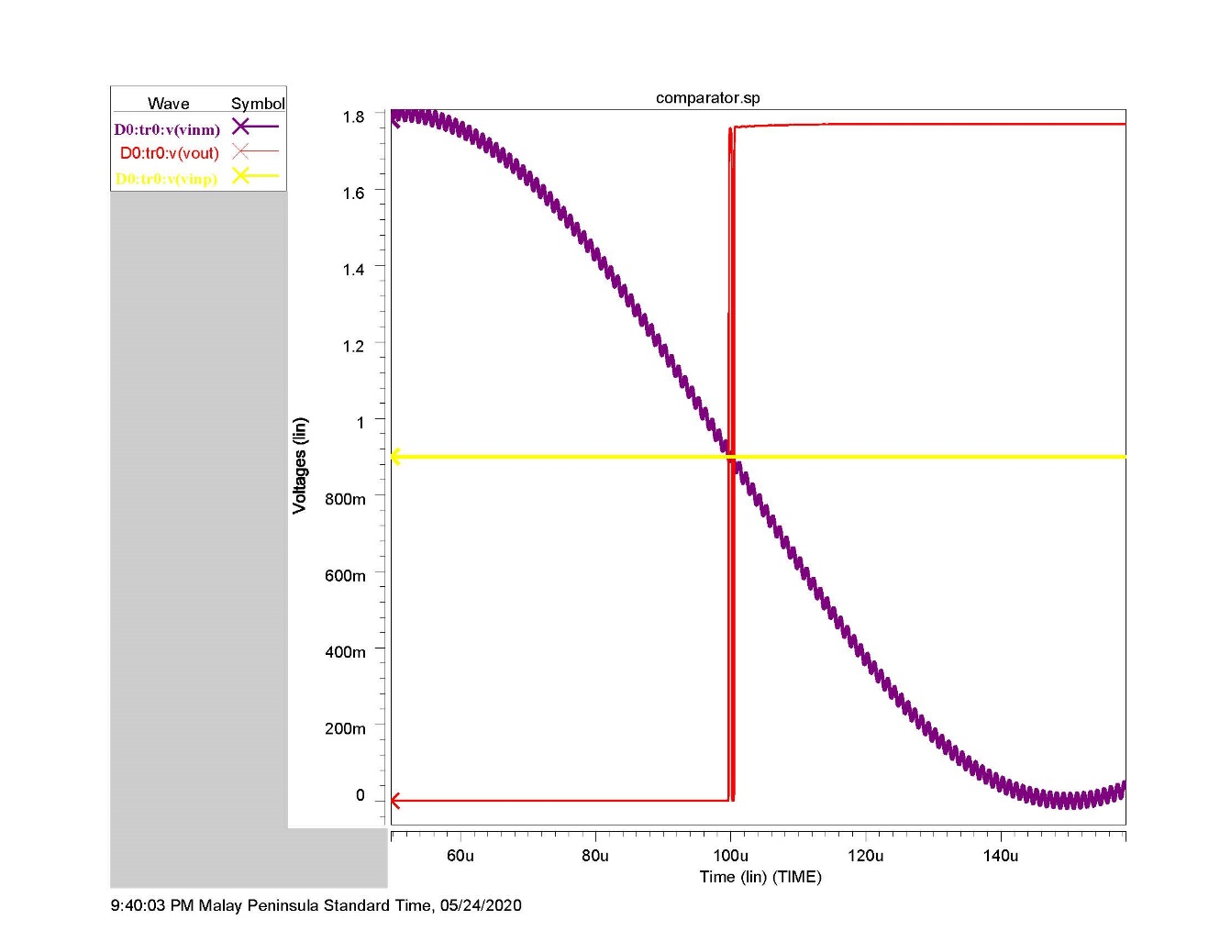
Noise @ 20mVpp

Slide 8
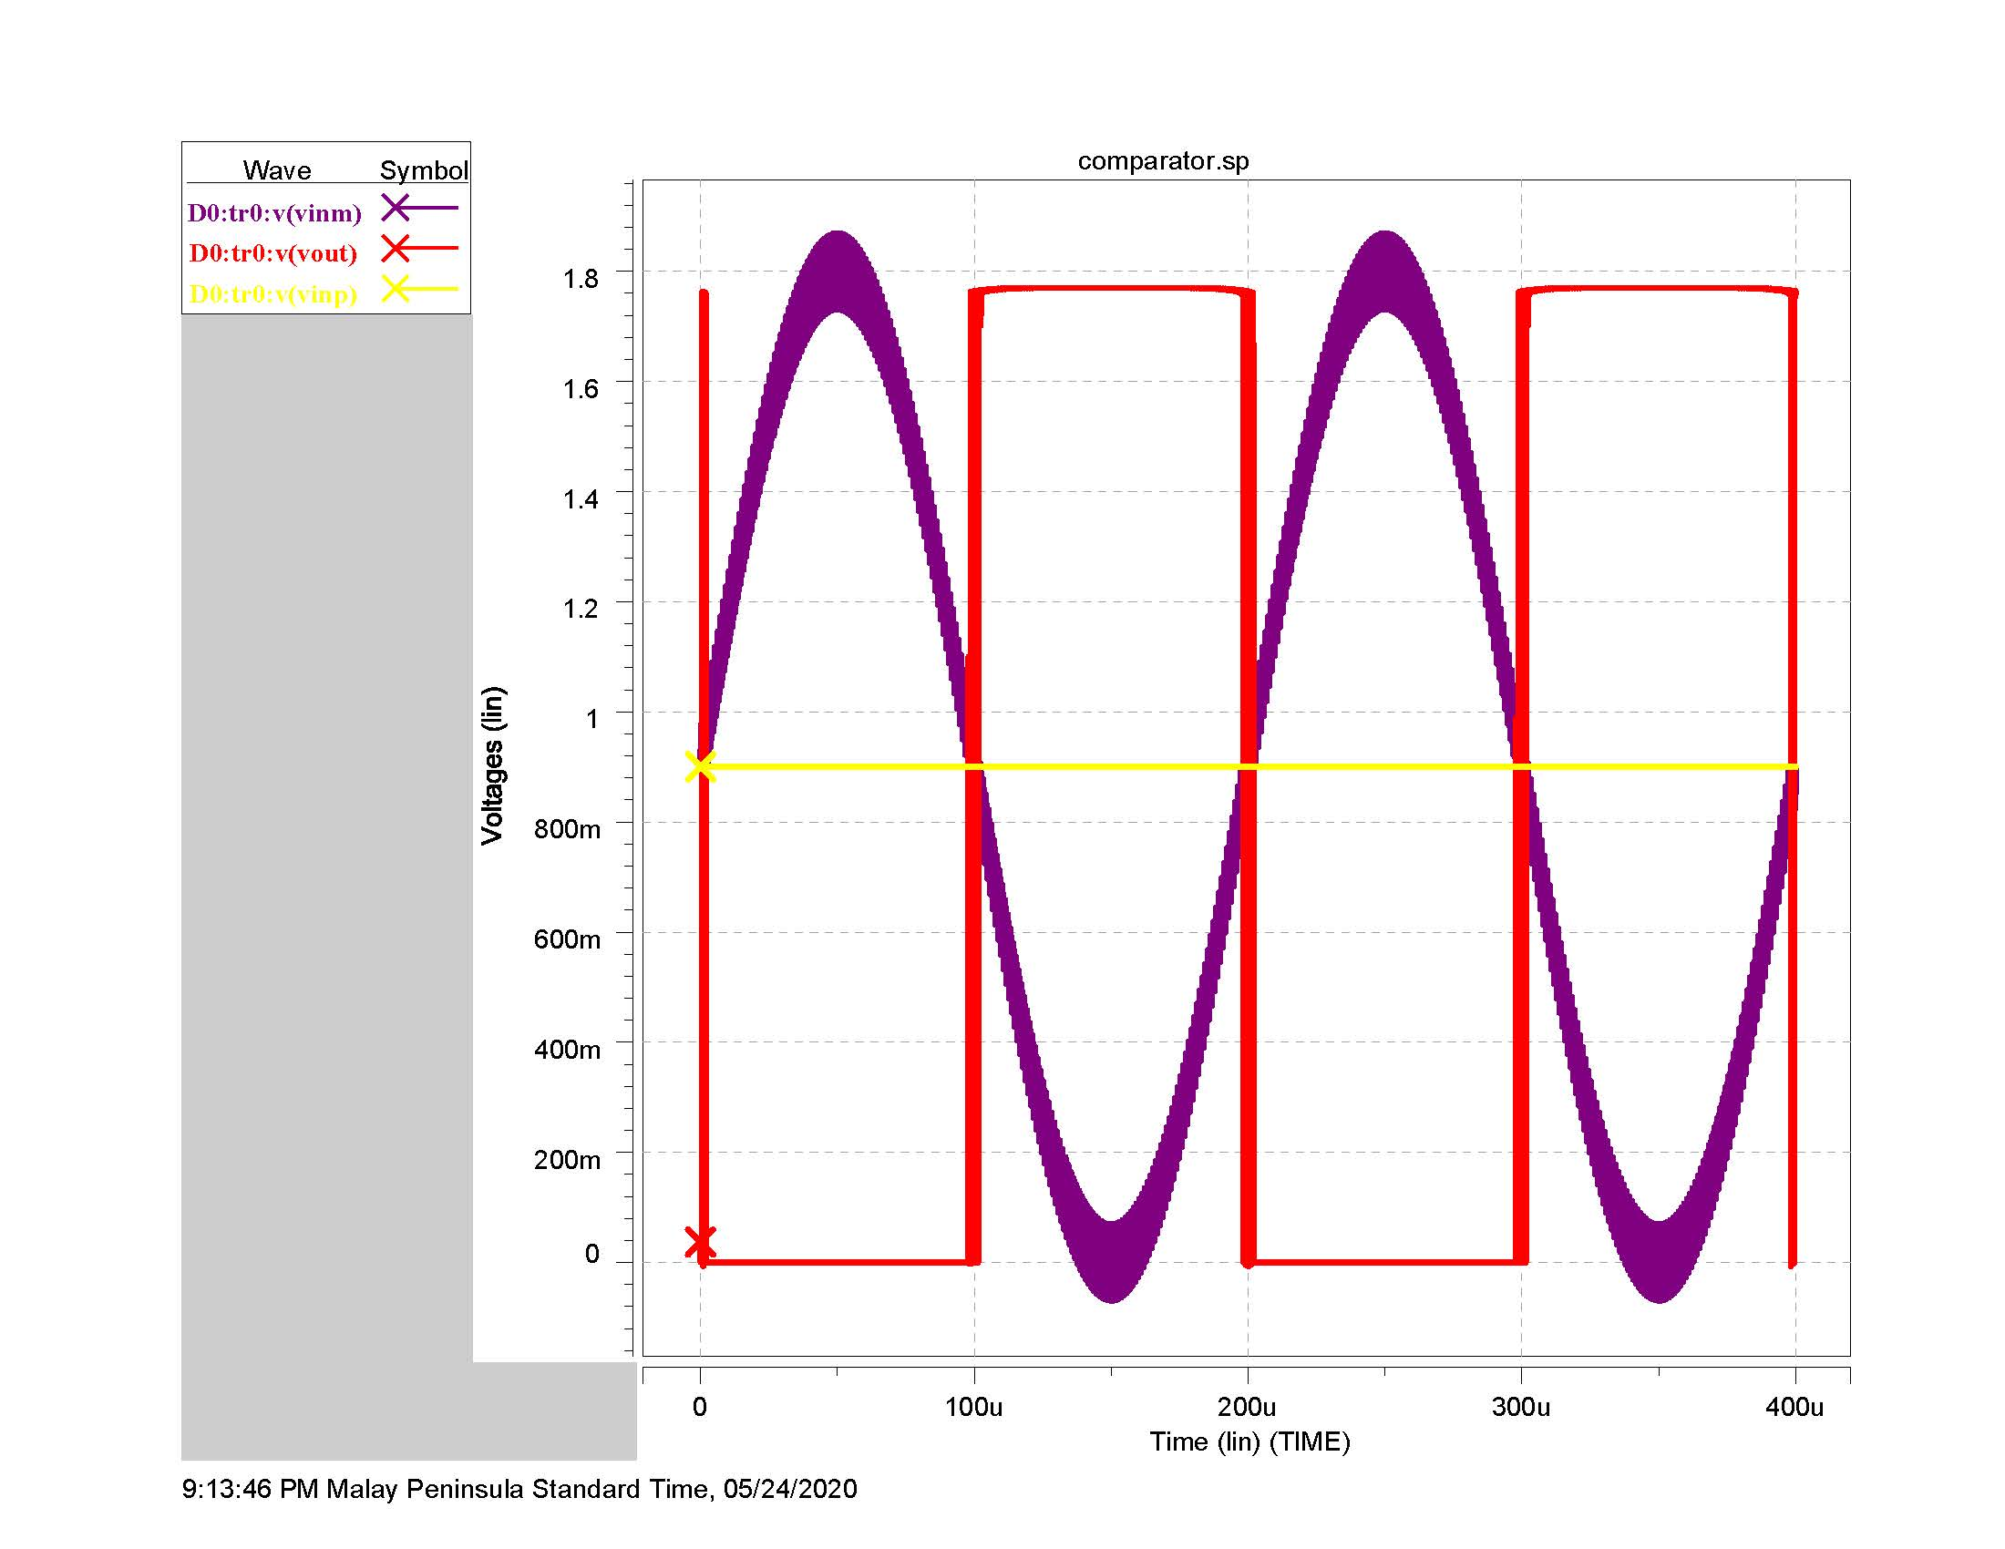
Noise= 70mVpp

Slide 9
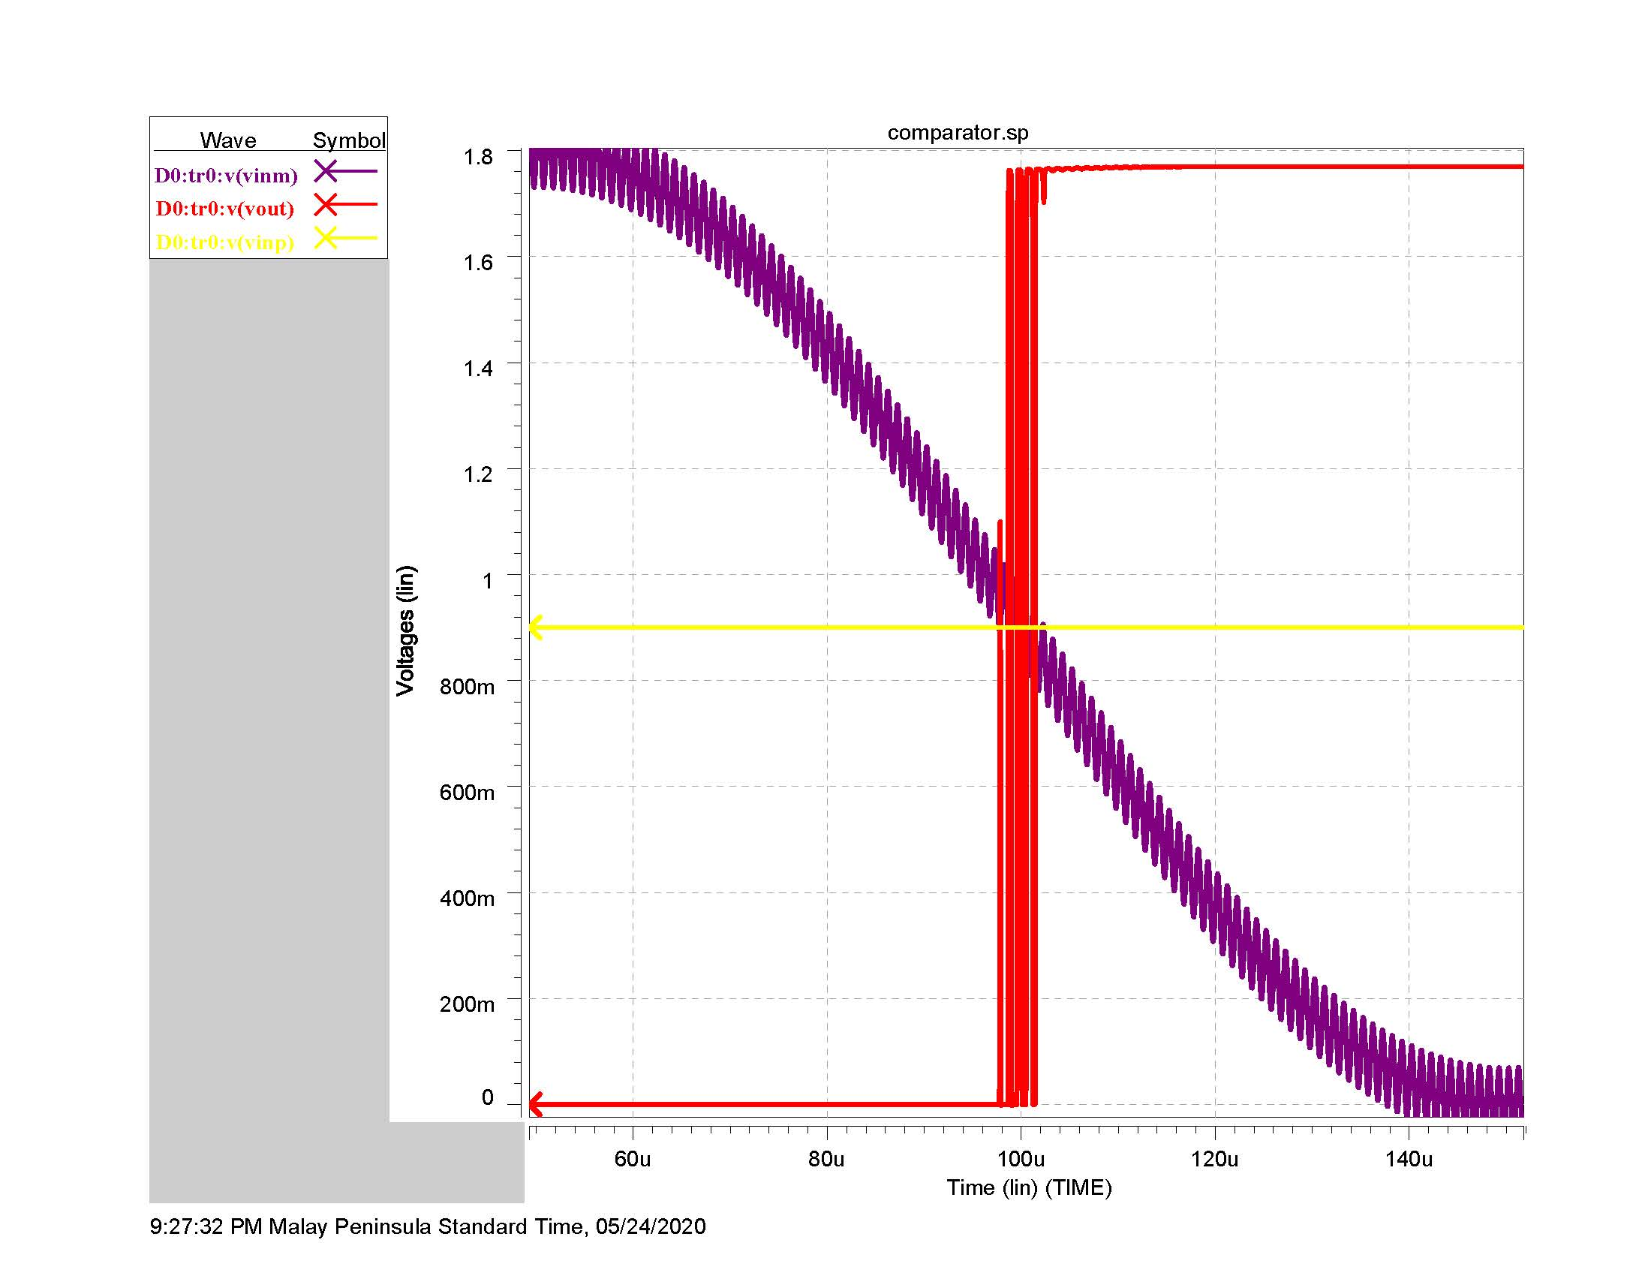
Noise @ 70mVpp

Slide 10
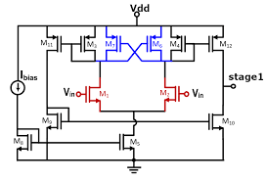
EMPLOYING A COMPARATOR WITH HYSTERESIS

Slide 11
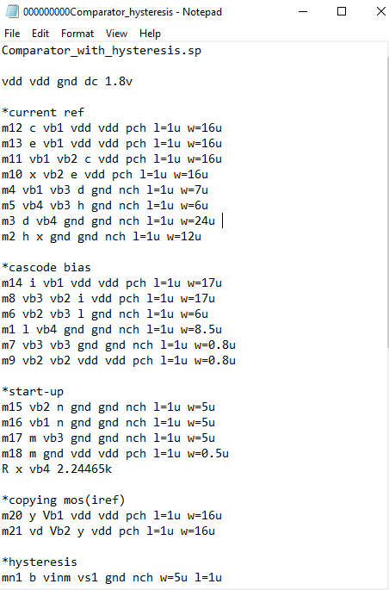
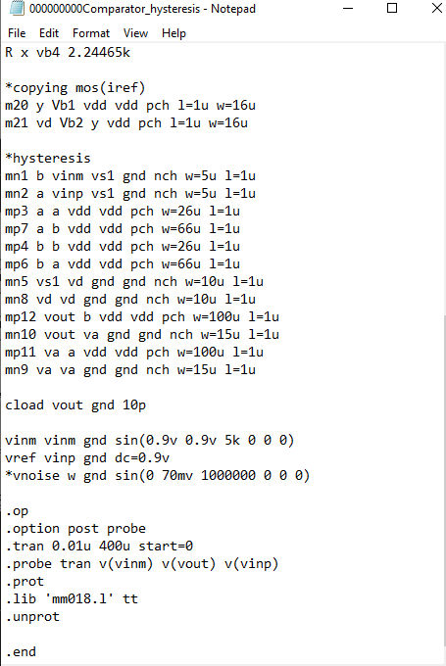
HSPICE CODE FOR NOISELESS COMPARATOR WITH HYSTERESIS

Slide 12
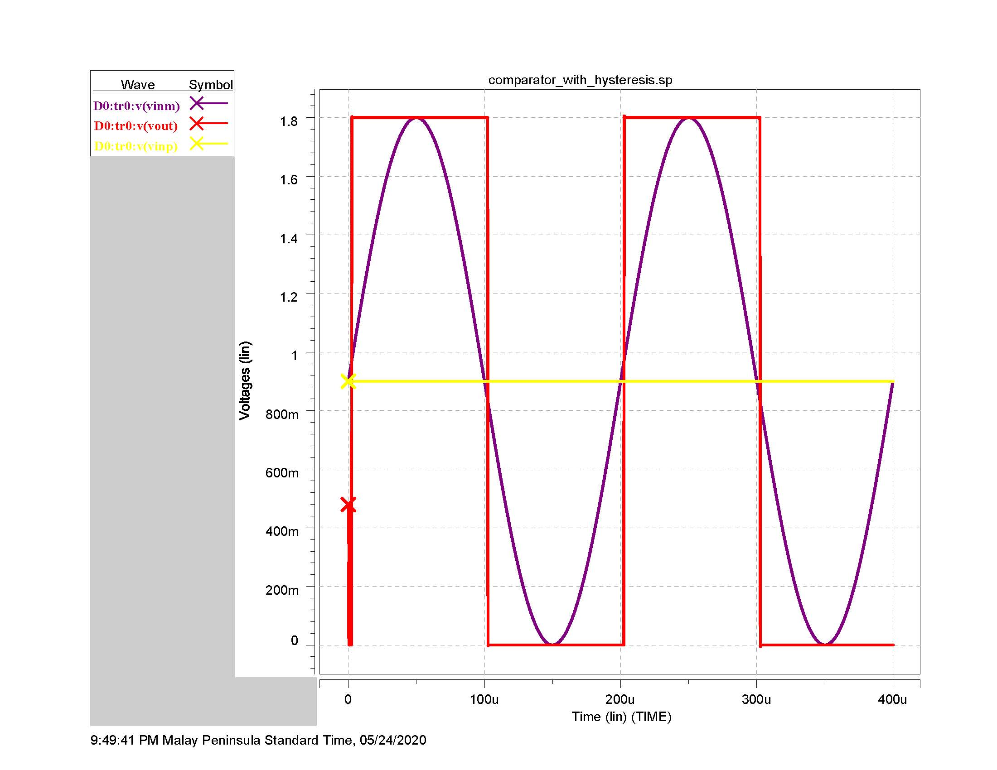

Slide 13
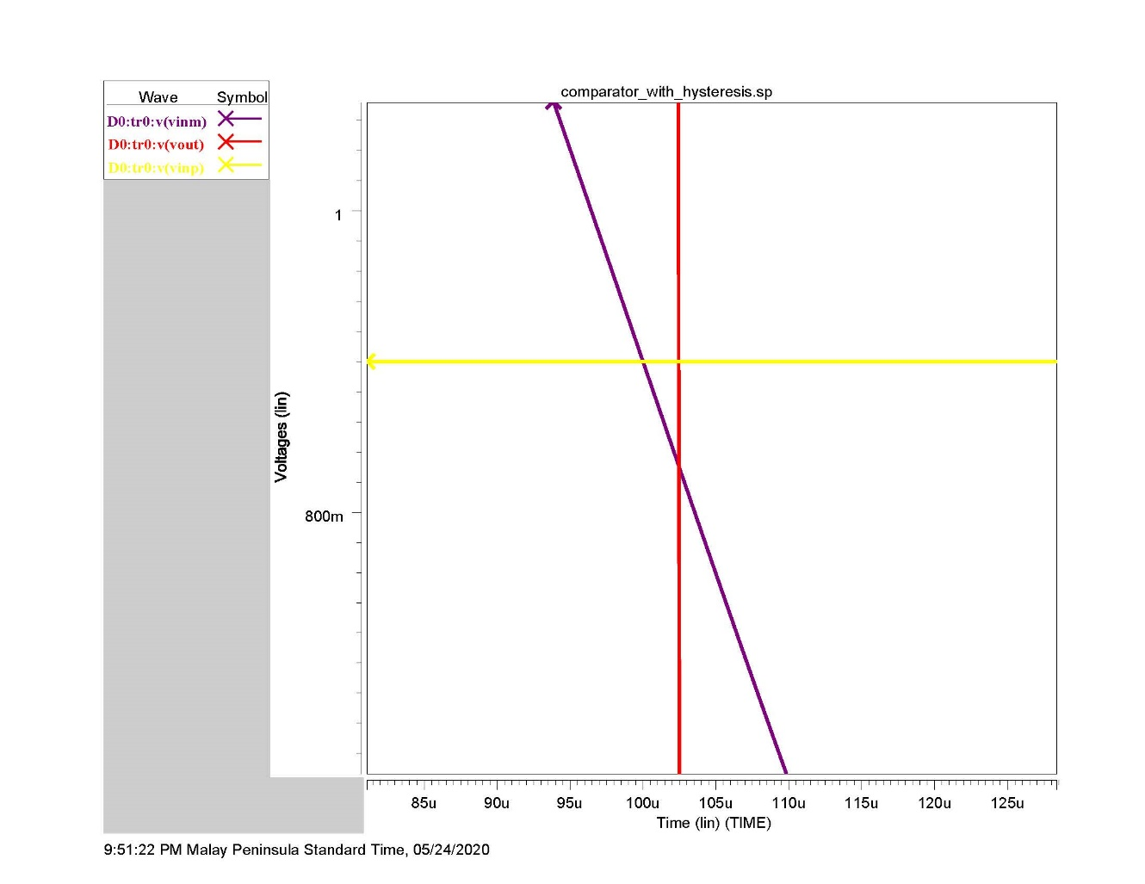
Zoomed

Slide 14
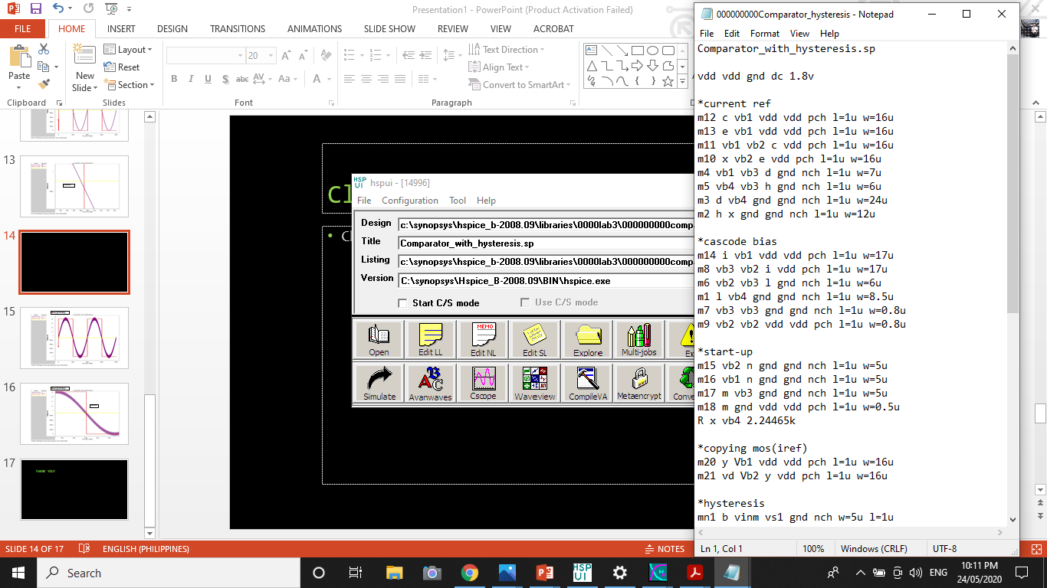
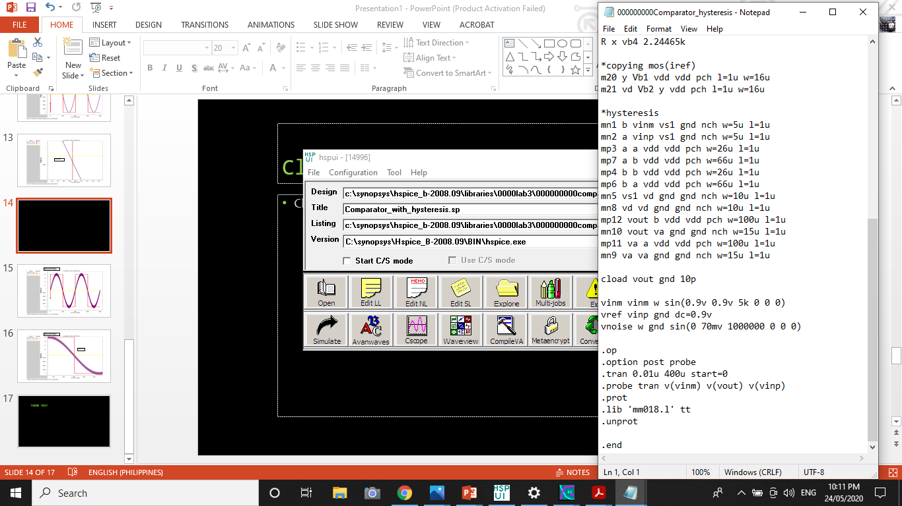
HSPICE CODE FOR HYSTERESIS WITH NOISE

Slide 15
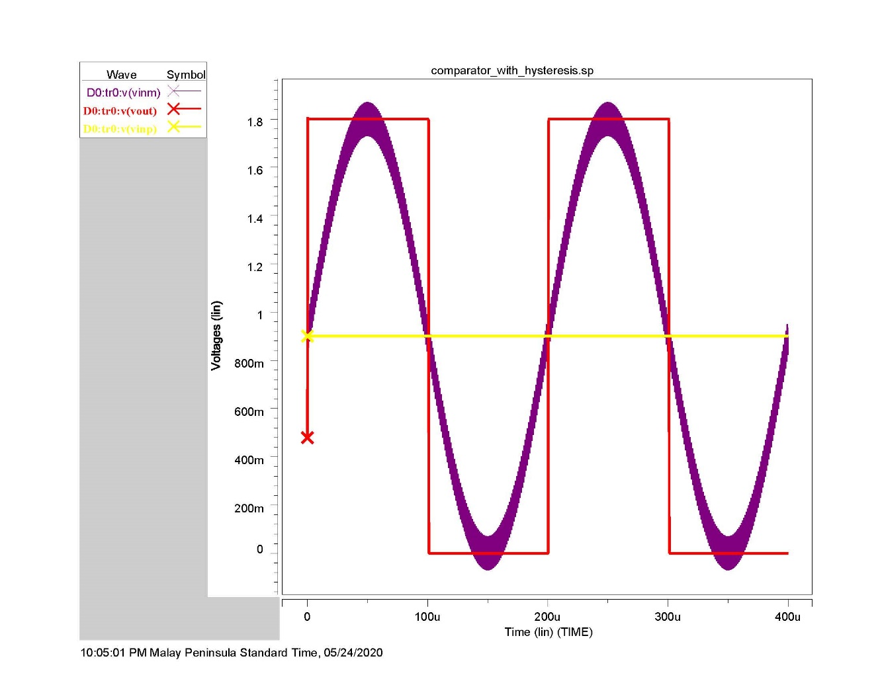
Noise @ 70mVpp

Slide 16
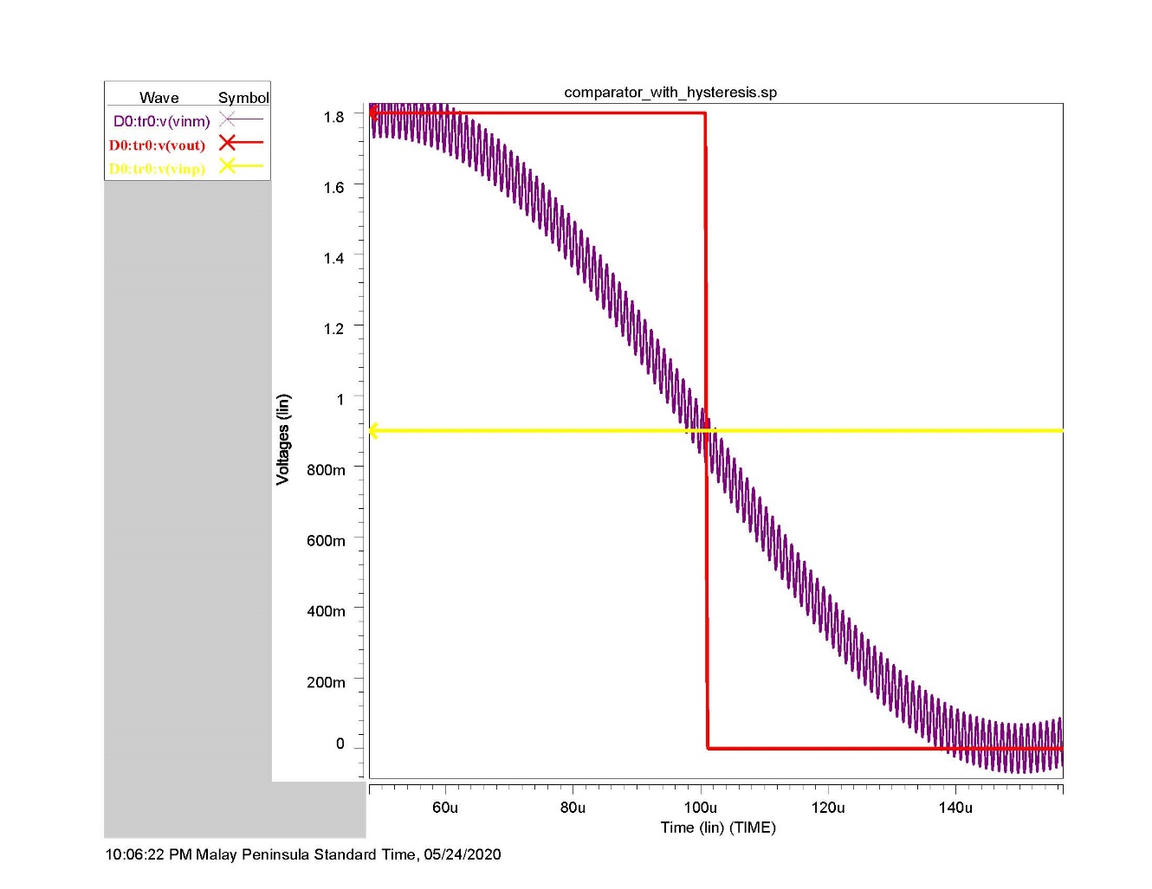
Noise @ 70mVpp
zoomed

Slide 17
THANK YOU!

