Slide 1


Slide 2


Slide 3
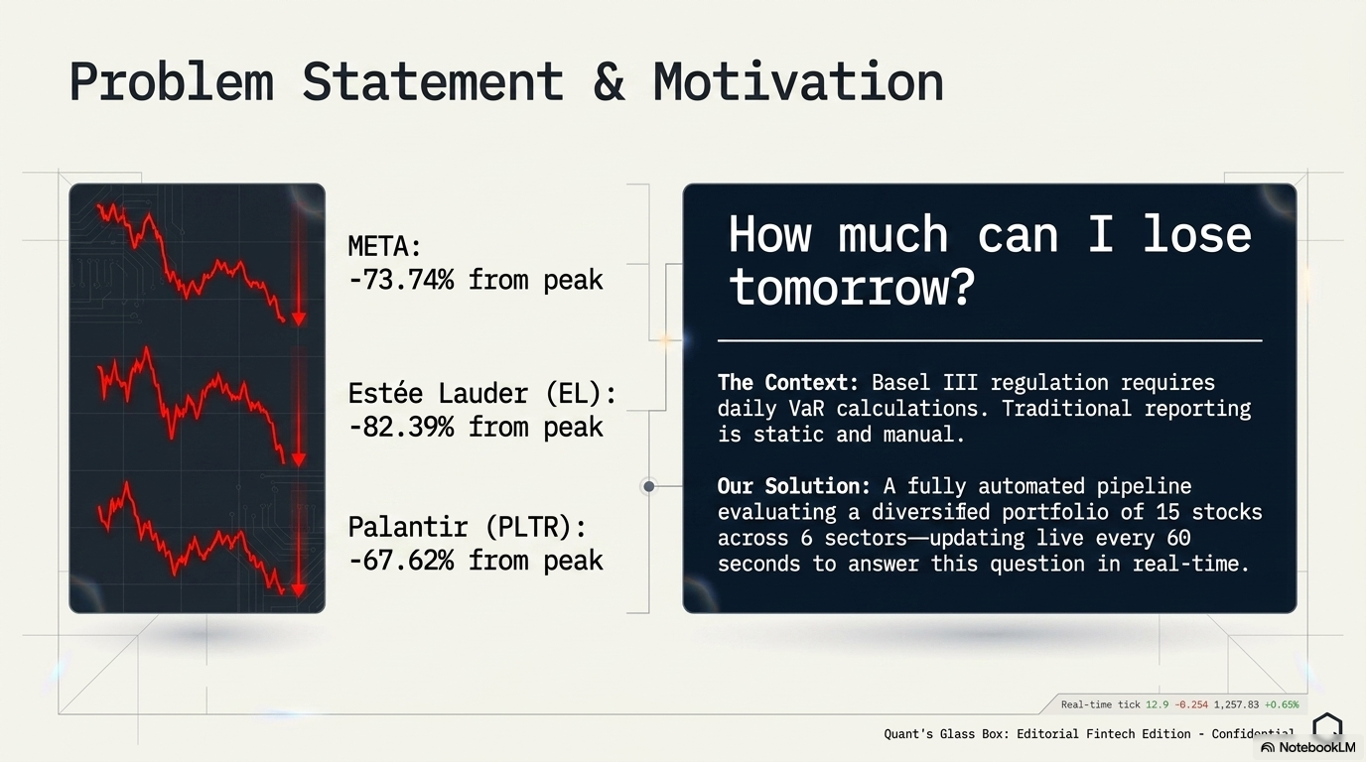

Slide 4
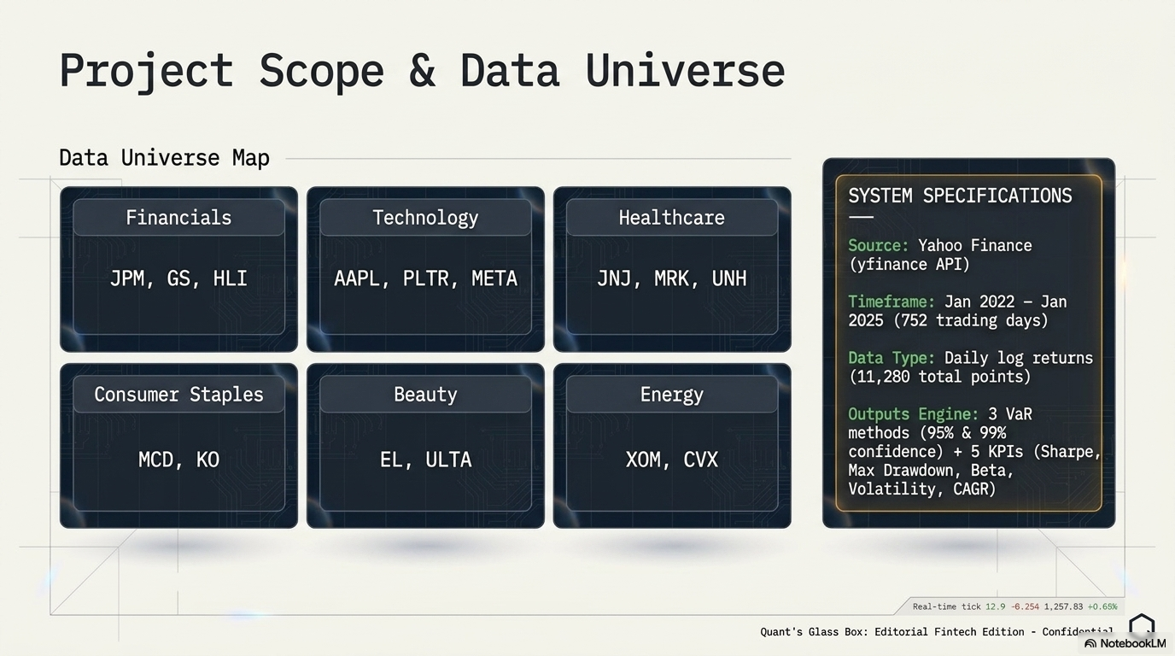
v

Slide 5
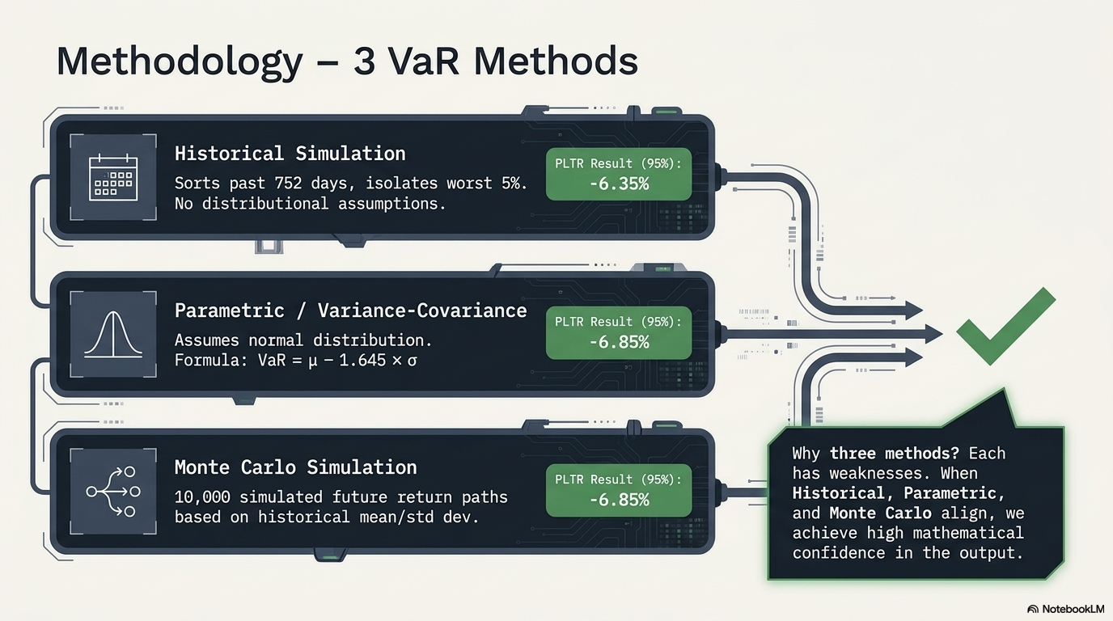

Slide 6
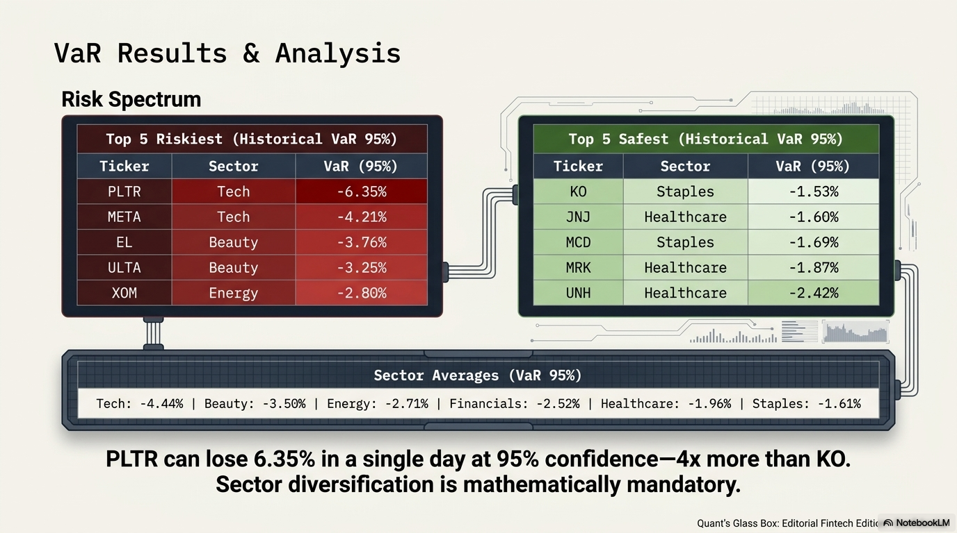

Slide 7


VaR 95% all stocks (ranked)
Historical vs Parametric vs Monte Carlo comparison

Slide 8
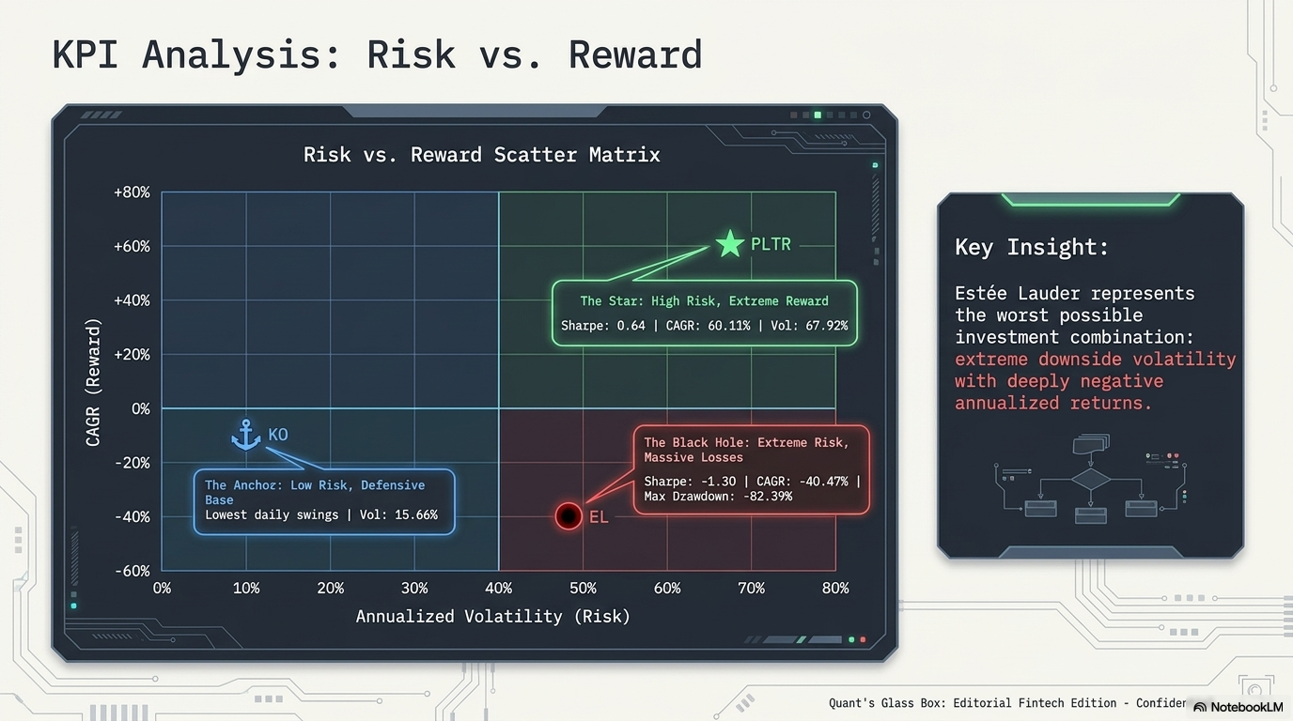

Slide 9



Sharpe Ratio all stocks
CAGR all stocks
Volatility all stocks

Slide 10
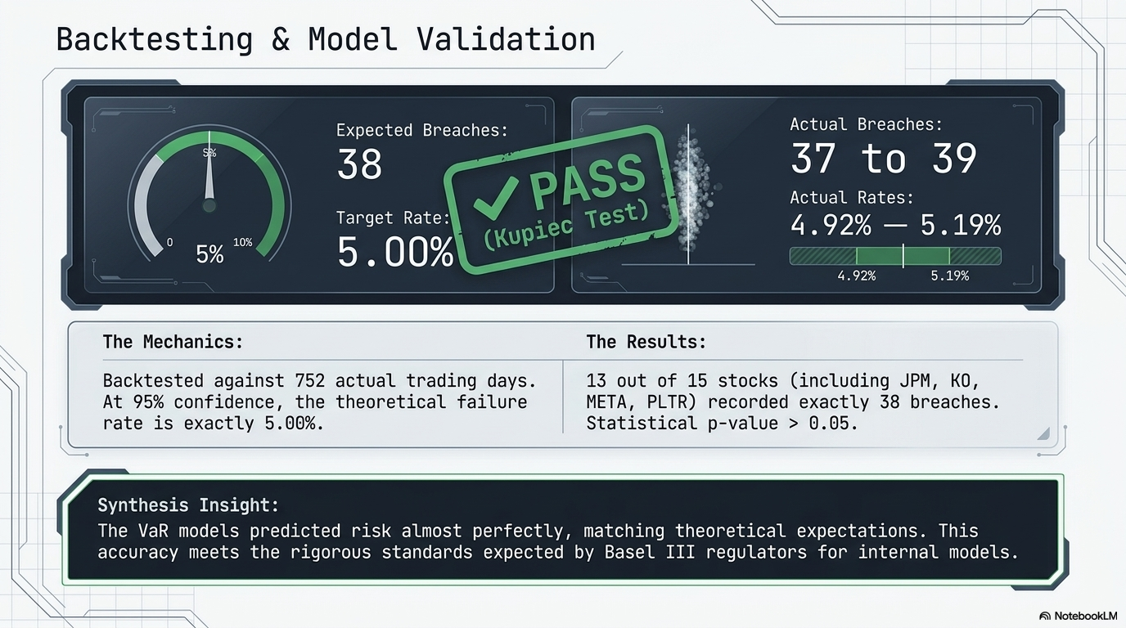

Slide 11
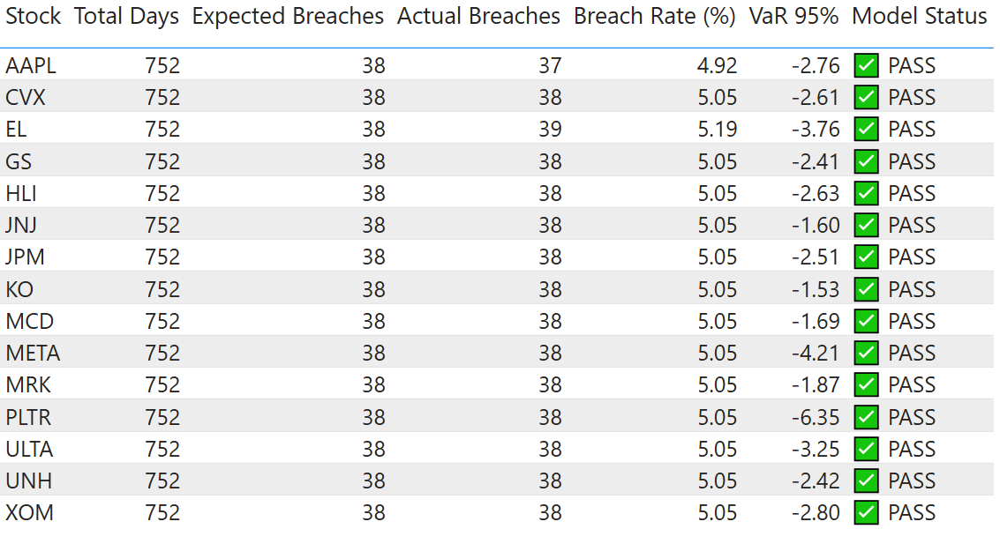
Full backtesting results

Slide 12
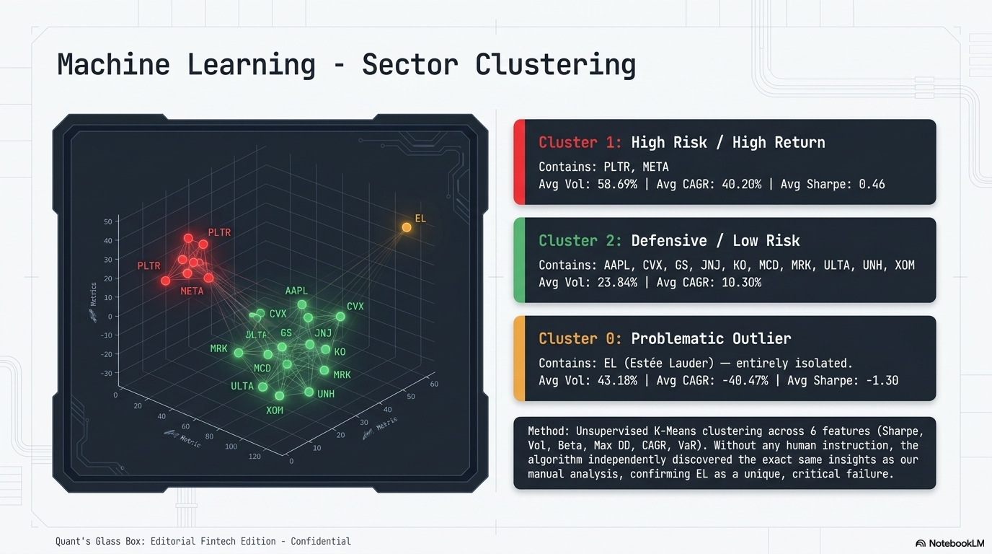

Slide 13


Slide 14
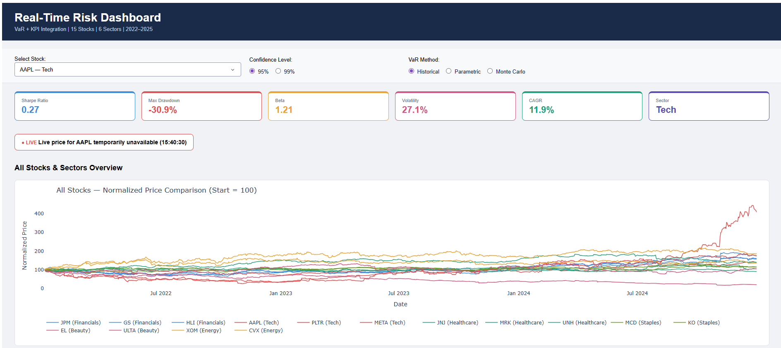

Slide 15


Slide 16


Slide 17
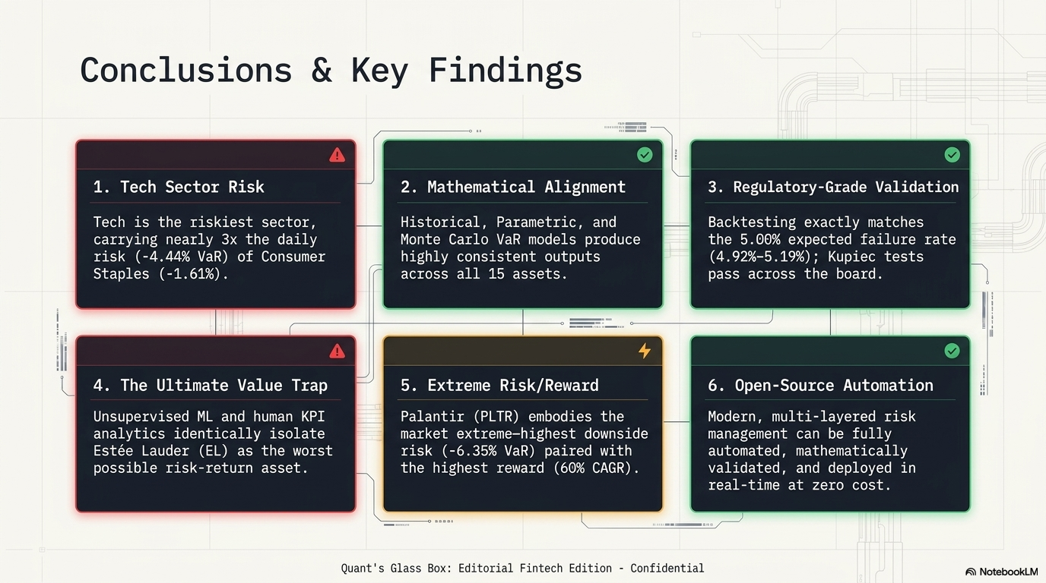

Slide 18


Slide 19


