Slide 1
Team 0xDEADBEEF
Requirements and Design Presentation
Tuesday, March 6, 2012

Slide 2
Introductions
Greck Cannon
Charles Chavez
Paul Doose

Slide 3
Solution Strategy

Slide 4
Solution Strategy
Movement & Navigation
Using DifferentialPilot library
Search methodology
Traverse entire playing field, then search back towards home position
Use data from DifferentialPilot to determine home position

Slide 5
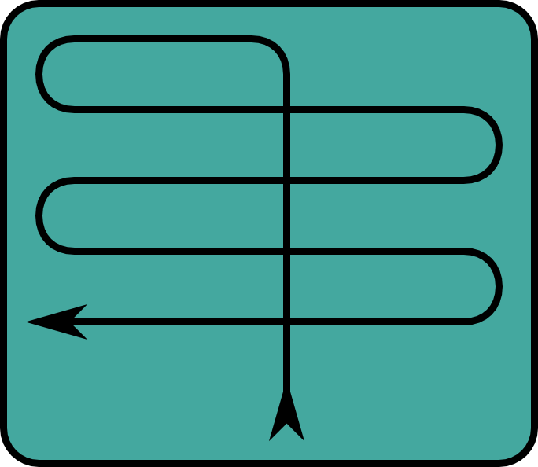
Solution Strategy
Movement & Navigation

Slide 6
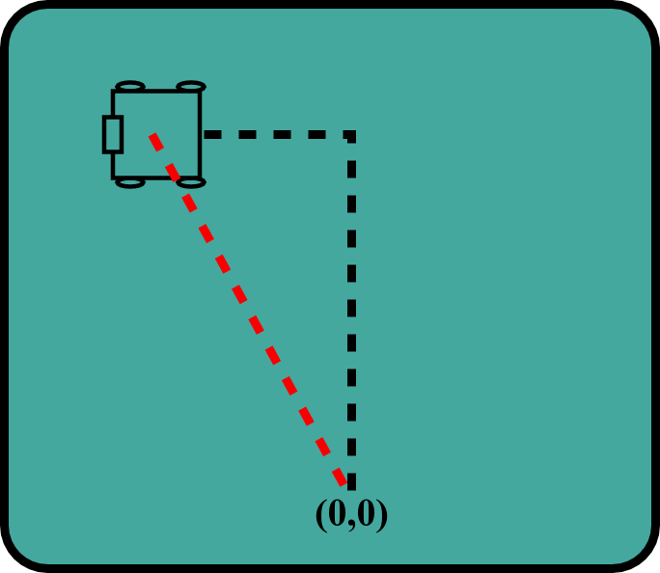
Solution Strategy
Movement & Navigation

Slide 7
Solution Strategy
Object Identification & Transport
Ultrasonic sensor identifies balls
Effective range of 7 – 20 cm
Most effective when sensor is pointed at the center of the sphere
Color sensor identifies ball color
Articulated claw closes on ball

Slide 8
Physical Design

Slide 9
Physical Design
Two powered drive wheel
Two swiveling tail-dragger wheels
Overhead claw eliminates positioning issues with the ultrasonic sensor
Claw must exert sufficient pressure to maintain ball control

Slide 10
Key Requirements

Slide 11
Key Requirements

Slide 12
Architectural Design

Slide 13
Architectural Design

Slide 14
Conclusion

Slide 15
Conclusion

Slide 16
Q&A

