Slide 1
Team 0xDEADBEEF
Requirements and Design Presentation
Tuesday, March 6, 2012

Slide 2
Introductions
Greck Cannon
Charles Chavez
Paul Doose

Slide 3
Solution Strategy

Slide 4
Solution Strategy
Movement & Navigation
Modular hardware and software components
Re-use as much code from HW1 as possible
Low-level routines to control basic movements
Use leJOS-provided libraries for mapping

Slide 5
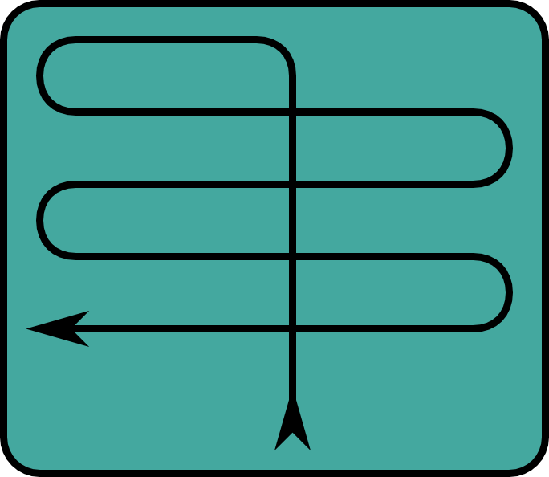
Solution Strategy
Movement & Navigation

Slide 6
Solution Strategy
Movement & Navigation
Demo video

Slide 7
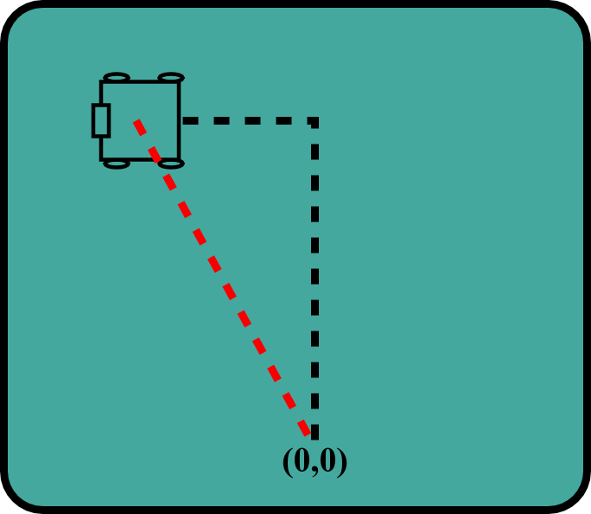
Solution Strategy
Movement & Navigation

Slide 8
Solution Strategy
Object Identification & Transport
Ultrasonic sensor identifies balls
Effective range of 7 – 20 cm
Most effective when sensor is pointed at the center of the sphere
Color sensor identifies ball color
Articulated claw closes on ball

Slide 9
Physical Design

Slide 10
Physical Design
NXT brick placed sufficiently above mechanical components
Two powered drive wheels
Two swiveling tail-dragger wheels
Helps stabilize body during turns
Overhead claw eliminates positioning issues with a forward-looking ultrasonic sensor
Claw must exert sufficient pressure to maintain ball control

Slide 11
Physical Design
Photo of the robot

Slide 12
Physical Design
Detail photo of the sensors

Slide 13
Key Requirements

Slide 14
Key Requirements
Functional Requirements
Motion
Sensing
Manipulation
Navigation

Slide 15
Key Requirements
Non-functional requirements
Physical size
Behavioral restrictions
Software infrastructure

Slide 16
Architectural Design

Slide 17
Architectural Design
Essentially Firby’s three-layer architecture
Skill layer mapped to “Recipes”
Sequencing layer embodied by skill groupings
Planning imposed by overall state machine design

Slide 18
Architectural Design
FSM

Slide 19
Architectural Design
DifferentialPilot
OdometryPostProvider

Slide 20
Architectural Design
Concerns
Positioning accuracy
Infinite regress of error-correcting
Exceptional handling
L/T/B

Slide 21
Conclusion

Slide 22
Conclusion
Success factors
Simple hardware interface (only one NXT brick)
Streamlined software enables rapid development
Failure factors
Environmental complexity
Ball positioning, boundary location, etc.
Finite state machine can only manage what situations we have imagined

Slide 23
Q&A

