Slide 1
Group Project – Machine Learning in Finance
Group 2
Authors: Cléo Greb, Juraj Malovecky, Morris Niklaus, Pascal Kägi and Yiwei Gong

Slide 2
Pre-processing and Data sets
Categorical values: One hot encoder
Features selection: SelectFromModel, Random Forest Classifier
Standardisation: StandardScaler
Oversampling: SMOTE
Data Sets:
Small data set: factorization, feature selection
Large data set: dummy variables

Slide 3
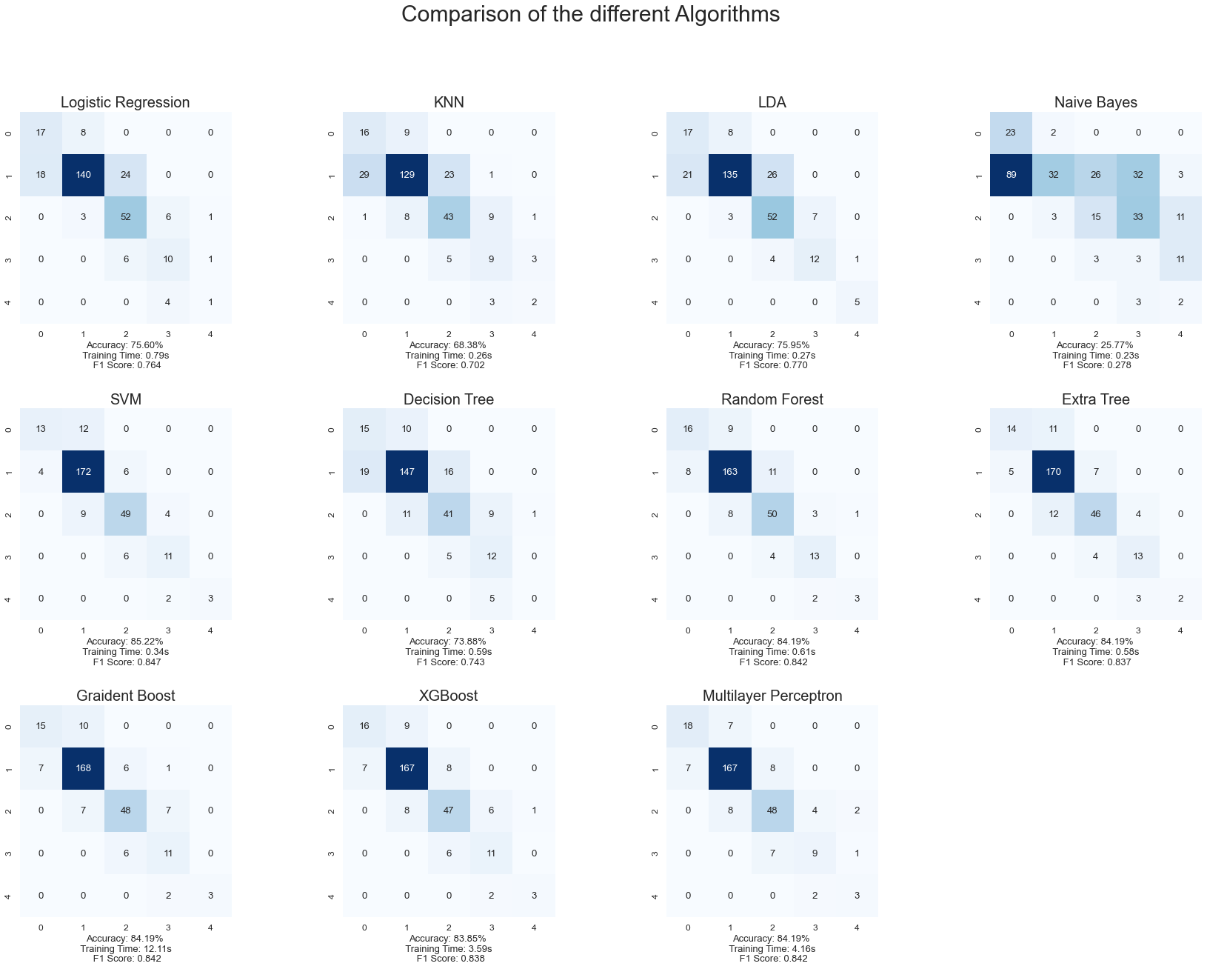
Comparison of different Algorithms – Small Data Set

Slide 4
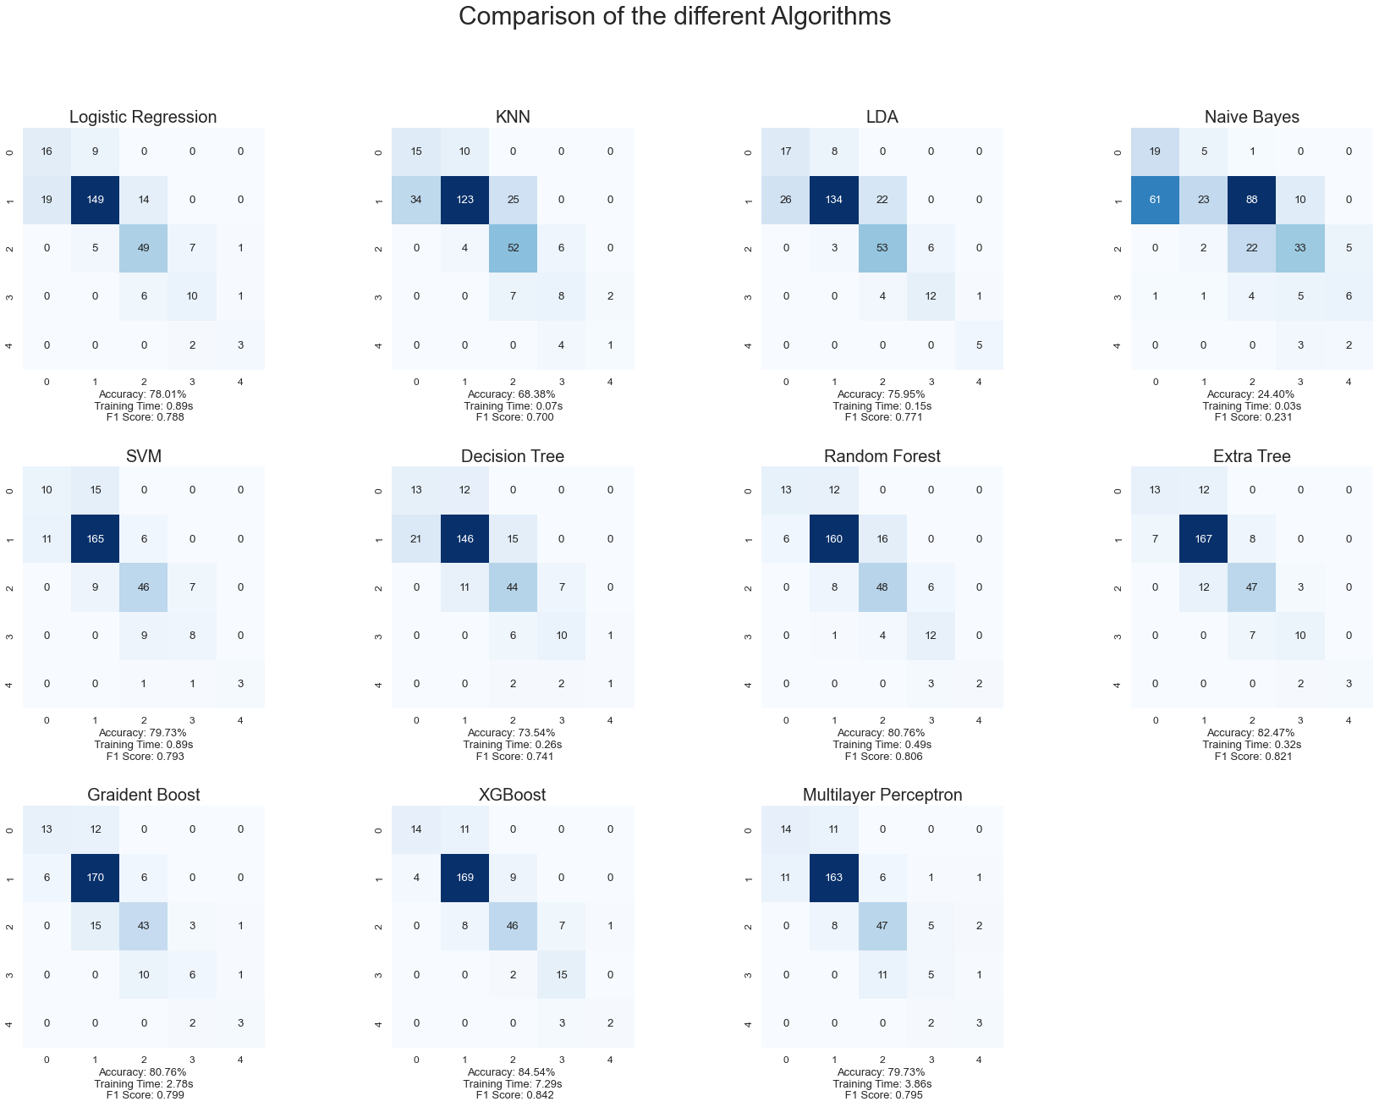
Comparison of different Algorithms – Large Data Set

Slide 5
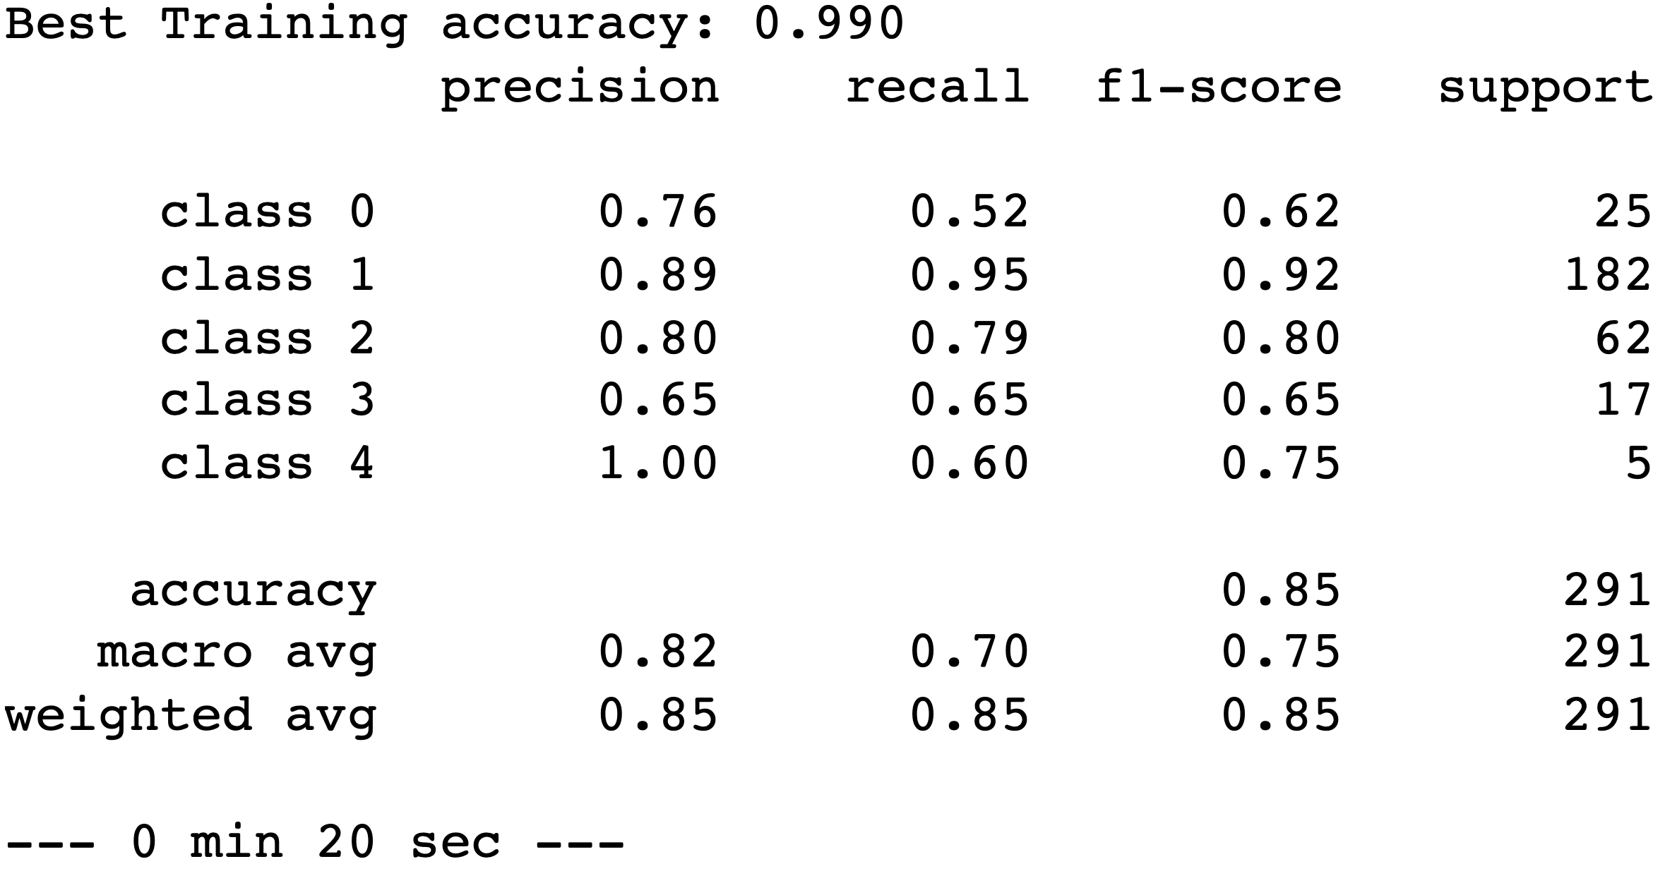
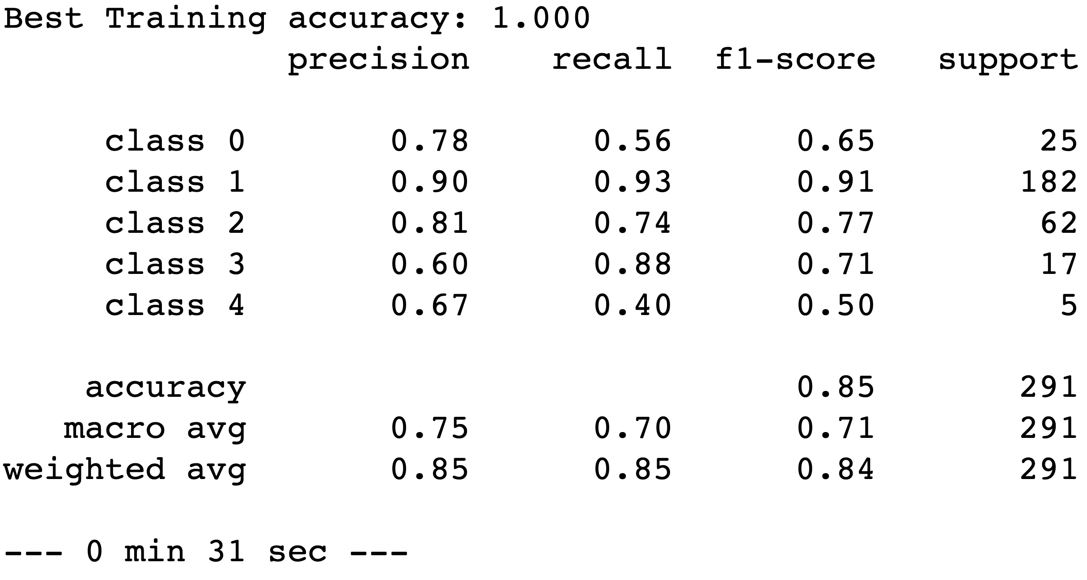
Small data set Large data set
Discussion about the Best Algorithms for the SD and LD
Support Vector Machine
Pros: good accuracy and distribution over the classes
Cons: overfitting: C↑, gamma ↓
XGBoost
Pros: Best for the large data set
Cons: overfitting, although it should be an algorithm that prevents overfitting

Slide 6
Discussion & Limitation Talking Points:
Data Set
Small data set ⇔ Large data set
Multicolinearity; causality
Time components: feature selection, algorithm choice, grid search
Overfitting
Parameter selection
Feature extraction (PCA)

Slide 7
Q&A

