Slide 1


Oemof Workshop Week Basics
Martha Hoffmann
Session I
RLI, 16.09.2019
© Reiner Lemoine Institut

Slide 2
Aim of this session
Theoretical and practical introduction to using oemof
All workshop contents at: https://github.com/smartie2076/oemof_workshop
Notes:
Erhöhte Versorgungssicherheit durch Reduzierung der starken Abhängigkeit von fossilen Brennstoffimporten
Effizienzsteigerung durch Lastoptimierung der Dieselgeneratoren → Vermeidung von Teillast
Erhöhte Versorgungssicherheit durch Reduzierung der starken Abhängigkeit von fossilen Brennstoffimporten
Senkung der Stromgestehungskosten durch kompetitive und zuverlässige Technologien

Slide 3
Agenda
Introduction
Components and Solver-Options
Conclusion
Package Structure
What is the main idea behind oemof?
Programming examples
Creating an own oemof application

Slide 4
Agenda
Introduction
Components and Solver-Options
Conclusion
Package Structure
What is the main idea behind oemof?
Programming examples
Creating an own oemof application

Slide 5
Motivation for open source tools
Open source software is crucial to …
meet scientific standards in software based research
foster bottom-up approaches by reducing barriers associated with high license cost of proprietary software tools
improve research quality & completeness & knowledge pooling due to collaborative modelling

Slide 6
Agenda
Introduction
Components and Solver-Options
Conclusion
Package Structure
What is the main idea behind oemof?
Programming examples
Creating an own oemof application

Slide 7


What is the main idea behind oemof?
Is a community-driven open-Source modelling framework initiated by:
Python package/library specifically developed for energy system modelling
Model individual requirements/aspects in research projects, dissertations, Bachelor/-Master thesis
Official website: http://oemof.org

Slide 8


What is the main idea behind oemof?
Collaborative, public development
Recycling and expansion of existing models
Modular structure with defined interfaces to correlate other approaches/packages
Improved review process by the community
collaborative
modular
open source

Slide 9
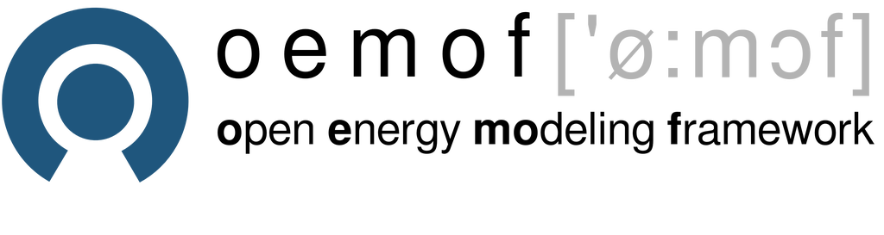









Oemof projects at RLI
Research projects
Publicly funded by EU,
BMWI, BMWF
Research studies
Contract work
Model development
Workshops
Web-applications
General oemof uses: https://oemof.org/projects/

Slide 10
Installation of oemof
Necessary to install:
Python programming environment (eg. pycharm)
Package manager (eg. miniconda)
Solver (eg. coinor-cbc)
Python library oemof
More information:
Slides: Oemof_Workshop_02_Installation.pptx
Youtube tutorial for Windows: https://www.youtube.com/watch?v=eFvoM36_szM

Slide 11
Agenda
Introduction
Components and Solver-Options
Conclusion
Package Structure
What is the main idea behind oemof?
Programming examples
Creating an own oemof application

Slide 12
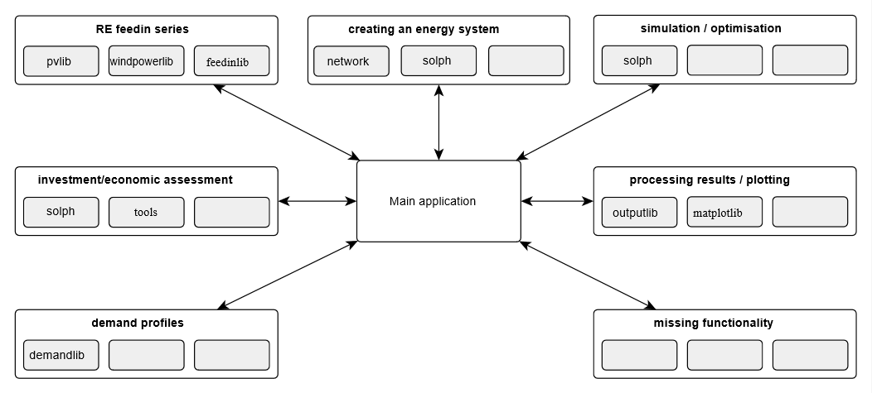
Package Structure

Slide 13
Package Structure

Slide 14
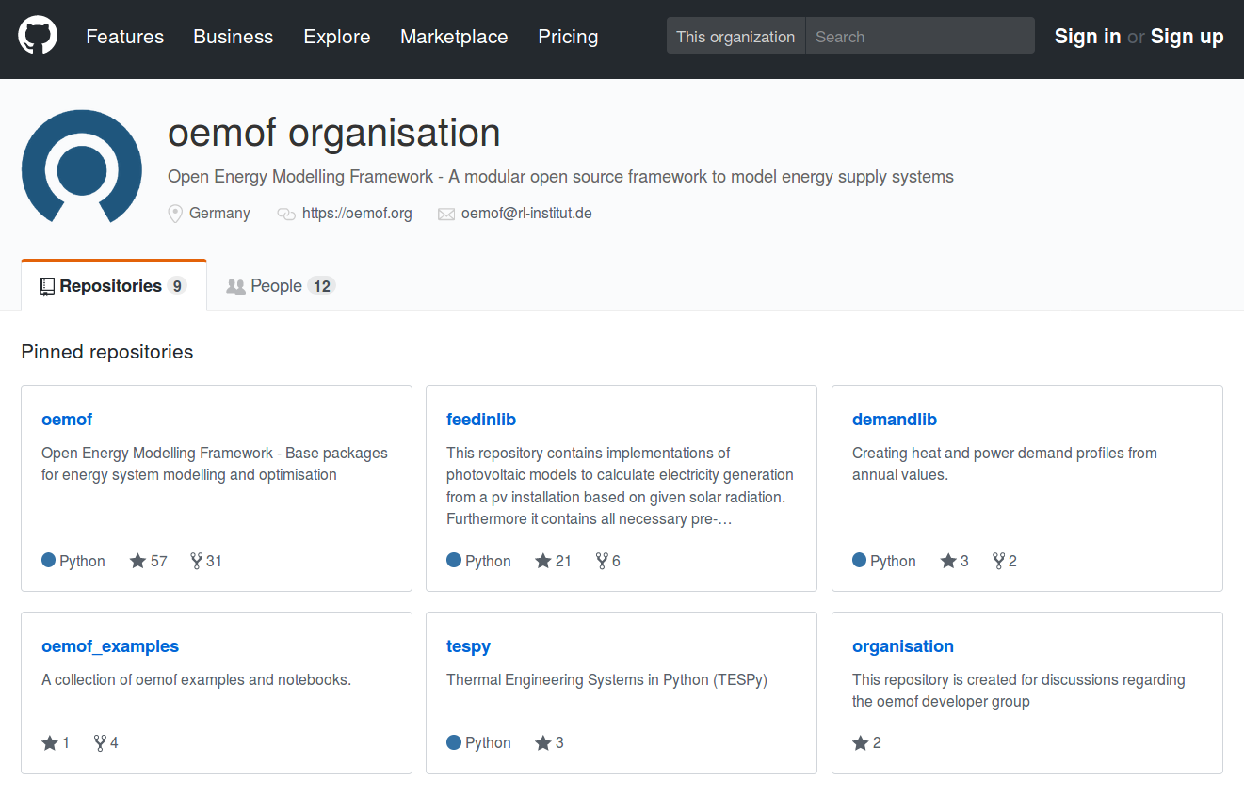
Framework-Konzept: Toolbox
Source code: https://github.com/oemof
Auswahl Repositories der oemof-Toolbox:
oemof - Base packages for energy system modelling and optimisation
oemof_examples - A collection of oemof examples and notebooks
feedinlib - implementations of photovoltaic models to calculate electricity generation from
demandlib - Creating heat and power demand profiles from annual values.
oemof_visio - Visualisation package of oemof
tespy - Thermal Engineering Systems in Python (TESPy)

Slide 15
Agenda
Introduction
Components and Solver-Options
Conclusion
Package Structure
What is the main idea behind oemof?
Programming examples
Creating an own oemof application

Slide 16
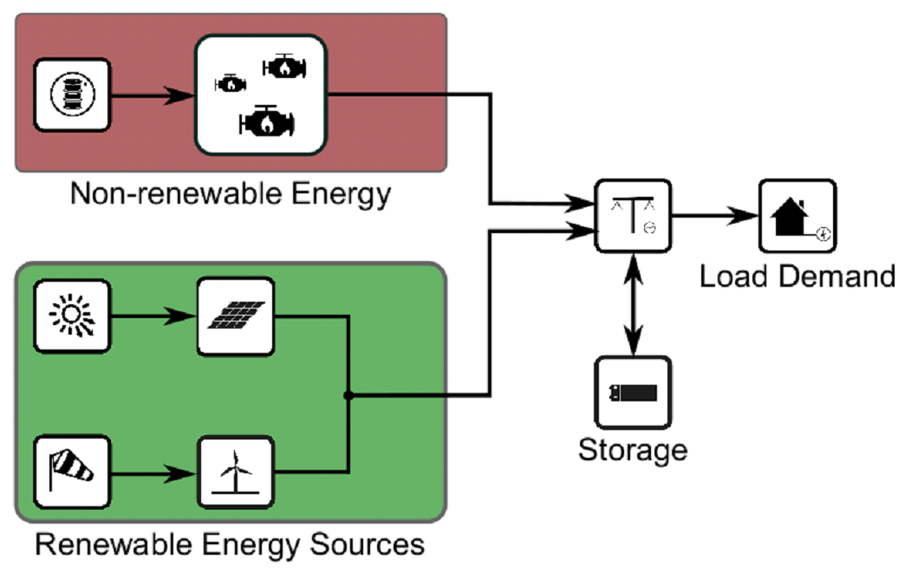
Example II: Optimizing a Hybrid Mini-Grid
Simplified single-node model
Source/Caption:

Slide 17
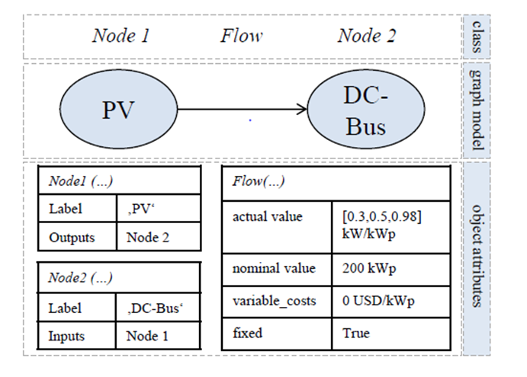
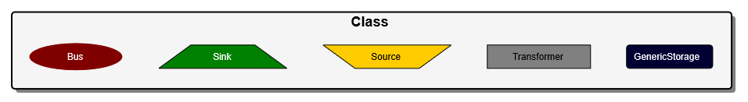
Components and Solver Options
Components
Graph-Based Modelling: „Nodes are connected with Flows to built the energy system“
Existing Components (Node-objects):

Slide 18
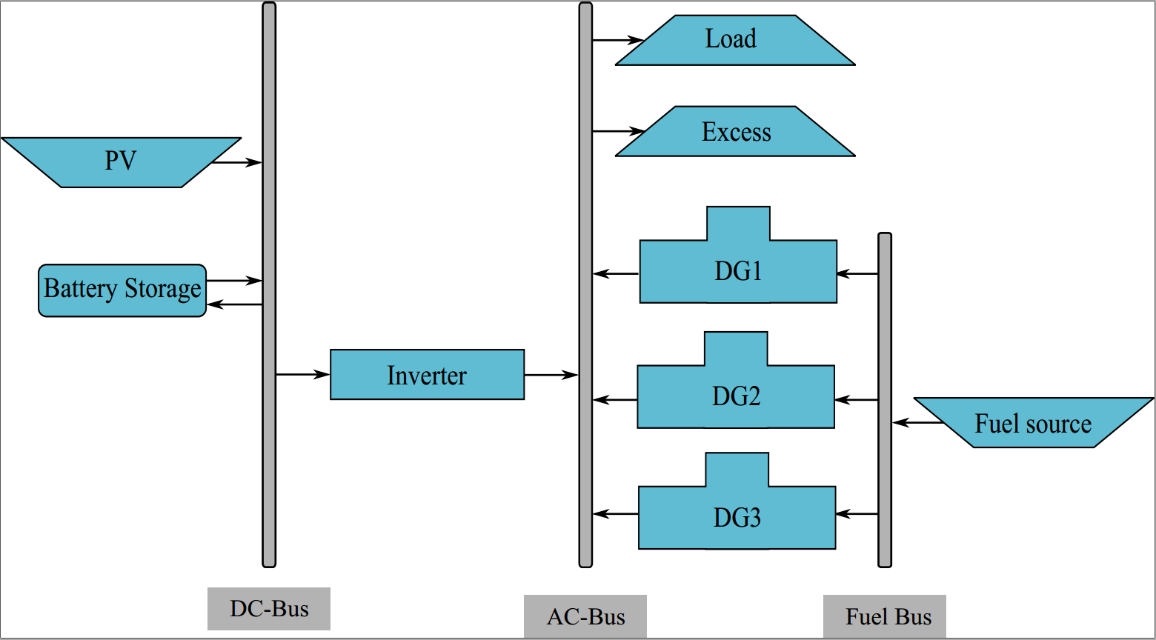
Components and Solver Options
Energy System Model
Source/Caption:

Slide 19
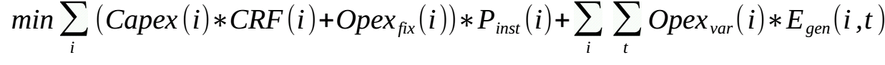
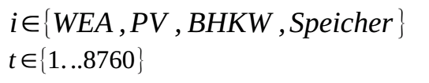
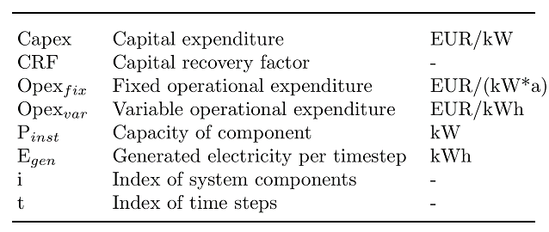
Optimizing with oemof – Objective value
Oemof generates a linear equation system describing the energy system model
Solves for the minimal objective value (costs)
Target function:

Slide 20
Agenda
Introduction
Components and Solver-Options
Conclusion
Package Structure
What is the main idea behind oemof?
Programming examples
Creating an own oemof application

Slide 21
Building an own oemof application

Slide 22
Data requirements of an oemof model
Economic parameters:
Fix and variable cost of the system components
For internal processing of costs: WACC, project lifetime)
Timeseries with values for each timestep:
Sources (non-dispatchable generation)
Sinks (non-dispatchable demands)
Technical parameters:
Transformer (eg. generator) efficiencies
Technical storage parameters

Slide 23
Agenda
Introduction
Components and Solver-Options
Conclusion
Package Structure
What is the main idea behind oemof?
Programming examples
Creating an own oemof application

Slide 24
Tutorials - Jupyter notebooks
Dispatch optimization with fixed capacities: \Day_1_Oemof_Basics\1a_tutorial_dispatch.ipynb
Investment and dispatch optimization: \Day_1_Oemof_Basics\2a_tutorial_investment_optimization.ipynb

Slide 25
Tasks - Jupyter notebooks
Download git reprository of this workshop from git: https://github.com/smartie2076/oemof_workshop
Dispatch optimization with fixed capacities: \Day_1_Oemof_Basics\1b_task_dispatch.ipynb
Investment and dispatch optimization: \Day_1_Oemof_Basics\2b_task_investment_optimization.ipynb
→ Solutions are provided

Slide 26
Agenda
Introduction
Components and Solver-Options
Conclusion
Package Structure
What is the main idea behind oemof?
Programming examples
Creating an own oemof application

Slide 27
Working with oemof
Download and use oemof
Register on and post and discuss issues on: https://forum.openmod-initiative.org/tags/c/qa/oemof
Indicate or post own projects/coding examples via mail or github
Find documentation on: http://oemof.readthedocs.io/en/stable/
Register errors in documentation via mail or issue or pull request (github)
Find oemof examples on: https://github.com/oemof/oemof_examples

Slide 28
Helping oemof develop
Documentation
Register or correct spelling and grammar mistakes
Re-write sections that are unclear
Add missing explainations
Code
Register or fix bugs
Fix docstring or code layout
Create and submit own components or constraints
Add own features or implement requested features
When developing: Fork/clone oemof reprository: http://github.com/oemof/oemof

Slide 29
Oemof user&developer meetings
Yearly user&developer meetings
Half-yearly developer meetings
Next meeting: 4. to 6.12.2019, Berlin
Register and develop agenda on:https://oemof.org/2019/09/11/oemof-turns-5-anniversary-developer-meeting-in-december-2019/

Slide 30
THANK YOU FOR YOUR ATTENTION !
How to follow Oemof’s activities?
Website: https://oemof.org/
Github: https://github.com/oemof
Or join our mailing list!
License
Except where otherwise noted, this work and its content (texts and illustrations) are licensed under the Attribution 4.0 International (CC BY 4.0)
See license text for further information.
Tel: +49 (0)30 1208 434 88
E-Mail: martha.hoffmann@rl-institut.de
Web: http://www.rl-institut.de
Twitter: @rl_institut
Please quote as: “PRESENTATION TITLE” © Reiner Lemoine Institut | CC BY 4.0

Slide 31
oemof.solph: Klassenstruktur

