Slide 1


Oemof Workshop Week Constraints
Martha Hoffmann
Session 4
RLI, 18.09.2019
© Reiner Lemoine Institut

Slide 2
Introducing words
Welcome to the RLI!
All workshop contents at: https://github.com/smartie2076/oemof_workshop
Notes:
Erhöhte Versorgungssicherheit durch Reduzierung der starken Abhängigkeit von fossilen Brennstoffimporten
Effizienzsteigerung durch Lastoptimierung der Dieselgeneratoren → Vermeidung von Teillast
Erhöhte Versorgungssicherheit durch Reduzierung der starken Abhängigkeit von fossilen Brennstoffimporten
Senkung der Stromgestehungskosten durch kompetitive und zuverlässige Technologien

Slide 3
Motivation
Open source software is crucial to …
meet scientific standards in software based research
foster bottom-up approaches by reducing barriers associated with high license cost of proprietary software tools
improve research quality & completeness & knowledge pooling due to collaborative modelling
All workshop contents at: https://github.com/smartie2076/oemof_workshop
Notes:
Erhöhte Versorgungssicherheit durch Reduzierung der starken Abhängigkeit von fossilen Brennstoffimporten
Effizienzsteigerung durch Lastoptimierung der Dieselgeneratoren → Vermeidung von Teillast
Erhöhte Versorgungssicherheit durch Reduzierung der starken Abhängigkeit von fossilen Brennstoffimporten
Senkung der Stromgestehungskosten durch kompetitive und zuverlässige Technologien

Slide 4
Agenda
Introduction
Introducing own constraints
Examples
Linear equation systems generated by oemof
The idea behind linear optimizations

Slide 5
Agenda
Introduction
Introducing own constraints
Examples
Linear equation systems generated by oemof
The idea behind linear optimizations

Slide 6
Linear Optimizations
Linear Problem (LP) / Mixed Integer (Linear) Problem (MI(L)P) consists of :
a target function
a set of constraints and balances
Solver searches on the edges of the solutions space for the optimal solution
Available solvers: CBC, GLPK, Gurobi, …
Time steps adjustable (e.g. 15 mins, hourly)

Slide 7
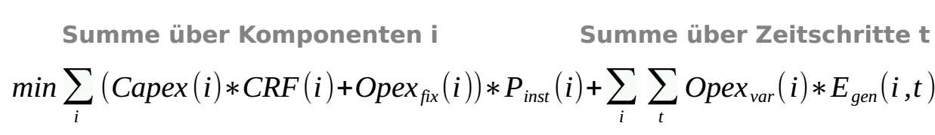
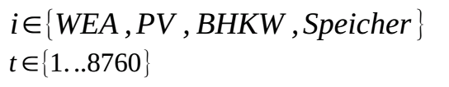
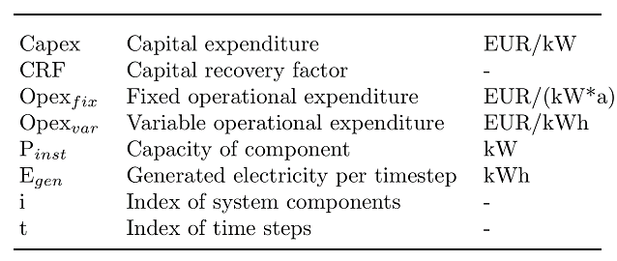
Optimizing with oemof – Objective value
Oemof generates a linear equation system describing the energy system model
Solves for the minimal objective value (costs)
Target function:

Slide 8
Agenda
Introduction
Introducing own constraints
Examples
Linear equation systems generated by oemof
The idea behind linear optimizations

Slide 9
Agenda
Introduction
Introducing own constraints
Examples
Linear equation systems generated by oemof
The idea behind linear optimizations

Slide 10
Agenda
Introduction
Introducing own constraints
Examples
Linear equation systems generated by oemof
The idea behind linear optimizations

Slide 11


What is the main idea behind oemof?
Collaborative, public development
Recycling and expansion of existing models
Modular structure with defined interfaces to correlate other approaches/packages
Improved review process by the community
collaborative
modular
open source

Slide 12
Components and Solver Options
Solver Options
Linear Problem (LP) / Mixed Integer (Linear) Problem (MI(L)P) consists of :
a target function
a set of constraints and balances
Solver searches on the edges of the solutions space for the optimal solution
Available solvers: CBC, GLPK, Gurobi, …
Time steps adjustable (e.g. 15 mins, hourly)
Source/Caption:

Slide 13
Components and Solver Options
Target Function

Slide 14
THANK YOU FOR YOUR ATTENTION !
How to follow Oemof’s activities?
Website: https://oemof.org/
Github: https://github.com/oemof
Or join our mailing list!
License
Except where otherwise noted, this work and its content (texts and illustrations) are licensed under the Attribution 4.0 International (CC BY 4.0)
See license text for further information.
Tel: +49 (0)30 1208 434 88
E-Mail: martha.hoffmann@rl-institut.de
Web: http://www.rl-institut.de
Twitter: @rl_institut
Please quote as: “PRESENTATION TITLE” © Reiner Lemoine Institut | CC BY 4.0

