Slide 1


Oemof Workshop Week E-Lands MVS
Martha Hoffmann
Session 5
RLI, 19.09.2019
© Reiner Lemoine Institut

Slide 2
Introducing words
Welcome to the RLI!
All workshop contents at: https://github.com/smartie2076/oemof_workshop
Notes:
Erhöhte Versorgungssicherheit durch Reduzierung der starken Abhängigkeit von fossilen Brennstoffimporten
Effizienzsteigerung durch Lastoptimierung der Dieselgeneratoren → Vermeidung von Teillast
Erhöhte Versorgungssicherheit durch Reduzierung der starken Abhängigkeit von fossilen Brennstoffimporten
Senkung der Stromgestehungskosten durch kompetitive und zuverlässige Technologien

Slide 3
Agenda
Introduction
Components and Solver-Options
Discussion
Package Structure
What is the main idea behind oemof?
Examples
Data requirements

Slide 4
Agenda
Introduction
Components and Solver-Options
Discussion
Package Structure
What is the main idea behind oemof?
Examples
Data requirements

Slide 5

Motivation: Software Tools for Hybrid Mini-Grids
Open source software is crucial to …
meet scientific standards in software based research
foster bottom-up approaches by reducing barriers associated with high license cost of proprietary software tools
improve research quality & completeness & knowledge pooling due to collaborative modelling
„ (…) models need to meet scientific standards as public acceptance becomes increasingly important“
Hilpert et. al³⁾
Notes:
Erhöhte Versorgungssicherheit durch Reduzierung der starken Abhängigkeit von fossilen Brennstoffimporten
Effizienzsteigerung durch Lastoptimierung der Dieselgeneratoren → Vermeidung von Teillast
Erhöhte Versorgungssicherheit durch Reduzierung der starken Abhängigkeit von fossilen Brennstoffimporten
Senkung der Stromgestehungskosten durch kompetitive und zuverlässige Technologien

Slide 6
Agenda
Introduction
Components and Solver-Options
Discussion
Package Structure
What is the main idea behind oemof?
Examples
Data requirements

Slide 7


What is the main idea behind oemof?
Is a community-driven open-Source modelling framework initiated by:
Python package/library specifically developed for energy system modelling
Model individual requirements/aspects in research projects, dissertations, Bachelor/-Master thesis

Slide 8


What is the main idea behind oemof?
Collaborative, public development
Recycling and expansion of existing models
Modular structure with defined interfaces to correlate other approaches/packages
Improved review process by the community
collaborative
modular
open source

Slide 9
Agenda
Introduction
Components and Solver-Options
Discussion
Package Structure
What is the main idea behind oemof?
Examples
Data requirements

Slide 10
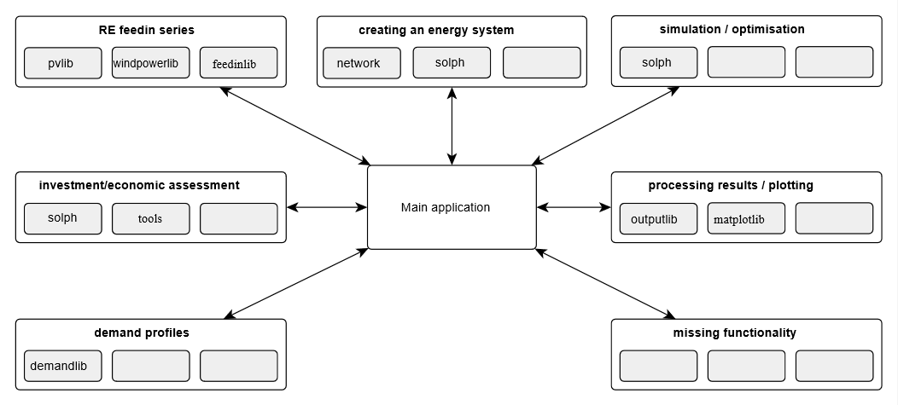
Package Structure

Slide 11
Package Structure

Slide 12
Agenda
Introduction
Components and Solver-Options
Discussion
Package Structure
What is the main idea behind oemof?
Examples
Data requirements

Slide 13
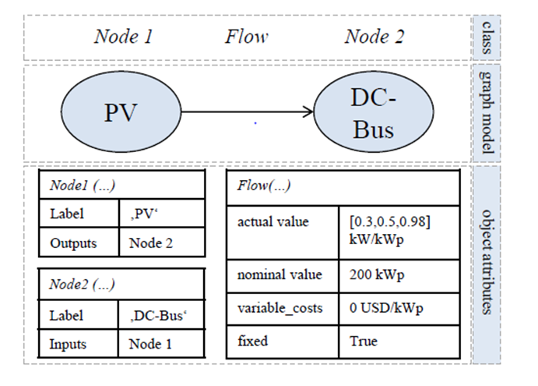
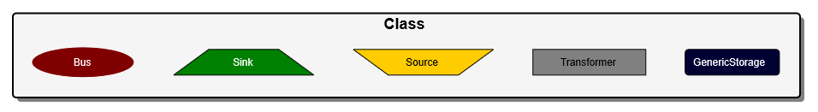
Components and Solver Options
Components
Graph-Based Modelling: „Nodes are connected with Flows to built the energy system“
Existing Components (Node-objects):

Slide 14
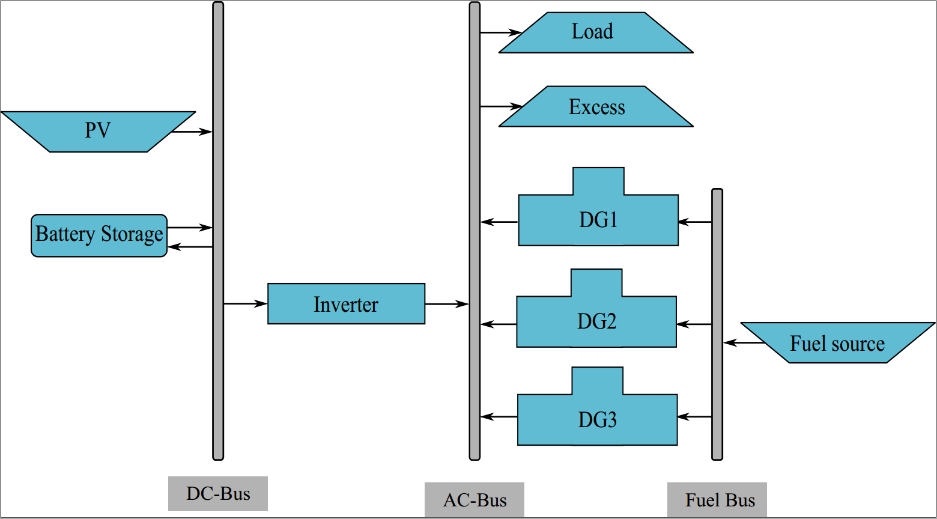
Components and Solver Options
Energy System Model
Source/Caption:

Slide 15
Components and Solver Options
Solver Options
Linear Problem (LP) / Mixed Integer (Linear) Problem (MI(L)P) consists of :
a target function
a set of constraints and balances
Solver searches on the edges of the solutions space for the optimal solution
Available solvers: CBC, GLPK, Gurobi, …
Time steps adjustable (e.g. 15 mins, hourly)
Source/Caption:

Slide 16
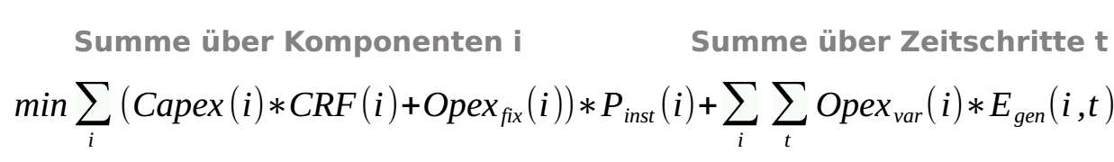
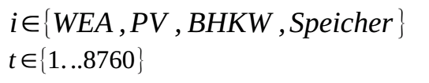
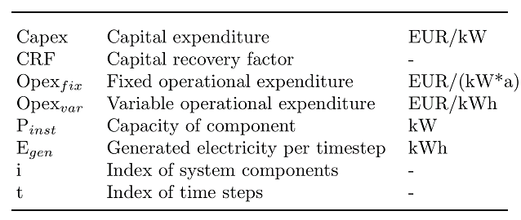
Components and Solver Options
Target Function

Slide 17
Agenda
Introduction
Components and Solver-Options
Discussion
Package Structure
What is the main idea behind oemof?
Examples
Data requirements

Slide 18
Data requirements
Load profiles for each time step
Economic parameters (fix and variable cost, WACC, project lifetime) of the system components
Location or concrete feedin timeseries of RE components
Technical parameters DG (efficiencies or fuel curve, min/max runtime, min/max loading) an BESS (minimum SOC, input/output efficiencies, C-rate) if included

Slide 19
Agenda
Introduction
Components and Solver-Options
Discussion
Package Structure
What is the main idea behind oemof?
Examples
Data requirements

Slide 20
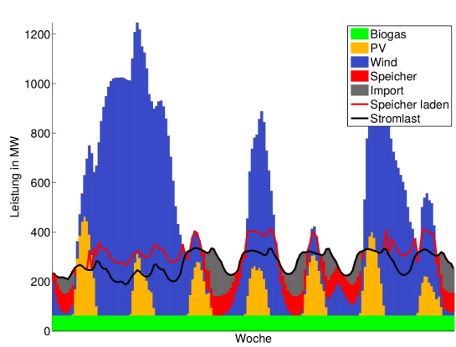
Example I : Hourly Dispatch
Sizing, optimization and dispatch of generator power and battery energy storage system
Target of optimization:
Minimize total system cost
Constraints:
Cover demand at each time increment
Share of Renewables min. 80 %

Slide 21
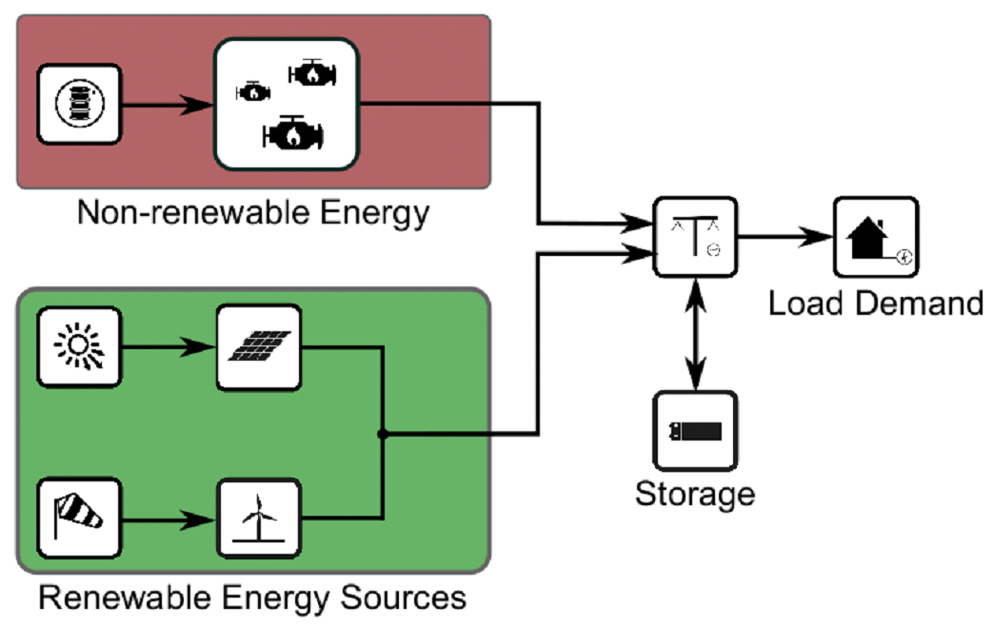
Example II: Optimizing a Hybrid Mini-Grid
Simplified single-node model
Source/Caption:

Slide 22
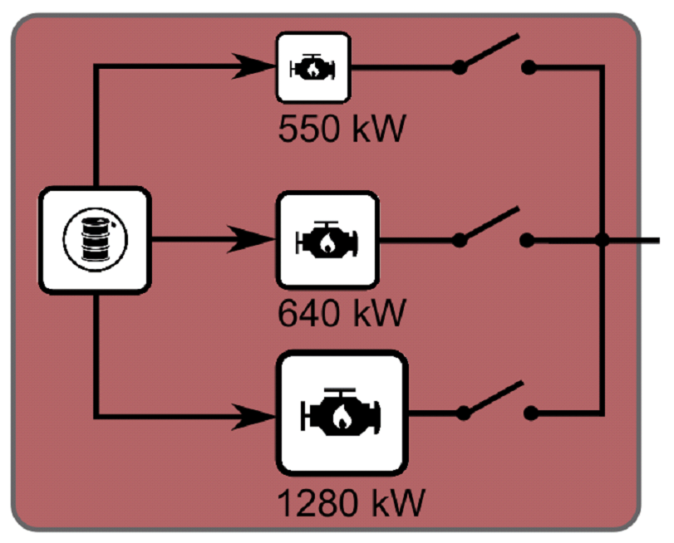
Example II: Optimizing a Hybrid Mini-Grid
Simplified single-node model
Multiple diesel gensets instead of one combined/generic
Different parameter sets per gen set (efficiencies, load curves)
Dispatchable (turned „on“ and „off“)
Genset related constraints
Minimal loading
Spinning reserve
(Minimal runtime)
Source/Caption:

Slide 23
Example II: Optimizing a Hybrid Mini-Grid
Simplified single-node model
Multiple diesel gensets instead of one combined/generic
Different parameter sets per gen set (efficiencies, load curves)
Dispatchable (turned „on“ and „off“)
Genset related constraints
Minimal loading
Spinning reserve
(Minimal runtime)
Source/Caption:

Slide 24
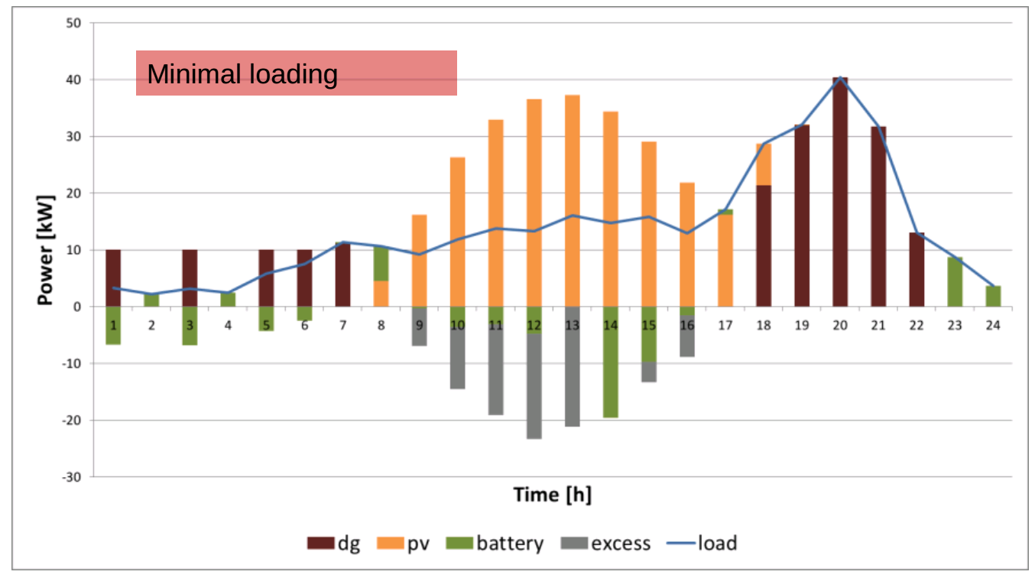
Example II: Optimizing a Hybrid Mini-Grid
Simplified single-node model
Source/Caption:

Slide 25
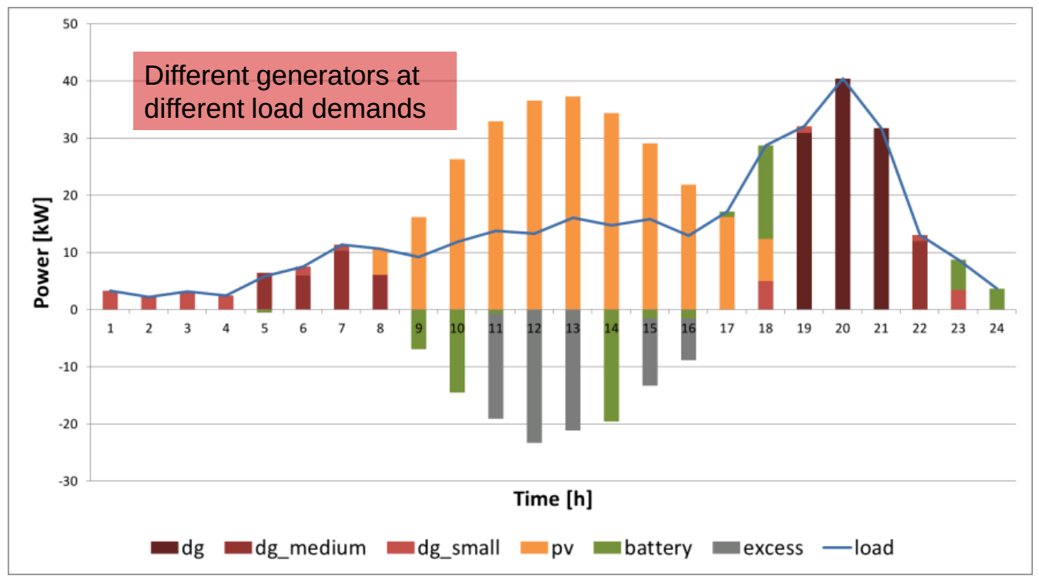
Example II: Optimizing a Hybrid Mini-Grid
Simplified single-node model
Source/Caption:

Slide 26
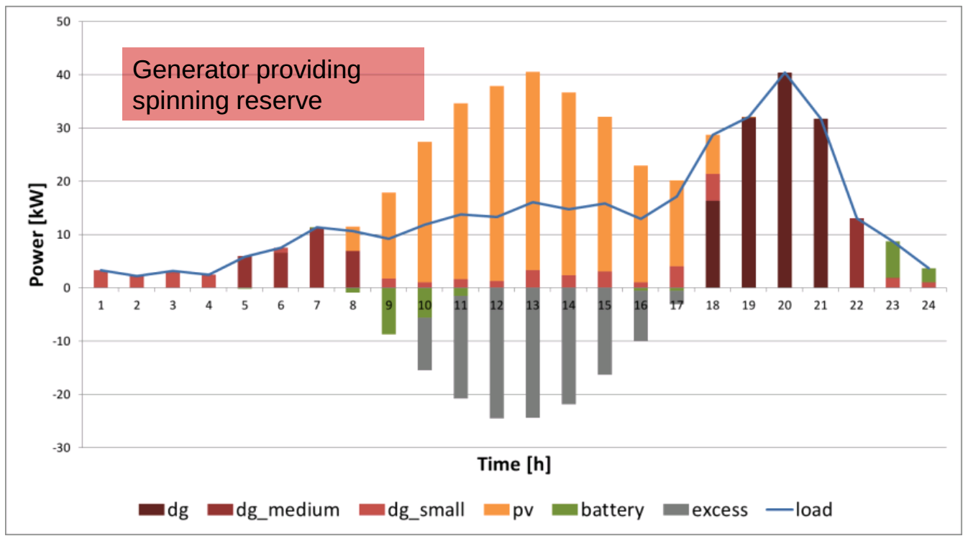
Example II: Optimizing a Hybrid Mini-Grid
Simplified single-node model
Source/Caption:

Slide 27
THANK YOU FOR YOUR ATTENTION !
How to follow Oemof’s activities?
Website: https://oemof.org/
Github: https://github.com/oemof
Or join our mailing list!
License
Except where otherwise noted, this work and its content (texts and illustrations) are licensed under the Attribution 4.0 International (CC BY 4.0)
See license text for further information.
Tel: +49 (0)30 1208 434 0
E-Mail: sarah.berendes@rl-institut.de
Web: http://www.rl-institut.de
Twitter: @rl_institut
Please quote as: “PRESENTATION TITLE” © Reiner Lemoine Institut | CC BY 4.0

