Slide 1


Oemof Workshop Week E-Lands MVS
Martha Hoffmann
Session 5
RLI, 19.09.2019
© Reiner Lemoine Institut

Slide 2
Introducing words
Getting to know the
Multi-Vector Simulator (MVS)
All workshop contents at: https://github.com/smartie2076/oemof_workshop
Notes:
Erhöhte Versorgungssicherheit durch Reduzierung der starken Abhängigkeit von fossilen Brennstoffimporten
Effizienzsteigerung durch Lastoptimierung der Dieselgeneratoren → Vermeidung von Teillast
Erhöhte Versorgungssicherheit durch Reduzierung der starken Abhängigkeit von fossilen Brennstoffimporten
Senkung der Stromgestehungskosten durch kompetitive und zuverlässige Technologien

Slide 3
Agenda
MVS in the context of E-Land
MVS development
Outlook: Next steps of the tool development
Requirements (WP3.2)
Use cases (WP3.1)
Current status of development of the MVS

Slide 4
Agenda
MVS in the context of E-Land
MVS development
Outlook: Next steps of the tool development
Requirements (WP3.2)
Use cases (WP3.1)
Current status of development of the MVS

Slide 5
Challenges addressed by E-Land
Sector-coupling of electricity, gas and heat
…can improve overall system efficiency
…can provide flexibility and storage
…can increase system autonomy
Energy sectors should be analyzed, planned and operated in an integrated manner
Integrated perspective from business, societal, systems, operations and planning perspective

Slide 6
The E-Land Toolbox
Framework, which can couple and co-optimize sector-coupled systems
Multiple layers with different focusses:
Community engagement
Business models
Technical layer, including decision-making support tools
→ Layers integrated over the Enterprise Service Bus ESB)

Slide 7
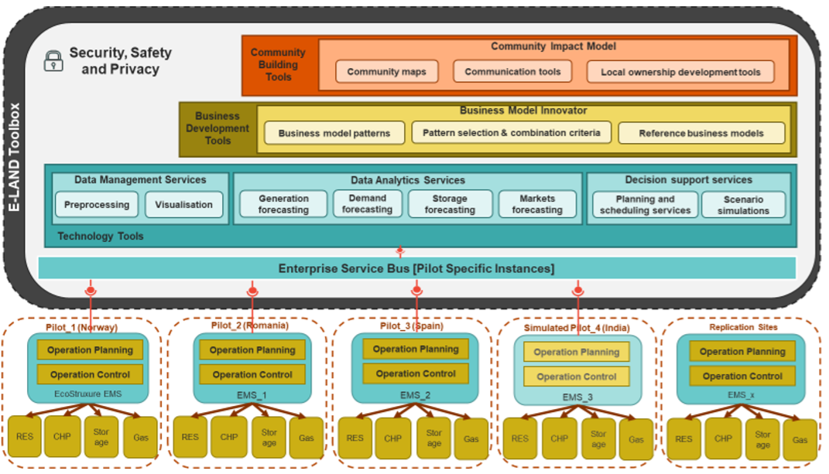
The E-Land Toolbox

Slide 8
Agenda
MVS in the context of E-Land
MVS development
Outlook: Next steps of the tool development
Requirements (WP3.2)
Use cases (WP3.1)
Current status of development of the MVS

Slide 9
Use case definition (WP3.1)
High-Level Use Case (HLUC)
Generic concepts describing involved actors but not processes
Primary Use Case (PUC)
UC defined with clear boundaries
Necessary to fullfill to adress HLUC
Secondary Use Case (SUC)
More granular, less abstract description of core functionalities

Slide 10
High-Level Use Cases
“Energy Management System (EMS) integration with DER and BMS”:
Integration of various systems
Modelling interoperability of ES
Optimization of operation of LES
Optimal (day-to-day) operation
Optimal sizing of a Local Energy System
New investments into assets (energy production, storage)

Slide 11
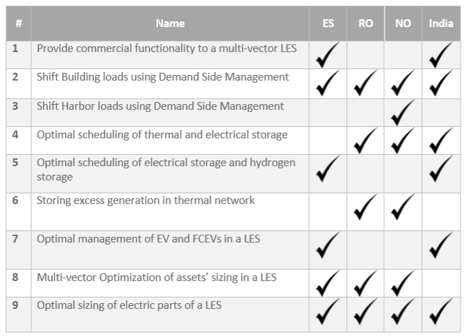
Primary Use Cases (PUCs) and the pilots

Slide 12
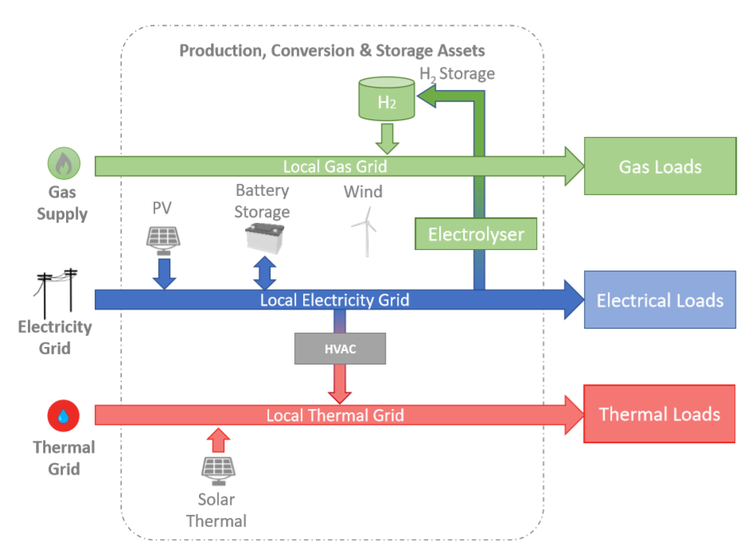
Walqa Technology Park, Spain

Slide 13
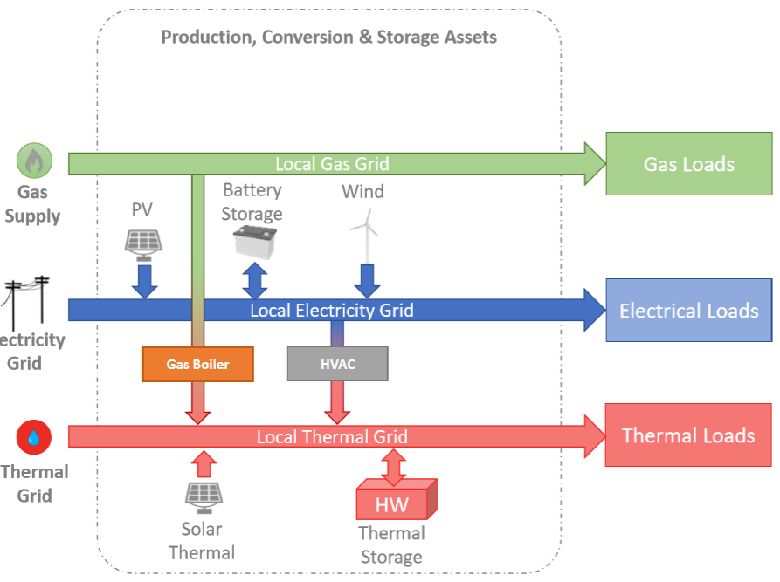
UVTgv University Campus, Romania

Slide 14
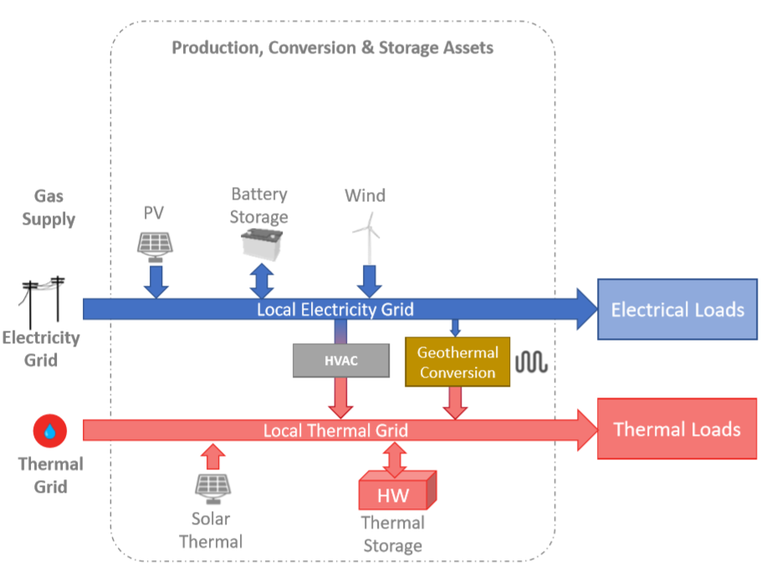
Port of Borg, Norway

Slide 15
Agenda
MVS in the context of E-Land
MVS development
Outlook: Next steps of the tool development
Requirements (WP3.2)
Use cases (WP3.1)
Current status of development of the MVS

Slide 16
Functional requirements
WP 3.2 described in detail the tasks the MVS has to perform
Automatic generation of LES
Solving LES
Manual set-up of LES (custom components)
Optimization results
Integrated assets of production/conversion
Setting the optimization goal
Specific energy cost models
Load profiles
Data processing for asset parameters
Introducable constraints

Slide 17
Non-Functional requirements
Additional requirements set for MVS in WP 3.2
Preprocessing of model input
Postprocessing of model results
Communication between MVS/ESB
Time-step lenghts
Interface for technical parameter setting
Interface for economic parameter setting

Slide 18
Agenda
MVS in the context of E-Land
MVS development
Outlook: Next steps of the tool development
Requirements (WP3.2)
Use cases (WP3.1)
Current status of development of the MVS

Slide 19
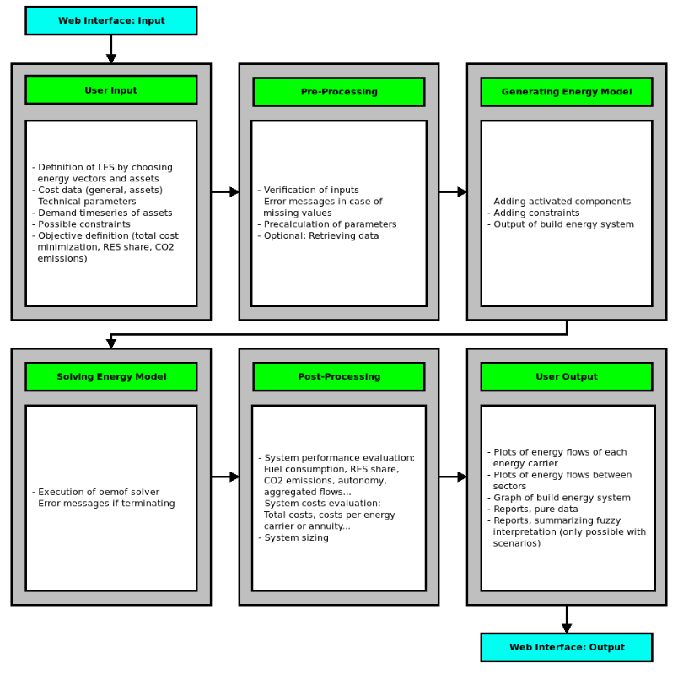
General MVS modular structure

Slide 20
Modular structure of the MVS
mvs_eland_tool
A_initialization
B0_data_input
C0_data_processing
D0_modelling_and_optimization
E0_evaluation
F0_output
Tool still under development. Can be found in: https://github.com/smartie2076/mvs_eland

Slide 21
Possible components of the MVS
PV Generation
Wind Generation
Electricity Storage Systems
Gas Boilers
HVAC Systems
Solar Thermal Generation
Hot Water Thermal Storage
Hydrogen-based Storage Systems
Geothermal Conversion
LNG Storage Systems
Electrolyser
Additionally: External energy providers, project data, general economic data
A lot of information to input and process

Slide 22
User input: Excel file
As an intermediary, an Microsoft Excel file is used for user input:
All project parameters
Information concerning energy sectors
Technical and economic parameters of assets
Demand profiles (via .csv-files)
Excel Template: https://github.com/smartie2076/mvs_eland/blob/master/inputs/test_input_file_v1.xlsx

Slide 23
User Input: Web application
E-Land collegues ICOM from Greece develop interactive web-application
Data input
Execution of MVS (stored on server)
Postprocessing and vizualization
Data exchange format with MVS: JSON
Standalone usage of the MVS from the toolbox will be continued
This process has just kicked-off

Slide 24
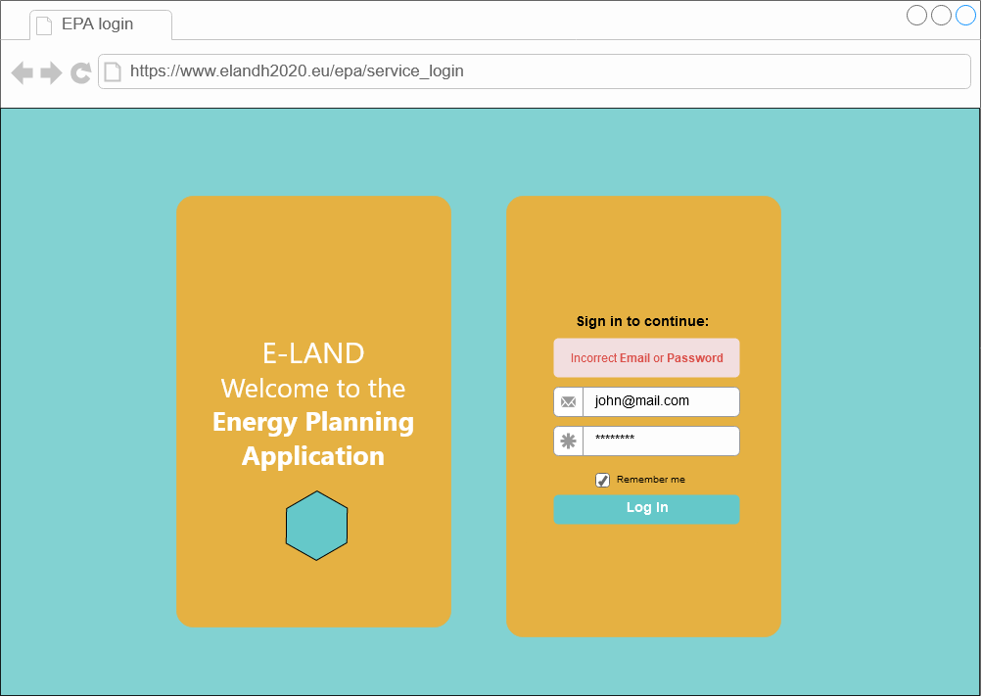
User Input: Web application

Slide 25
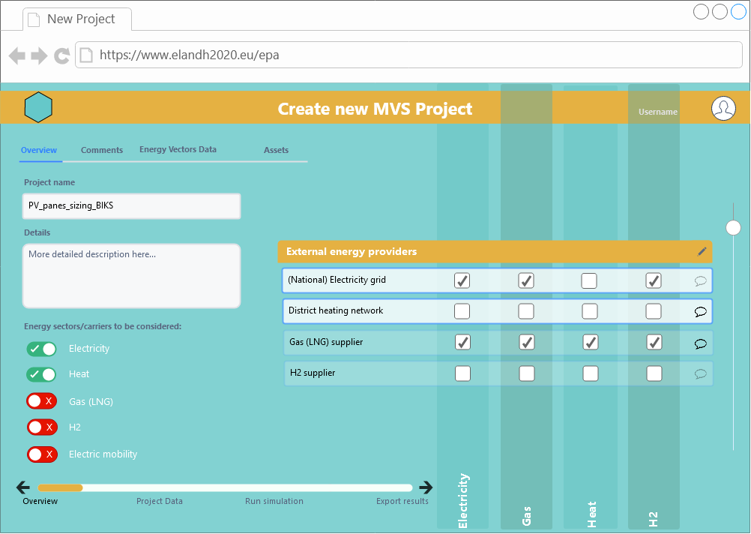
User Input: Web application

Slide 26
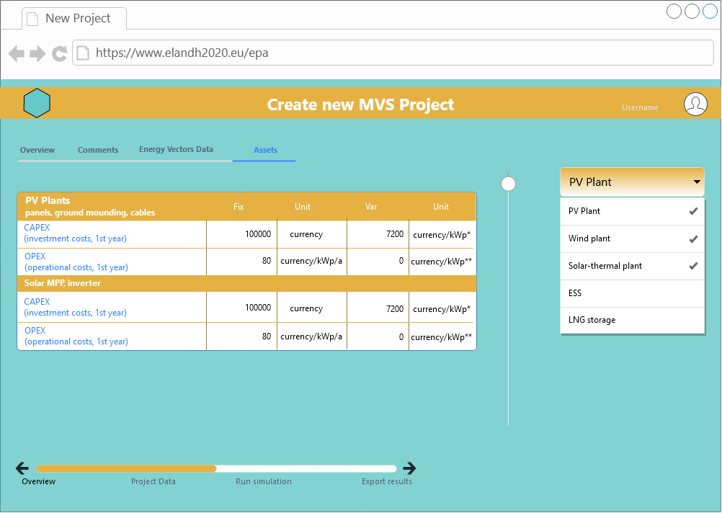
User Input: Web application

Slide 27
Modular structure of the MVS
mvs_eland_tool
A_initialization
B0_data_input
C0_data_processing
D0_modelling_and_optimization
E0_evaluation
F0_output
Tool still under development. Can be found in: https://github.com/smartie2076/mvs_eland

Slide 28
Agenda
MVS in the context of E-Land
MVS development
Outlook: Next steps of the tool development
Requirements (WP3.2)
Use cases (WP3.1)
Current status of development of the MVS

Slide 29
Development status of the MVS
Adapted to simulate BIKS (1st step)
Sole electricity system model
Optimization goal: Decrease peak demand pricing costs by installing PV and storage

Slide 30
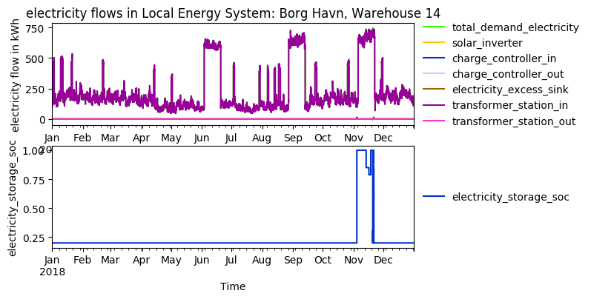
BIKS: Current intermediate output

Slide 31
Agenda
MVS in the context of E-Land
MVS development
Outlook: Next steps of the tool development
Requirements (WP3.2)
Use cases (WP3.1)
Current status of development of the MVS

Slide 32
Next extensions
Implement multiple transformer stations to mirror peak demand pricing of BIKS
Add post-processing
Graphs
Scalar output
Key performance indicators (KPI)
Change input-format to json
Restructure/clean automatized generation of energy system models
Clean project parameter dictionary
Reach out to other pilots and integrate their needs

Slide 33
THANK YOU FOR YOUR ATTENTION !
How to follow Oemof’s activities?
Website: https://oemof.org/
Github: https://github.com/oemof
Or join our mailing list!
License
Except where otherwise noted, this work and its content (texts and illustrations) are licensed under the Attribution 4.0 International (CC BY 4.0)
See license text for further information.
Tel: +49 (0)30 1208 434 0
E-Mail: sarah.berendes@rl-institut.de
Web: http://www.rl-institut.de
Twitter: @rl_institut
Please quote as: “PRESENTATION TITLE” © Reiner Lemoine Institut | CC BY 4.0

