Slide 1
Roomies
By: Albie, Greco, and Matt

Slide 2
What we will cover
Project Summary
Project Goals
Product Features
Limitations
Design & Documentation
Demo Video

Slide 3
Project Summary
Roomies is a mobile app that will help the day-to-day life of people living with Roommates.
It will be a place for roommates to square-up their bills, delegate and track chores, keep track of damages and accountability, and track everyday shared items, like milk and toilet paper.
This application was developed for the Android OS.

Slide 4
Project Goals
The goal of the project is for our application to become a one stop shop for everyone living with roommates to use to help manage, record, and distribute all the different shared responsibilities that come with living with other people.
We want our application to take the stress out of living with people, by organizing their information and having an actual record to reference.

Slide 5
Product features
A Bill manager that will keep track of all bills assigned from user to user.
Bills can either be payed in cash between users or payed via Venmo. Venmo is a credit card processing application that allows two users to pay each other via smartphone.
All bills will be stored in our sql database.

Slide 6
product features cont.
A Grocery List will be shared by all members of the household.
Each Roomie can add items and remove them as they purchase them. When items are purchased a bill is automatically created and billed to each member of the house.
A Chores Board will be shared by all members of the household.
Each Roomie will be able to add chores for themselves or other members of the house. When a user completes the chore, a record will be stored in the database

Slide 7
product features
A Maintenance List will be keep track of all damages that occur while the roomies live in the house/apartment.
If someone breaks a door or smashes a window, any user can create a Maintenance event and assign it to the user who caused it.
A Point System will keep track of Roomie Points. The point system follows the “Rules are made up and points don’t matter” principal.

Slide 8
Limitations
Most roommate maps on the market are aimed at trying to find roommates. Roomies will not have that functionality.
All phone-to-phone transactions are at the mercy of Venmo and Roomies will not claim responsibility for their faults.
Roomies will not be responsible for any conflicts that arise from the use of our app. It is simply a platform for roommate organization and shall not be used for any legal purposes.

Slide 9
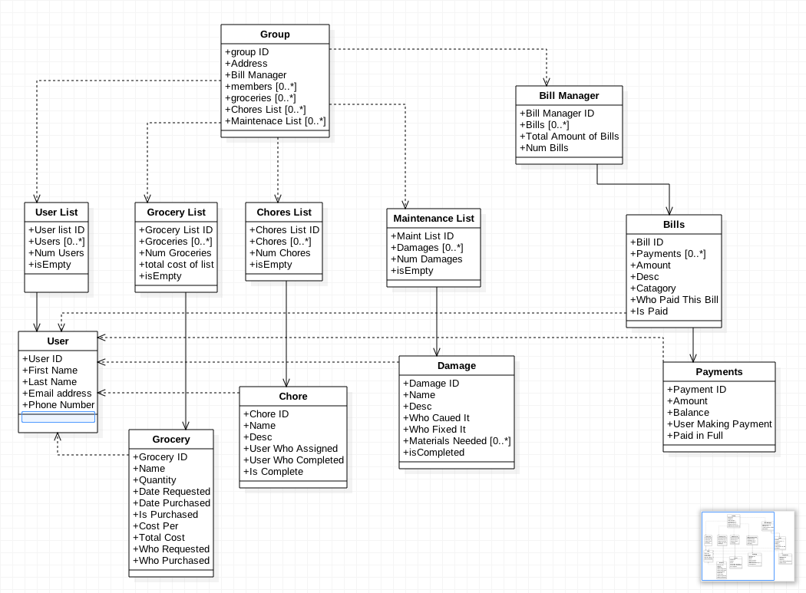
Class Design

Slide 10
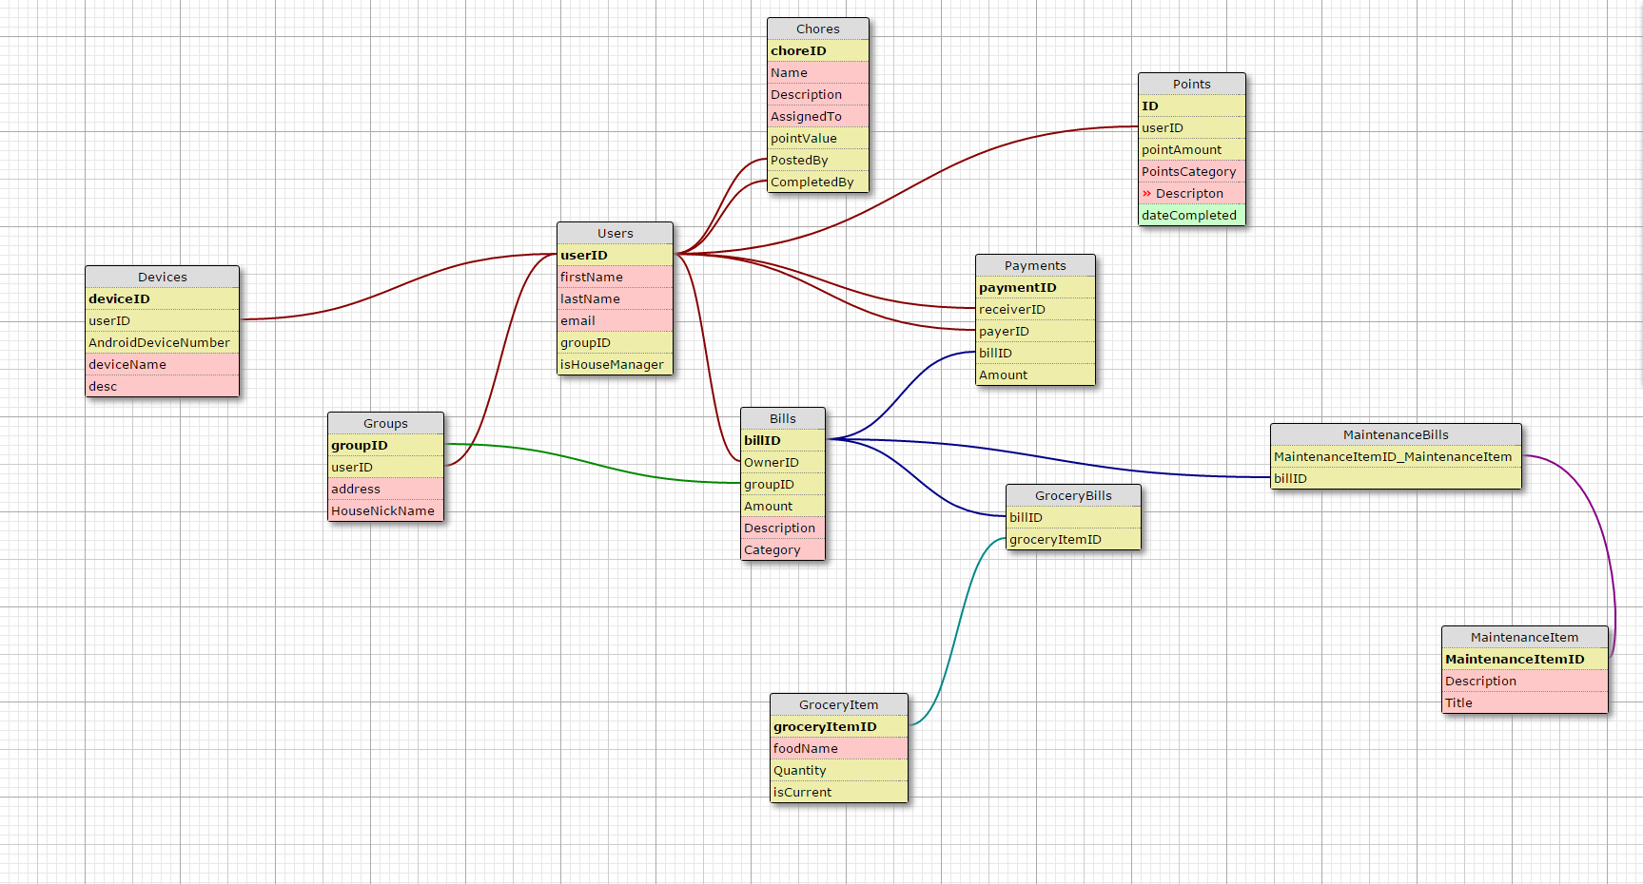
Database design

