Slide 1
Data Movement
Data Movement Research

Slide 2
Problem Statement
Energy Sector customers have significant historical data stores required to be available in the OSDU system before it becomes a viable platform to switch to.
Historical data can be multiple petabytes in size.
Actual numbers have not been shared yet with regard to low, average, and high volumes of customer data.
Currently, all data must be ingested to the OSDU storage system. That system is backed by Azure Blob Storage making azcopy a viable tool for the actual data copy mechanism.

Slide 3
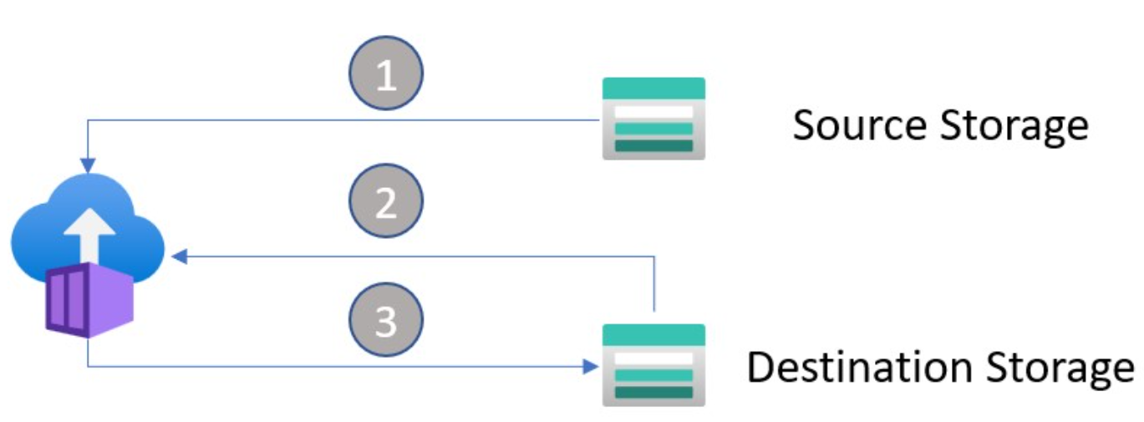
Methodology
Utilize Azure File Share and Azure Blob Storage as source and destination accounts.
Mix the source and destination locations between Azure subscriptions and Azure regions.
Utilize azcopy to perform the data movement.
Move a pre-defined number of 101GB files utilizing several Azure Container Instances.
Average out the execution time between containers to find running time.
Divide GB moved by running time to get GB/Minute calculations
Calculate an estimate of how long the process would take to move a PB.

Slide 4
Summary Overview*
Azure Subscriptions (Sub): Two used delineated by A and B
Days to Petabyte (PBD) in whole days
Source | Region | Sub | Dest | Region | Sub | Avg GB/Min | PBD
Blob | EastUS | A | Blob | EastUS | A | 291 | 2.50
Blob | EastUS | A | Blob | EastUS | B | 176 | 4.13
File | EastUS | A | Blob | EastUS | A | 130 | 5.60
File | EastUS | A | File | EastUS | A | 29 | 25.14
Blob | EastUS | A | Blob | WestUS | A | 7.16 | 79.24
* Up to 8TB of data per test, further testing will be required for larger data sets and configurations.
** Multiple containers did not show significant drop off in throughput as opposed to a single container.

Slide 5
Summary Overview – ~1 PB
Using same sub/region storage accounts move ~1 PB data
Data consists of a single file 100.99GB in size moved over and over
10 ACI Containers each moving 1000 copies
Each container moving 1000*100.99*10 = 1,009,9000 GB == 986.23 TB (96.3% PB total)
Uses Standard and Premium SKU for Azure Blob Storage
SKU | Region | GB / Min | Total Time (Hours/Days)
Standard (10 X 1000) | East US | Avg: 1.45 min/file 692.7 GB/Min | Avg: 1457.9/min = 24.29/hour
Standard (4 X 2500) | East US | Avg: 2.78 min/file 281.13 GB/Min | Avg: 3592.25 = 59.87/hour
Premium (10 X 1000) | East US | Avg: 3.18 min/file 317.373 GB/Min | Avg: 3182/Min = 53.04/hour
Notes:
Seems that Metrics (Classic) does not work with Premium storage accounts.
Standard performance is 50% of premium performance in this case. Storage team indicates it would be faster for smaller files….but there is no need to use premium in these cases as it will just cost more.
10 ACI , 1000 each
Standard Storage: Average time (1410-1470) = 1457.9 minutes = 1.45 min each avg = 24.29 hours total
1000 Files at 100.99 GB = 100,990 GB = 98.62 TB = 69.27 GB/Min
Premium Storage: Average Time 3182 minutes = 3.18 min each average = 53.04 hours total
1000 Files at 100.99 GB = 100,990 GB = 98.62 TB = 31.73 GB/Min
Interestingly towards the end as some processes fell off (finished) the remaining ones had super fast completion times for a couple of records : 1 min, but not many
"Elapsed Time (Minutes): 1.0338",
"Number of File Transfers: 1",
4 ACI, 2500 each
- Not seeing times

Slide 6
Data Movement High Points
Data is moved from its source location to a Blob Storage account owned by OSDU as part of the OSDU ingest pattern. Given that, we only need to look at file moves where the destination is Azure Blob Storage.
Blob Storage to Blob Storage in the same region is highly performant, and most effective where the source and destination accounts reside in the same subscription.
File Share to Blob Storage, within the same subscription and within the same region could be acceptable if the data to move isn’t larger than 100 TiB, the limit of a premium SKU storage account.
Cross region data movement should be avoided at all costs as it is the least performant, even when using the most performant underlying service (Azure Blob Storage).

Slide 7
Continuation of Investigation - External
Data residing outside of Azure should first be ingested into Azure.
HTTP transfers will not suffice to move very large data sets into Azure due to time constraints.
azcopy seems to be the most efficient tool at moving data around Azure.
A system with sufficiently large enough storage to try azcopy from a local source to Azure is not currently present.
Azure DataBox is an area to investigate with regards to mass data ingestion into the Azure Ecosystem.
Storage team asking “how” the data is stored off site. Their primary suggestions is to network it in (tapes/drives) at about 14 days/pb but network dependent.
Databox can only be ordered by sub owner where storage account is located to load into. Have to look into this on OSDU side if possible.
Notes:
AZCOPY with Azure Data Lake https://docs.microsoft.com/en-us/azure/storage/blobs/data-lake-storage-known-issues
Have to test move/azcopy with data lake.
Blob Storage File Size Limit: 190.7TiB
https://docs.microsoft.com/en-us/azure/azure-resource-manager/management/azure-subscription-service-limits#azure-blob-storage-limits
https://docs.microsoft.com/en-us/rest/api/storageservices/Understanding-Block-Blobs--Append-Blobs--and-Page-Blobs?redirectedfrom=MSDN
Azure Storage Ingress/Egress
https://docs.microsoft.com/en-us/azure/storage/common/scalability-targets-standard-account#scale-targets-for-standard-storage-accounts
“Azure Storage standard accounts support higher capacity limits and higher limits for ingress and egress by request. To request an increase in account limits, contact Azure Support”
Azure Storage File Share Limit: 100TiB
https://docs.microsoft.com/en-us/azure/storage/files/storage-files-scale-targets
Data Lake Gen 1:
https://azure.microsoft.com/en-us/solutions/data-lake/
Data Lake Gen 2:
https://azure.microsoft.com/en-us/services/storage/data-lake-storage/
Transferring Data (Data Lake Documentation):
https://docs.microsoft.com/en-us/azure/storage/blobs/data-lake-storage-introduction
For generating interest in Storage: them https://aka.ms/azstoragedeals

Slide 8
Continuation of Investigation - OSDU
What should a target time be to move 1PB of data into OSDU?
Investigate with OSDU team in regard to a BYOADS (Bring your own Azure Data Store)
Is this on a road map?
Is this feasible?
What sort of additional work, such as generating metadata/acl’s/etc. would be required if it was supported?
Assume we have to azcopy into OSDU. When a record is copied and metadata is then added (in some, presumably, automated form), how long until the record is available in elastic search?
How can it be automated? Customer feedback on ACL/Legal Tags/etc?
Notes:
AZCOPY with Azure Data Lake https://docs.microsoft.com/en-us/azure/storage/blobs/data-lake-storage-known-issues
Have to test move/azcopy with data lake.
Blob Storage File Size Limit: 190.7TiB
https://docs.microsoft.com/en-us/azure/azure-resource-manager/management/azure-subscription-service-limits#azure-blob-storage-limits
https://docs.microsoft.com/en-us/rest/api/storageservices/Understanding-Block-Blobs--Append-Blobs--and-Page-Blobs?redirectedfrom=MSDN
Azure Storage Ingress/Egress
https://docs.microsoft.com/en-us/azure/storage/common/scalability-targets-standard-account#scale-targets-for-standard-storage-accounts
“Azure Storage standard accounts support higher capacity limits and higher limits for ingress and egress by request. To request an increase in account limits, contact Azure Support”
Azure Storage File Share Limit: 100TiB
https://docs.microsoft.com/en-us/azure/storage/files/storage-files-scale-targets
Data Lake Gen 1:
https://azure.microsoft.com/en-us/solutions/data-lake/
Data Lake Gen 2:
https://azure.microsoft.com/en-us/services/storage/data-lake-storage/
Transferring Data (Data Lake Documentation):
https://docs.microsoft.com/en-us/azure/storage/blobs/data-lake-storage-introduction
For generating interest in Storage: them https://aka.ms/azstoragedeals

Slide 9
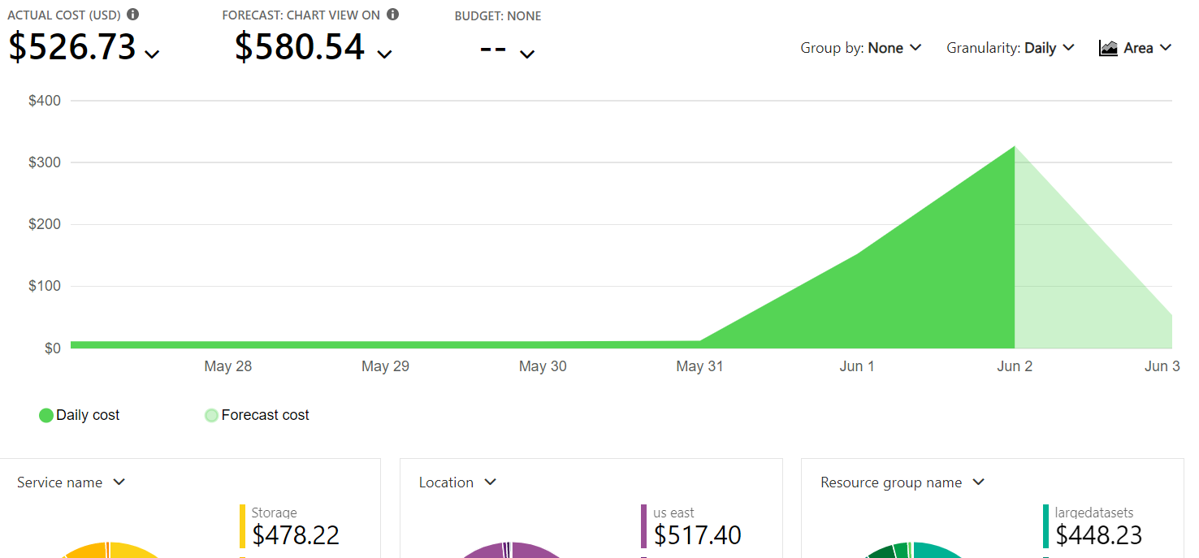
High Level Data Movement Costs
Taken on June 3 after starting 2 processes, each moving ~1pb data in same region.

Slide 10
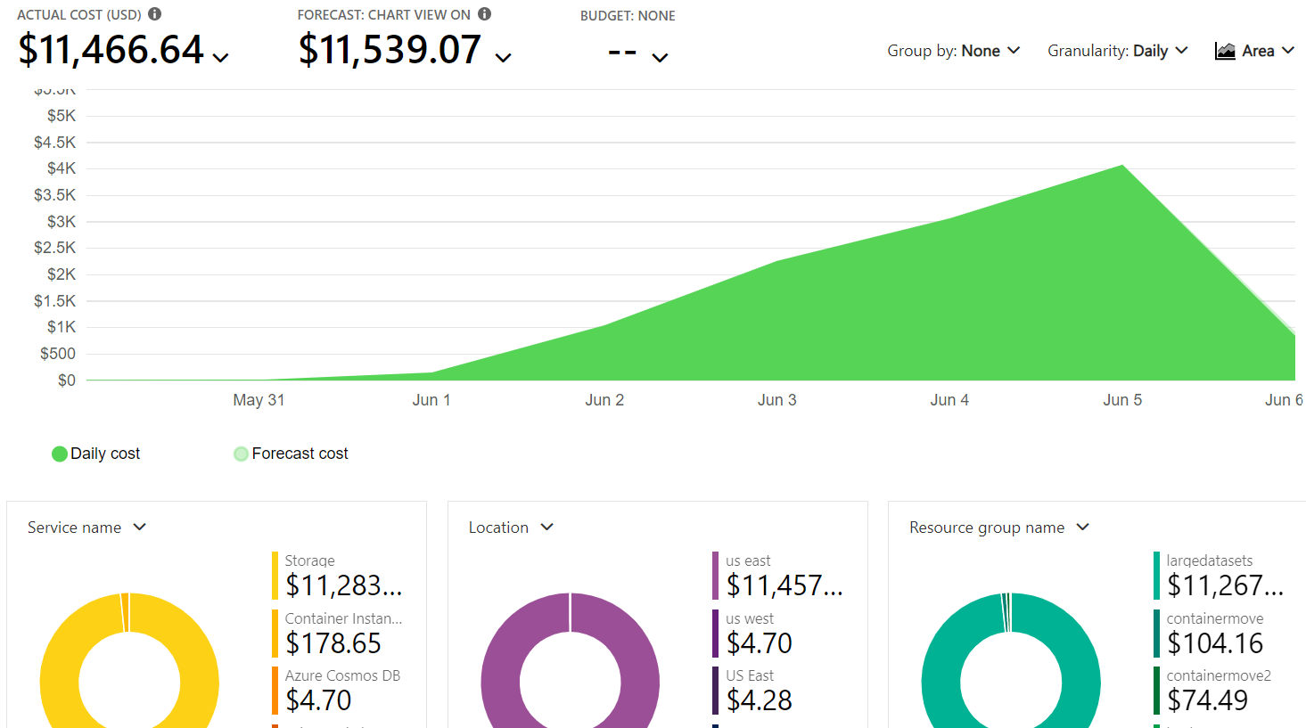
Summary Overview – ~1 PB Costs
Tests 6/1-6/6 : Premium storage starts on 6/2
Notes:
What does it cost to move data in region?
Prices seem to be pretty high just for moving data (really copying)
These prices reflect movement of about 4PB, is this right?
Premium storage moves had significant impact here, slower and SUPER expensive.
What are the costs of keeping data in storage?

