Slide 2





1
2
3
4
5

Slide 3






Customer Actions
1
2
1
2
3
1
2
3
4
5
6

Slide 4

Load Container
3
1
5
6
L
2
4
W
W

Slide 5
Work container
1
W
5
2
3
6
4

Slide 6



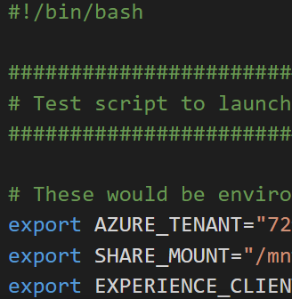

Icon Placeholders
Registry
Storage
Subscriptions
Data Lake
Container
Resource Group
EH
Cloud Shell
Shell Script
Functions
OAK

