Slide 1

Python Dictionaries

Slide 2
What is a Dictionary?
A dictionary is an unordered collection of values that are stored in key value format.
A dictionary “key” must be an immutable type (String, Int, Float, Tuple, etc) but values can be ANY valid Python object.
List
Dictionary
Function
Etc…

Slide 3

What is a Dictionary?
Keys in a dictionary are unique, you cannot add the same key twice, doing so simply overwrites the value that was already there.
You declare a dictionary using curly braces.

Slide 4
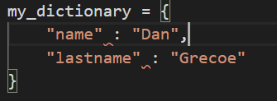

Initializing a dictionary:
You can create a pre-populated dictionary or an empty dictionary and just add things to it.
Simply setting a value creates the entry..
Key value separated by colon….

Slide 5
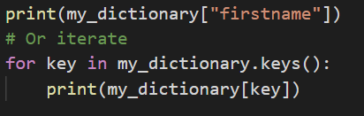
Dictionaries accessing values
You access values by using the key into the dictionary. You can either access using the key, or use the key collection to iterate.

Slide 6
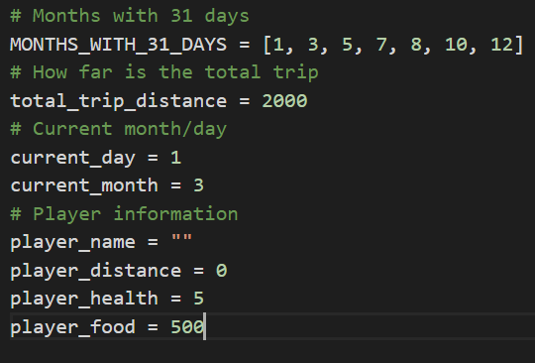
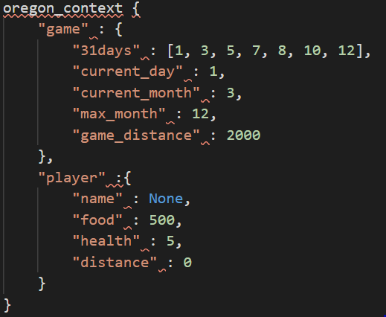
Dictionaries Example
Consider the Oregon Trail program, we could contain all of our settings in a dictionary and just pass that around.

Slide 7
Dictionary Help
Basic dictionary operations and examples
https://github.com/grecoe/teals/blob/master/0_python/09_dictionary.py
Practice Using Dictionaries
https://github.com/grecoe/teals/blob/master/1_practice/dictionary_practice.py

Slide 8
Questions?

