Slide 1

Python Classes

Slide 2
What is a Class?
A class is a programming type that is used to hold
Members – Data that the class is responsible for
Methods – Functions that the class exposes to work on it’s member data or any other data.
A class stores all of it’s information on an internal member called __dict__ which is a Python dictionary where a key is the member name and the value is it’s value.

Slide 3
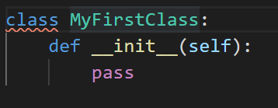
Declare a class
A class is declared using the special name ‘class’
Points of interest
Class is declared with ‘class’ name.
A class has a ‘constructor’ that is run each time a class instance is created. In python it’s a method (indented for class) called __init__(self)

Slide 4
Class methods
We have seen the first class method already, called __init__()
All class functions that wish to work on it’s member data declares a first parameter called ‘self’, just as the constructor did. This gives the call access to the member data.

Slide 5
Create a class instance
To create an instance of your class, you simply call it by the class name as a function. So for our simple class:
We create an instance like this:

Slide 6
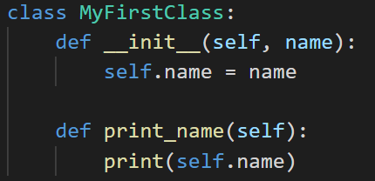


More involved example
We extend the basic class to take a parameter ‘name’ in the constructor ‘__init__’ then add a simple function to print it.
Now we create an instance and use it.

Slide 7
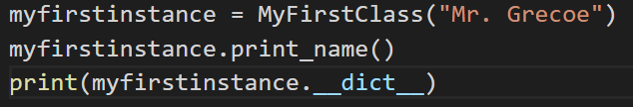

What’s in our class?
From the example we’ve just seen

Slide 8
Questions?

