Slide 1
C⁺⁺ computer codes for helping decision making process
Grecu Bogdan Octavian

Slide 2
Objectives
Multiple Critera Decision Making Methods- basic concepts, examples
SAW method- main steps
TOPSIS method- main steps
Implementation into computer codes of these methods
Examples
Conclusions
References

Slide 3
Decision Making Process
  Define the problem
  Determine requirements and establish goals
  Identify alternatives
  Define criteria
  Select a decision making tool/method
    Evaluate alternatives against criteria
    Follow the procedure described by the method
    Find the best solution

Slide 4
Multiple Criteria Decision Making Models
Many criteria are used and many solutions exist
Alternatives have sometimes contradictory responses to the criteria involved
There is no alternative that satisfies at the highest level all criteria involved
Two important and simple methods
  SAW method: Simple Additive Weighting;
  TOPSIS method: Technique for Order Preference by Similarity to Ideal Solution

Slide 5






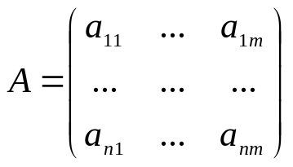
Basic Concepts
We suppose that we have n variants of decision (alternatives), and m criteria for doing the choice operation.
Let and denote the criteria and alternatives, respectively.
We also need to know the tipe of criteria.
represents the consequences matrix.
represents the satisfaction degree of criteria, in case of choosing variant .
Data normalization
  Scaling (uniform scaling) operation: represent a linear transformation that enlarges or shrinks intervals (can include type of criterion such as all become max criteria)
  Vector normalization (for TOPSIS method)
  Min-max normalization
Normalized consequences
Values of the consequences matrix stand in the same interval; can be better compared.
Need to establish weight of the criteria involved (scoring method) and their types.

Slide 6
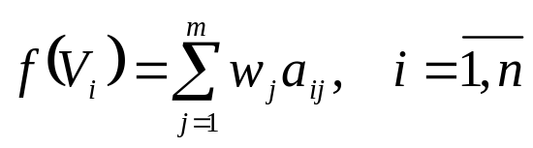
SAW vs TOPSIS
SAW method is based on the ideea that the best variant is that one for which an weighted sum has the highest value.
TOPSIS method is based on the idea that the optimal solutions must be as closed as it can be to the ideal solution and as far away as it can be from the worst solution;
  Evaluating the ideal (theoreticaly the best) variant and also the worst one (Important to establish max and min criteria and their importance);
  Evaluating the distances between each variant and the ideal, and between each variant and the worst one
  Establishing a score for each variant based on the above distances;
  Ranking the variants according to it.

Slide 7
SAW method implemented into a C⁺⁺ computer code
Input data:
  number of variants,
  number of criteria,
  type of criteria,
  matrix of consequences
  importance of criteria (scoring criteria by the user)
Output data: rank and values of the aggregation function for each variant (variants weighted sums)
Main steps:
  Based on criteria types the normalized matrix of consequences is evaluated using
    the scaling method
    the min-max method
  Evaluation for each variant the corresponding weighted sum.

Slide 8
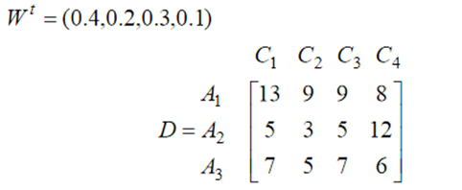


SAW1 computer code (scaling to [0-1])
SAW2 computer code (min-max normalization)
Example
  Input data
  Output data

Slide 9
TOPSIS method implemented into a C⁺⁺ computer code
Input data:
  number of variants,
  number of criteria,
  type of criteria,
  matrix of consequences
  importance of criteria (scoring criteria by the user)
Output data: rank and values of the scores
Main steps:
  The normalized matrix of consequences is evaluated using the scaling method, based on criteria types (first case), or using vector normalization (second case), when we do not need criteria type
  Find the ideal best solution, respective the worst one (only in the second case, because when the scaling method is used they can be deduced)
  Compute the distances between the envisaged variants and the best/worst variants
  Evaluate the scores
  Rank the varaints according to their scores – sort the vector of scores

Slide 10
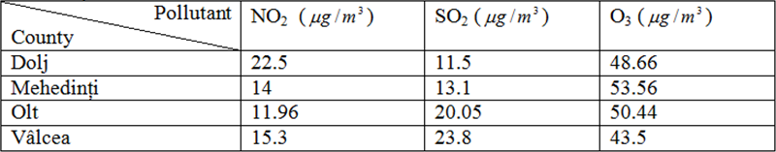
TOPSIS 1 computer code
TOPSIS 2 computer code
Example
  Input data
  Output data
  A4>A3>A1>A2

Slide 11
Conclusions
Different normalization techniques do change the final scores but not the ranking.
Multiple criteria decision making methods are not very difficult to be implemented into computer codes.
Computer codes for these methods are flexible and can be adapted for other kind of normalization techniques.
The program can be easily used by anyone without knowing nor programming languages, nor details about the methods used.

Slide 12
References
1. Figueira, J., Greco, S. and Ehrgott, M., Multiple Criteria Decision Analysis: State of the Art Surveys, Springer, New York, 2004.
2. Steuer, R. E., Multiple Criteria Optimization: Theory, Computation and Application, Wiley, New York, 1986
3. Văduva I., On solving Some Types of Multiple Attributre Decision-Making Problems, Romanian Journal of Economic Forecasting, 1/2012: 41-61
4. A. Memariani, A. Amini, A. Alinezhad, Sensitivity analysis of SAW: The results of change in the weight of one attribute on the final ranking of alternatives, Iranian Journal of Operations Research
5. Grecu L., Demian G., Demian M., A Mathematical Study for Choosing the Best Material when Many Criteria of Different Importance are Involved, Scientific Bulletin of the "Politehnica" University of Timişoara Transactions on Mechanics, Tom 52 (66), Fasc.2.2007, pag 87-92.

