Slide 1

BYTEBUDDY: THE CODING CHATROOM
TEAM MEMBERS:
JAMES ELLIOTT
ALEKZANDER GREEN
AAKANSHA ARORA
KHOA NGUYEN

Slide 2
PROJECT OVERVIEW
ByteBuddy is a versatile programming assistance application designed to empower students in their coding endeavours.
The application enables students to create chat rooms where they can seek assistance, collaborate, and receive guidance on their programming and coding projects.
What sets ByteBuddy apart is its integrated code editing capabilities, allowing students to write and edit code seamlessly within the application.

Slide 3
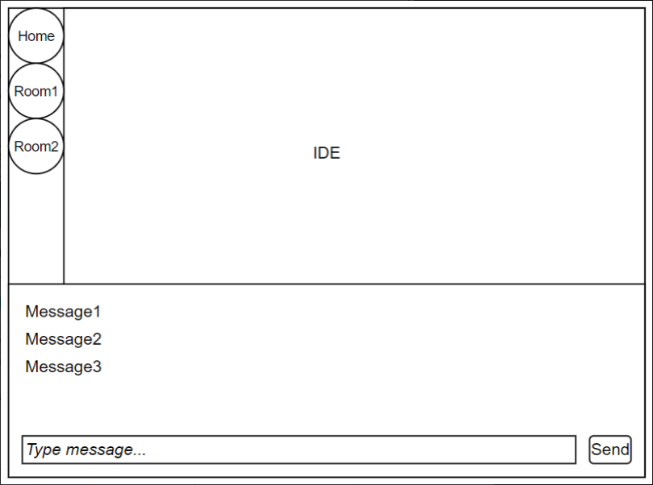
FRONTEND UI PROTOTYPE

Slide 4
PROJECT Architecture OVERVIEW
Frontend
Svelte
Backend
Django
DjangoRestFramework
Database
SQLite3

Slide 5
FUNCTIONAL REQUIREMENTS (Must-Haves)
A user shall be able to signup, login, and logout of the application.
A user shall be able to create and delete a chat room.
A user shall be able to send, edit, delete messages, upload images or use emojis within the chat room.
A user shall be able to get, copy, and share a link to the chat room.
A user shall be able to create, edit, collaborate through an embedded editor.
A user shall get a notification when they have new messages in chat rooms.
A user shall be able to see all messages in a chat room in chronological order
A user shall be able to change user settings.

Slide 6

FUNCTIONAL REQUIREMENTS (Nice-to-Haves)
The database should store users with data for email and profile picture
The code execution results should be stored in the database.
The database should store IDE sessions for later retrieval
The code in the editor should be executed on backend and results presented to user

Slide 7
NON-FUNCTIONAL REQUIREMENTS
The system should have a load time < 3 seconds.
The system should use an authentication protocol for login.
The system should use a data cache system for caching messages
The system should be able to support > 100 users.
The system should use Django and Django REST Framework for backend.
The system should use JavaScript and Svelte framework for frontend

Slide 8
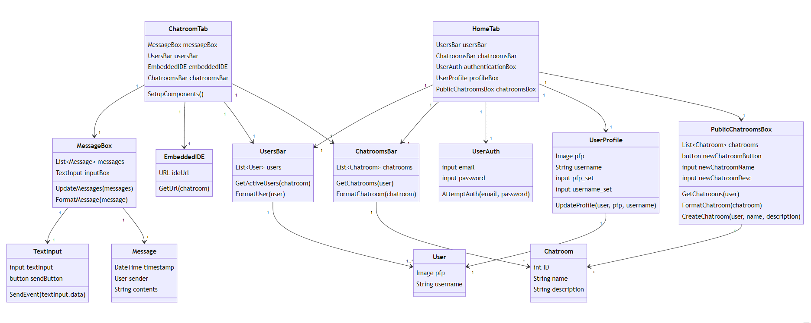
SYSTEM MODEL- FRONTEND DIAGRAM

Slide 9
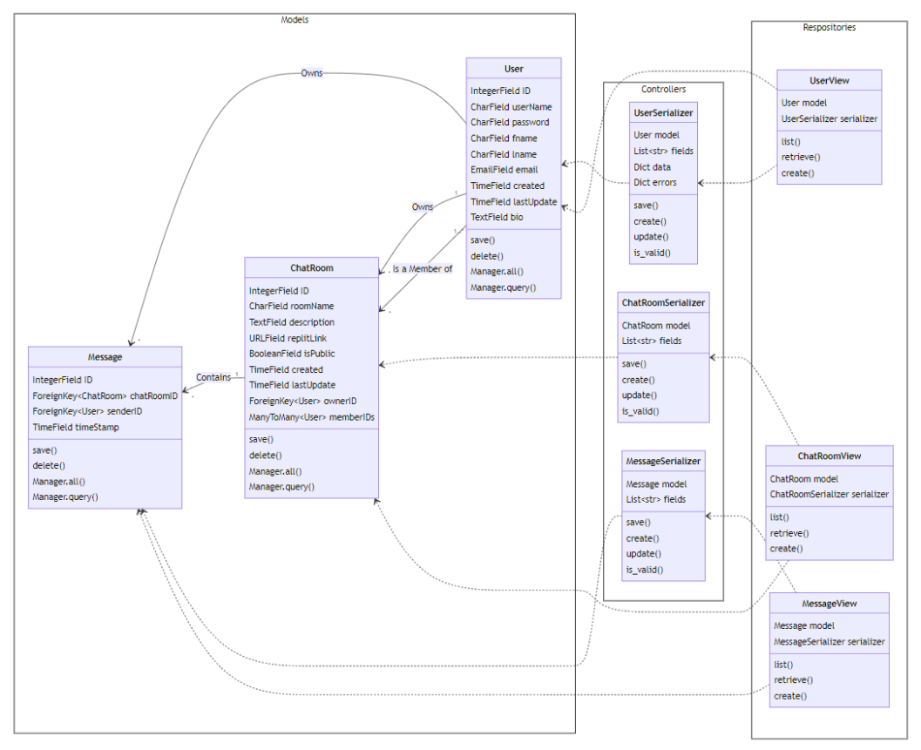
SYSTEM MODEL- BACKEND DIAGRAM

Slide 10
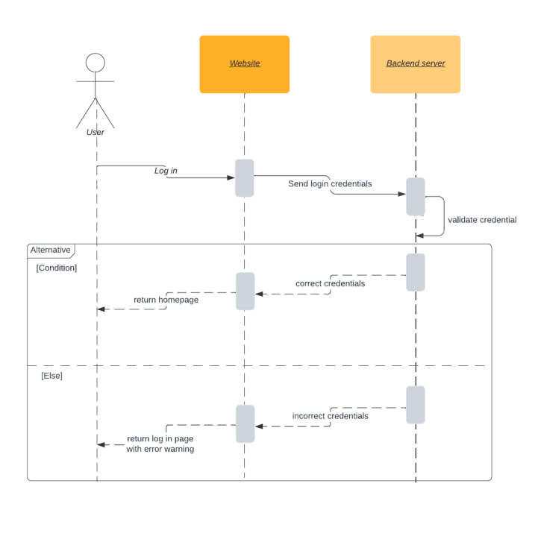
SYSTEM MODEL- SEQUENCE DIAGRAM

Slide 11
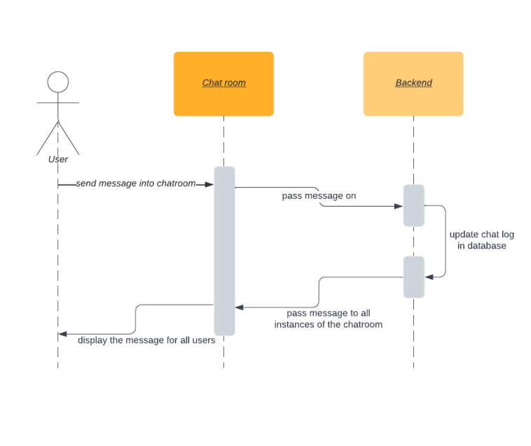
SYSTEM MODEL- SEQUENCE DIAGRAM

Slide 12
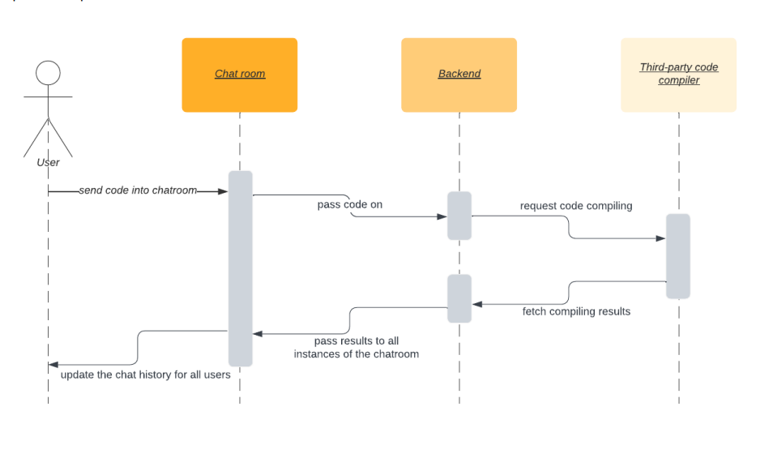
SYSTEM MODEL- SEQUENCE DIAGRAM

Slide 13
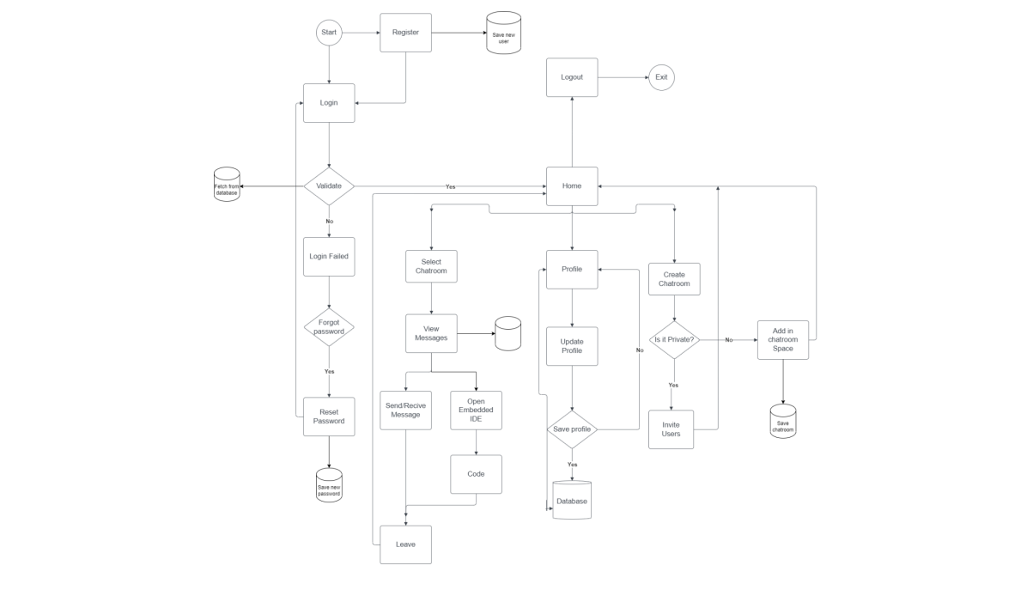
SYSTEM MODEL- FRONTEND FLOWCHART AND BACKEND CALLS

Slide 14
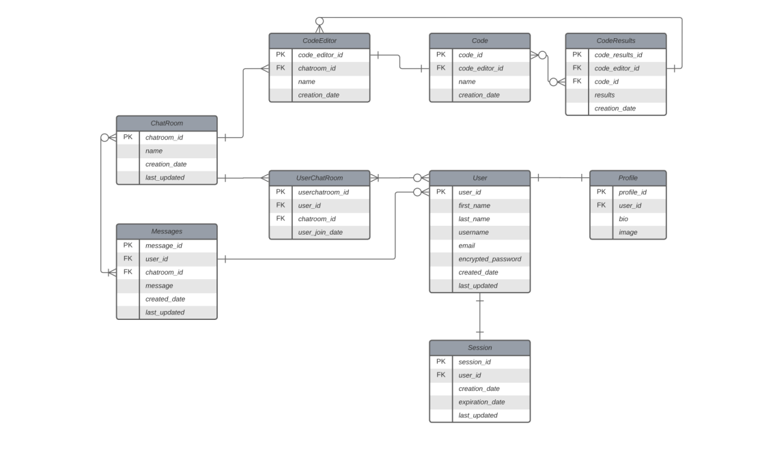
SYSTEM MODEL- ENTITY RELATIONSHIP DIAGRAM

Slide 15
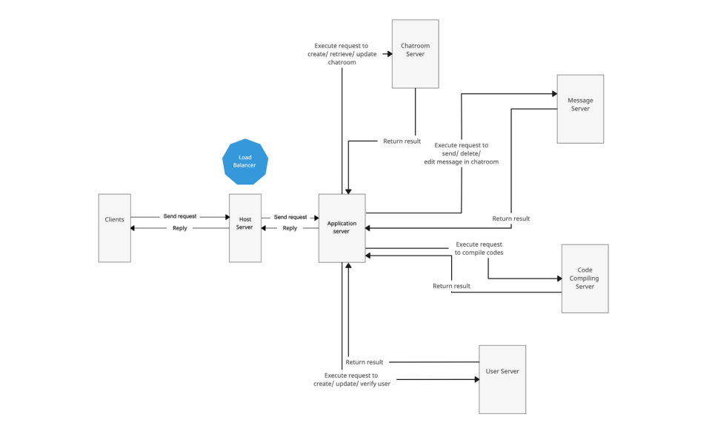
ARCHITECTURE MODEL – CLIENT SERVER

Slide 16
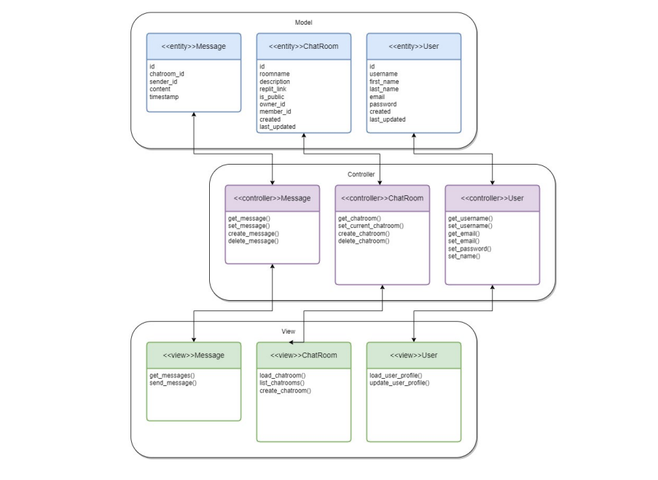
ARCHITECTURE MODEL – MODEL VIEW

Slide 17
Thank You!
Q&A

