Slide 1
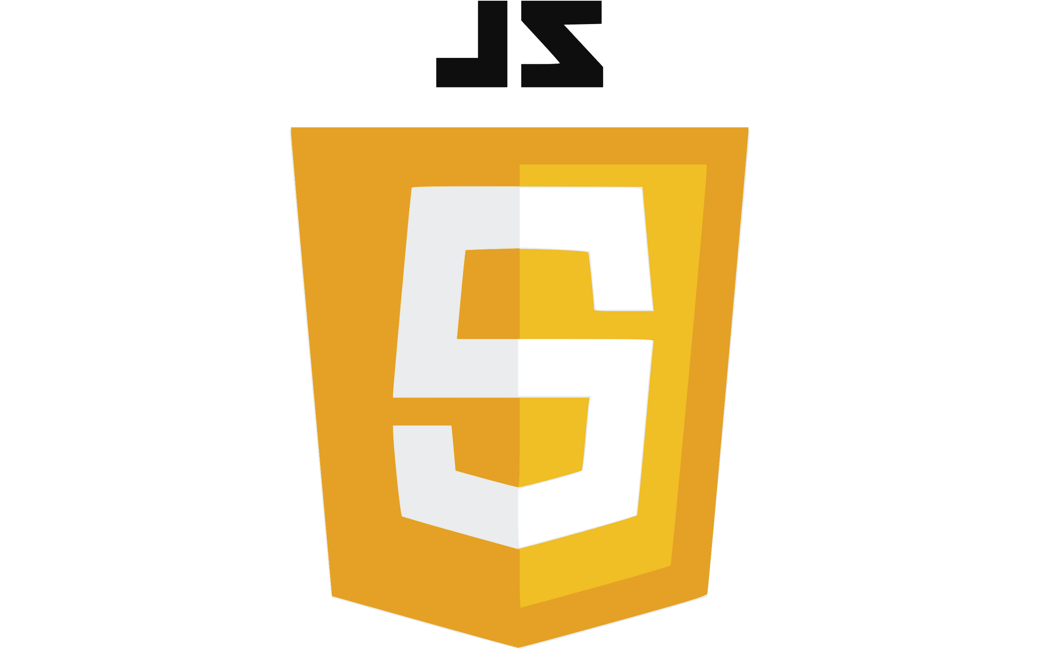


Web Development Back-End
Client-Server
NPM
Intro to NodeJS and Express

Slide 2
References
W3school NodeJS
https://www.w3schools.com/nodejs/default.asp
Nodejs.dev Docs
https://nodejs.dev/en/learn
Expressjs.com Docs
https://expressjs.com/en/guide/routing.html
MDN Web Docs
https://developer.mozilla.org/en-US/docs/Learn/Server-side/Express_Nodejs

Slide 3
Outline
Intro to NPM
Intro to NodeJS
NodeJS Modules
Built-In
Custom Scripts/Modules

Slide 4
NPM
A package manager for Node.js packages/modules
Similar to pip for Python or NuGet for .NET
https://www.npmjs.com
Module? Package? Library? Framework?
https://dev.to/hamza/framework-vs-library-vs-package-vs-module-the-debate-3jpp

Slide 5
NPM Commands
Basic npm commands:
npm i packageName Install a package
-g for global install
--save-dev for development-only install
npm run scriptName Runs a named script in package.json
npm start Runs the “start” script in package.json
npm ls List of installed packages
npm docs packageName Opens the package documentation
https://docs.npmjs.com/cli/v7/commands

Slide 6
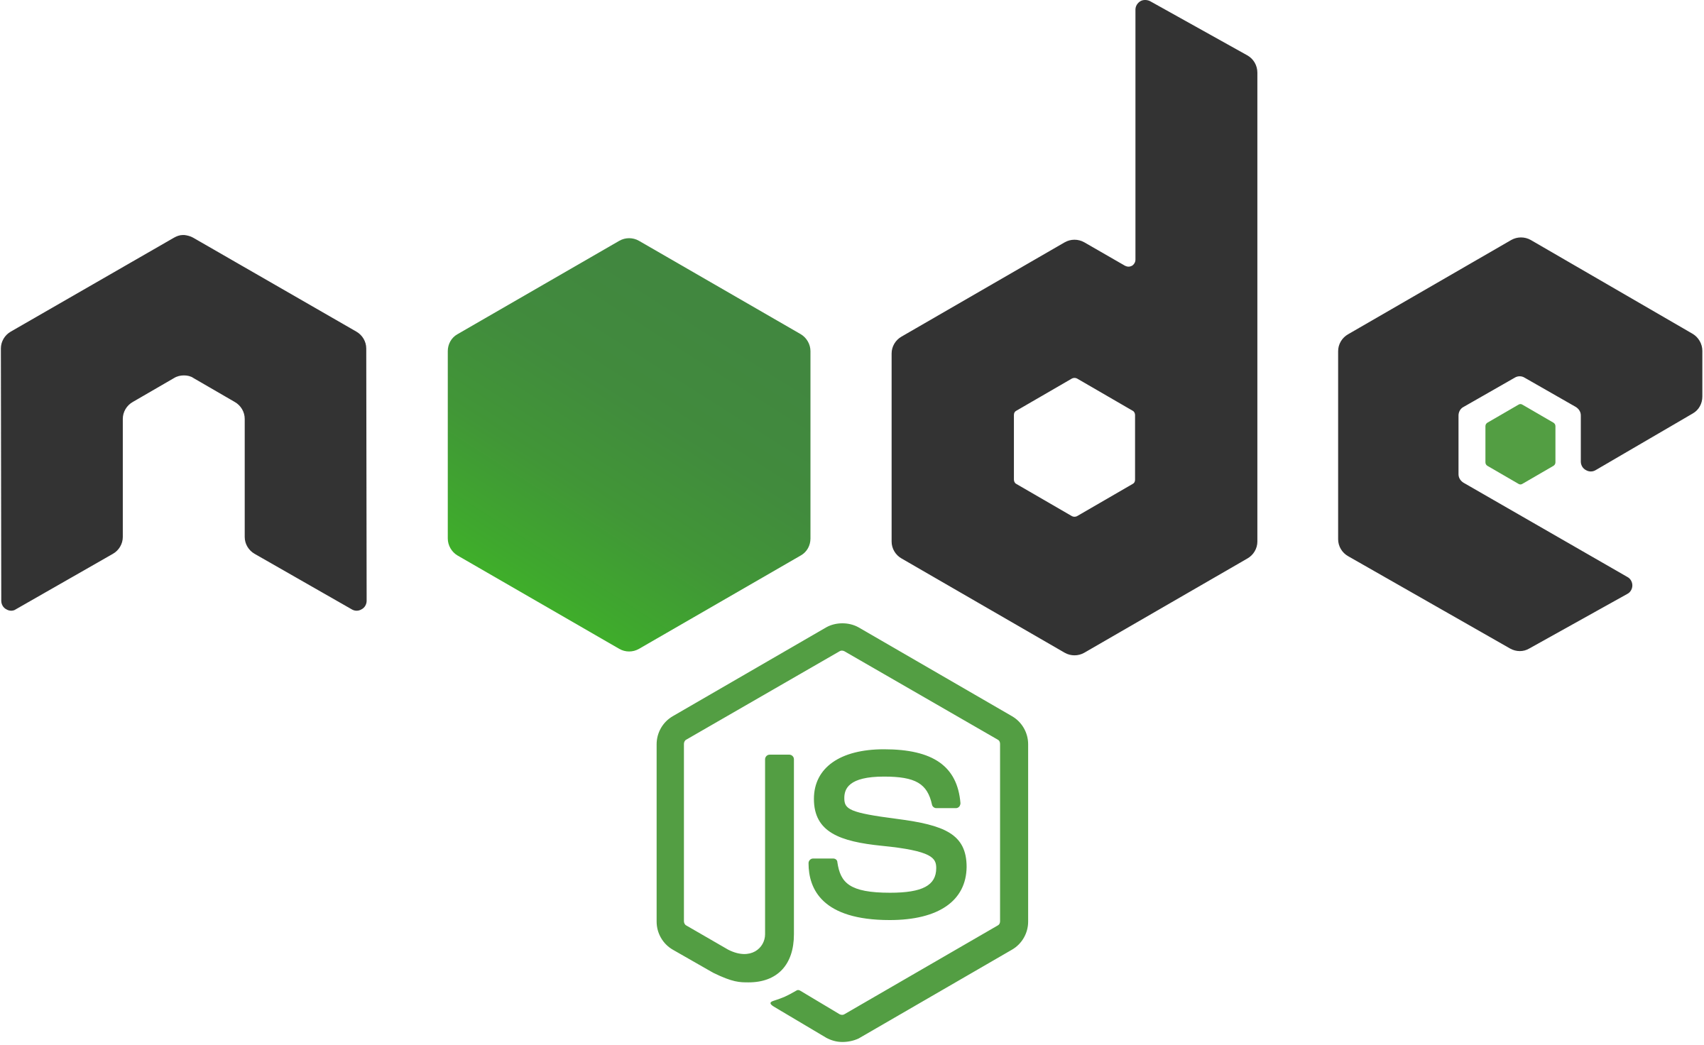
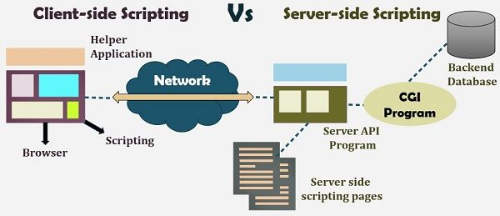
Nodejs – Your Back-End
Node.js:
Open-source server framework
Uses JavaScript on the server (Full-Stack JavaScript)
Asynchronous
Runs single-threaded and non-blocking

Slide 7









NodeJS In Industry
Node.js:
Free, Popular and multi-platform friendly

Slide 8
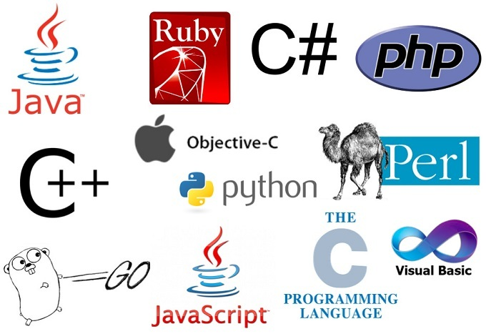
What About PHP or Python?
Still popular, but…
Different language syntax
Some complexities to consider
Synchronous/Asynchronous
Ultimately – Do what works best for you!
(or what your company may require…)

Slide 9
Node.js – Event-Driven
A Node.js file usually contains functions that will be executed under certain circumstances:
An HTTP request is received on a certain port that the Node script is listening for
A server event routine is triggered
Yet, it is a regular JavaScript file

Slide 10
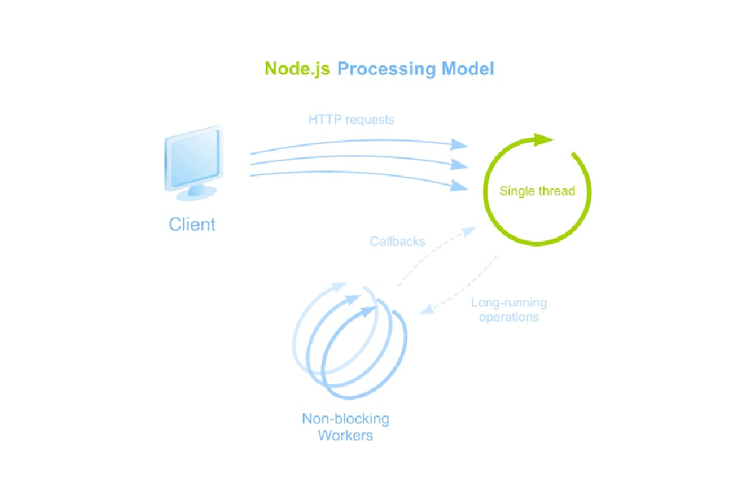
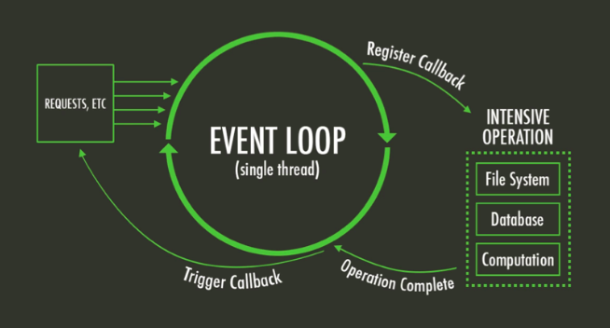
Node.js – Event Driven

Slide 11

Launch A Node Script
Launch a file in Node environment (server-side)
$ node filename.js
Run in VSCode
Can also debug, of course!

Slide 12
Debugging Node in VSCode
Use a launch configuration
Debug the file directly or
Attach a debugger to an existing process
"configurations": [
//Debugs the currently opened NodeJS file
{
"type": "node",
"request": "launch",
"name": "Debug This NodeJS File",
"skipFiles": ["<node_internals>/**"],
"program": "${file}"
}
//Attaches a debugger to a running NodeJS process
//Must run node with --inspect=9229 flag
{
"type": "node",
"request": "attach",
"name": "Attach to NodeJS Process",
"skipFiles": ["<node_internals>/**"],
"port": 9229
},

Slide 13


Development – nodemon
nodemon is a npm package
Restarts the node process when a file is modified
Install by running:
$ npm i --save-dev nodemon (install as development-only)
Replace node command with nodemon:
$ nodemon hello_world.js
Or add a script to your package.json to run the script
"scripts": {
"hello": "nodemon hello_world.mjs",
},

Slide 14
“Hello World” Examples

Slide 15
NodeJS Global Variables/Functions
setTimeout() and setInterval()
process - A Nodejs global variable
process.env: Environment variable
Requires dotenv module config() function
process.argv: Command-line arguments
process.exit(): Manually exit/terminate script
https://nodejs.org/api/globals.html#global-objects

Slide 16
console
Printing
console.log()
console.table(tableData)
console.error()
console.trace() – print stack trace
Timing
console.time(label) – start
console.timeLog(label) – current time elapsed
console.timeEnd(label) – stop
https://nodejs.org/api/console.html

Slide 17
What is a Module in Node.js?
A group of variables/functions you want to include in your application.
Three categories of modules:
Built-in modules
Your custom modules
Modules written by others

Slide 18
Brief History of Modules
Used to use syntax like exports.modules.something
Now the standard is to use ES6 modules
Named and default exports, imports
You have already done this in React with imported components and hooks
In Node, use the .mjs file extension to indicate ES6 modules
Two module loaders in NodeJS
CommonJS – Synchronous (old, eww!)
ECMAScript Module Loader (Current standard since 2018)
https://nodejs.org/api/esm.html#enabling
https://blog.logrocket.com/commonjs-vs-es-modules-node-js/

Slide 19
CommonJS vs. ES6: Some Differences
In CommonJS format, the following global variables are available:
Current Directory Name
Current File Name
Command-Line Arguments
In ES6, a little more work needs to be done to access the same data:
__dirname
__filename
process.argv[i]
import { argv } from 'process';
import * as url from 'url';
const __filename = url.fileURLToPath(import.meta.url);
const __dirname = url.fileURLToPath(new URL('.', import.meta.url));

Slide 20

Built-in/Core Modules
http: make requests (client) and accept requests (server)
https: same as http but for HTTPS (secure)
Express is often used instead, but these can be more performant
fs: work with files and folders from the server filesystem
path: parse file system paths across platforms
crypto: handle encrypted data (hash, sign/verify, cipher, etc.)
url: parse URLs
events: custom event emitters (Node observer pattern)
https://nodejs.org/api.html
https://www.w3schools.com/nodejs/ref_modules.asp

Slide 21
Nodejs Core Module Practice
Create a Node.js script that:
Reads the contents of a text file “words.txt”
Scrambles the inside of each word in the file.
Prints all scrambled words to the console
Welcome to CS590, enjoy the class!
Wlemcoe to C9S50, eonjy the cslas!
https://www.dictionary.com/e/typoglycemia/

Slide 22
Your Own Modules
To explicitly use ECMAScript module loader, create your modules as a .mjs file extension
myfirstmodule.mjs:
getDate.js:
export function getDate(){
return Date();
};
import http from "http";
import {getDate} from "./myfirstmodule.mjs";
http.createServer(function (req, res) {
res.writeHead(200, {'Content-Type': 'text/html'});
res.write("The date and time are currently: " + getDate());
console.log(getDate());
res.end();
}).listen(8080);

Slide 23
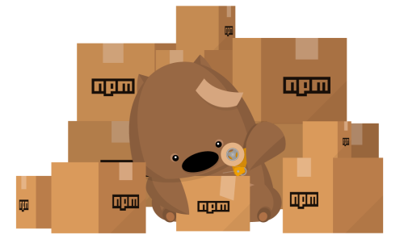
Internet of Packages
When you need a server feature:
Look at Node.js built-in modules
But don’t reinvent the wheel…
Look online for a module that already exists
Commercial use: always check package
Write your own!
https://leanylabs.com/blog/npm-packages-for-nodejs/
https://www.creativebloq.com/features/20-nodejs-modules-you-need-to-know
https://www.esparkinfo.com/node-js-packages.html

Slide 24
NodeJS in 2024
NodeJS version 18 (LTS)
Comes with fetch API!
https://www.angularminds.com/blog/article/node-js-18-features-and-updates.html
NodeJS version 19 (LTS)
Crypto stability
AWS Lambda
https://www.bacancytechnology.com/blog/whats-new-in-node-19
NodeJS version 20 (Latest)
Permission Model
Stable Test Runner
https://nodejs.org/en/blog/announcements/v20-release-announce

