Slide 1

Capstone Final Presentation
Analysis of Risk-Adjusted Cost Outcomes for Patients with Hypertension

Slide 2
Purpose of Today’s Presentation
Provide a 360º view of the data sets used and present some visualizations.
The Issue
Description of the problem
The mission: raise awareness about potential out-of-pocket expenses
The solution: data science!
Predicting Out-of-Pocket Expenses
The Cost of Health Services
Potential Outcomes Due to Hypertension
Modelling Risk Factors
3. Real-World Application
An Example of a Real Life Patient
Next Steps

Slide 3
SECTION 1 The Issue: Hypertension

Slide 4
The Problem
About 1 of 3 US adults have high blood pressure. Only 54% of these people have their high blood pressure under control.
A variety of lifestyle factors cause high Prevalence of hypertension
General lack of understanding and lack of prevention programs
Years of neglect cause the hypertension to worsen
Increased Risk of hospital inpatient cardiovascular event
Increased severity level of events when they do occur
High cost to the health system and out-of-pocket expenses to patients
Resulting situation
Personal bankruptcies
Overburdened system

Slide 5
The Mission
Build a model that can help patients increase their awareness of risk to outcomes related to hypertension. Quantify how much a potential event will cost the patient.
Raise awareness about potential out-of-pocket expenses.

Slide 6



The Solution: Data Science!
Connecting probabilities to outcomes
Provider inpatient charges data set:
202,656 observations
Includes cost of hospital inpatient procedures
Can be grouped by procedure type
Insurance Plans Data Sets:
Over 12M observations across 3 data sets
Includes 2016 insurance market plan attributes and premiums
National Health Records:
33,014 obervations
Contains key patient information such as BMI, age, sleep hours, etc…
Used to predict probability of hypertension

Slide 7
SECTION 2 Predicting out-of-pocket expenses

Slide 8

The Cost of Health Services
The way insurance companies see you.
Insurance Companies try to assess how much they will have to spend on insuring you against using the health system. The formula above can be explained by:
OOP($): Your out-of-pocket expense for given time period
P(n): probability that you have a given health related condition
Cost(n): the cost associated if a health system usage should occur
minOOP($): plan premium accrued during the time period

Slide 9
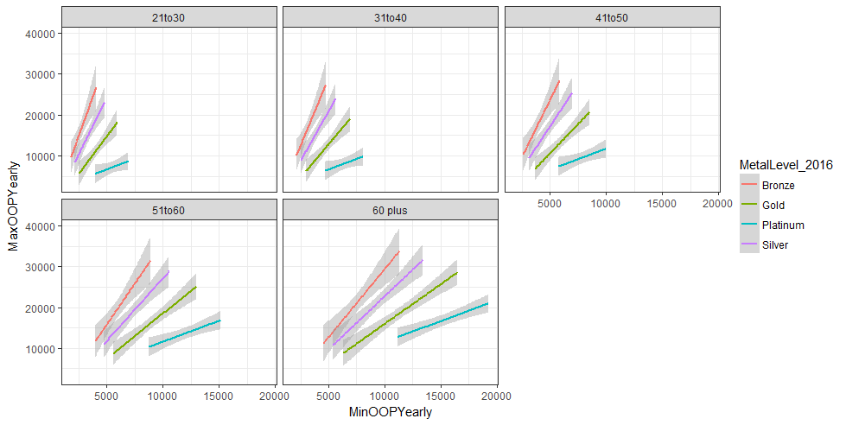
The Cost of Health Services
Plan Rate Drivers
Key risk drivers such as Age, Smoker Status, Body Mass Index, Stress levels, diet, etc… are modelled to produce insurance products with varying coverages, do you know which one to choose?

Slide 10
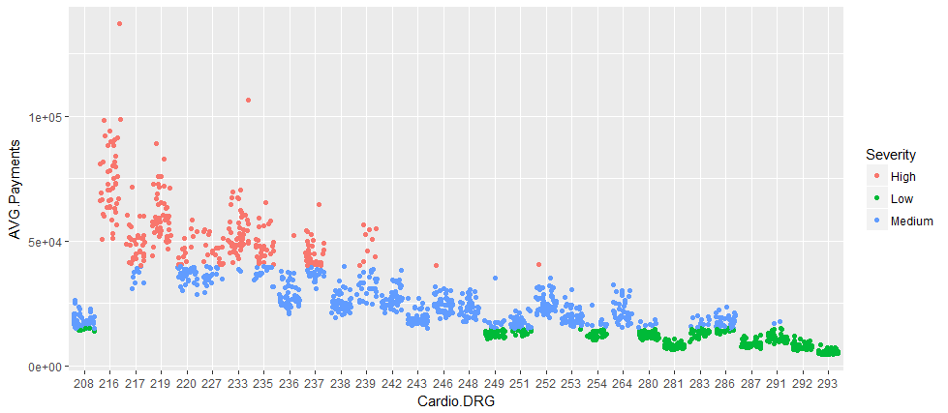
Potential Outcomes Due to Hypertension
The average cost of a cardiology procedure linked to hypertension can be as high as $75,000 to well over $100,000 for a high severity intervention.

Slide 11
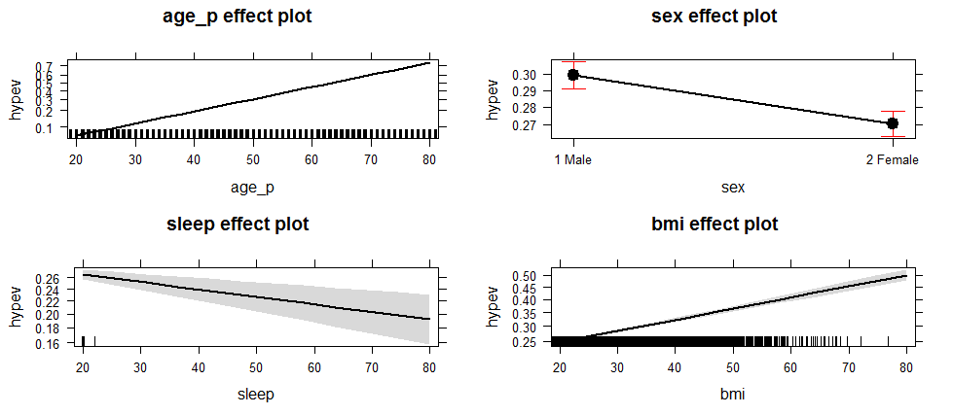
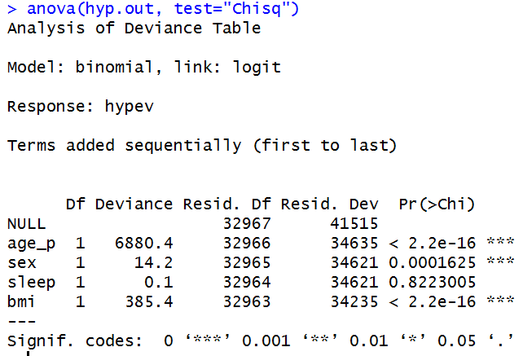
Modelling Risk Factors
A logistic regression model using historical patient data can help predict your risk of being diagnosed with hypertension based on inputs like Age, Sex, Sleep hours, and BMI

Slide 12
SECTION 3 Real World Application

Slide 13

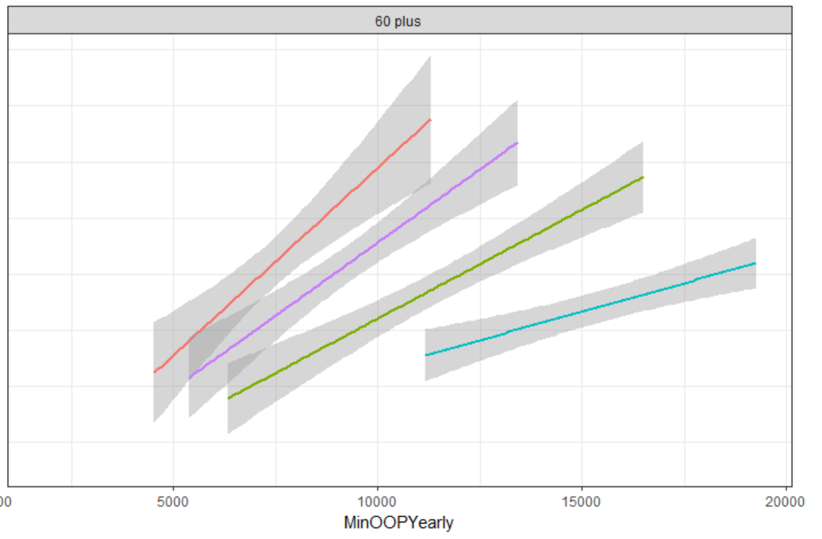
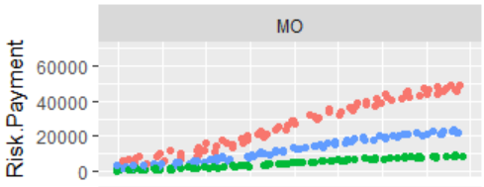
An example of a real-life patient
P(n)
minOOP
Cost(n)
A 69 year-old male, with a BMI of 39, living in Missouri, would be able to choose the appropriate health coverage given that there is a 64% probability that they have hypertension.

Slide 14

Next Steps
Front-End development of a visual tool to help patients navigate the process.

