Slide 1
Introduction to Programming
Project presentation
Paolo Molinaro & Rutger Arend Nieuwenhuis

Slide 2
The project is aimed to work with and analyse large texts, implementing two different data structures:
A binary search tree based table
A hash based set
We use these data structures to solve and analyse different types of word related tasks.

Slide 3
Part 1: Divide text into words
The word list will have the following characteristics:
Words with an apostrophe will be written contracted, ”don’t” will become “dont”.
Case insensitive, so "Hello" and "hello" will count as the same word.
Words like "test-case" will be counted as two words, "test" and "case".
With this set of rules, the word count for the two file will be:
11353 for holy_grail.txt (Grail file)
1989396 for eng_news_100K-sentences.txt (news_100k file)

Slide 4
Part 2: Implementing data structures

Slide 5
Hash set
The result obtained with the DJB2 algorithm is different from the given result in “word_set_main.py”.
Its high efficiency is revealed when used with large files and consequently with larger bucket sizes, maintaining a relatively low and consistent number of elements in the same bucket independently from the quantity of unique words in the word set.
The largest bucket size obtained is 5 in the holy_grail.txt (Grail) file and 7 in the eng_news_100K-sentences.txt (news_100k) file.

Slide 6
BST table
The results obtained with our implementation are the same as in “table_main.py”.
With our implementation the max depth is 26 for the holy_grail.txt (Grail file) and 39 for the eng_news_100K-sentences.txt (news_100k file).

Slide 7
Part 3: Word related exercises

Slide 8
Hash set - Unique word count
Given that a set, by definition only contains unique words, so the count can be accomplished by adding together the length of every list of each bucket in the word set.
Unique words count:
1876 for the holy_grail.txt (Grail file)
77601 for the eng_news_100K-sentences.txt (news_100k file).

Slide 9
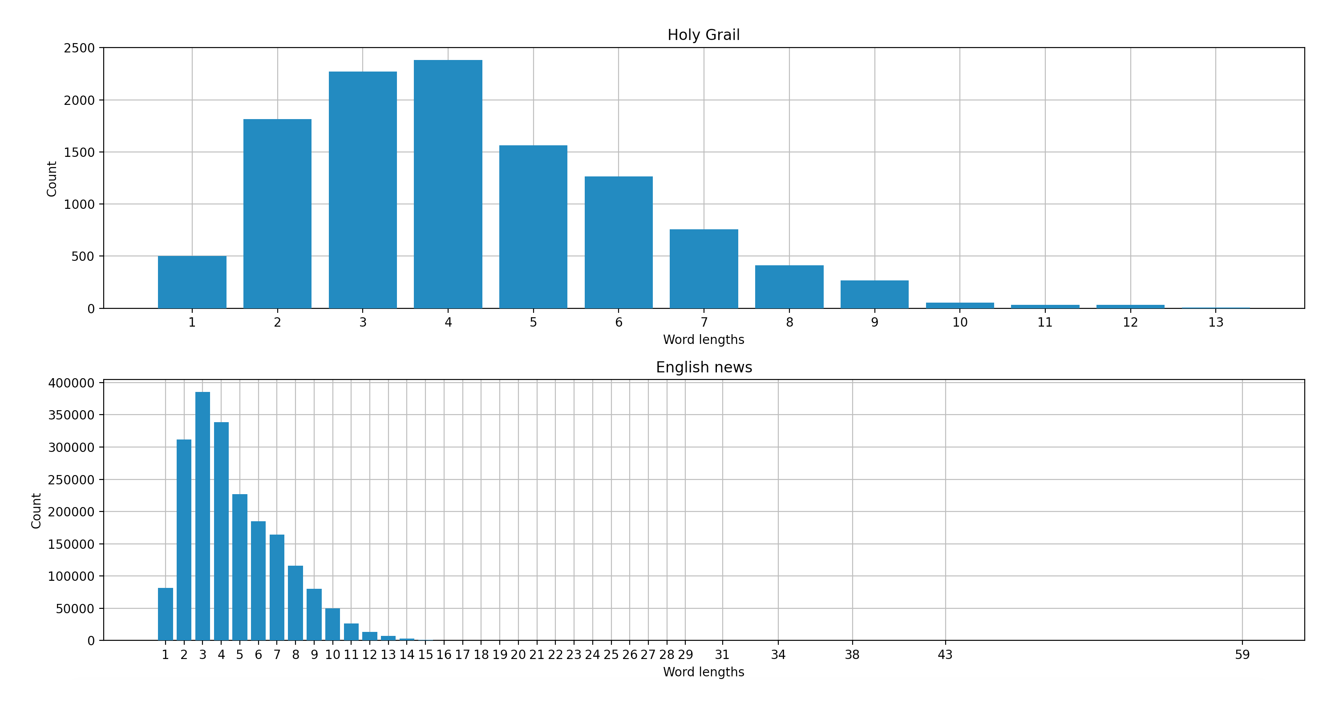
BST table - Words lengths count
Counting the length of the words in each file
Adding them to the BST, with the word length as the key and the count as the value.

Slide 10
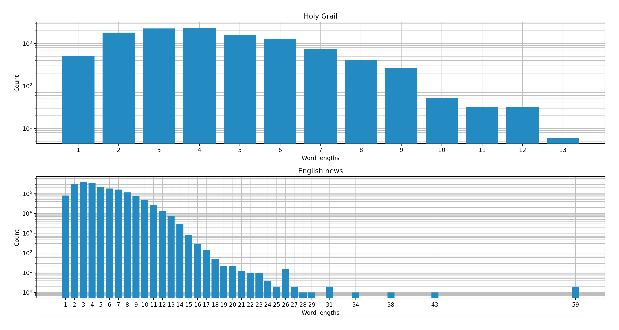
logarithmic
y axis

Slide 11
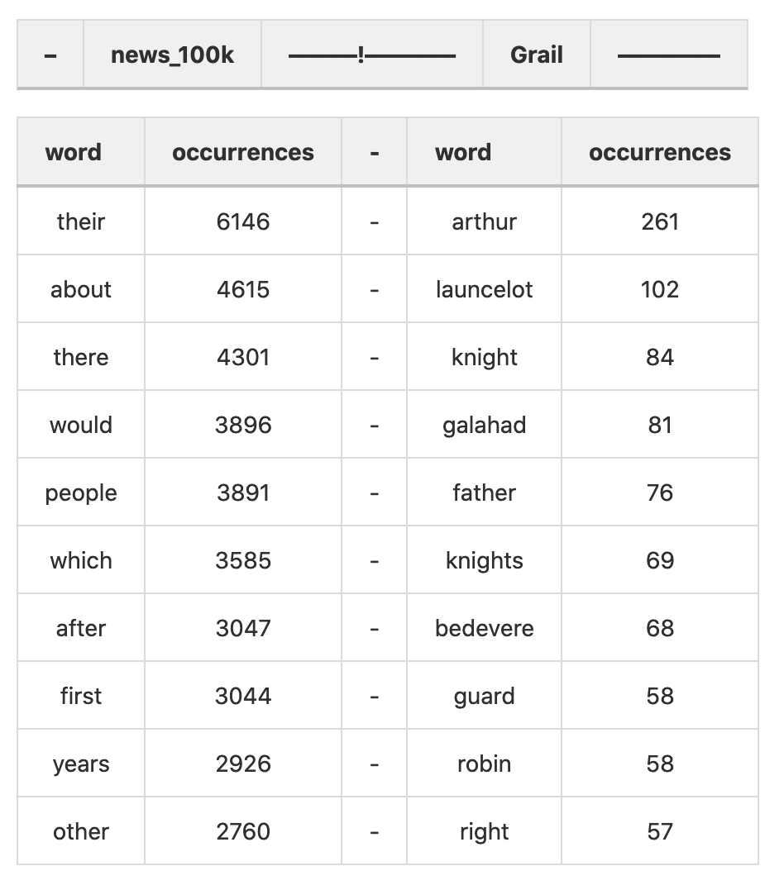
BST Table - Top 10 most frequent words
Creating a BST with all the words in each file with a length larger than 4 as the keys and the amount that they occur as the value.
Creating a list of tuples with the 10 most frequently used words and their amount of occurrences.
Writing the list file with the supplied words and their amount of occurrences provided by previous function.

Slide 12
Part 4: Measuring time

Slide 13
BST table
Measure the time to look-up a fix number of keys in trees of different sizes, measuring also the max tree depth at the same sizes.

Slide 14
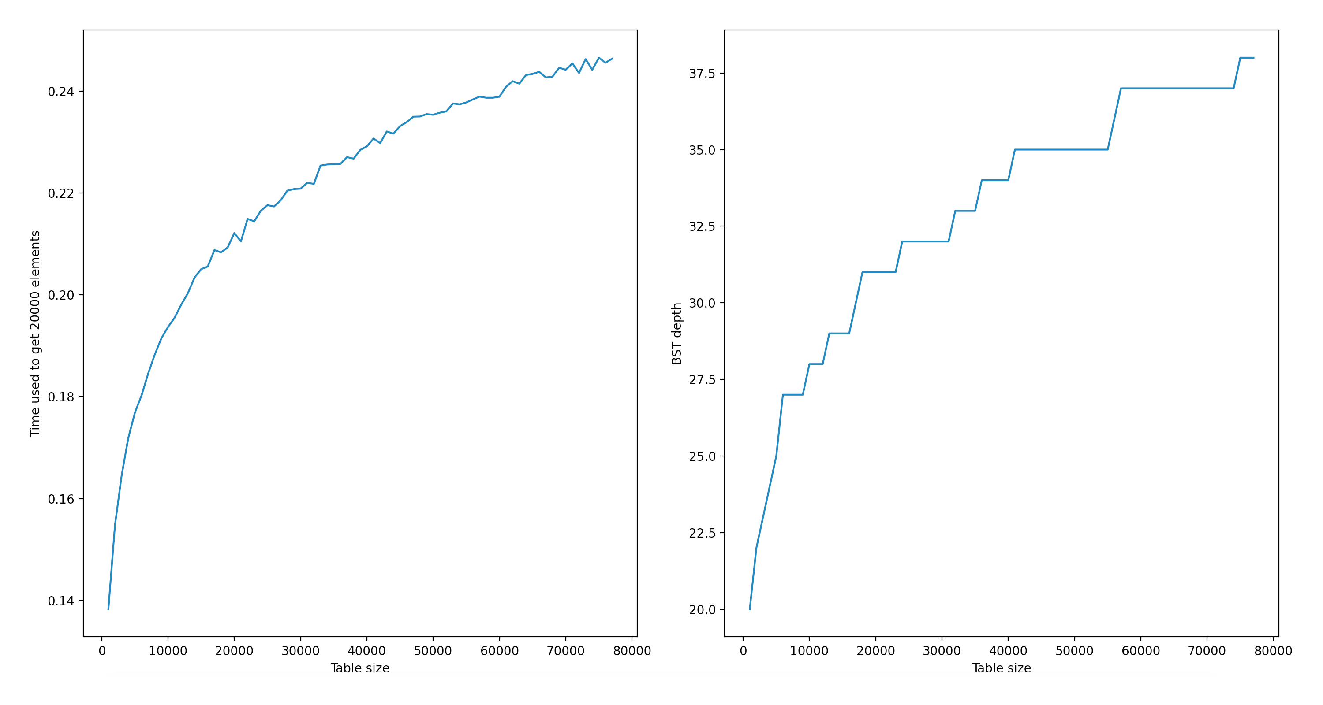

Slide 15
Hash set
Measure the time it takes to add new elements to your hash set and how it correlates to rehashing, measure also the max bucket size at various set sizes.

Slide 16
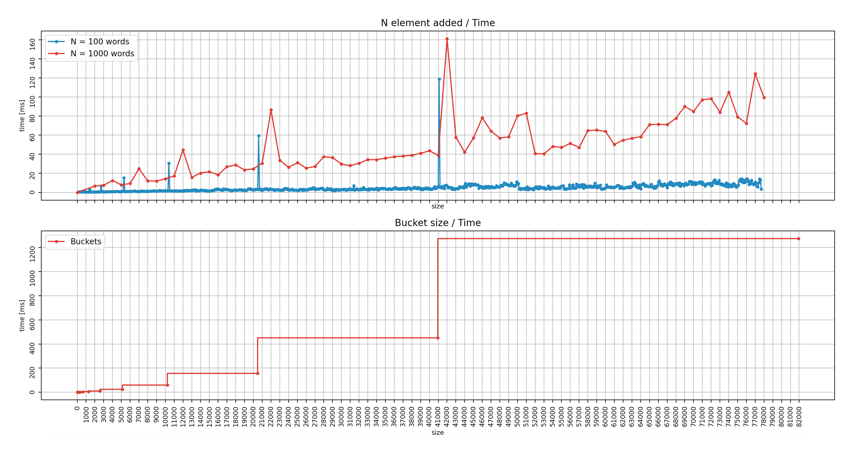
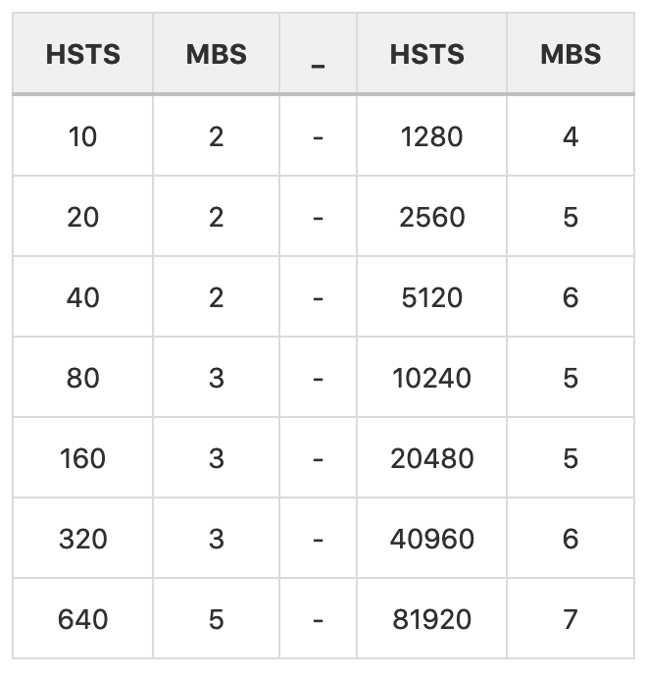
complete
word
set

Slide 17
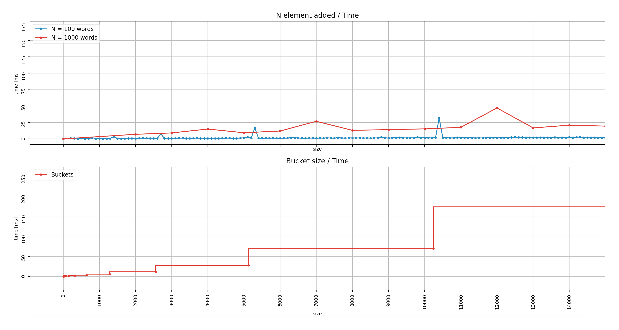
zoom-in

Slide 18
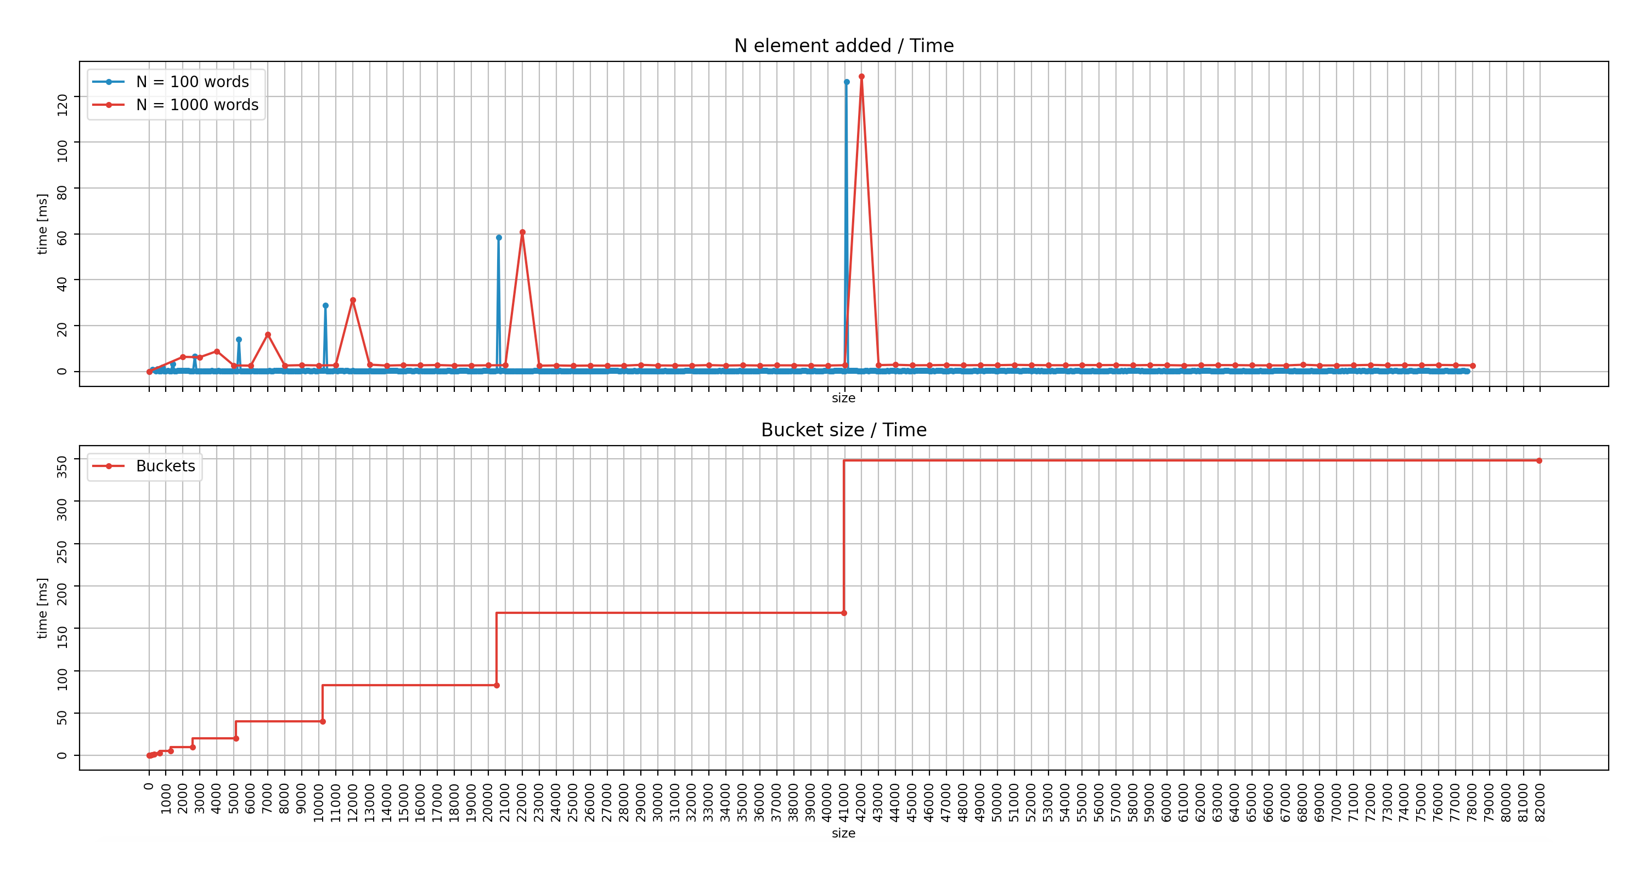
unique word set

Slide 19
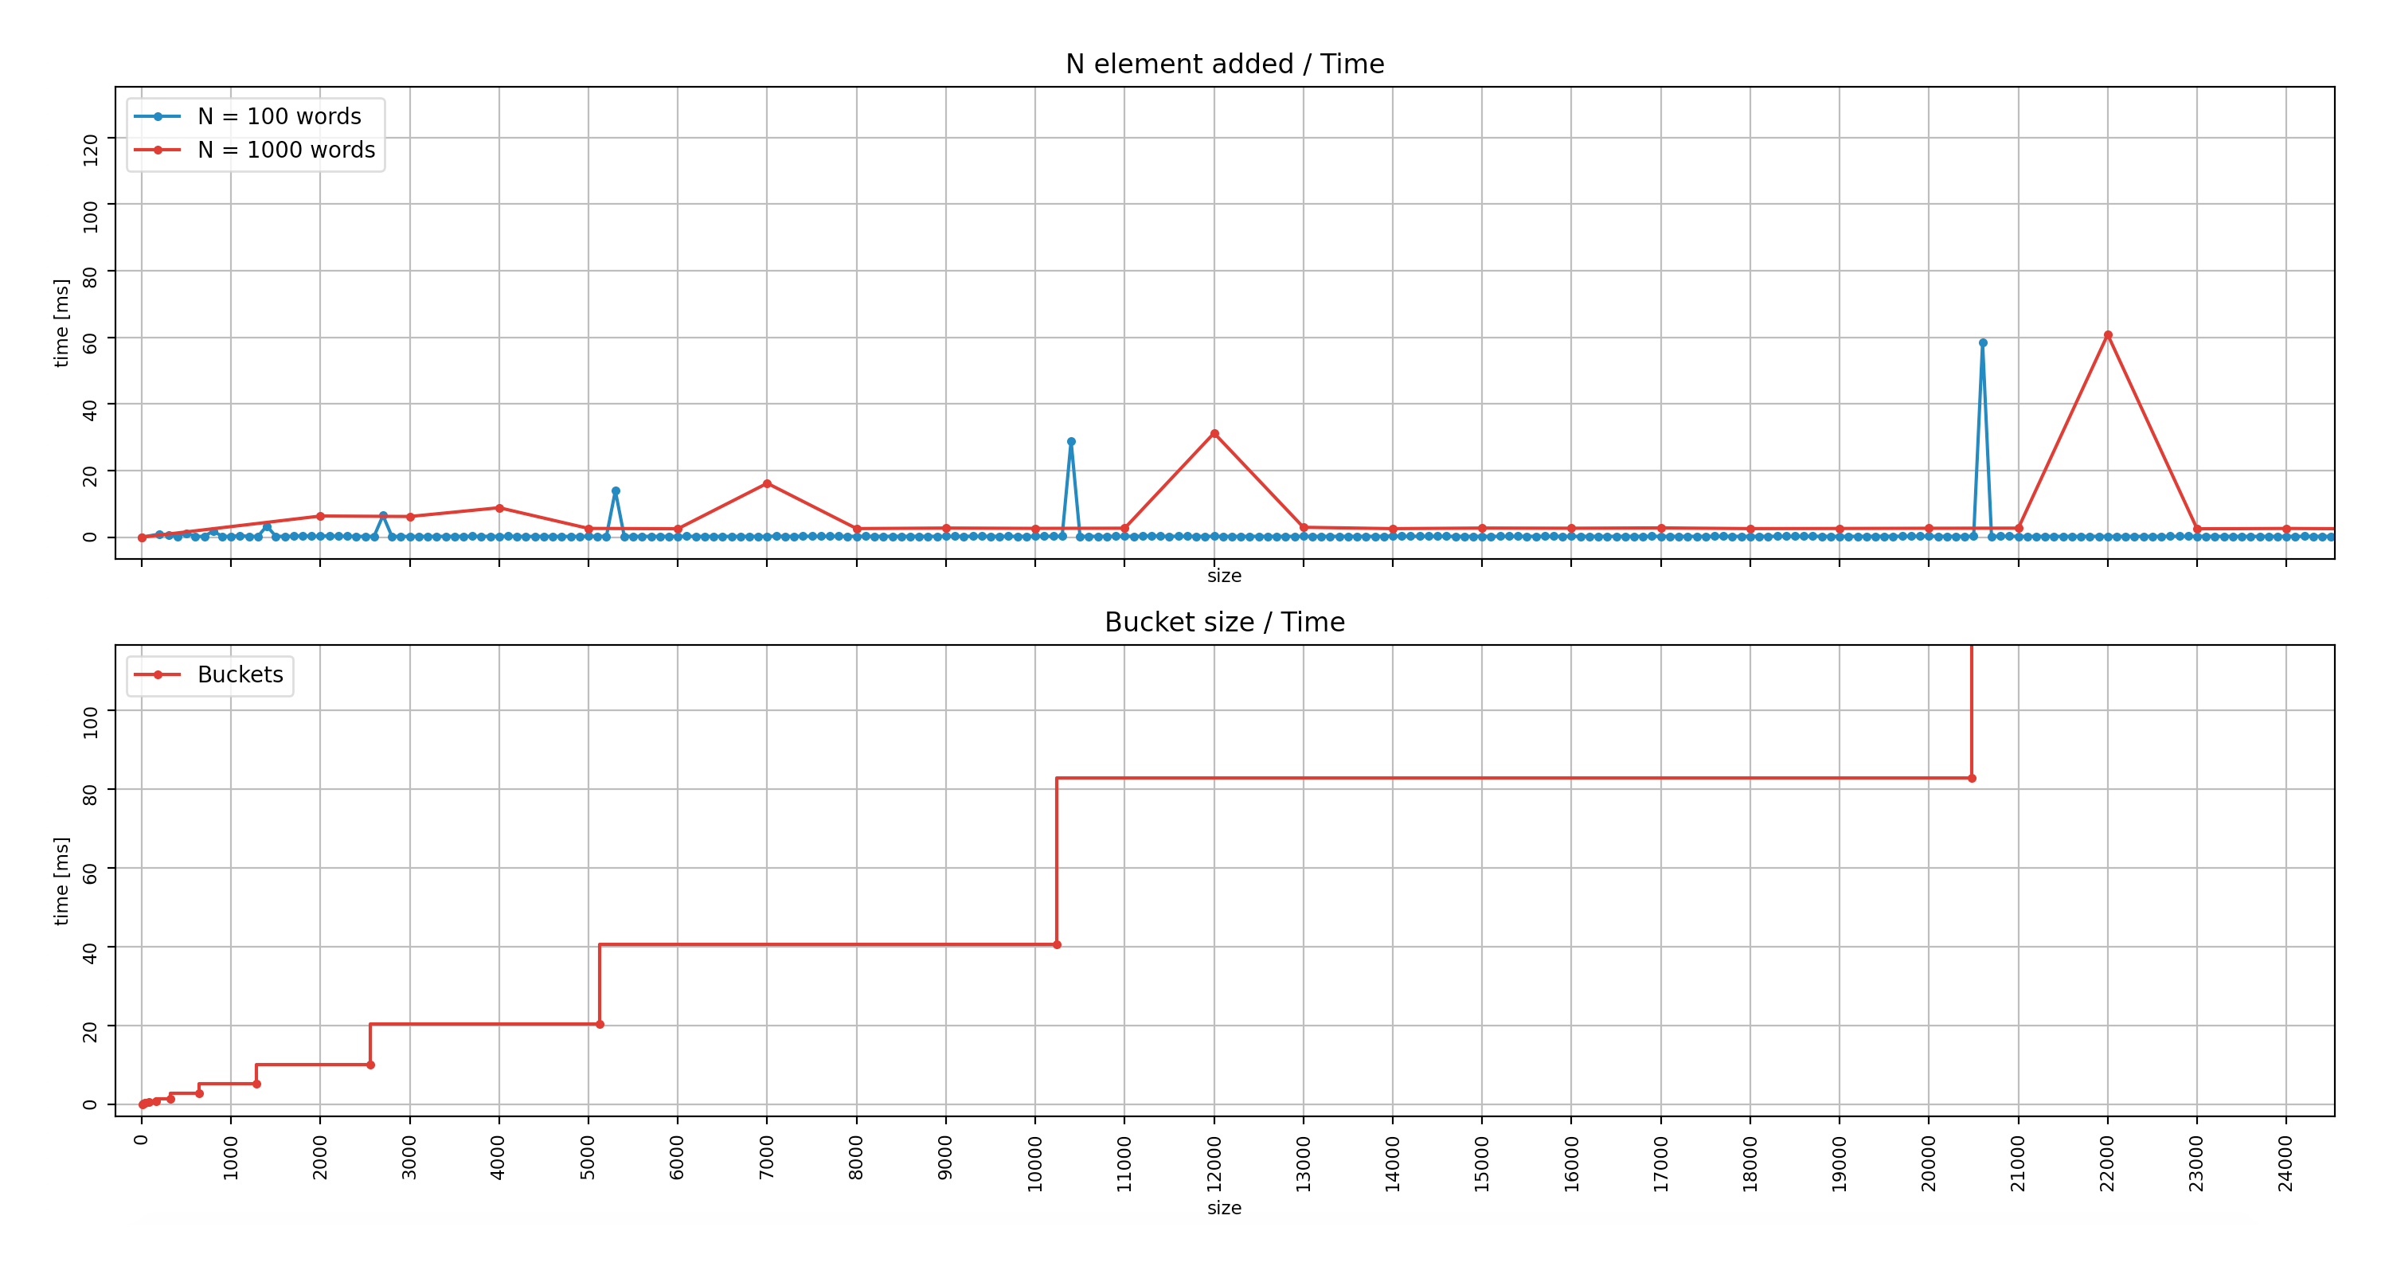
zoom-in

