Slide 1

1990
A general-purpose, statically-typed, purely functional programming language with type inference and lazy evaluation
CMPT 383
Summer 2022
SFU Surrey

Slide 2
What was going on in 1990?

Slide 3
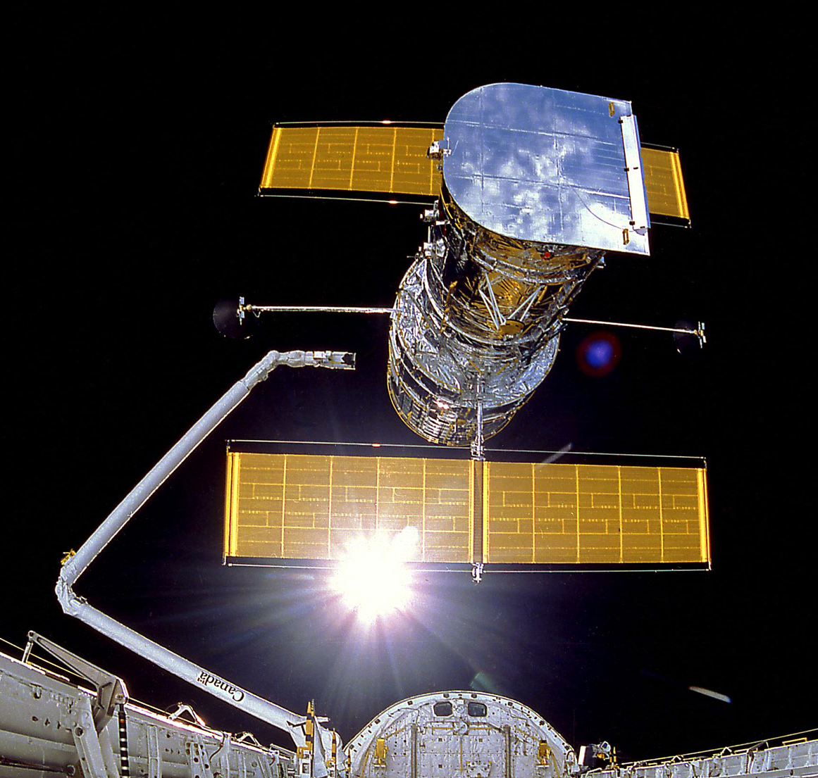
1990: First Appearances
Hubble Space Telescope

Slide 4
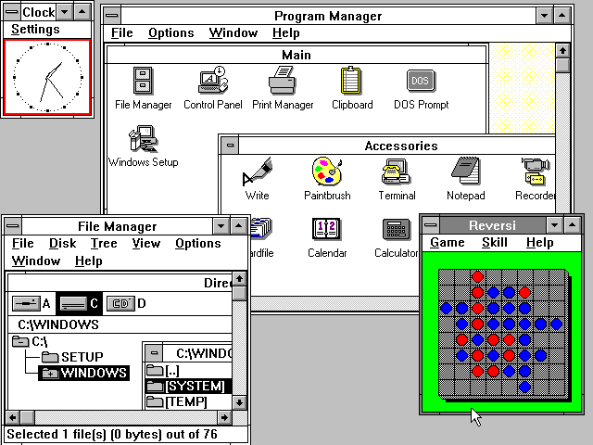
1990: First Appearances
Windows 3.0

Slide 5
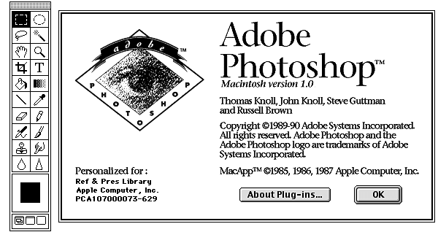
1990: First Appearances
Photoshop 1.0

Slide 6
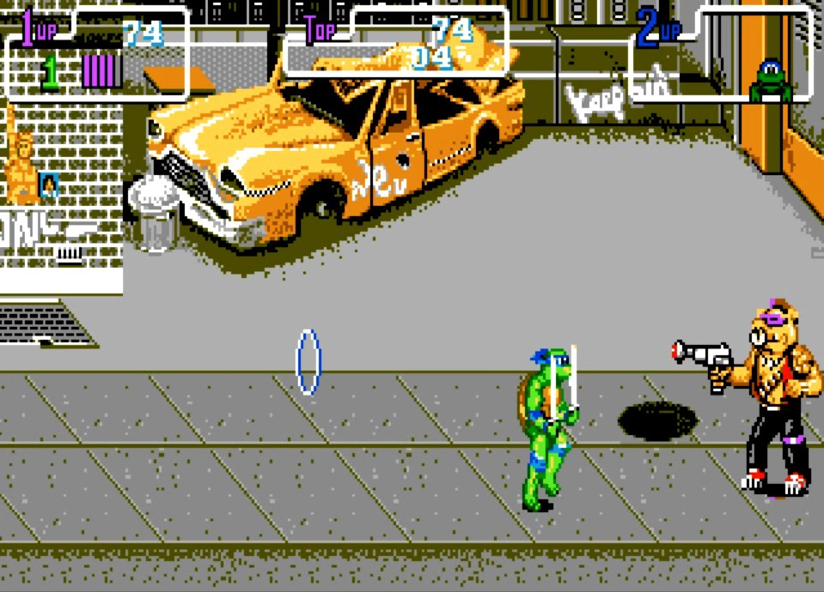
1990: Highest-grossing Arcade Game
Teenage Mutant Ninja Turtles

Slide 7
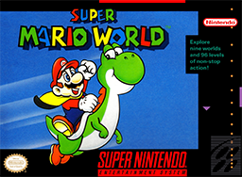
1990: Highest-grossing Home Game
Super Mario World

Slide 8
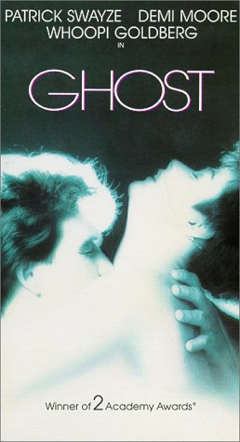
1990: Highest-Grossing Movie

Slide 9
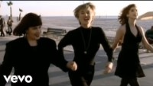
1990: Most Popular Song
Hold On
Wilson Philips

Slide 10
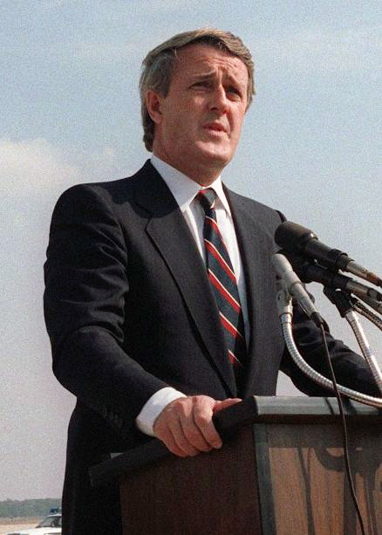
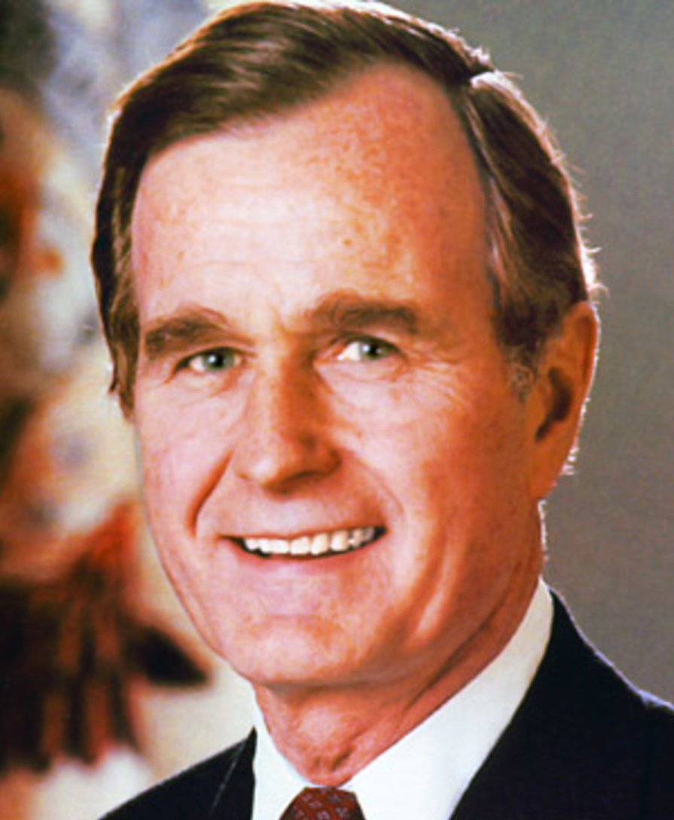
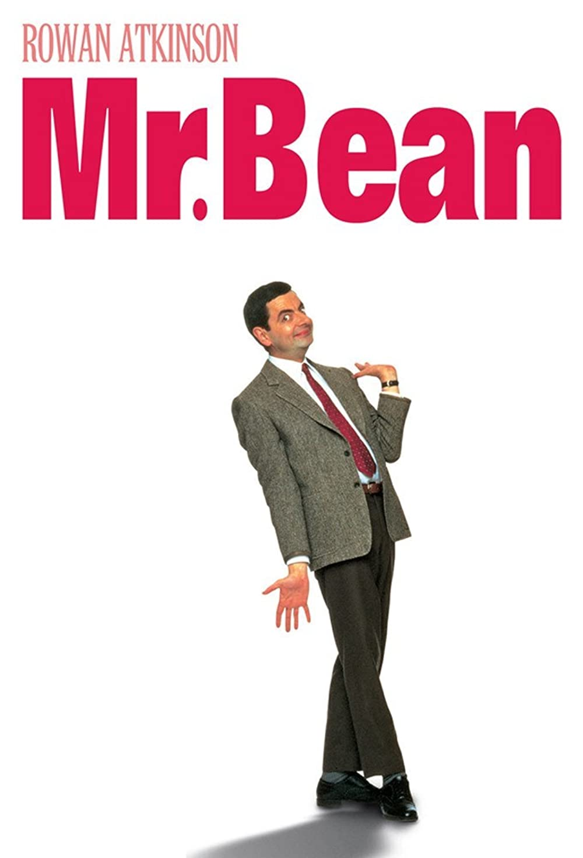
1990
Canadian PM
US President
This TV show started
Brian Mulroney
George H. W. Bush

Slide 11
1990
A general-purpose, statically-typed, purely functional programming language with type inference and lazy evaluation

Slide 12
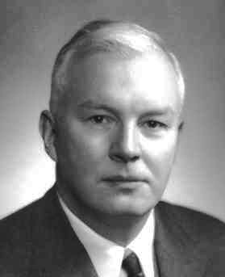
Haskell’s Namesake
Haskell Curry
1900 – 1982
Mathematician who did much of foundational work in the lambda calculus, the mathematical foundation of functional programming.
He wasn’t involved with the Haskell language itself.

Slide 13
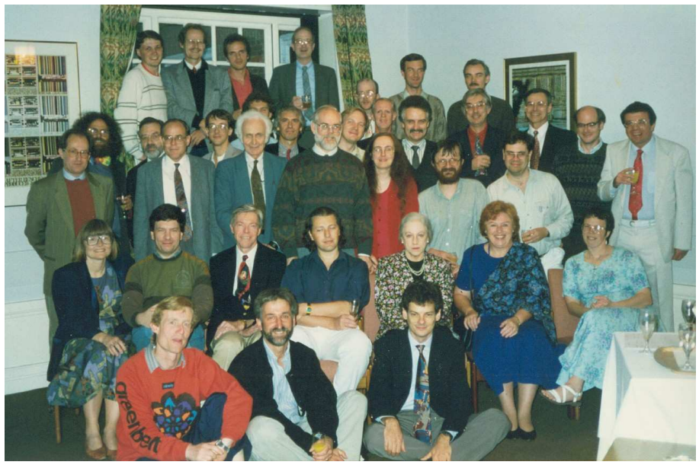
Haskell’s Original Designers
1992 Haskell Working Group

Slide 14
Haskell Probably Can’t Get You a Job!
Haskell has been most influential as a research language used by a subset of academic programming language researchers.
Similar to LISP, Haskell is filled with lots of ideas that have influenced many other languages.

Slide 15
What’s Haskell Good for?
Programming language type systems.
Inspiration and new ways of thinking about programming.
Further development of the functional programming paradigm, aiming towards practicality.

Slide 16
What’s Haskell Not so Good For?
Haskell is often not as efficient as other languages.
Immutability can lead to inefficient solutions to problems that can be easily implemented efficiently in other languages.
Compared to the most popular mainstream languages, Haskell is not used much in practice, so it can be hard to find support for it.
Haskell’s was born in academia and has a very mathematical flavor, which many programmers find quite different than C-style languages.
Haskell syntax can be extremely terse, and can use many obscure operators.
Haskell’s strict typing can take some getting used to, and may be frustrating at first.
Measuring the performance of different programming languages is surprisingly difficult to do fairly. Check out the Computer Language Benchmarks Game.

Slide 17
Major Features of Haskell
Functions are first-class objects
Functions can be passed and returned (closures)
Interpreted and Compiled
Easy to evaluate individual expressions
Memory-safe and garbage-collected
No manual memory deletion

Slide 18
Major Features of Scheme
Types
Statically typed, i.e. types checked before run-time
Type inference, i.e. often Haskell infer what types must be with the programmer needing to write them explicitly
Purely Functional
All values are immutable: once you create them, they cannot be changed
All functions are pure: no side-effects, output depends only on input
Lazy Evaluation
When you pass an expression to a Haskell function, the expression is passed unevaluated to the function

Slide 19
Major Features Not in Haskell
Features not part of Haskell
No pointers
No object-oriented programming
No exceptions

Slide 20
Hello, World!
Follow the download instructions at https://www.haskell.org/downloads/
We’ll mainly use ghci, the Glasgow Haskell interpreter. You can compile Haskell programs with ghc.
❯ ghci
GHCi, version 8.6.5: http://www.haskell.org/ghc/ :? for help
Prelude> putStrLn "Hello, World!"
Hello, World!

