Slide 1

GFA week 01
DianaKiss
from IBM DSS - ISC

Slide 2
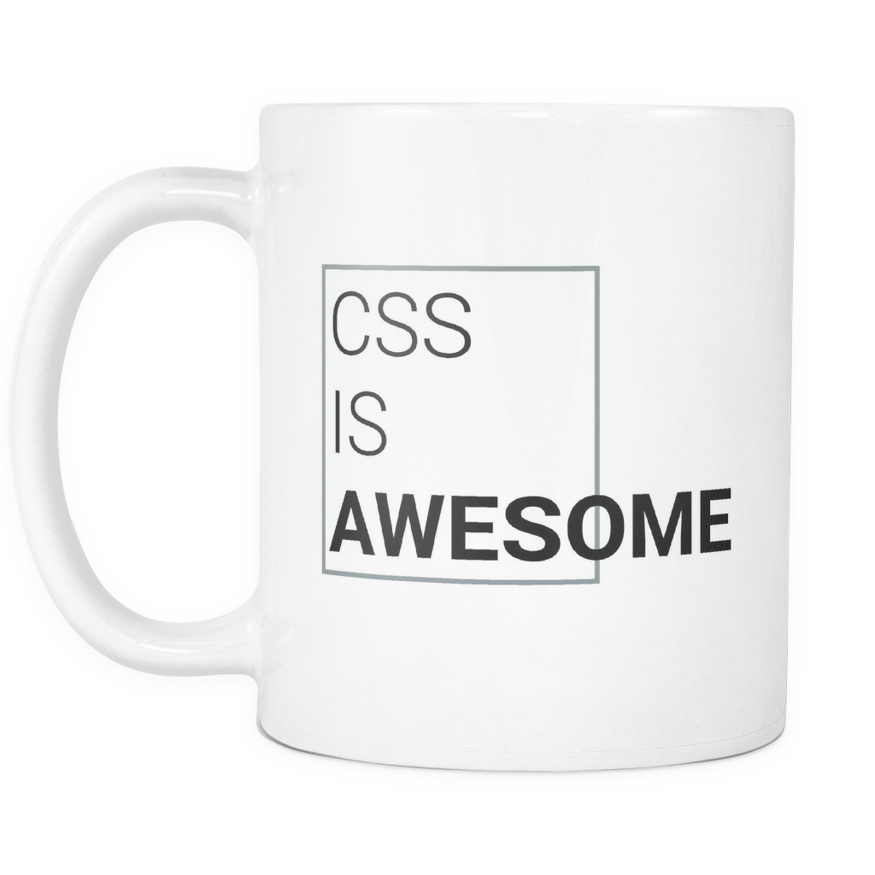
HTML and CSS
Image / Text positioning
Text align
Just make it look nice...

Slide 3
GIT and GitHub
Git conflicts taught me:
-- rebase
-- force

Slide 4
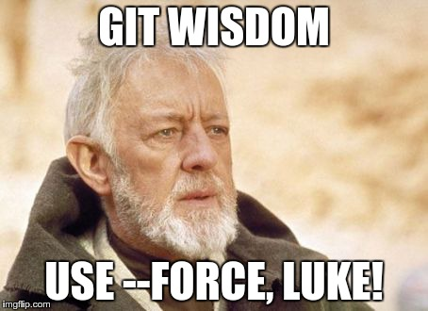
You feel like:

Slide 5
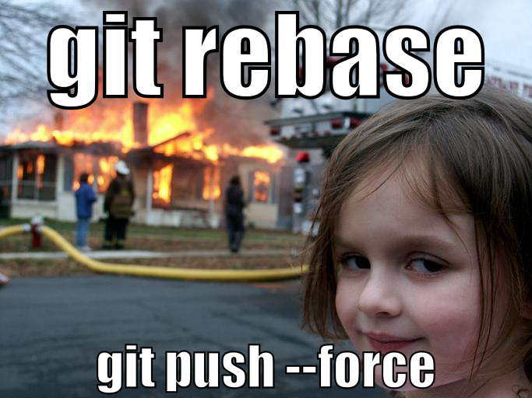
It’s rather...

Slide 6
JavaScript
for / if / var types… etc.
pick up the logic
do stuff more fast
Excersises -> help to get used to things

Slide 7

SUMMARY

