Slide 1
Sz. Kis László

Slide 2
About my self | What new I learned | What I liked the most
Learned: BME KSK
C# and SQL
Worked: Ghibli Kft: Assistant
Freight Forwarding Manager
Learned excel and VBA
Notes:
Learnd at BME with KSK faculty, and warehouse managemant major
Worked at Ghibli Kft. for two years as assistant, and freight forwarding manager
Learned excel and VBA by myself during this time
Learned C# and SQL in the last half year

Slide 3
About my self | What new I learned | What I liked the most
Alert
Function
Object
Class
Recursion
Notes:
For me all of these topics were new. For me to understand all of this, i excercise a lot. Alert, and Function was the easiest thing for me to understand. The other 3 was a little bit tought for me. For me to understand Objects, and Classes i worked my ass of. For bette understanding, i imagened the whole thing like a tamplet for cars, or like a tamplet for Orks. I know it sounds nerdy, but this is what helped me a lot. I dont have a specific code i can show you this. But if i say a car has a brand, type, engine size, door number etc., it helped me to understand it.

Slide 4
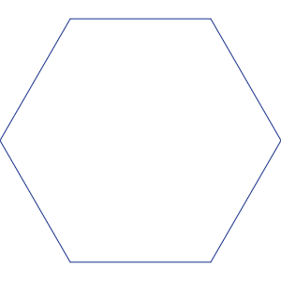
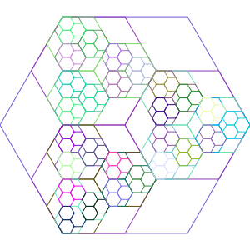
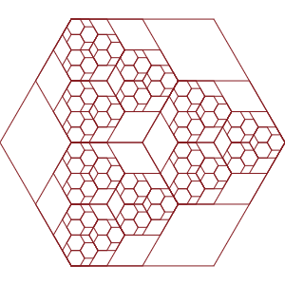
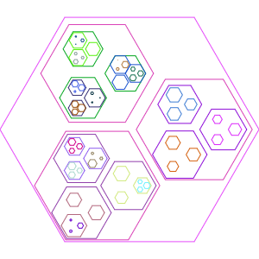
About my self | What new I learned | What I liked the most
Notes:
To show you what i liked about recursion, i would like to show you the development of one code. In it we had to draw a hexagon fractal. I already had a way to draw one, or draw many in a specific shape, but did’t know how to do fractal. After i managed how to draw it i figured i want to have differetn color, for all the hexagon i drawed at the same time. I already have a random color generator function. All I had to do to use the code at the right place. So i did that to, and it was a little bit fun. After i that i decided to make the whole draw animated. For that i cant show you picture. Later that i chanced the code so it would draw the inner hexgon in different size.

