Slide 1
Sz. Kis László

Slide 2
About me
Learned: BME KSK
C# and SQL
Worked: Ghibli Kft: Assistant
Freight Forwarding Manager
Learned excel and VBA
Notes:
Learnd at BME with KSK faculty, and warehouse managemant major
Worked at Ghibli Kft. for two years as assistant, and freight forwarding manager
Learned excel and VBA by myself during this time
Learned C# and SQL in the last half year

Slide 3
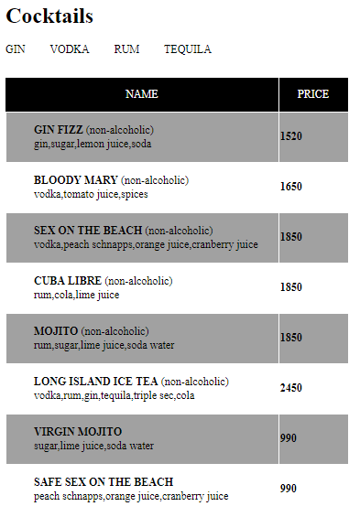
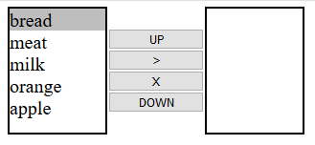
Things that I learned this week
CSS
DOM
Templating

Slide 4

Two task that made me enjoy this week

Slide 5
Thank you for your attention
Find me on Github, and LinkedIn:
https://github.com/Eszkis
https://www.linkedin.com/in/sz-kis-l%C3%A1szl%C3%B3-84836a177/

