Slide 1
Week 4 Demo
Jeffery

Slide 2
Review
HTTP protocol
MVC pattern
Razor templates
Dependency Injection

Slide 3
Issues
Why we use MVC?
Using ViewModel
Controller & View association
What is Dependency Injection?
Redirection
For using static files like image, HTML, CSS and JavaScript app.UseStaticFiles() must be added.

Slide 4


Controller View Association

Slide 5

Controller View Association

Slide 6
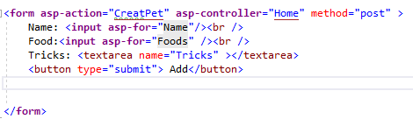
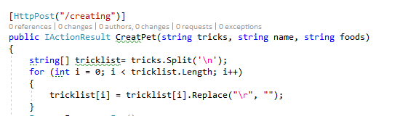
Controller View Association

Slide 7
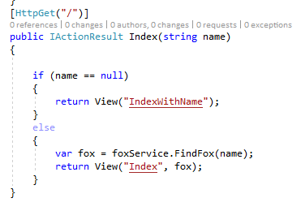
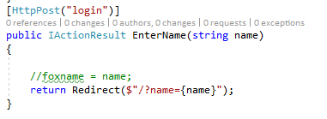
Redirection

Slide 8
Thank you !

