Slide 1
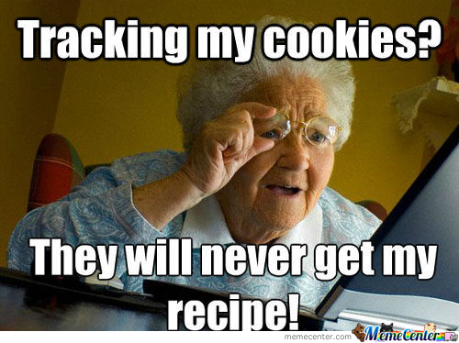
Internet Cookie

Slide 2
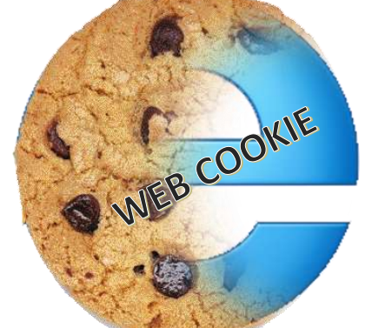
History of Cookie
Inventor:
Lou Montulli (a very famous web browser programmer) in 1994.
The name:
The term cookie is derived from the word ” magic cookie” which is a packet of data a program receives and sends back unchanged, used by Unix programmers
Purpose:
To provide solution to the issue of implementing a virtual shopping cart in a e-commerce application.

Slide 3
Web without Cookies
Let’s have a look at what the Internet world is like without cookies

Slide 4
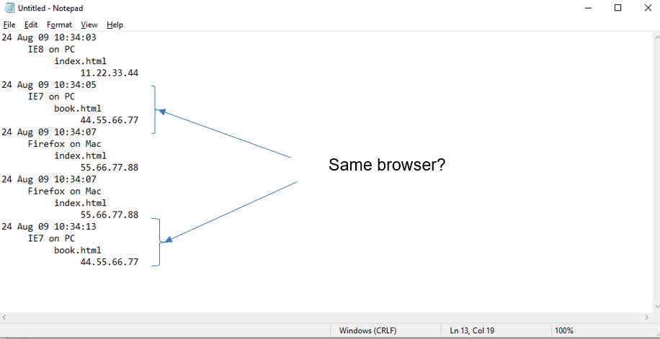
Log massages

Slide 5
Cookie contents
Number of pages viewed.
Subscription form already has been displayed.
File name of shopping cart items.
Personal name or ID.
Search term used to find the page
.

Slide 6
How does it work

Slide 7

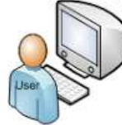

Browser
The server will be able to identify and track user’s browsing habits to effectively deliver a personalize content.
User
Server
Notes:
Whenever we are visiting a website for the 1st time it stores our personal preferences in our web browser on a cookie. • On the 2nd time when we visit the same website there is no need to provide the details again as the website can remember our preferences through the cookies. • The web browser on the 2nd visiting sends the stored cookies back to the only related server to notify user’s previous activity

Slide 8
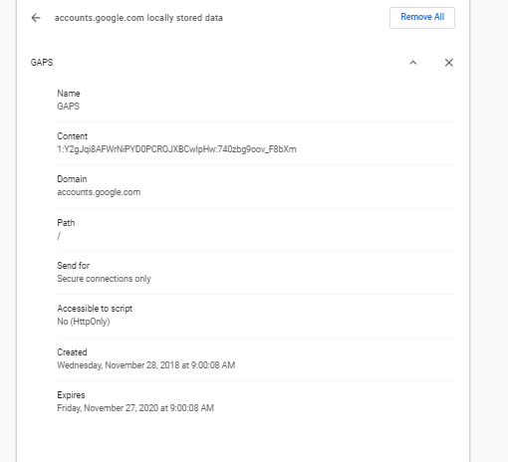

Slide 9
How Cookies are used?
Shopping
Log ins
Ad tracking
Personalization

Slide 10
Thank you !

