Slide 1
EPAM .NET ACADEMY Demo3 by Jeffery

Slide 2
1.
About what I learned.
Abstract & Interface
Abstract
Interface
GC & Dispose Pattern
Managed & Unmanaged Memory
Implementing “Dispose”
Struct & Generics
xUnit & Automated Testing
Fact
Theory
Notes:
An abstract class is a special class that contains both abstract and non-abstract members in it. A class can only inherit from one abstract Class.
We cannot create object of an abstract class.
Interface contains only abstract methods.
We cannot create object of an interface.
The default scope for a member in Interface is Public. So, no need to use the Public access specifier in the program.
NOTE - In case of multiple inheritance, use Interface.

Slide 3
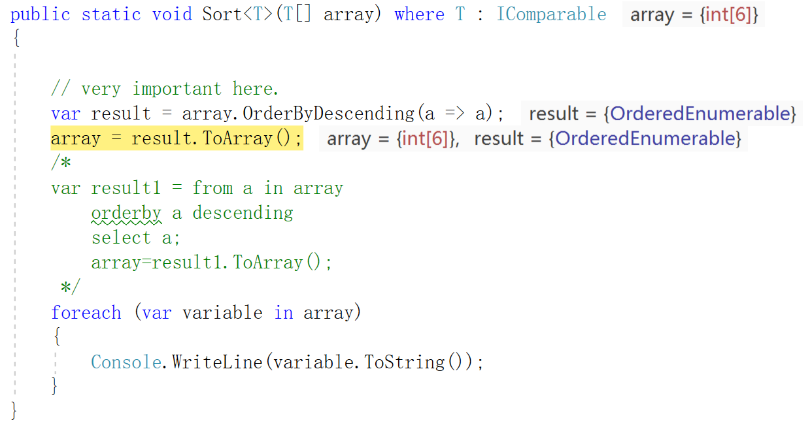
Linq Query Operation
.
.

Slide 4
?.
What is a Query
Relational Database -> SQL(Structured Query Language)
XML -> XQuery
LINQ -> Various Data Source
Notes:
A query is an expression that retrieves data from a data source.
LINQ simplifies this situation by offering a consistent model for working with data across various kinds of data sources and formats.

Slide 5
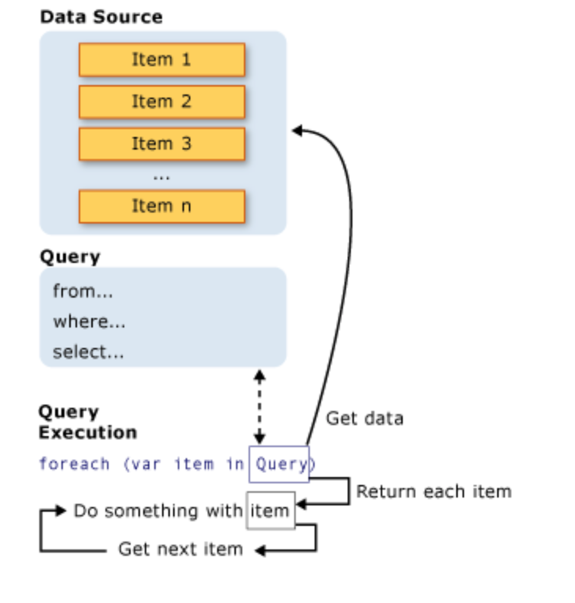
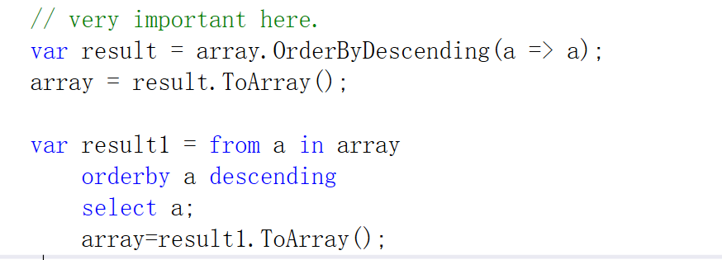
Data Source should support IEnumable Interface
Notes:
The query here is to manipulate this array with generic type, what it going to do here is to order the array itself by desensing
From command is to determin where the imformation coming from, this is coming from the array itself.
And going to be stored temperaly in a a variable.
Where command is to define condition that must be met to be able to put into the new collection result which is a orderedenumberable
Orderby command is to determine what data we are going to order by which way, decending or assending.
Select defines the varable which met these conditions, and generate a new collection. Which assign to the result varable.
All LINQ query operations consist of three distinct actions:
Obtain the data source.
Create the query.
Execute the query.
The data should support Ienumerable Interface;

Slide 6
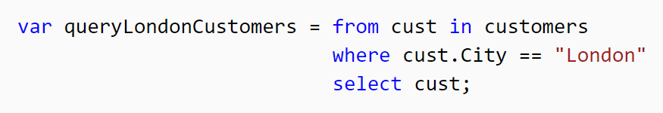
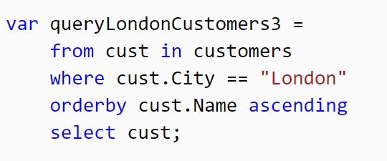
Filtering
Ordering
Etc..

Slide 7
THANKS!

