Slide 1
Demonstration
For 1st week
Reporter: Jeffery
EPAM .NET Academy

Slide 2
What I learned?
A fancy way to make my own Website (HTML & CSS).
Windows Operating System and PowerShell (Cmdlet & Pipeline)
Git & Github
C# Syntax & Vocabulary (≈ C++)
EPAM .NET Academy

Slide 3



Challenges
Totally new things ( HTML?? CSS?? PowerShell??????????????????????????????????????????????...)
Complex System Command.
Bad sleep..
EPAM .NET Academy

Slide 4
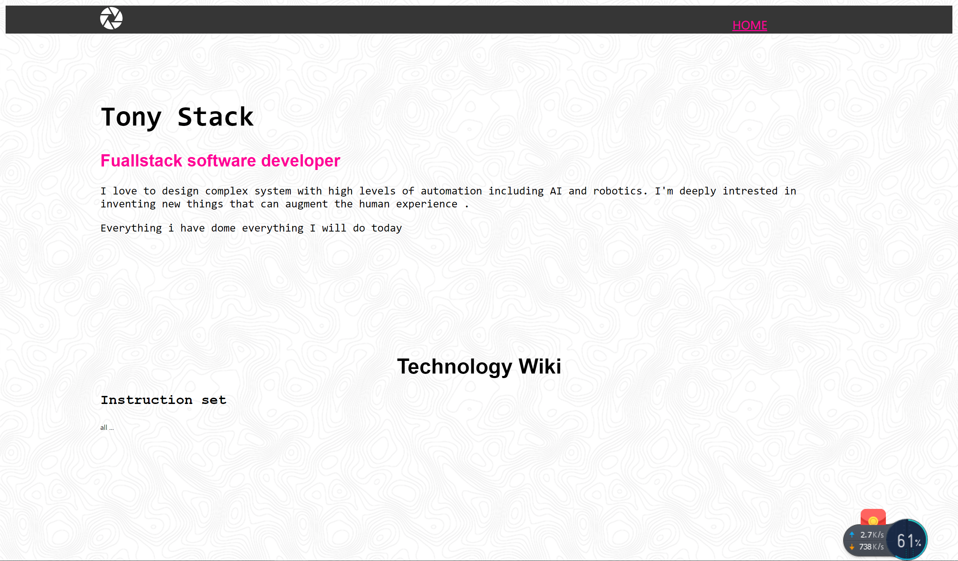


One hint to share

Slide 5
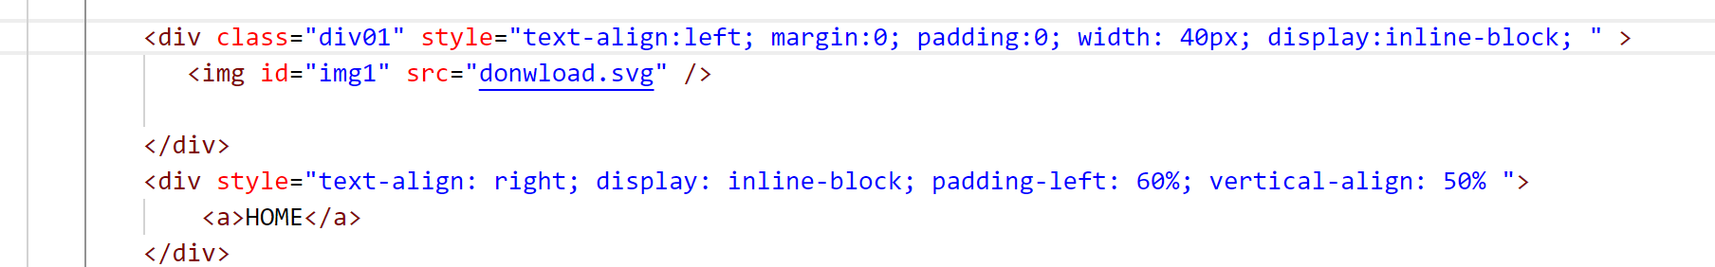

One hint to share

Slide 6
About EPAM
EPAM .NET Academy

Slide 7
Thank You!
EPAM .NET Academy

