Slide 1
art of GóréCode
Exhibition by: Keresztúri Péter
Github: Plonee

Slide 2
About the artist
26 years old
Marketing assistant and TQM expert
Likes music, movies, and video games
Dog person
Wine person
Favourite desert: caramell ice cream

Slide 3
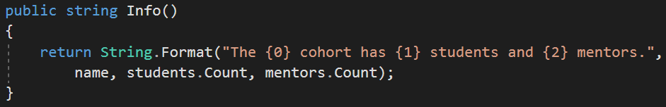
Inheritance room
Inheritance
String.Format()

Slide 4
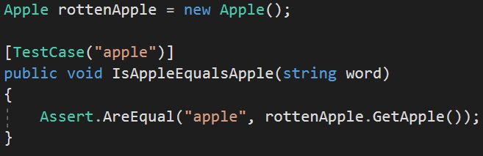
Hall of Test
NUnit
Testing

Slide 5
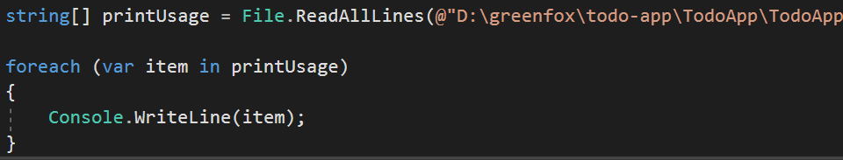
Corridor of the To do application
Console
csc Program.cs
Program.exe

Slide 6
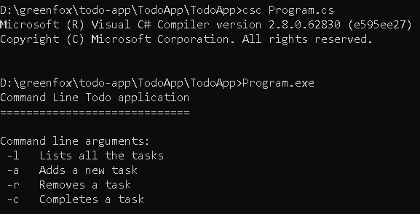
Written in console

Slide 7
Summary
Concentrate
Commit more
Practice, practice, practice
Don’t get upset, keep cool
Push it to the limit for the EXAM!

Slide 8

Good bye!
Thank you

