Slide 1
Deep/Dark web
Keresztúri Péter
Github: Plonee

Slide 2

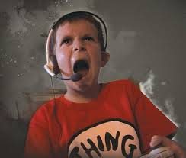
Has this ever happened to you?
TROLLS
12 year olds

Slide 3



Or this?
Drugs
Guns
Hookers

Slide 4
Up next on what not to do if you don’t want to scar yourself:
What is deep & dark web
How to access it
Tor browser
Most popular websites

Slide 5
DEEP WEB VS DARK WEB
Deep web
Dark web
The deep web refers to anything you can’t access in a search engine, either because it’s protected behind a password or because it’s buried deep within a regular website.
The dark web is a subsection of the deep web that you can only access with a special browser like Tor to mask your IP address. It includes illegal markets along with plenty of other less-objectionable websites.

Slide 6
DEEP / DARK WEB FACTS
The Deep Web contains 7.500 terabytes of information
Currency is Bitcoin
Buy credit cards details for pennies
80% of web traffic on the Deep Web relates to child pornography
A hitman’s price: Ordinary person – 20.000 euro
High-rank Govt. official – 100.000 euro
The Deep Web is a great source of illegal smuggling of drugs, weapons, human trafficking etc.

Slide 7

TOR BROWSER
Firefox based
Distributed network of relays
Anonymity
Access sites which are blocked

Slide 8
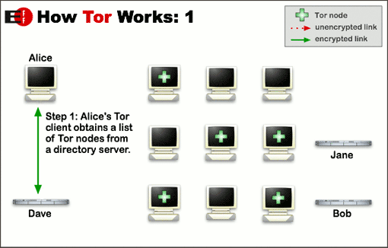

Slide 9
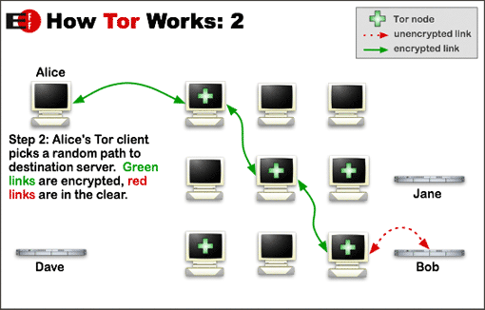

Slide 10
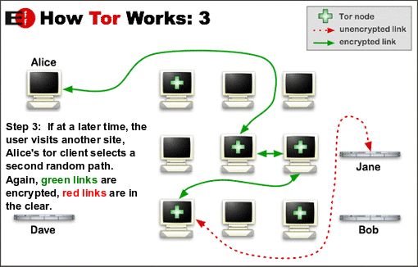

Slide 11


Search engines
Torch:
One of the biggest
DuckDuckGo:
Official engine of Tor

Slide 12

HIDDEN WIKI
Starting point
Contains links to all of the most popular sites
Also have a site on the clear net
Regularly updated

Slide 13

Silk Road 3.0
Online black market
Ever growing
Guns, drugs, „services”
Pay with Bitcoin
~10 000 products
70% smuggled

Slide 14
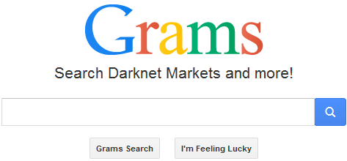
GRAMS
Buy drugs
Most relevant listings from all marketplaces
Bitcoin or real money
No meeting needed

Slide 15

WIKI LEAKS
Created by Julian Assange
Leak important data and information
High-profile government leaks
Upload anonymously

Slide 16
Thank you for your attention

