Slide 1

Peter Keresztúri and the case of the Orc Club
Github: Plonee

Slide 2



Info/References
26 years old
BGE Commercial & Marketing
Worked in pharma sector
Likes music, films, games
Been a detective for 42 years
Cases: Wanderer, Todo App

Slide 3
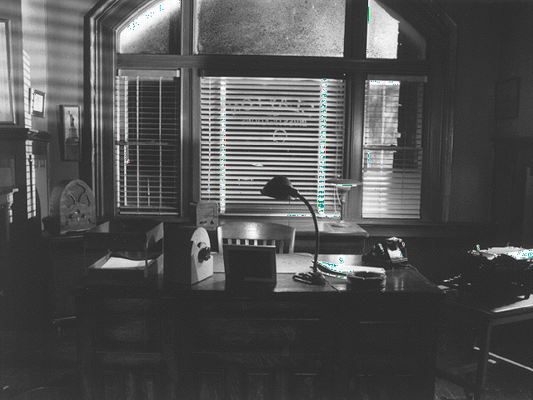
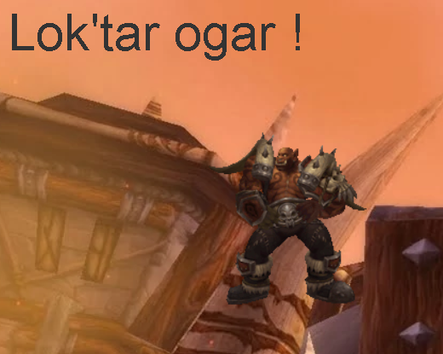
Orc Club

Slide 4
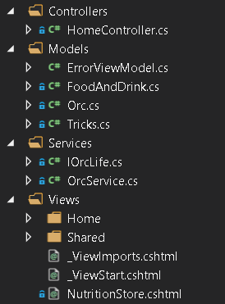
Classified

Slide 5
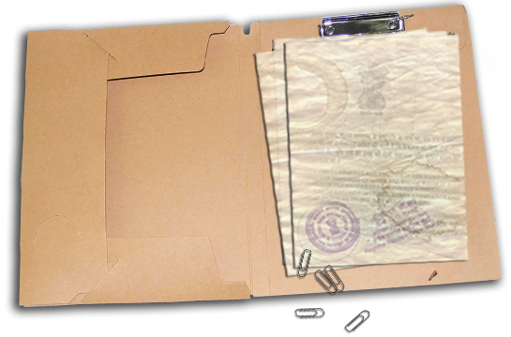
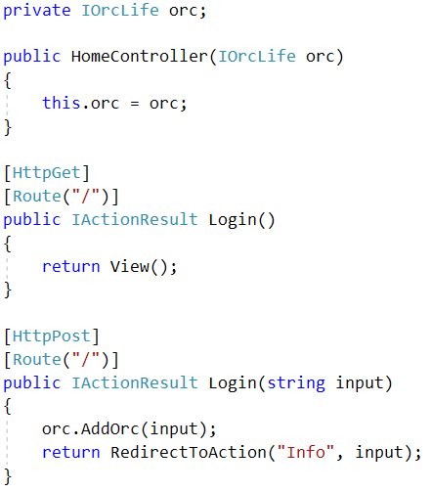
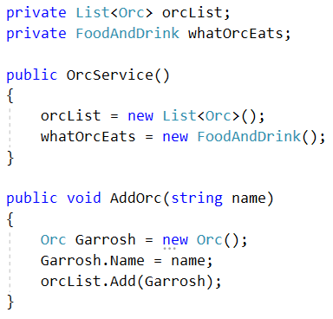


Slide 6
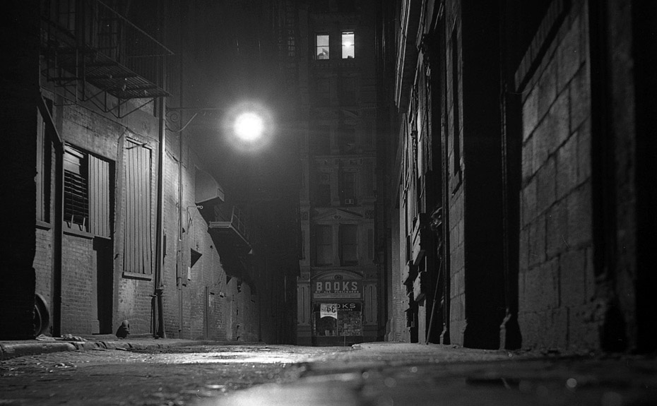
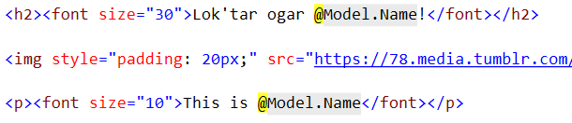

Slide 7

Andras89 repo

Slide 8
Conclusion
Understand the case as a whole
Draw your ideas
Code in small portions
Search the web
Never give up

Slide 9
Thank you for your attention!
Case closed

