Slide 1
Keresztúri Péter
Week 1 Demo

Slide 2

Topics and progress
HTML & CSS
Use of git & github
My progress in C#

Slide 3
Where I began
0

Slide 4
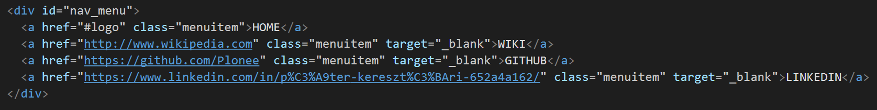
HTML & CSS
HTML:

Slide 5
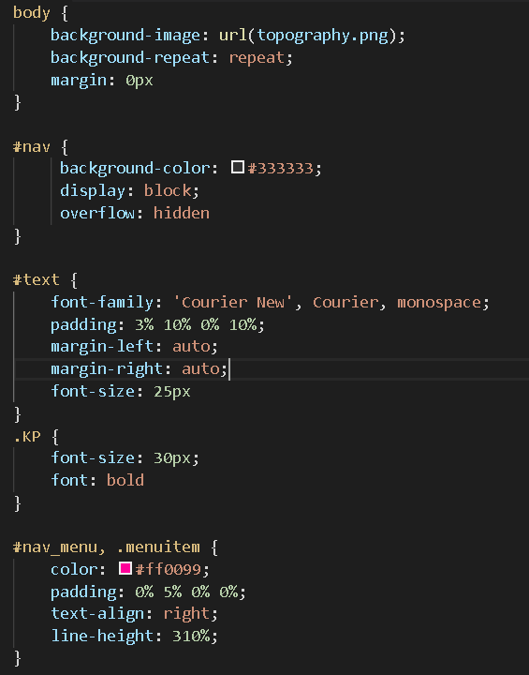
CSS:

Slide 6

Git & Github
Got the hang of it
Still etting used to it
Could help classmates

Slide 7
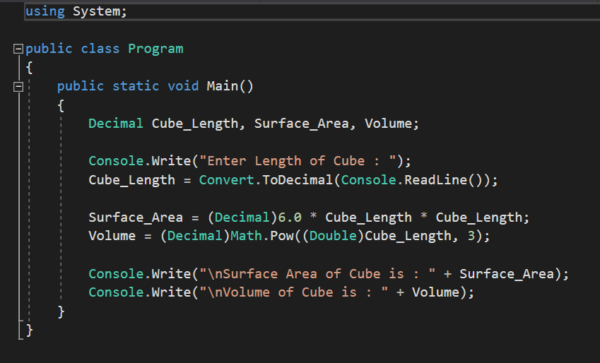
My progress in C#
Syntax
Declaring variables
If statements
For loops

Slide 8
Thank you!

