Slide 1
Super hexagon
Lotti Simon-Lamm
Green fox A4M, Week 10
14.01.2022.
LAMM.LOTTI@GMAIL.COM
+3620/5948060
HTTPS://GITHUB.COM/GREEN-FOX-ACADEMY/LOTTIL

Slide 2
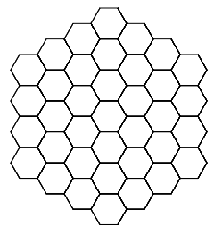
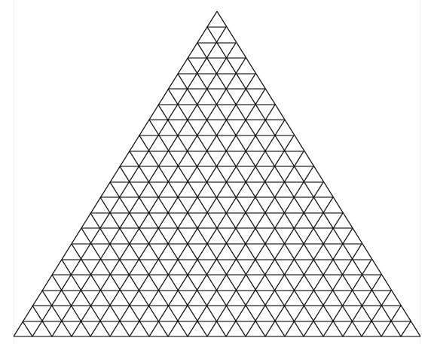
Super hexagon
Reproduce:
Why I choose this?
-I did not like drawing exercises (at first)
-Recognized, that I can reuse my codes
-When I see the Super Hexagon, I remembered
-then I remembered the „connect the dots”

Slide 3

How did I start?

Slide 4
How did I built my code?
-I had the connectTheDots function (from connect the dots)
I give coordinates, which need to be connected
-I had my drawLine function (from triangles)
I give the lineLength (how many hexagon is in one line), and the coordinates of starting point

Slide 5
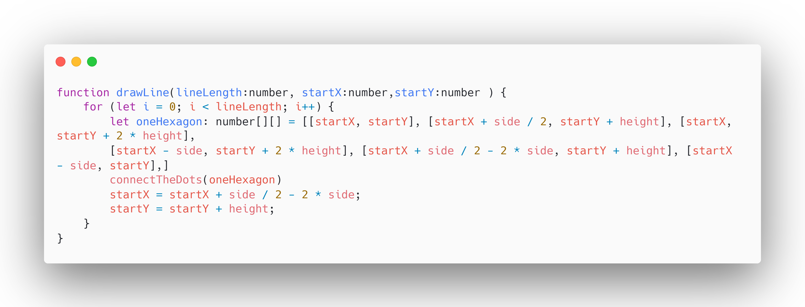
How did I built my code?

Slide 6
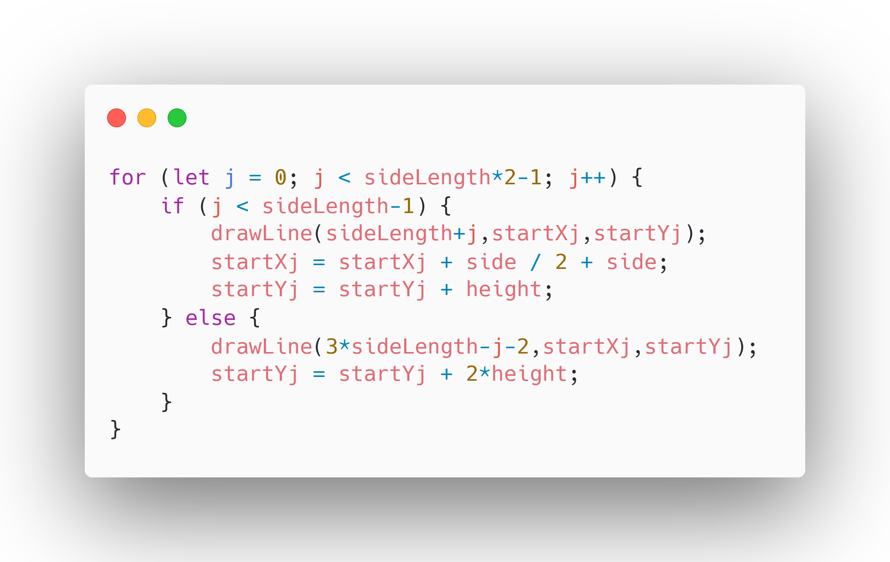
How did I built my code?

Slide 7
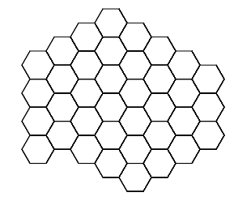
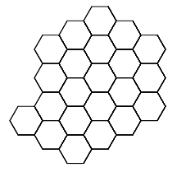
Problems
In else, I need to find out the formula for the linelength

Slide 8
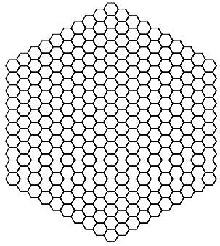
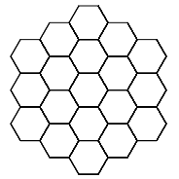

My „magic number”
sideLength+j-2*(j- sideLength +1)

Slide 9
Thank you for your attention!

