Slide 1
Bence Balazs Fulvipes Ocelot C#
First week demo

Slide 2
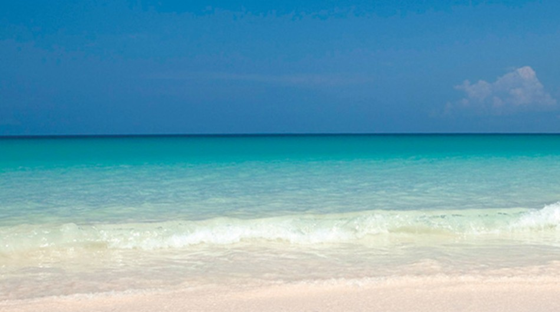
My main impression…

Slide 3
Html/css
Command line/github
C#

Slide 4
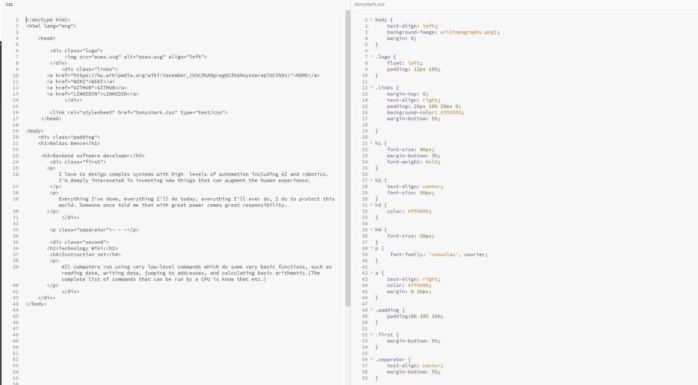

Slide 5
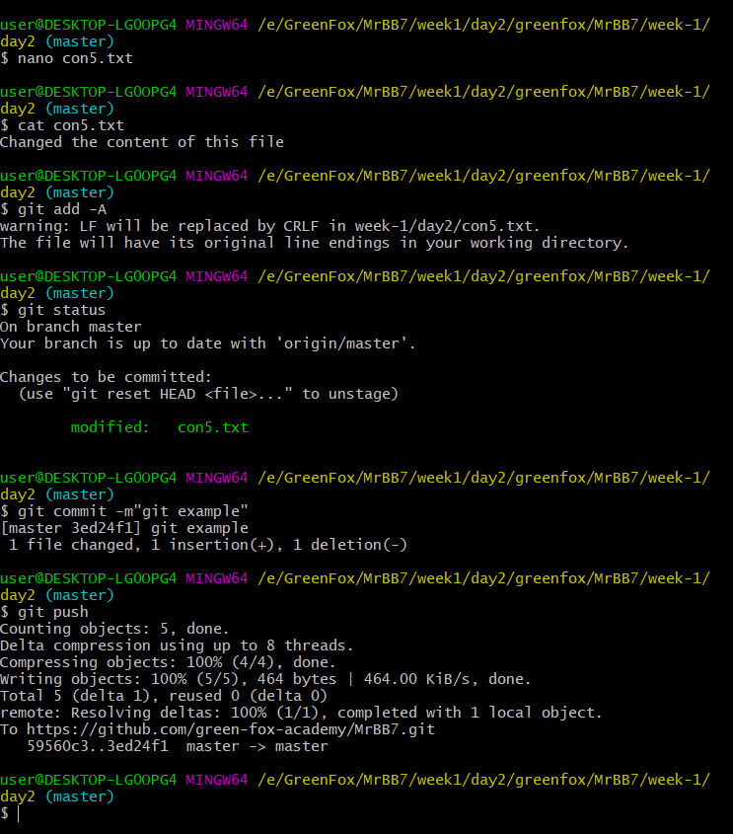


Slide 6
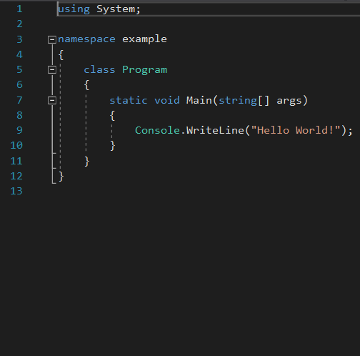
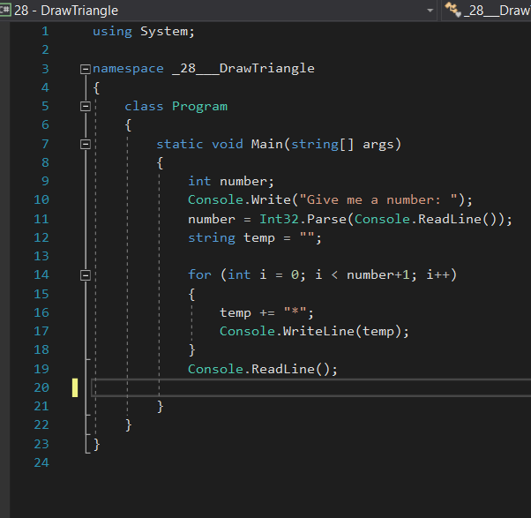

Slide 7

Have a nice weekend!

