Slide 1

VI –TH WEEK!
Kovács Gábor /Kovi/

Slide 2
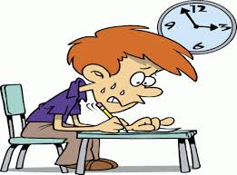
EXAM!
-- Sadness & Happiness --

Slide 3

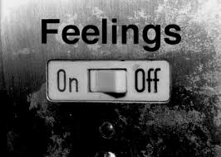
EXAM!
Mixed happiness with dissatisfied.

Slide 4
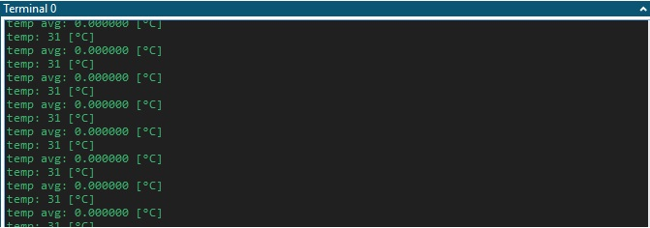
I2C !
When a dream come true.

Slide 5

Have a nice day!

