Slide 1

GFA - struggles of week 9
Gyula Rasztovich

Slide 2

Weekly review
Internet stuff - hmmm! It’s interesting!
TCP connect - hey! This starts to hurt!
multiple threads and multi-type servers…. hurts a lot!

Slide 3
Feels
Me: constant ++ for the methodology of the course, but…
it’s hard to start a project
its hard to find the exact, applycable answer – GIYF, but internet is huge, there are toooo much information out there…
header file implementions: cool, there are 1000+ lines of renamed typdefs of the renamed datastructures with uninterpretable function names – mehhhh… constant headache!

Slide 4
My goal
Understand basic operation principles,
beeing able to sketch a flowchart or make a list which contains the phases / main steps,
be able to find the necessary information alone,
understand stuff I implement in my code … (struct sockaddr)*&myserver …
develop my code in small but certain steps,
at first, focus on simplicity!
While coding, document as many hints and how-to’s as possible!

Slide 5
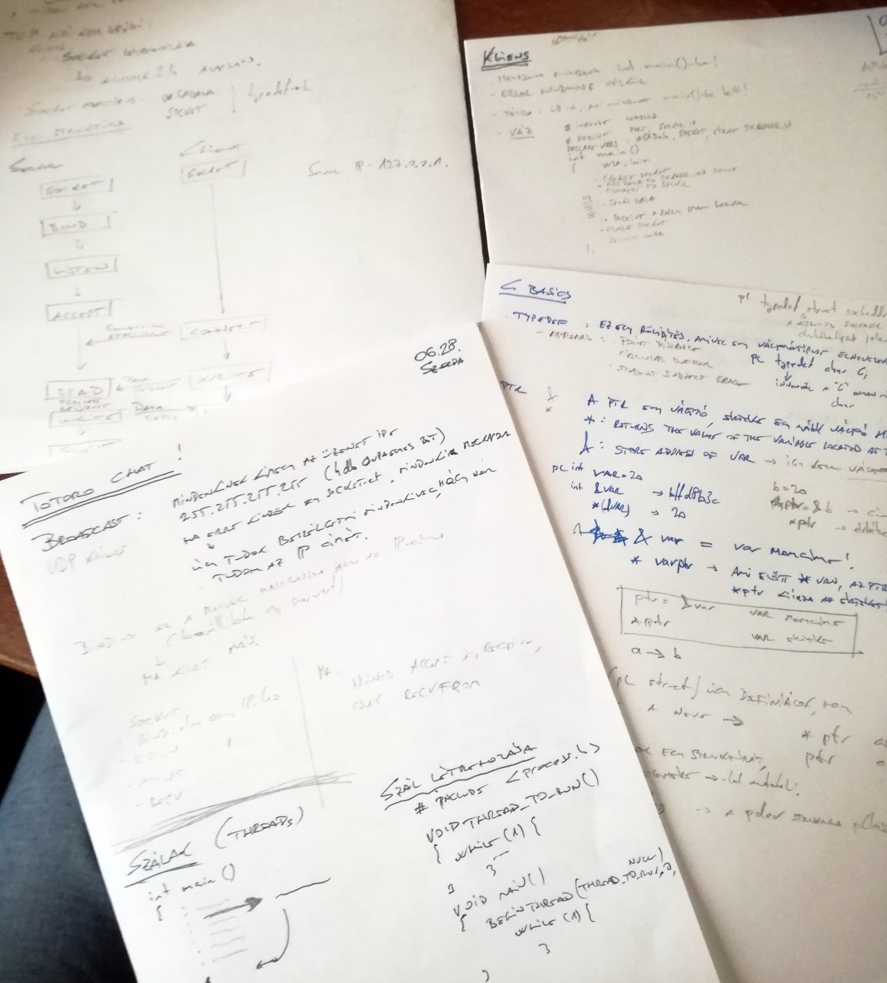
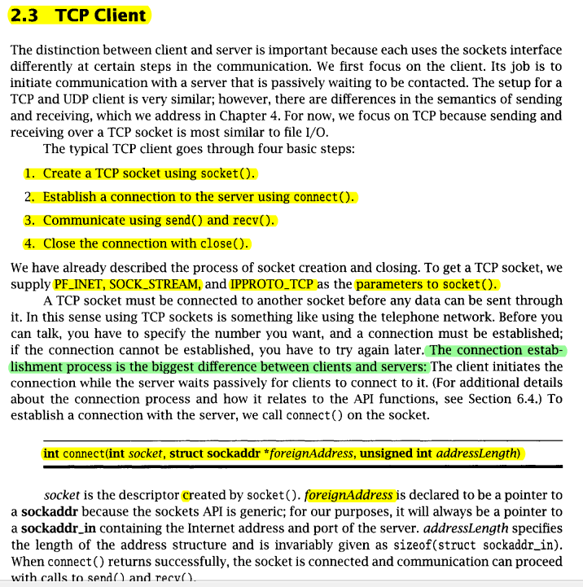
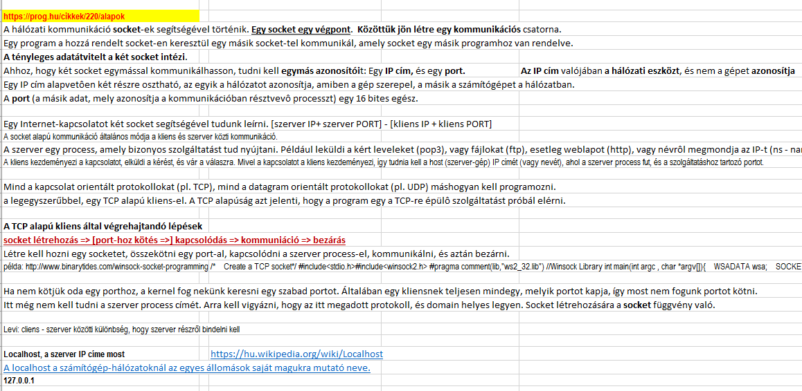
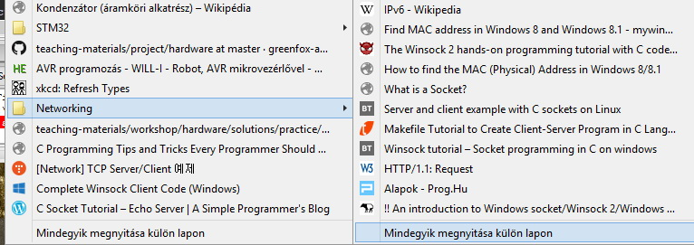
Notes and pre-design…

Slide 6
Short preview into my code comments…
Let’s take a short view in my code in Code::Blocks…

