Slide 1

GFA - after 5 weeks…
Gyula

Slide 2


Progress
successfully passed foundation exam – by 2nd try, but whatever…
basic programming skills improved significantly!
aaaaand…
that’s it.

Slide 3
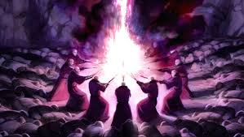
Project
not this time
after 3 weeks of full-throttle C programming, even finding the icon of AtmelStudio was a tough task
well, the I2C-temperature task seems like it should work well, but not.
dark sorcery kicks in again…

