Slide 1

GFA - 8 weeks of HW coding
Gyula Rasztovich

Slide 2

Brief
Introduction
Progress & results
A few closing thoughts

Slide 3
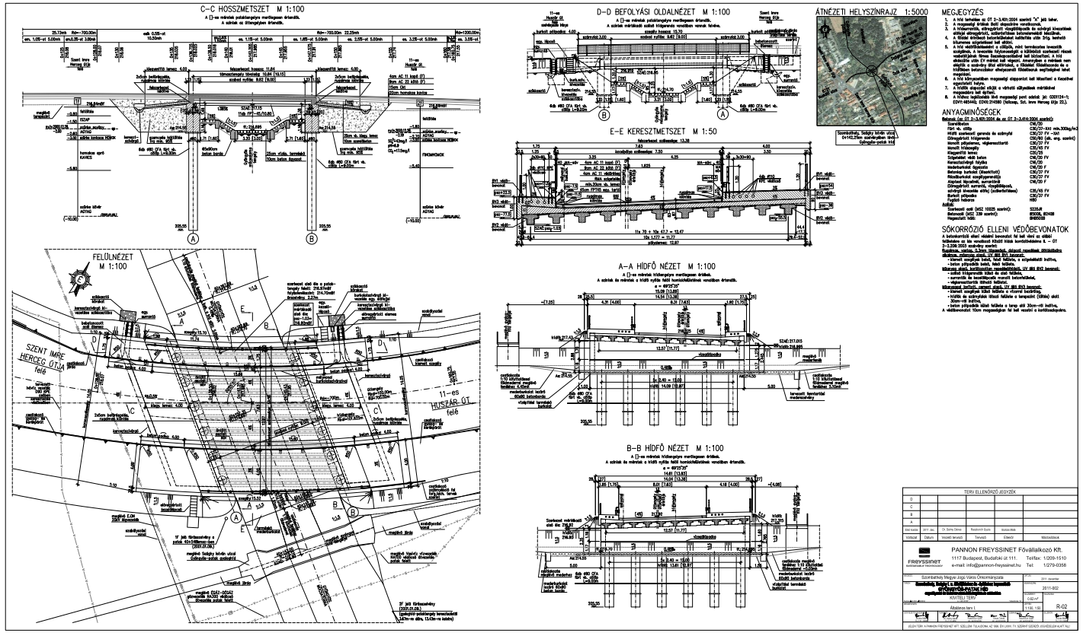
Introduction
MSc in Structural Engineering at Budapest University of Technology and Economics
Civil engineering experience – structure design, project preparation, site engineering, construction supervisioning, trading with construction products, bridge inspectioning and maintenance
No IT experience at all.

Slide 4
Progress – at start
Start level - 8 weeks ago:
zero experience in coding,
have never build a circuit,
haven’t ever worked with MCUs.

Slide 5
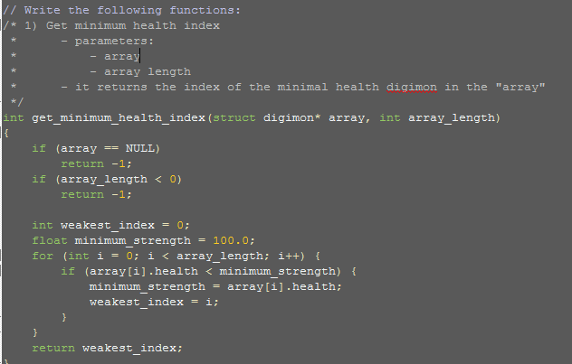
Progress – after 8 weeks
Acquire the basics and get deeper in C coding
basic algorithms, loops,
work with pointers,
handle data structures,
daily progress!

Slide 6
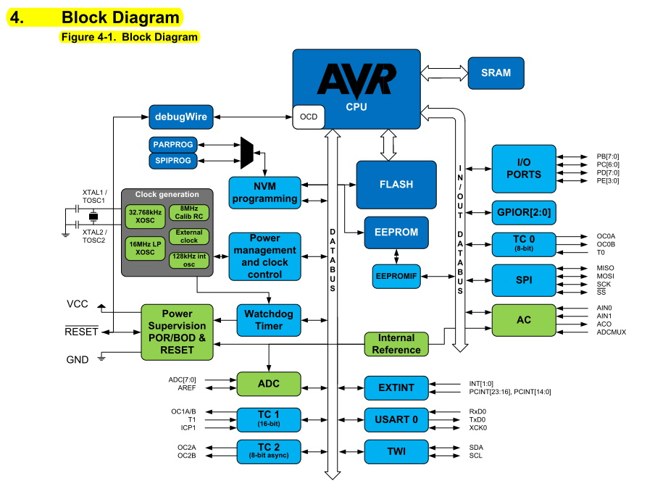

Progress – after 8 weeks
Getting familiar with coding MCUs
architecture of MCU,
operational principles, block diagram,
the way to find the necessary information - everything is in the Datasheet, - just look after it!

Slide 7
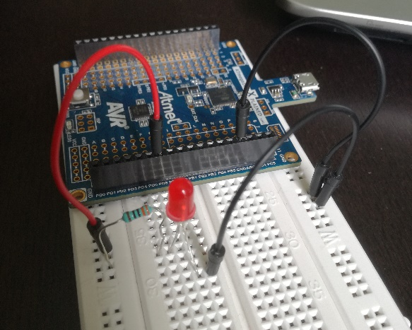
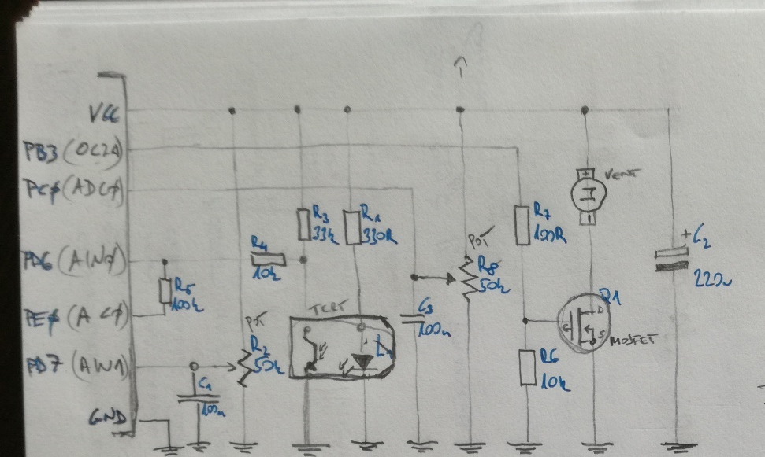
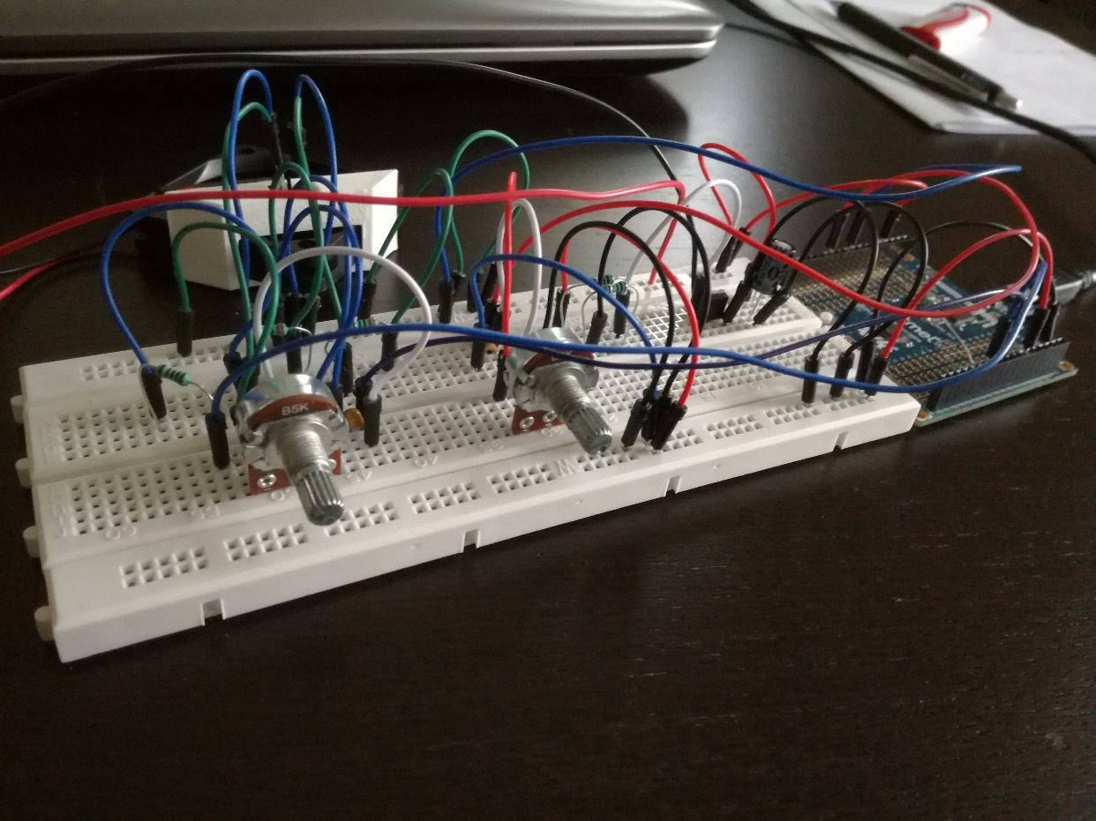
Progress – after 8 weeks
Getting familiar with coding MCUs
build up curciuts and code Atmel ATmega from easy tasks…
to quite complex hardware!

Slide 8
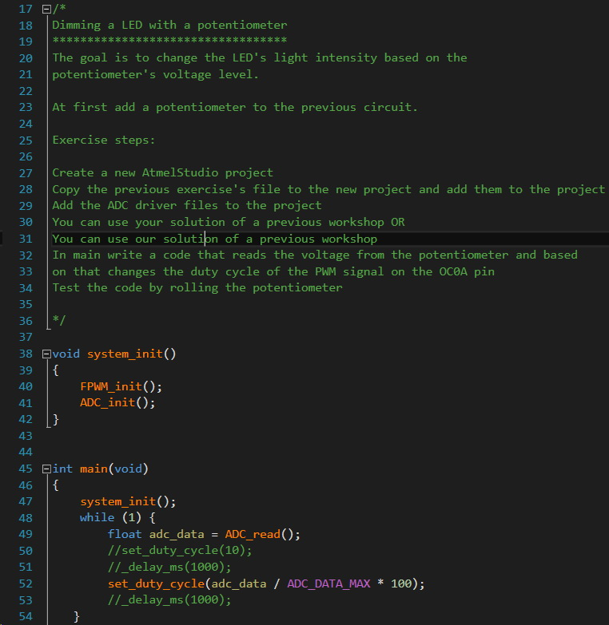
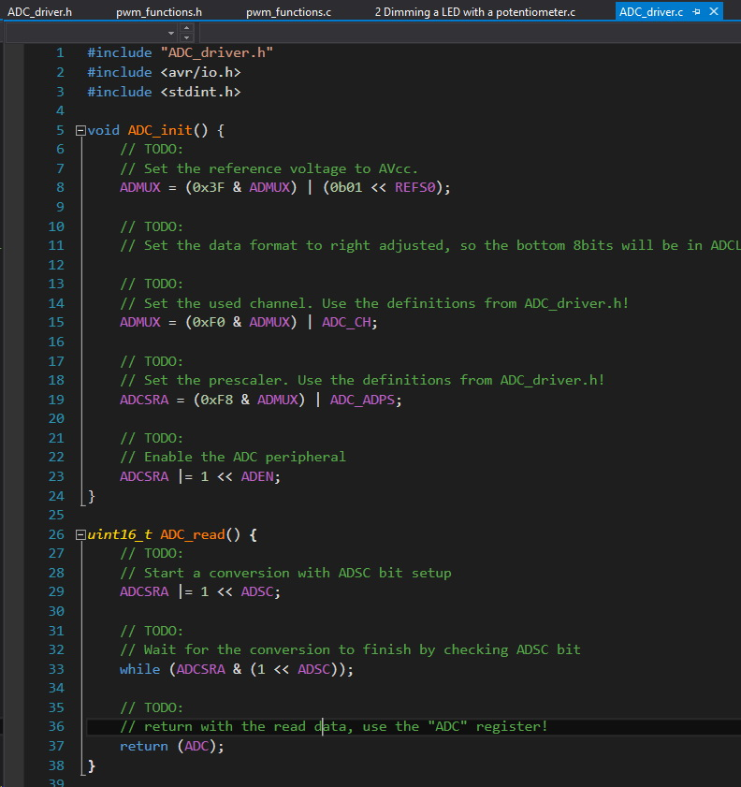
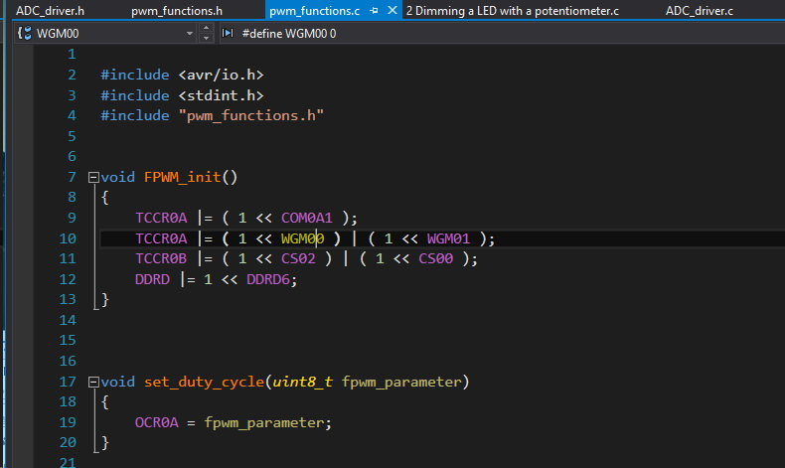
Progress – after 8 weeks
Atmega projects
blink a LED
timer interrupt
initializing pheripherals, such as UART, ADC, SPI, etc
complex projects:
oscilloscope
dimming a LED with potentiometer
thermometer
control a fan with PWM

Slide 9
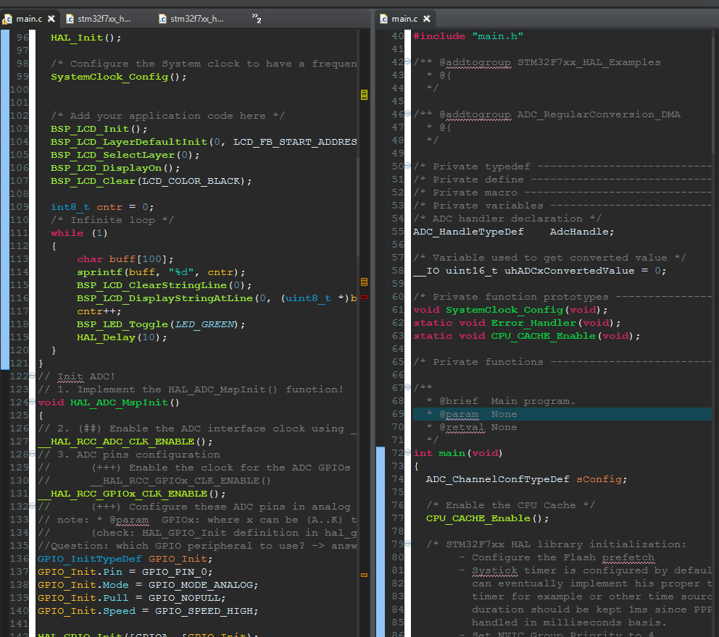
Progress – after 8 weeks
Just started to meet STM32F7 this week.
Getting friendly with its operation.
Struggle: longer and sliced datasheets – needs time to conform!
It is harder to find the needed information
But the answer is always inside the Getting started sheet / User manual / Datasheet / Reference manual,
or in an example code / HAL / BSP library..
new best friends: ctrl+space, ctrl+click, ctrl+f

Slide 10
Closing thoughts
We are learning interesting and useful things!
We are pushed to think hard and go on alone. but in the meanwhile our mentors are always supporting us.
Our learning methodology is similar like working in a workplace: be able to do your job alone, but ask a pro when you need.
There are so many opportunities in the future to connect previosly gained skills and freshly acquired junior-level coding skills!

Slide 11
Thank you for your attention!

