Slide 1

House price prediction
Ray Zhang

Slide 2
Process of my work
Data crawling
Data
pre-processing
Establish model
Get predicted result
Embed model into flask app
Show up result on the map

Slide 3
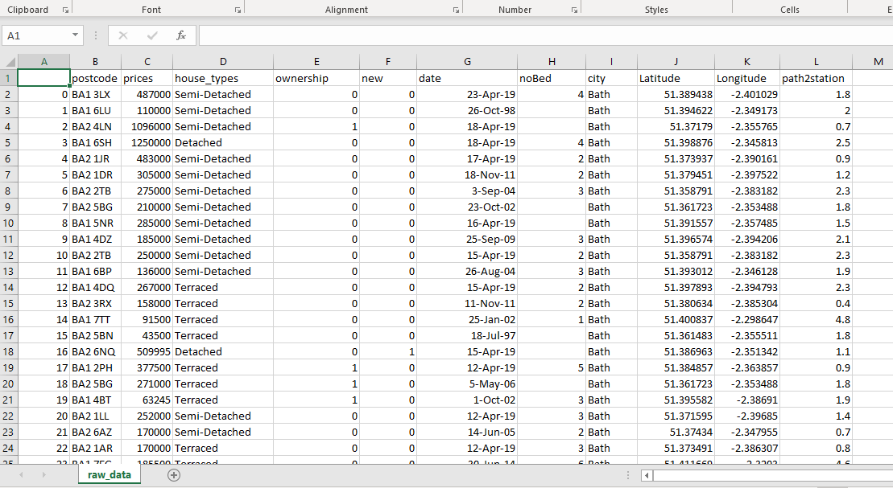
Raw data
Note:
Ownership: Freehold:1,Leasehold:2
New House:
Residential:0, Residential(New Build):1
NoBed :
Number of the bedrooms

Slide 4
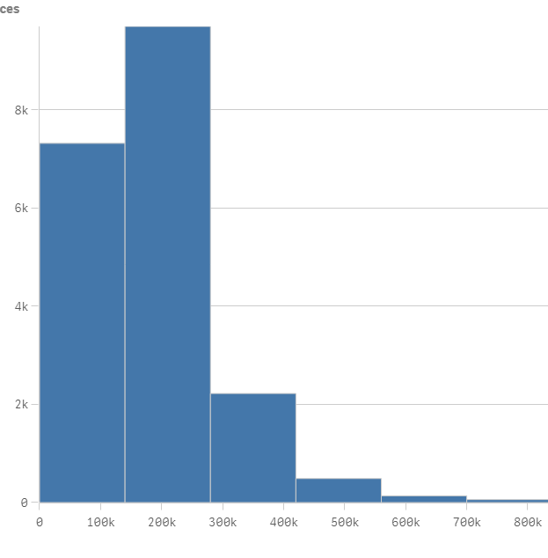
Raw Data analysis
The distribution of Prices

Slide 5
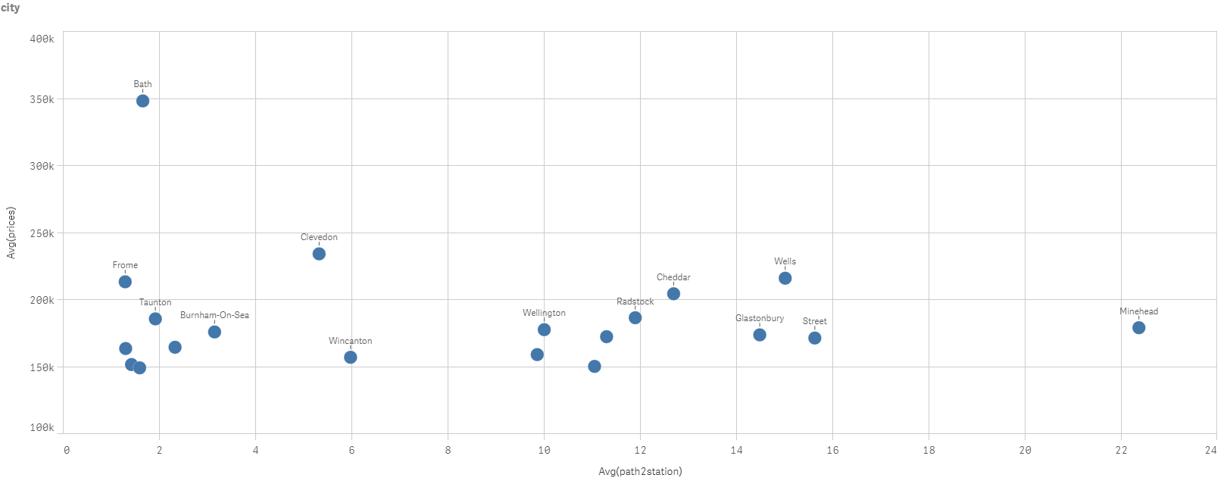

Slide 6
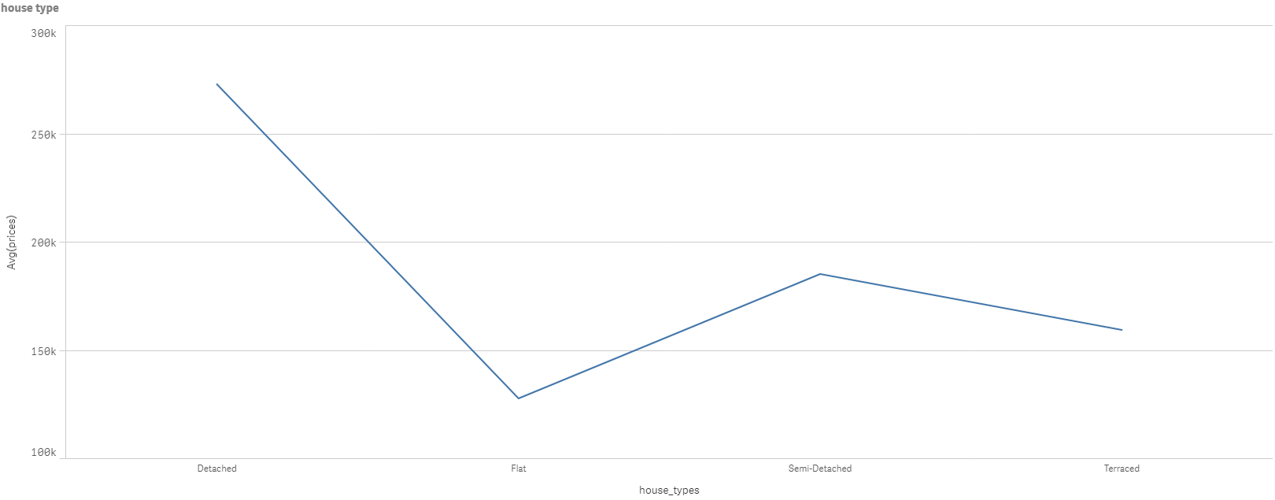

Slide 7
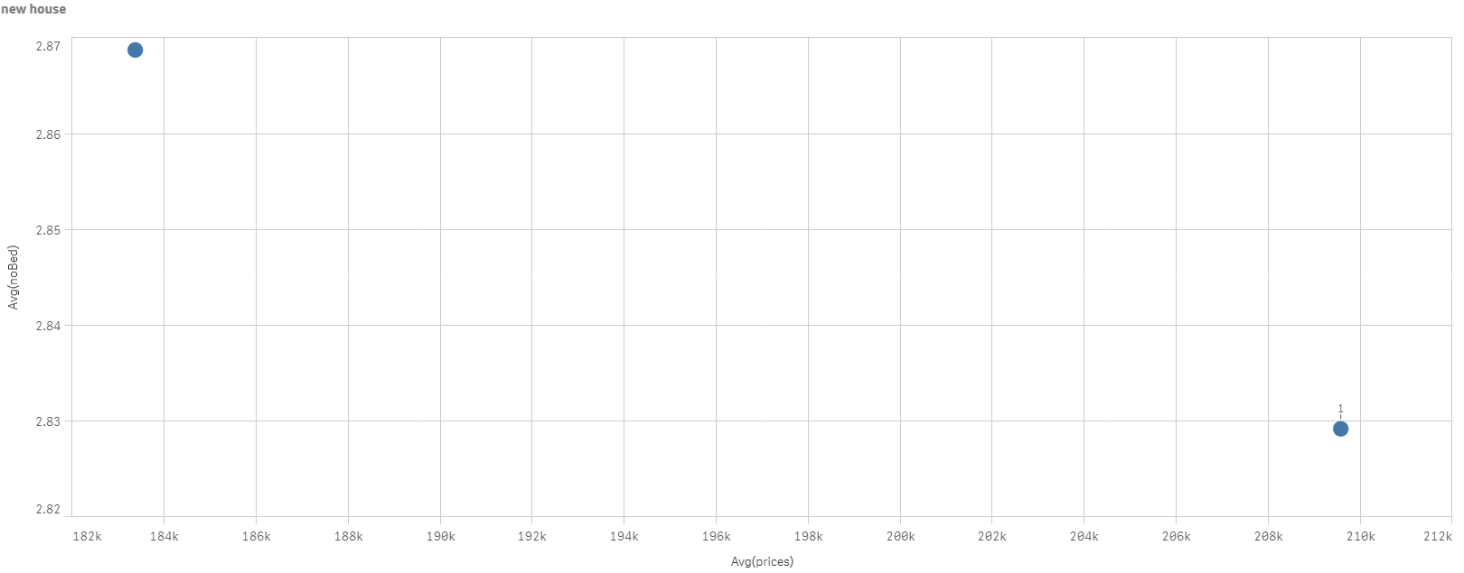

Slide 8
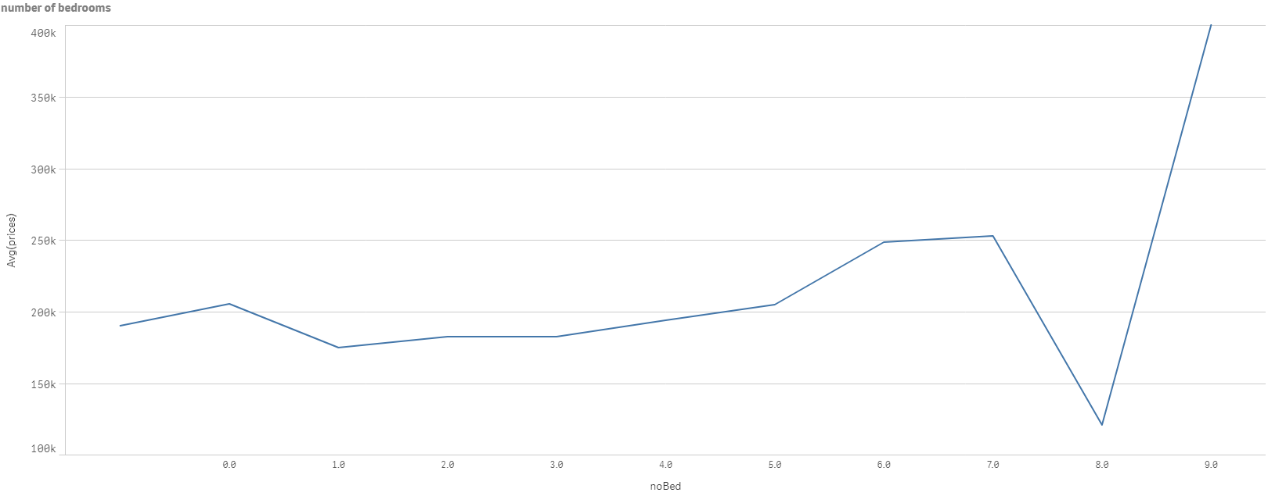

Slide 9
Model selection
Linear Regression

Slide 10
Demo:

Slide 11
Future work
1. Get more data on the real-estate website
2. Try others model
3. Add more information on data visualizing

Slide 12
THANK YOU

