Slide 1
Design patterns
Adam Bene

Slide 2
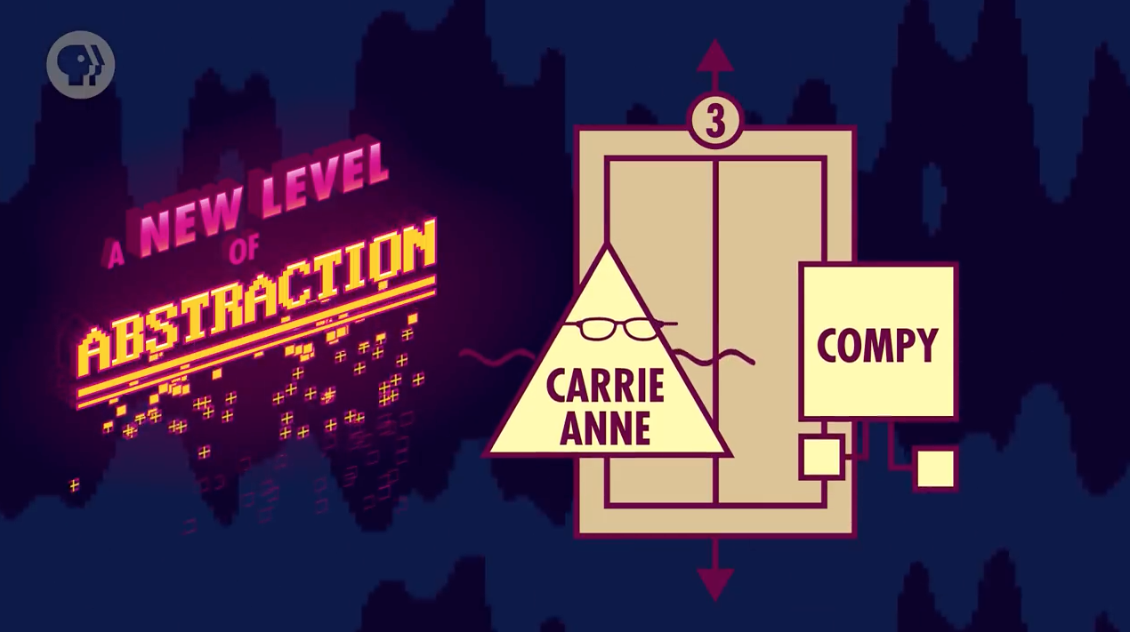

Slide 3
Definition
+ abstraction layer
Collection of best practices
For OO languages only
Usage
Countermeasure against subtle issues
Uniform approach

Slide 4
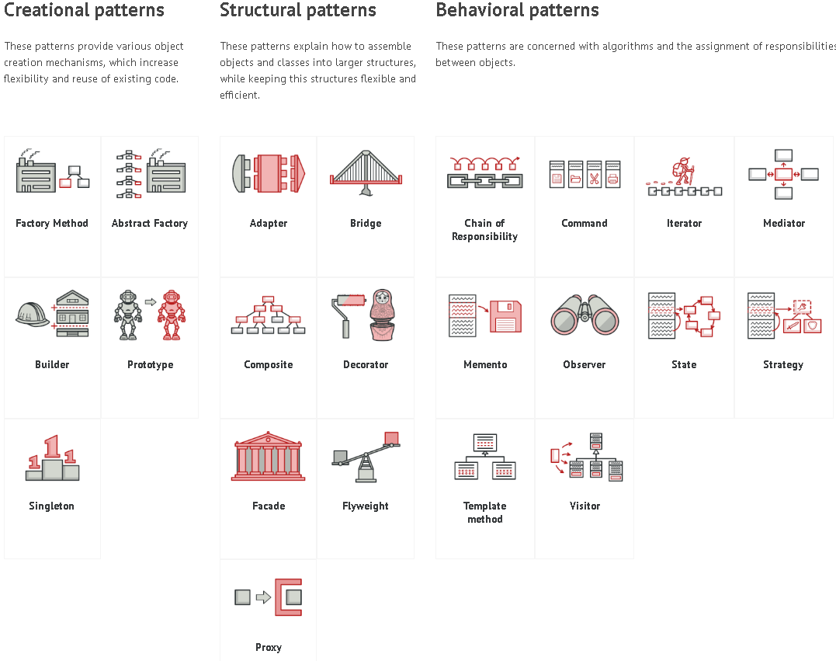

Slide 5


Slide 6
Our singleton
One class – one instance
Solves problems: -Unwanted access to shared resources -Difficult access to object -Unwanted overwriting of object

Slide 7
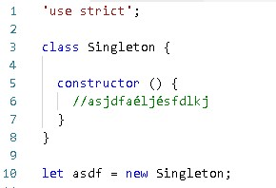

Slide 8
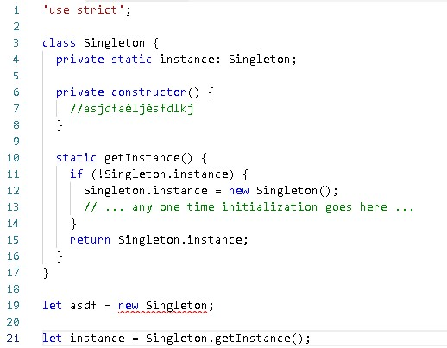

Slide 9
Criticism of design patterns
Undue usage -> too much complexity
Crutches for weak languages
Extra work

