Slide 1
Devops
Megalotis Devops team

Slide 2
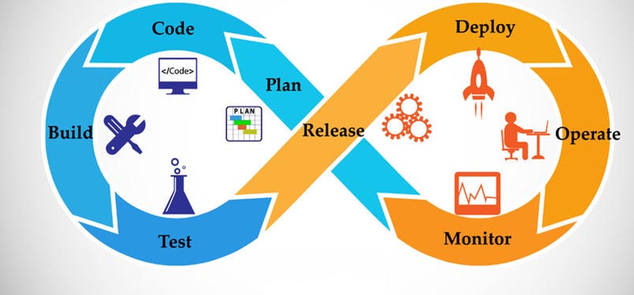
What is DevOps?

Slide 3
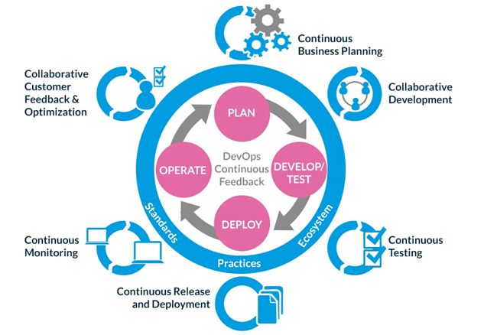

Slide 4
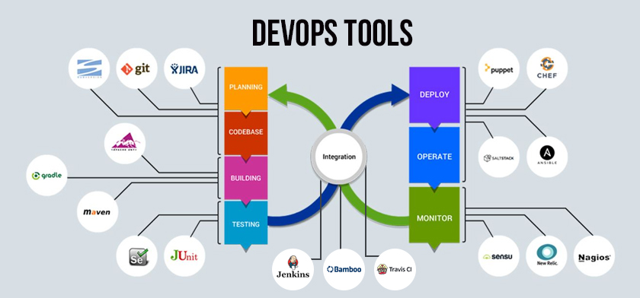
What kind of problems does a DevOps specialist solve?

Slide 5
What you need to know, what you skills you should have?
Patience: things WILL go wrong, troubleshooting is hard, documentation is sometimes hard to find
Diligence - you will have to write loooong documentations
Understand Linux
Understand how the internet works
Beefy computer

Slide 6
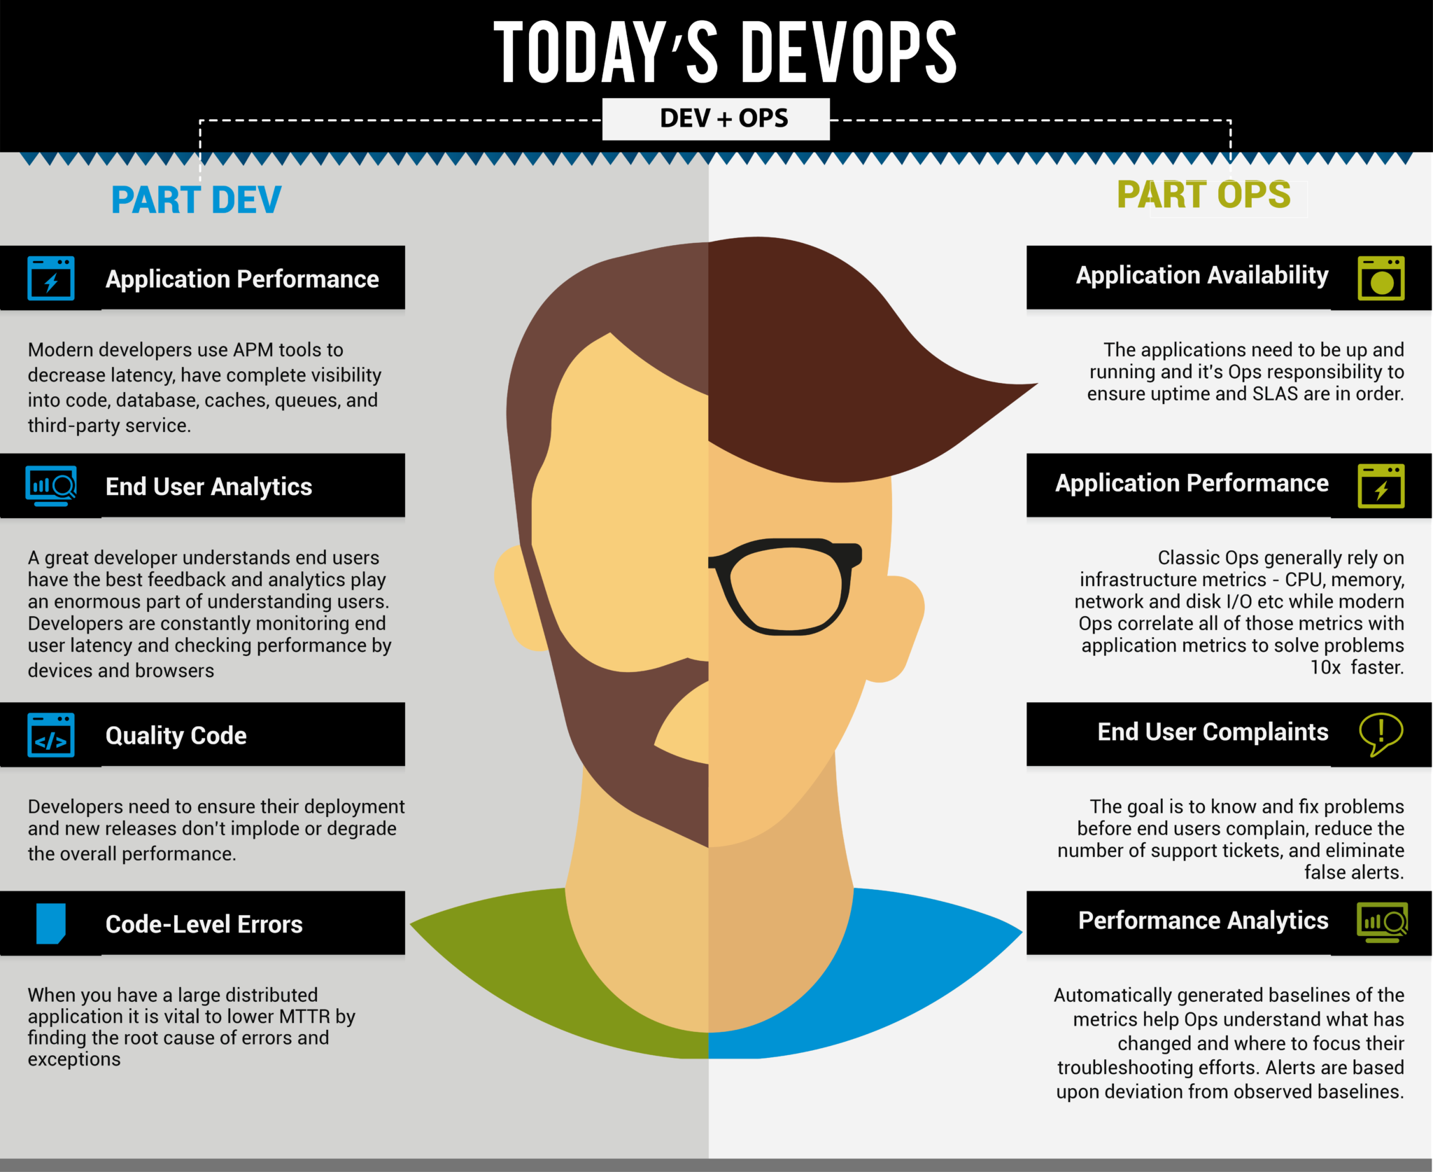

Slide 7


