Slide 1
WEEK 3 DEMO
Ági Rónay

Slide 2
Let’s see:
Previous 2 weeks
New things
Example
Struggles

Slide 3
Previous 2 weeks
(Waking up 5 times a week) ✓
{ } ✓
VSC errors ✓
Thinking before acting (and trying aimlessly..) ?✓

Slide 4

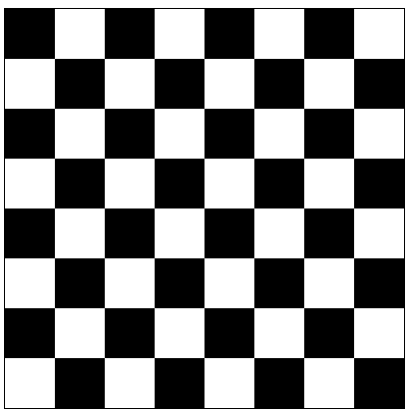
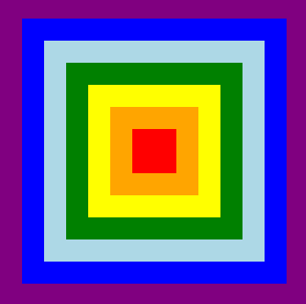
About the new things
Arrays, functions, drawing
Data structures, classes and objects💪
(FRACTALS?)

Slide 5

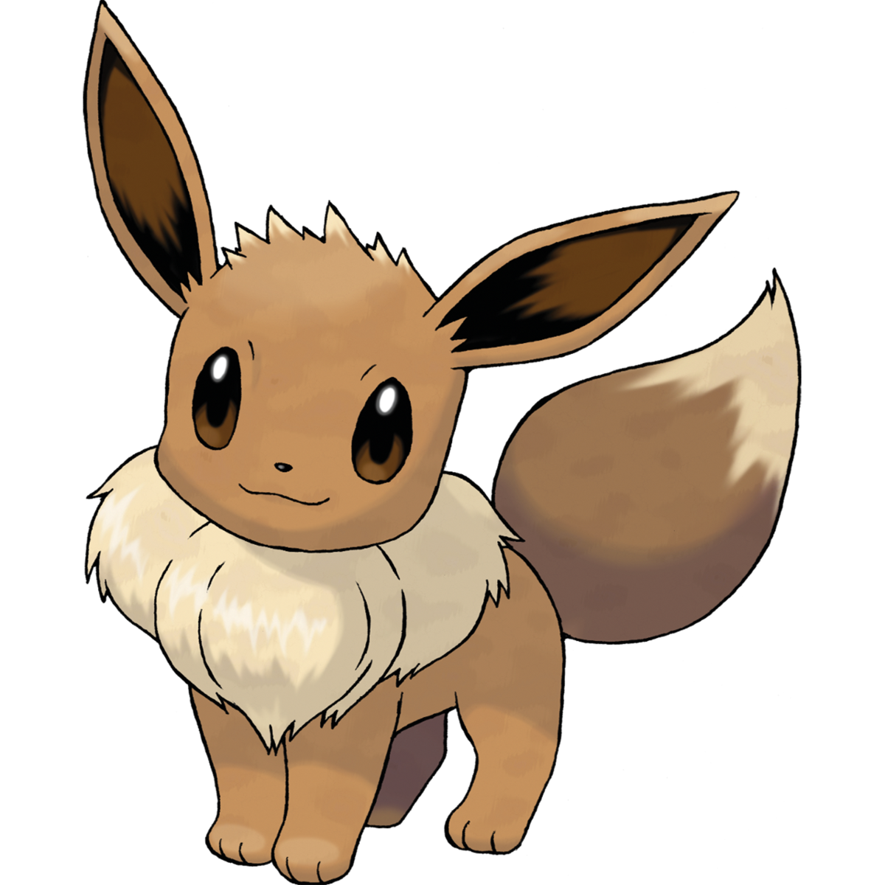
for (let i: number = 0; i <= pokemonOfAsh.length; i++) {
if (initializePokemon()[i].isEffectiveAgainst(wildPokemon)) {
console.log('I choose you ',initializePokemon()[i].name);
}
}

Slide 6
Struggles
Feeling behind
Unfinished tasks piling up
Prioritizing

Slide 7
Thank you! ☺

