Slide 1
Clean code chapter 1.
lightning talk by agi ronay

Slide 2
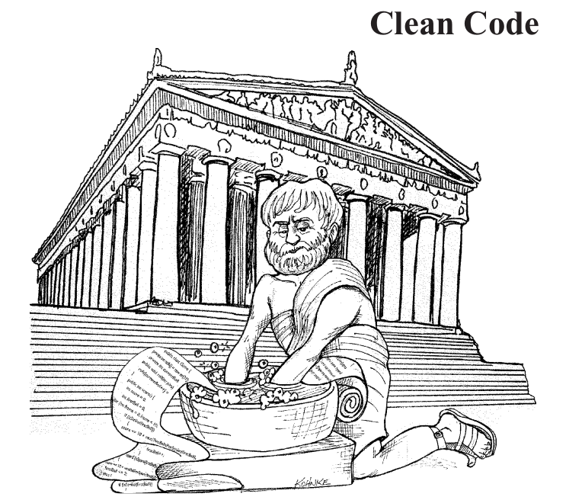
Clean.. What?
Book about good programming
Written by: Uncle Bob
TL;D(but you should)R
Notes:
He is a software engineer and instructor
He wrote (and co-wrote) several books
Currently he is operating 2 companies, Uncle Bob Consulting (consulting and training) and Clean Coders – online training

Slide 3
There will be code.. (Or not?)
Code is written
Programmers are needed
Code will be generated
Programmers won’t be needed
Notes:
DSL domain spesific language – HTML
Languages will become more specific

Slide 4
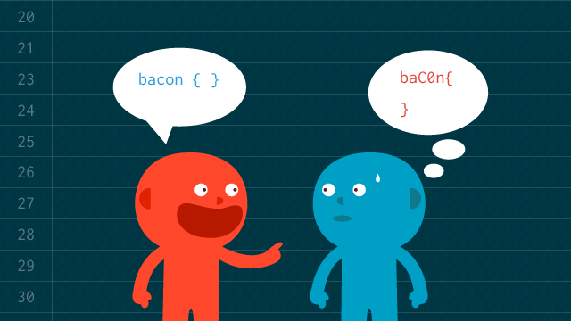
Bad code
Story
Working mess > nothing
Later = never
Notes:
The first outcome of a code is not perfect, it’s ugly, you put it together on the go
But you have a boss, you have a schedule, you have DEADLINES and you leave it like that. Ugly little code, which is bad

Slide 5
The total cost of owning a mess
Try to fix it
Make bad code
Messy code slows YOU down
YOUR messy code slows OTHERS down shame on you
Make it worse
Try to fix it
Notes:
If your code is already messy, and you have to go back to make changes, you might just make a bigger mess in the end, which is impossible to detangle → the team is stressed, they need help, more people get involved in the mess hired by mr.Boss, they won’t understand anything, everything is chaos and it repeats.. use SCRUM
you have to be the one who knows what you’re doing, you’re responsible, make your life easier by writing clean code

Slide 6

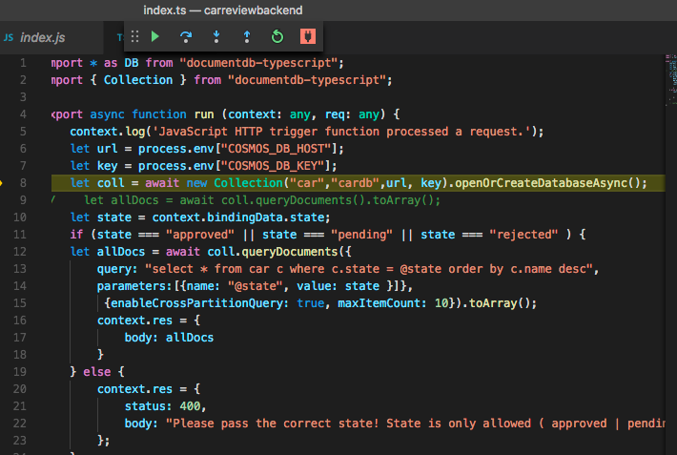

Writing clean code
„Code sense”
Notes:
You can tell whether a painting is nice or not – just like in clean code vs. Dirty code– but that doesn’t man you’re a great painter or clean coder!
This code-sense helps those blessed with it see how to apply the strategies of turning a dirty/bad/ew code into clean, beautiful system of code

Slide 7
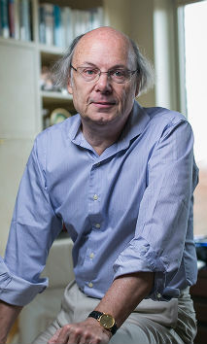
Bjarne Stroustrup
inventor of C++
„I like my code to be elegant and efficient. The logic should be straightforward to make it hard for bugs to hide, the dependencies minimal to ease maintenance, error handling complete according to an articulated strategy, and performance close to optimal so as not to tempt people to make the code messy with unprincipled optimizations. Clean code does one thing well.”
Notes:
Elegant – it should make you happy when you read it!
Complete error handling →attention to detail
One thing →bad code is bad because it wants to do many things, while clean code is focused and does what is has to do.

Slide 8
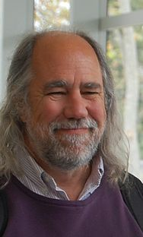
Grady Booch
author of Object Oriented Analysis
and Design with Applications
„Clean code is simple and direct. Clean code reads like well-written prose. Clean code never obscures the designer’s intent but rather is full of crisp abstractions and straightforward lines of control.”

Slide 9

Michael Feathers author of Working Effectively with Legacy Code
„I could list all of the qualities that I notice in clean code, but there is one overarching quality that leads to all of them. Clean code always looks like it was written by someone who cares. There is nothing obvious that you can do to make it better. All of those things were thought about by the code’s author, and if you try to imagine improvements, you’re led back to where you are, sitting in appreciation of the code someone left for you—code left by someone who cares deeply about the craft”

Slide 10
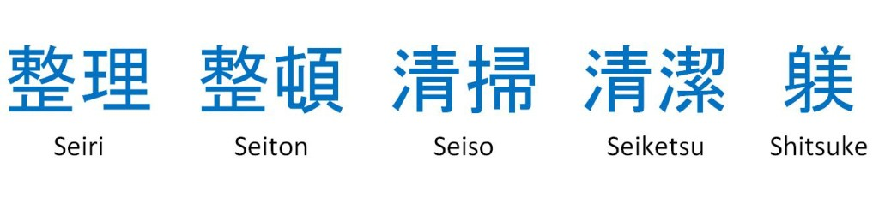
5s
Notes:
In about 1951, a quality approach called Total Productive Maintenance (TPM) came on the Japanese scene. Its focus is on maintenance rather than on production.
Seiri, or organization Knowing where things are—using approaches such as suitable naming—is crucial.
Seiton, or tidiness (think “systematize” in English). A piece of code should be where you expect to find it—and, if not, you should re-factor to get it there.
Seiso, or cleaning (think “shine” in English): Keep the workplace free of hanging wires, grease, scraps, and waste. What do the authors here say about littering your
code with comments and commented-out code lines that capture history or wishes for the future? Get rid of them.
Seiketsu, The group agrees about how to keep the workplace clean.
Shutsuke, or discipline (self-discipline).

Slide 11
Thank you! ☺

