Slide 1

First Demo at Greenfox Academy
What did we do on the first week?

Slide 2
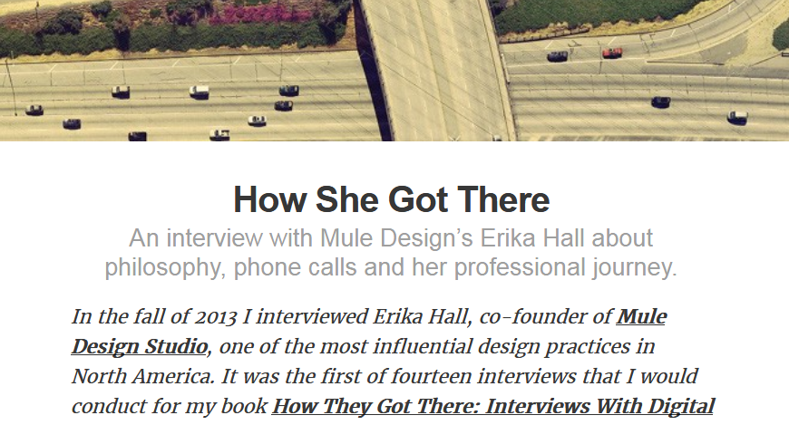
Introduction to HTML & CSS - in other words: How we got here

Slide 3
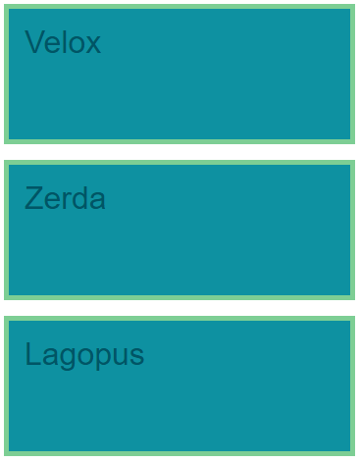
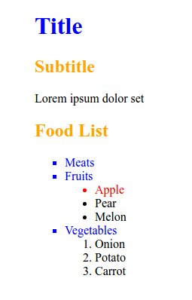
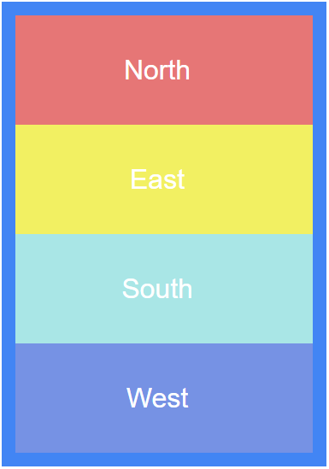
Digging a little deeper into CSS

Slide 4
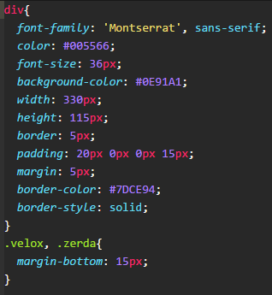
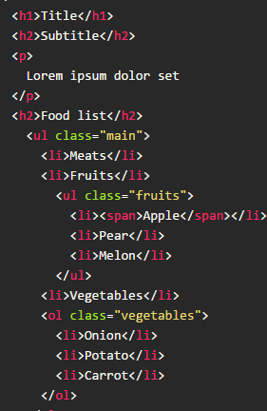
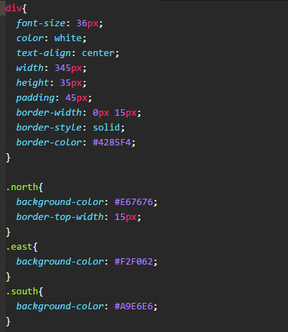
How did we do all this?

Slide 5

How did this all come together?

Slide 6
Thank you very much for your attention,
May the force be with us next week!

