Slide 1
DEMO
Frenkel Alex
Github: alexfrenkel92
10.01.2020

Slide 2
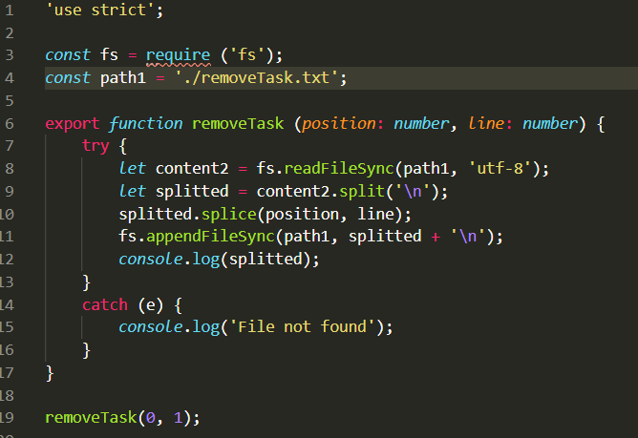
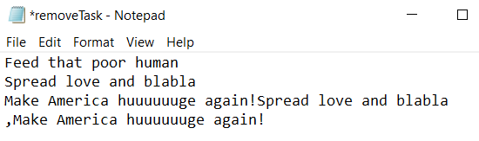
Remove Task exercise – not ready
99% good

Slide 3
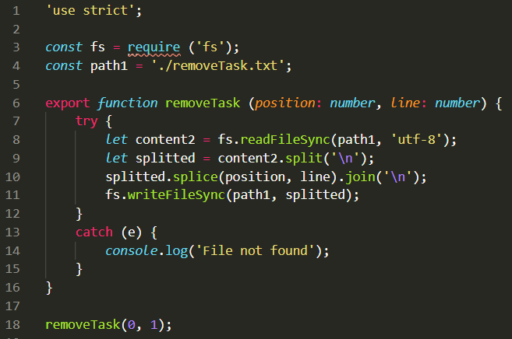
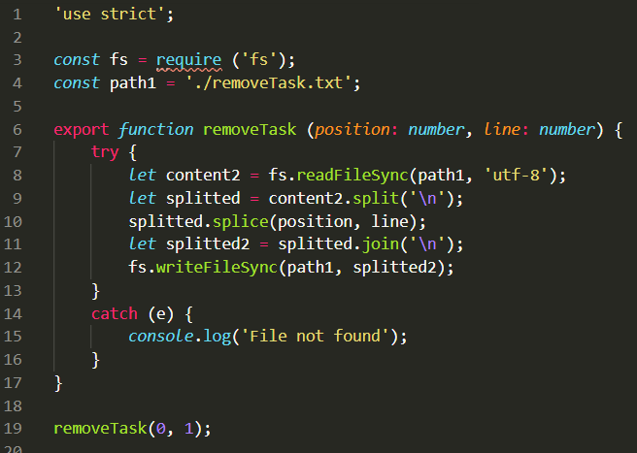
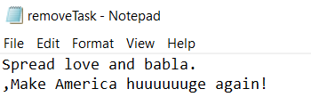
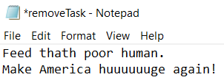
Remove Task exercise – not ready
99,5% good
100% good

