Slide 1
DEMO
Frenkel Alex
Github: alexfrenkel92
13.12.2019

Slide 2
The challenges
Loops
While, For, ‘Double For’
Functions
For loop in a function
Try – Catch error handling
Drawing

Slide 3
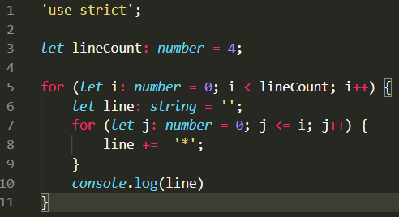
Double For loop

Slide 4


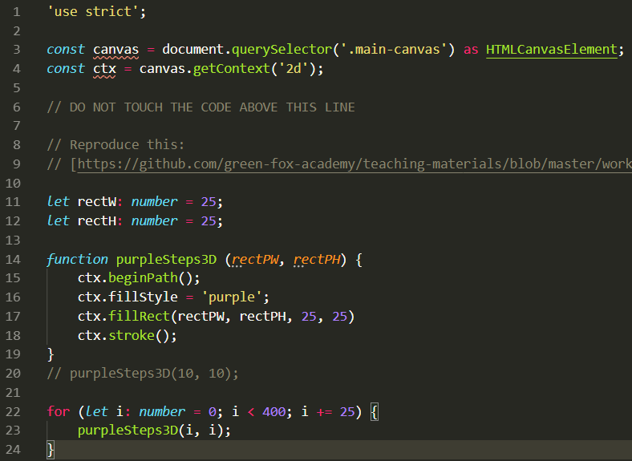
Drawing
“Avoid code duplication”

Slide 5
Thank you

