Slide 1
BŐSZE BALÁZS
WEEK 2 DEMO

Slide 2
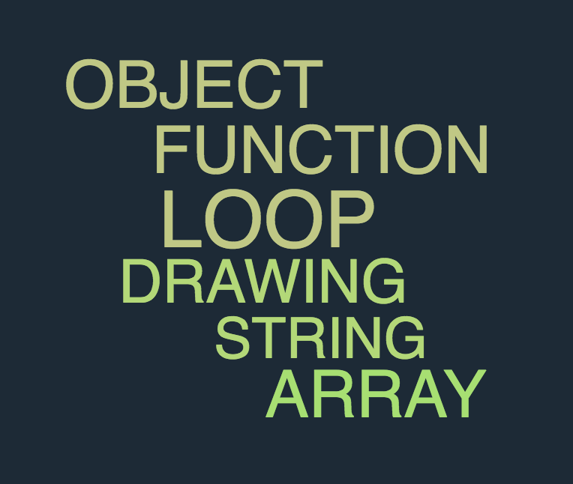
HOW WAS THIS WEEK?

Slide 3

HOW WAS THIS WEEK?
BASIC CONTEXT UNDERSTOOD
ADVANCED WORKSHOP EXERCISES

Slide 4
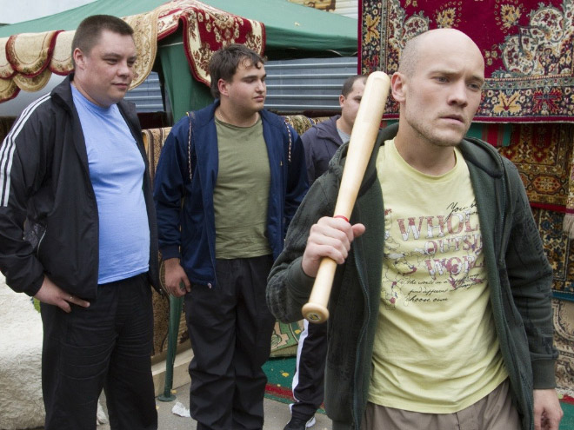
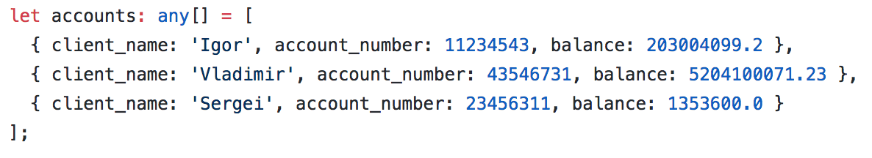
THE PROJECT
Names, Account numbers, Balances

Slide 5
THE PROJECT
Money transfer function with 4 parameter:
-the accounts
-money from (Name)
-money to (Name)
-amount of money
Gives an error message if any of the accounts don't exist.

Slide 6
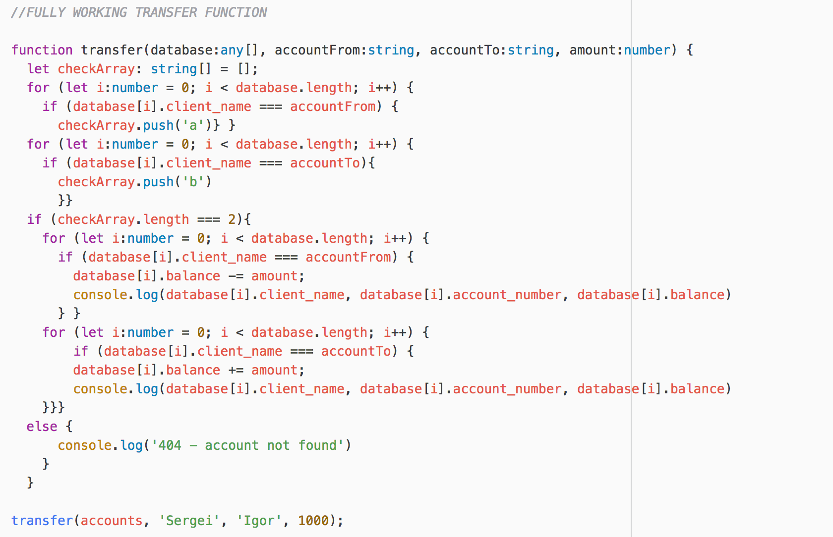
THE CODE

Slide 7
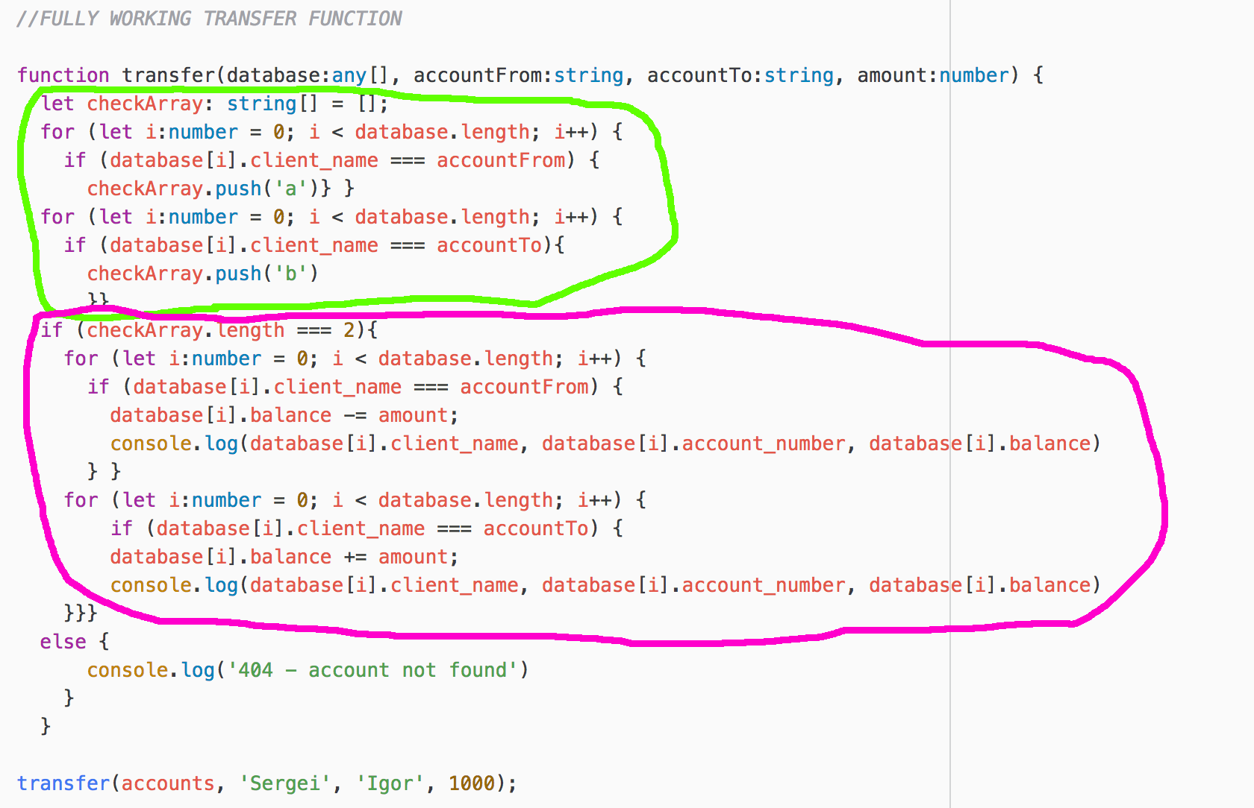
THE CODE

Slide 8
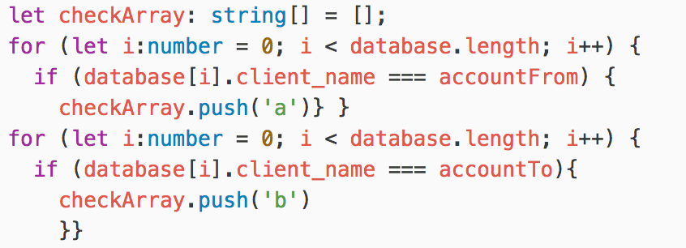
THE CODE - IDENTIFICATION
NAME EXISTS ====> push a string to an array

Slide 9
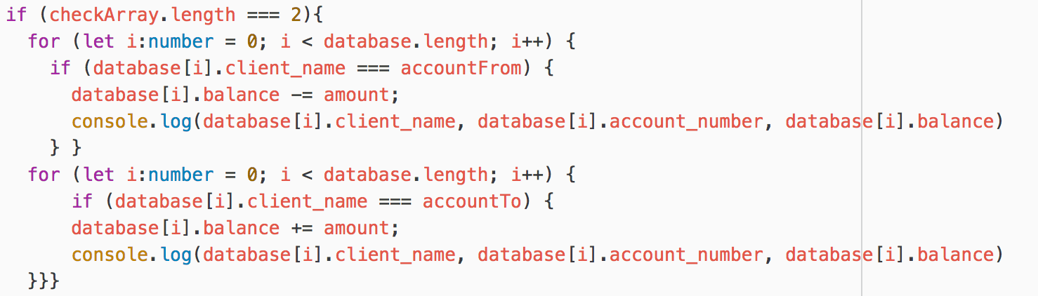
THE CODE – SUCCESSFUL TRANSFER
MONEY FROM
MONEY TO

Slide 10
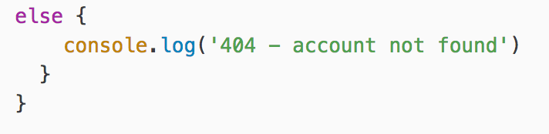
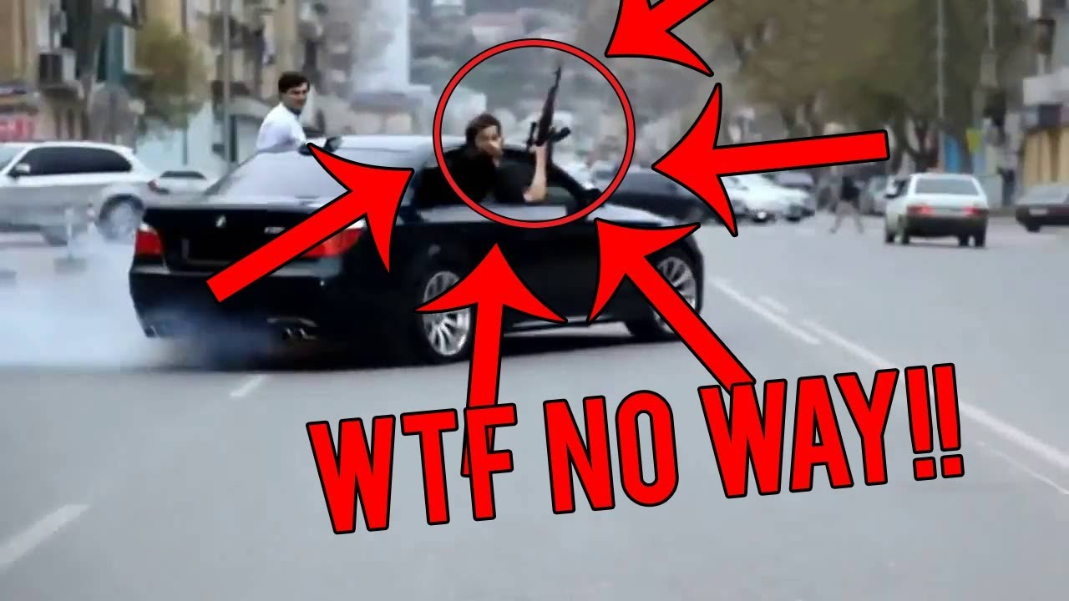
THE CODE – UNSUCCESSFUL TRANSFER

Slide 11
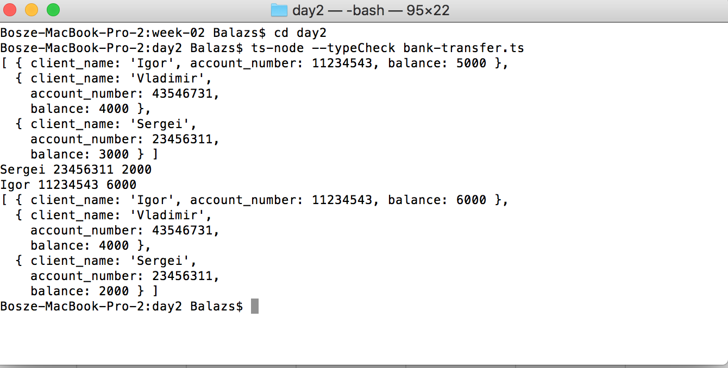
THE CODE – SUCCESSFUL TRANSFER

Slide 12
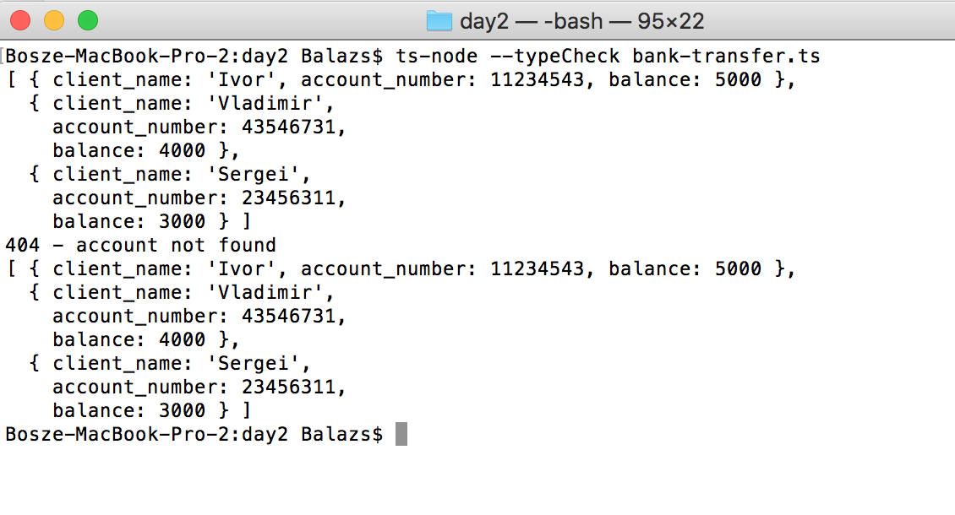
THE CODE – UNSUCCESSFUL TRANSFER

Slide 13
POSSIBLE IMPROVEMENTS
BALANCE CHECKER
SHORTER CODE
IDENTIFICATION WITH BOOLEANS

Slide 14
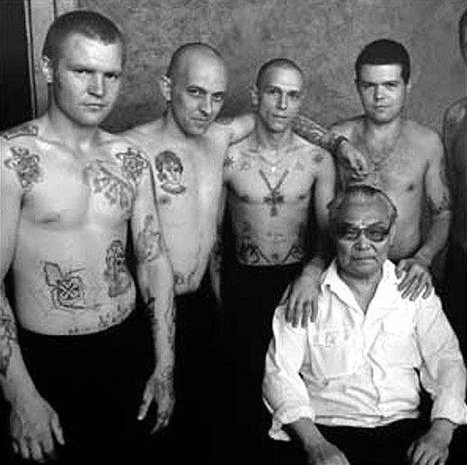
THANK YOU!

