Slide 1
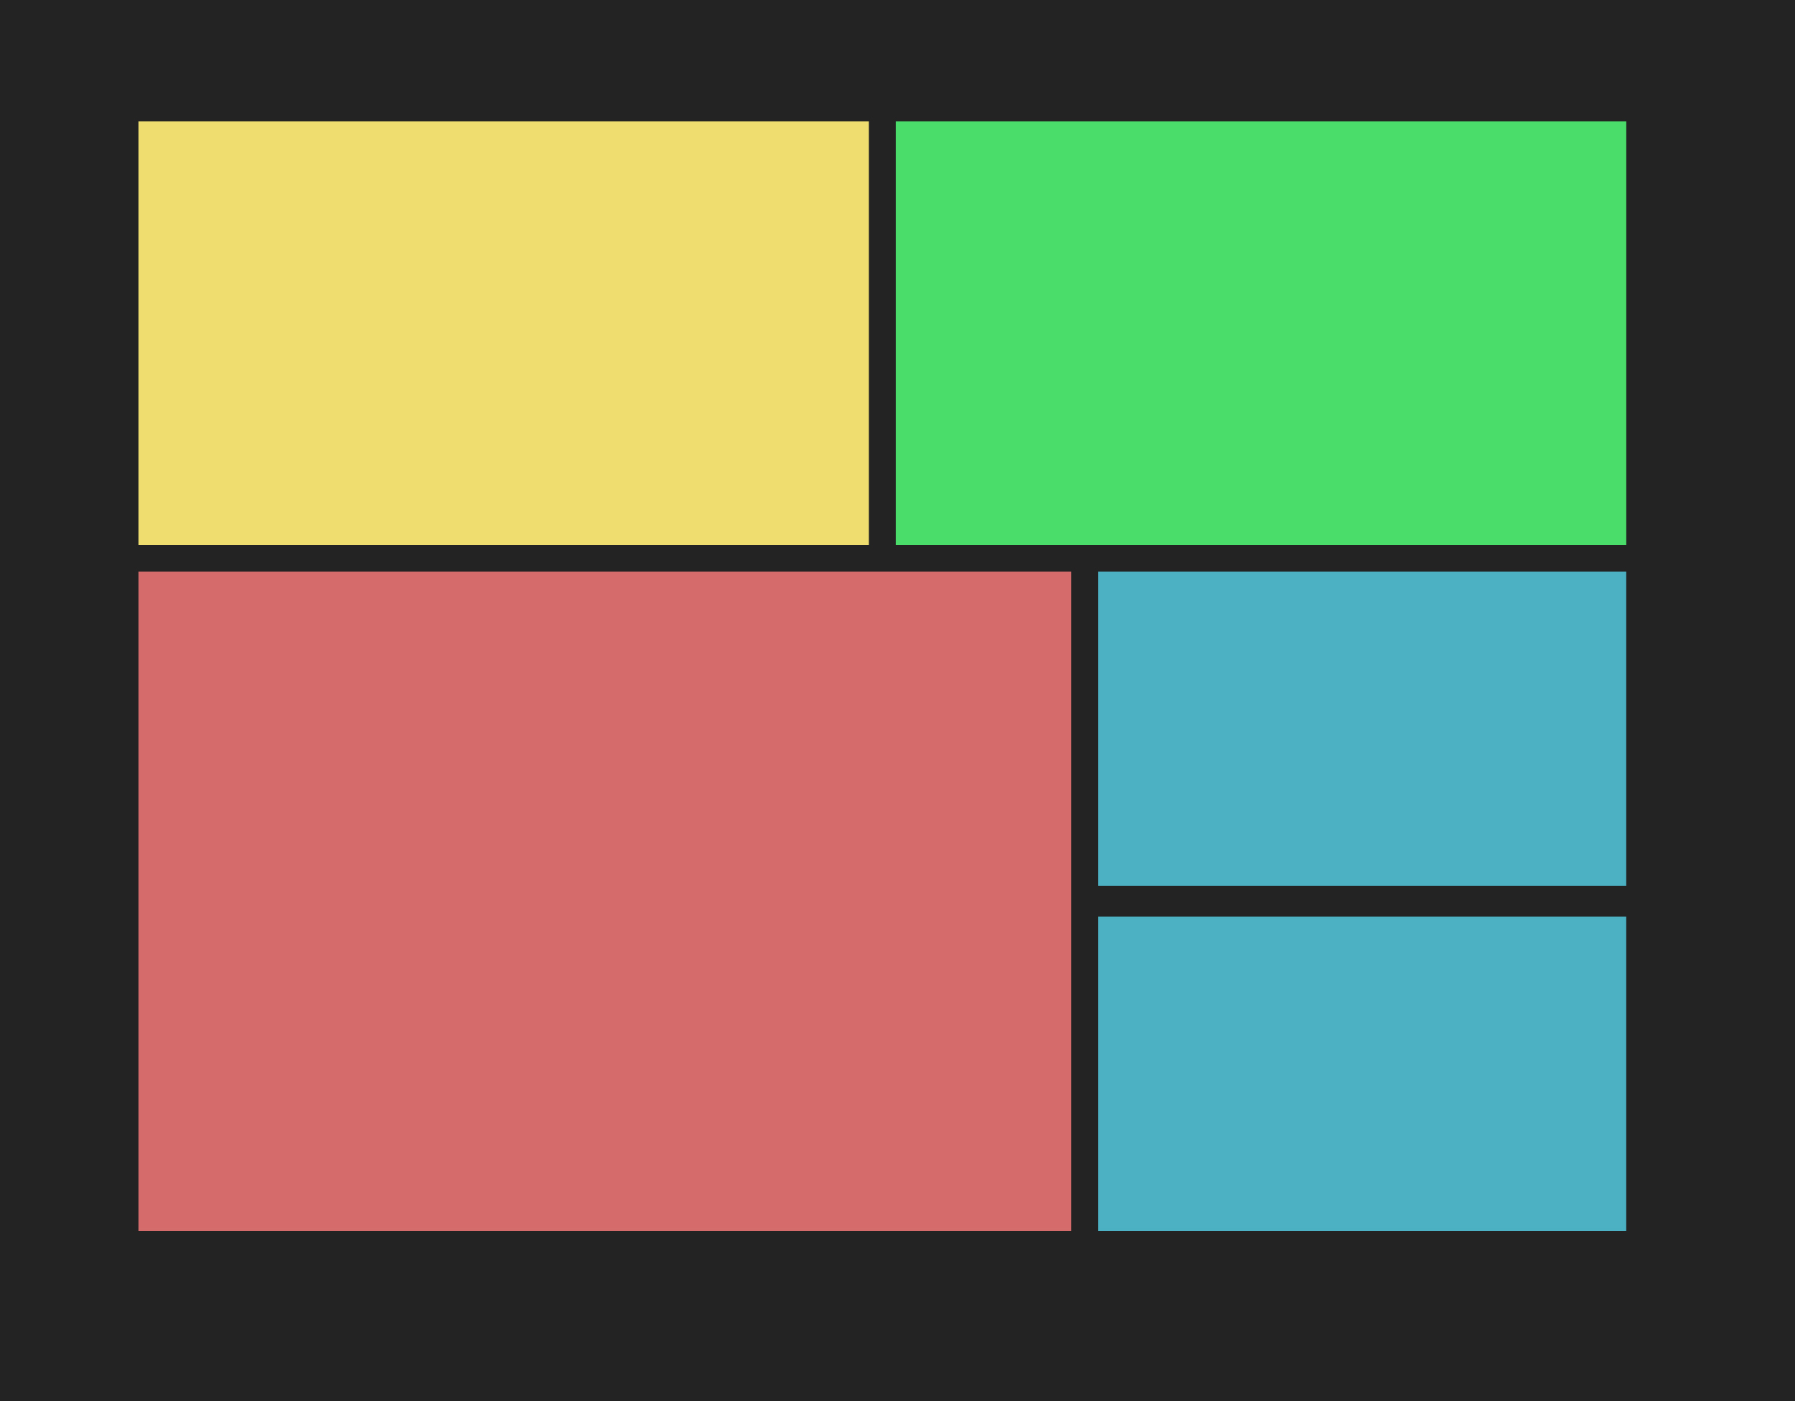

LIGHTNING TALK
BŐSZE BALÁZS
FLEXBOX
github.com/greenfox-academy/bbosze

Slide 2
WHAT IS FLEXBOX?
-layout model in CSS
-offers space distribution between items
-powerful alignment capabilities

Slide 3
ADVANTAGES
-writing less code
-doing more
-responsive layout

Slide 4
PROPERTIES
-display: flex
-properties for the parent
-properties for the children

Slide 5
USEFUL LINKS
A Complete Guide to Flexbox
https://css-tricks.com/snippets/css/a-guide-to-flexbox/
Flexbox froggy
http://flexboxfroggy.com/

Slide 6

GO
FOR
GO FOR IT!
IT!
github.com/greenfox-academy/bbosze

