Slide 1
Boldizár Kiss

Slide 2
TDD Poker
Main target: writing a small program which can compare the values of two hands by basic poker rules
Status checks are made by unit tests,

Slide 3
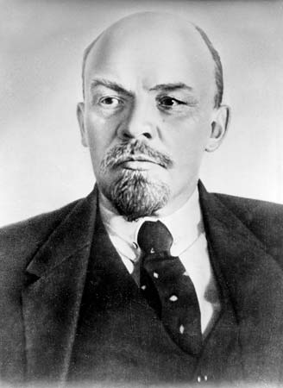
TDD Poker
Hand class (not represents the exact hands, but handles them
It sorts the cards and mark them if they are parts of a combination
The Game method calls others and returns with an int, depended on the comparison status

Slide 4
TDD Poker methods
SortElements – sorts the cards
Combination – gives the hand a combination value (also using SortElements) and marks the ones in the combination
RemoveElement – removes specific cards from the list (hand)
Game – uses all others

